Slide 1

Institutional Research & Evaluation: how to monitor progress & evaluate impact
[Dr Ada Adeghe & Dr Matt Horton]

Slide 2

UoW Context
Anchor institution for the Black Country. Social justice is central to our mission and we pride ourselves on being the University of Opportunity.
The University’s APP aims to eradicate attainment and non-continuation gaps between students with protected and non-protected characteristic groups by 2030.
We gained our REC bronze award in November 2020. UoW has created a robust action plan to address identified barriers/gaps by 2023. One of this is to address disparities between our GM student staff ratio particularly at senior levels.
A robust approach to evaluation is central to the UoW 2030 Vision of ‘Inclusive student success.’ We are on a journey of initiating cultural change in how we measure effectiveness and implement interventions based on evidence. We recognise that this work will play a pivotal role in improving equity of outcomes and ensuring our students realise their full potential.

Slide 3
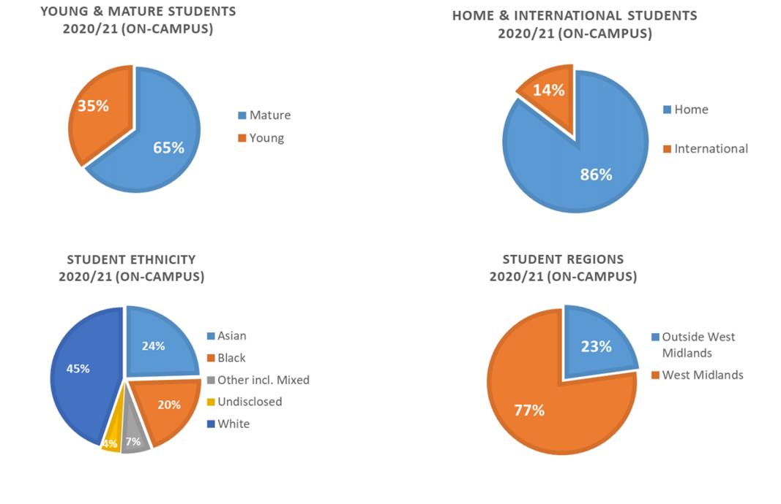
Diversity at University of Wolverhampton

Slide 4
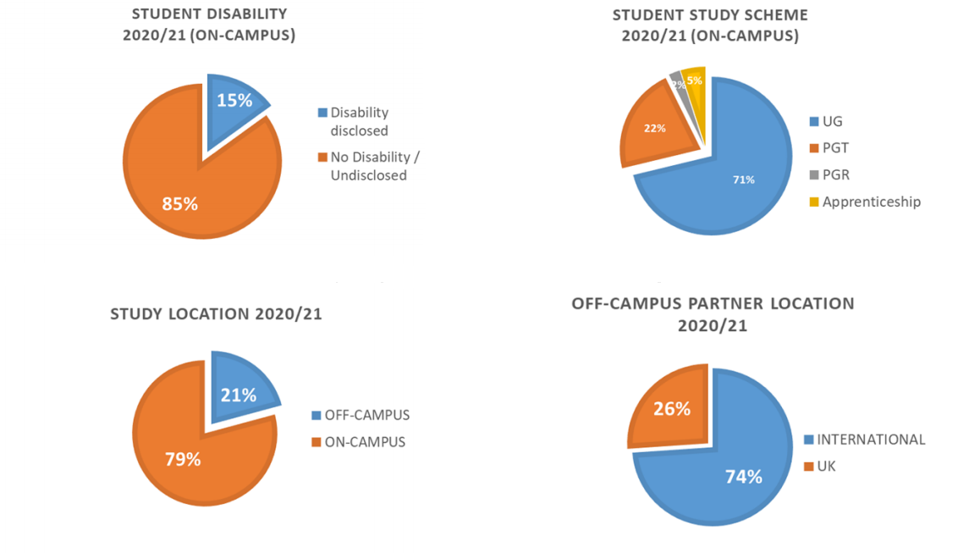
Diversity at University of Wolverhampton

Slide 5
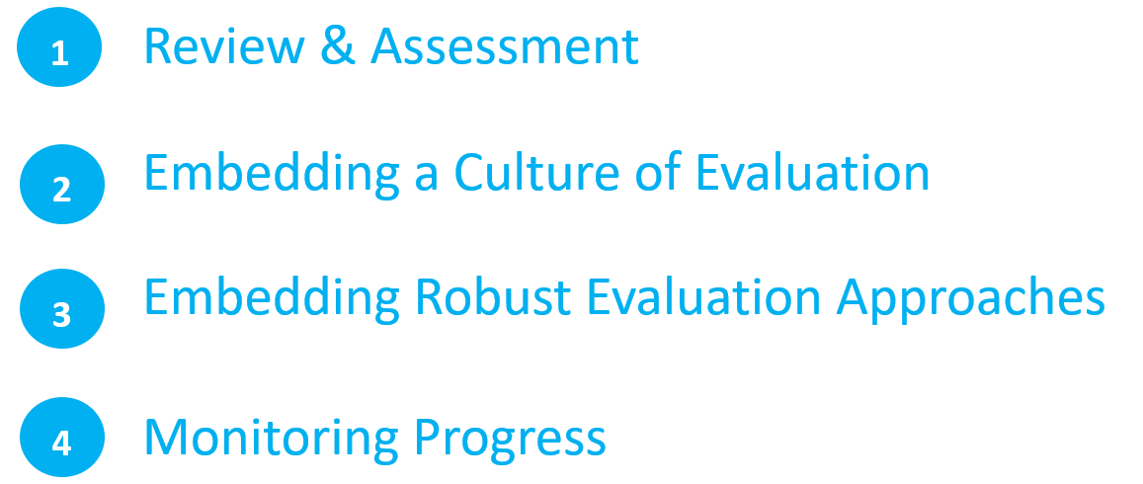
An Institutional Approach to Internal Evaluation

Slide 6
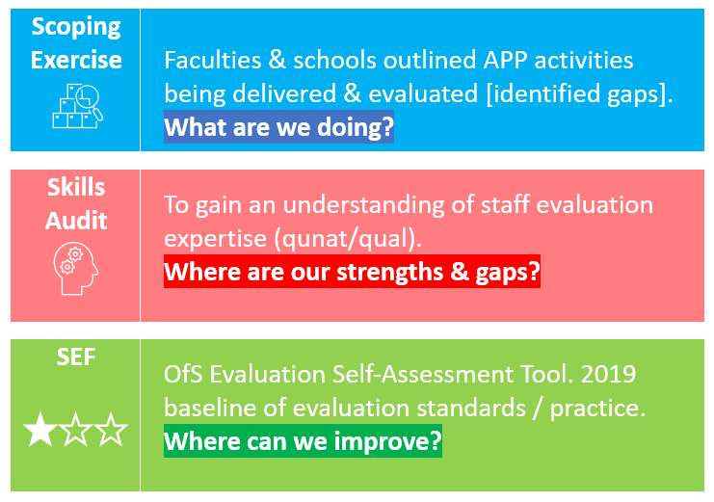
Review & Assessment
It is important to review where your institution is in terms of internal evaluation practice.

Slide 7
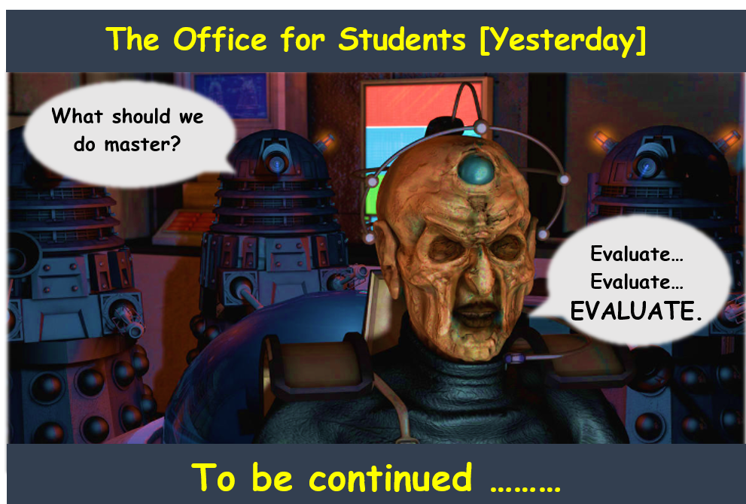


Embedding a Culture of Evaluation
Statutory APP obligations support a stronger strategic emphasis on evaluation:
Quantity + quality
ToCs
Publish

Slide 8


Embedding a Culture of Evaluation
Capacity & Expertise
Encouraging academics to evaluate. Surveying expertise / interest. Funded commissioned bids. Provides a more objective view of ‘what works’.
CPD / Workshops
ToC & Exp. methods [comparison / control groups & quasi exp. & RCTs]. Guidance resources.
Collaboration
WMEG launched to support collaboration & sharing effective practice
Strategic
Evaluation reporting lines to strategic committees & UoW evaluation group

Slide 9

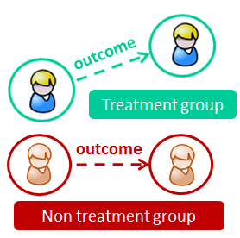
Workshops: Empirical & Causal Evaluation
We are encouraging an increased use of exp. methods to understand what might have happened without the intervention.
An improvement after taking part compared to before the activity
(e.g. via a pre and post event questionnaire / assessment data).
Sample includes those engaged in intervention only.
Quasi-exp: difference in outcomes between treatment & comparison
group. Groups matched in terms most imp. variables affecting outcome.
RCTs or Regression discontinuity design (RDD) – compares outcomes
between treatment & control group. More able to provide causal
findings. Randomisation to groups reduces selection bias of known &
unknown variables affecting outcome.
1
2
3

Slide 10




APP Evaluations 21-23
36
Evaluations
Access: Children’s University (RCT); Aspire2Uni (children in care / LAC).
Attainment: Maths diagnostic tool, step marking
Academic Coaches & STT’s
Mature Students Lit review [What Works]
Decolonise project
Non-continuation: Changes to assess & marking (business sch.), student finance (RCT), belonging survey
Progression: Carers registration survey, educational gains survey

Slide 11
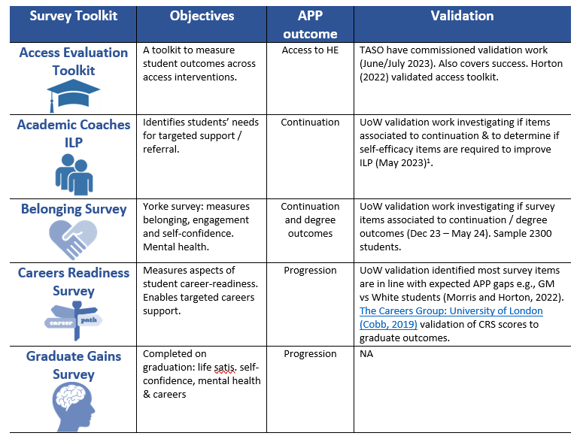
Evaluation: Validated Toolkits & Student Analytics

Slide 12
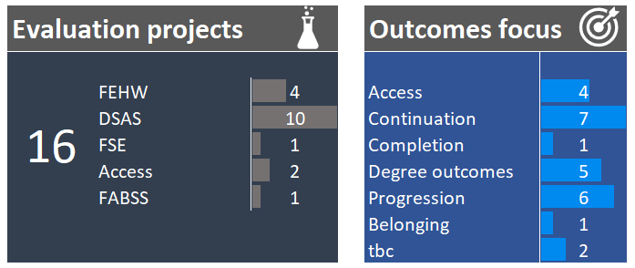
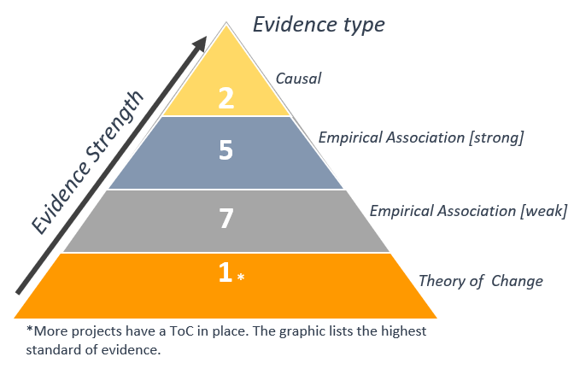
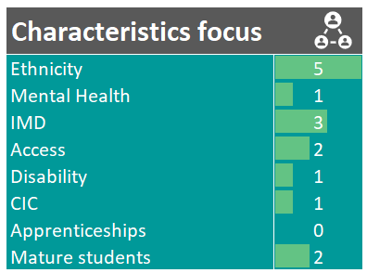
Monitoring Progress
In year we monitor progress via the Evaluation Tracker Dashboard:

Slide 13
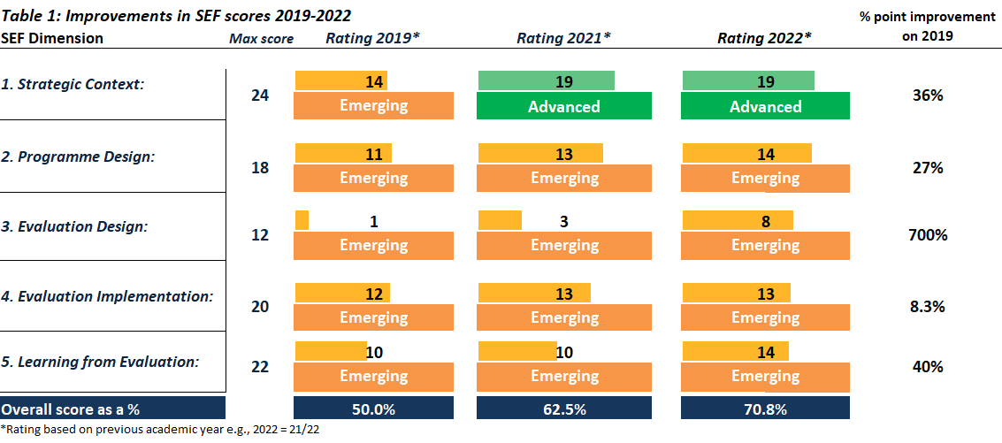
SEF: Monitoring Progress
Annually we complete the SEF to identify areas for improving our evaluation practice.

Slide 14
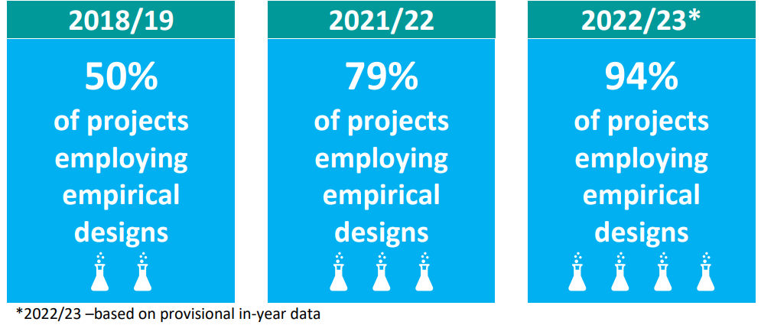
SEF: Monitoring Progress

Slide 15
Useful Resources
Resource | Description | Website
OfS Access and Participation Standards of Evidence & Using Standards of Evidence to Evaluate Impact of Outreach | Standards of evidence with examples | https://www.officeforstudents.org.uk/publications/standards-of-evidence-and-evaluating-impact-of-outreach/
OfS SEF | To review evaluation practice | Follow links above (bottom of page)
OfS website | Evidence reviews of effective interventions in Access, Success & Progression. | https://www.officeforstudents.org.uk/advice-and-guidance/promoting-equal-opportunities/effective-practice/
TASO | What Works Evidence Toolkit | https://taso.org.uk/evidence/toolkit/
TASO | TASO evidence reviews | https://taso.org.uk/evidence/
TASO | Evaluation guidance ToC and methods | https://taso.org.uk/evidence/evaluation/ https://taso.org.uk/evidence/resources-hub/
Report ‘What Works’ at Kings College London | Innovative interventions, methods and a ToC. | https://www.kcl.ac.uk/study/widening-participation/what-works/what-works
Optimising the impact of a multi-intervention outreach programme on progression to HE (Burgess, Horton & Moores) | Example of how to evaluate multi-intervention programmes | Optimising the impact of a multi-intervention outreach programme on progression to Higher Education: recommendations for future practice and research — Aston Research Explorer
Evaluation of access and participation plans: Understanding what works (Moores, Summers, Horton, Woodfield, Austen & Crockford) | Policy paper – independent evaluation & collaboration | Frontiers | Evaluation of access and participation plans: Understanding what works (frontiersin.org)
Aimhigher (NCOP) evaluation plan | Provides a ToC and useful evaluation methodologies | https://aimhigherwm.ac.uk/research-impact/
SMOG | Use to improve the readability of your survey questions | https://tinyurl.com/yxdlqsyb
NESTA and TSIP (2014) Guidance for developing a ToC for your programme | Explains how to use a ToC to improve programmes and evaluation | https://www.nesta.org.uk/toolkit/theory-change/

