Slide 1

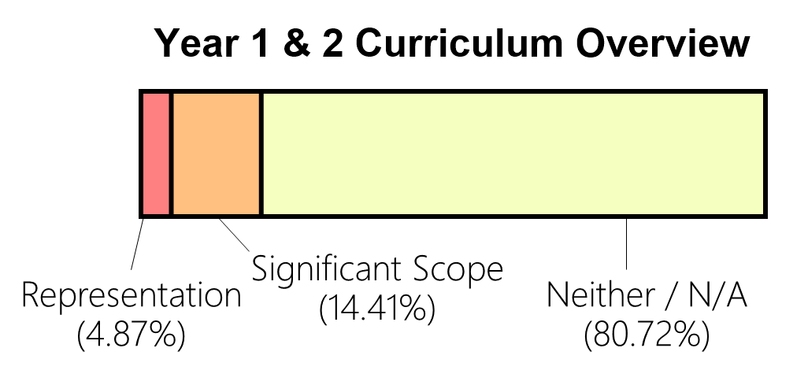
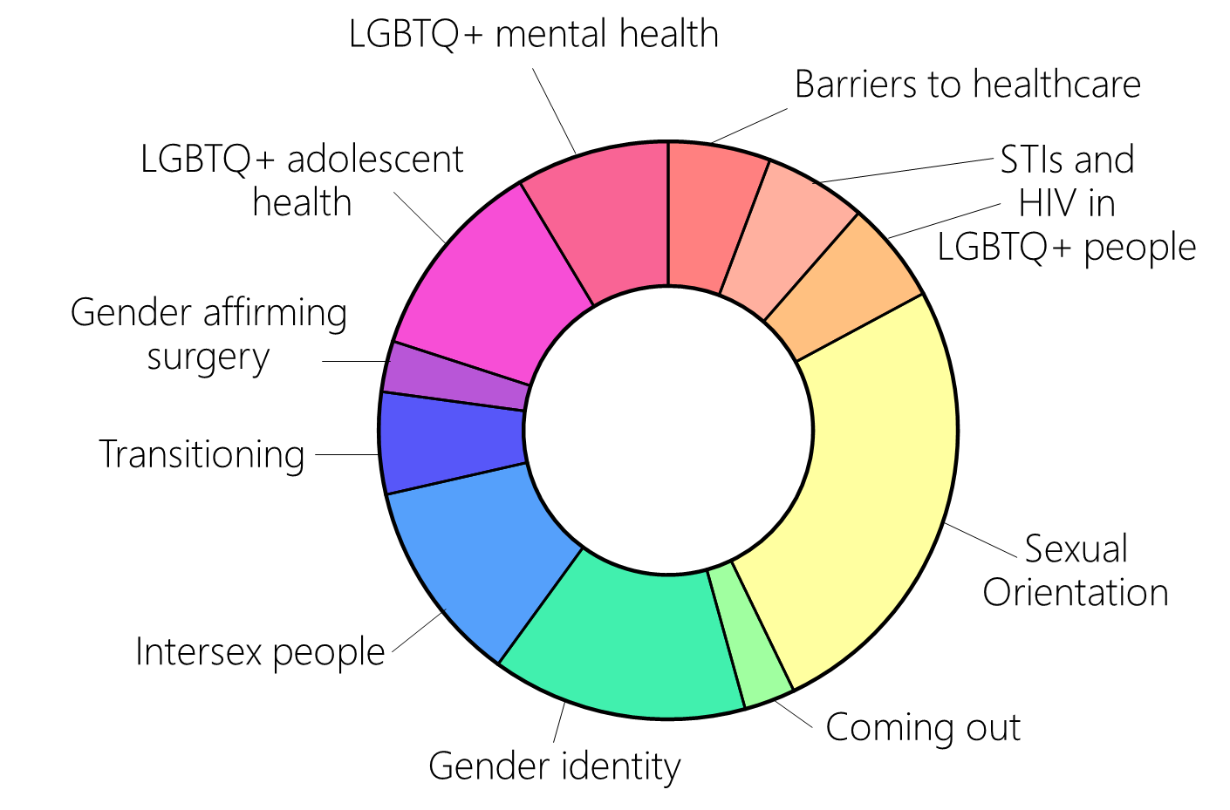
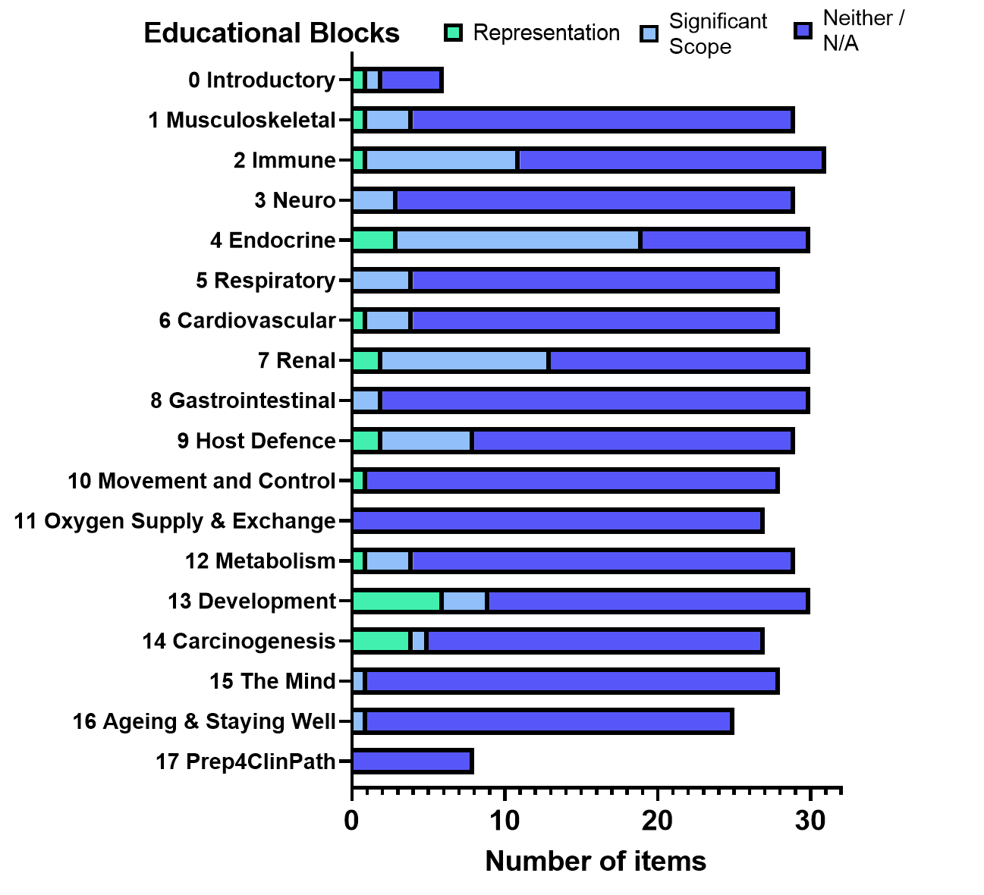













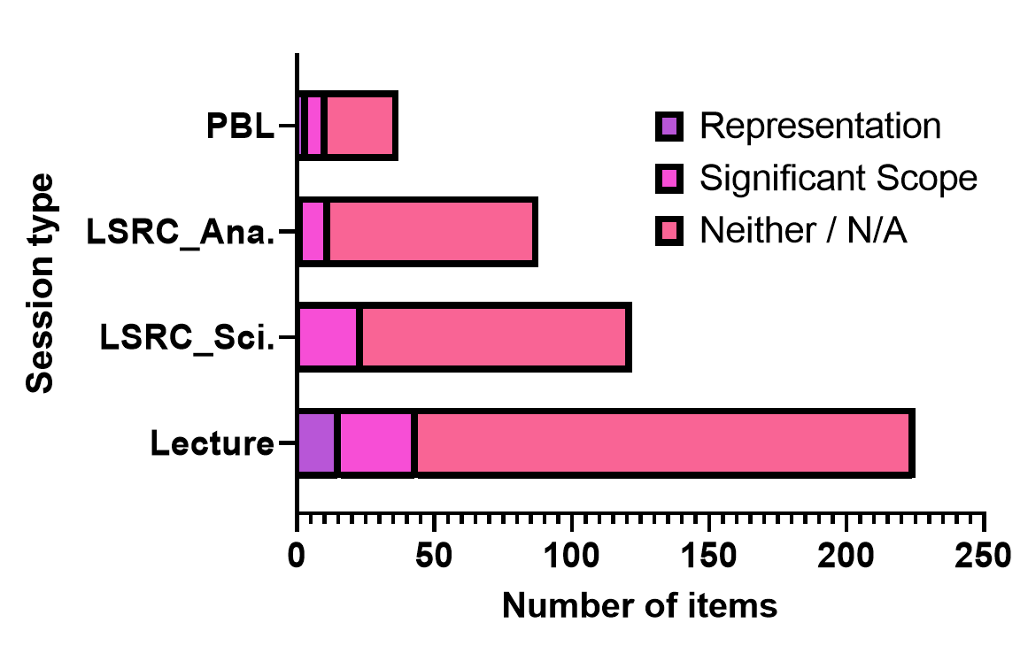




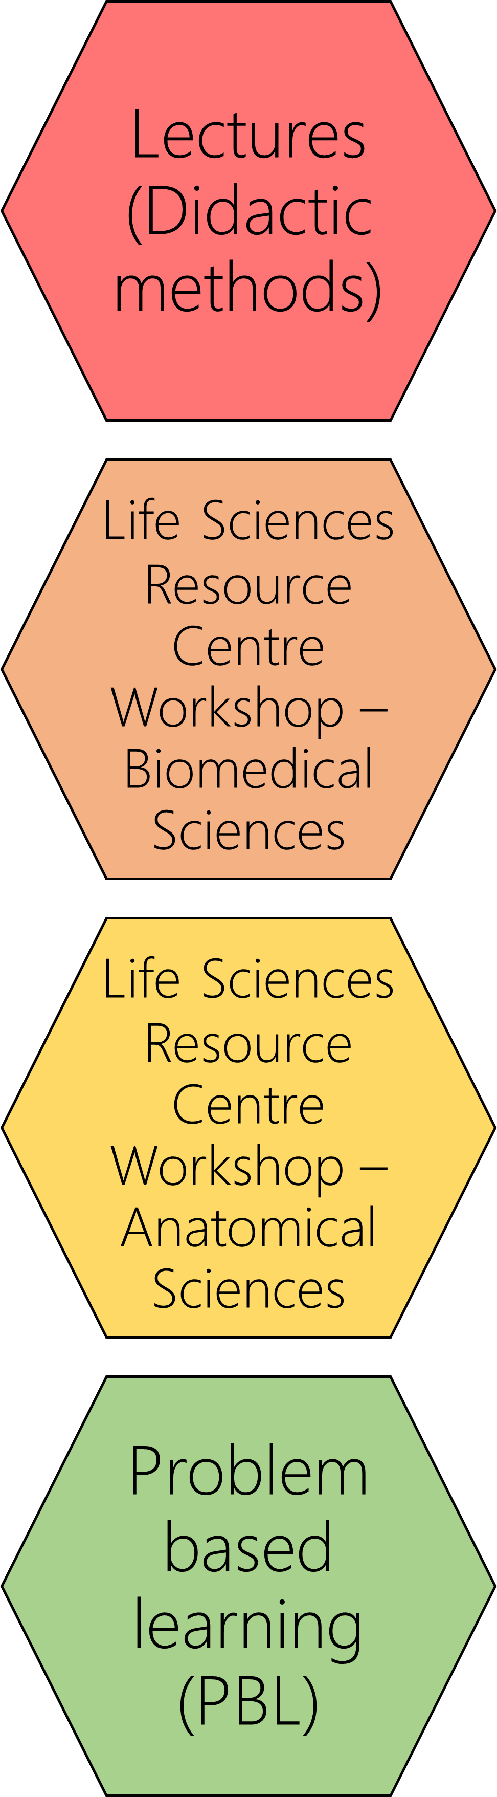
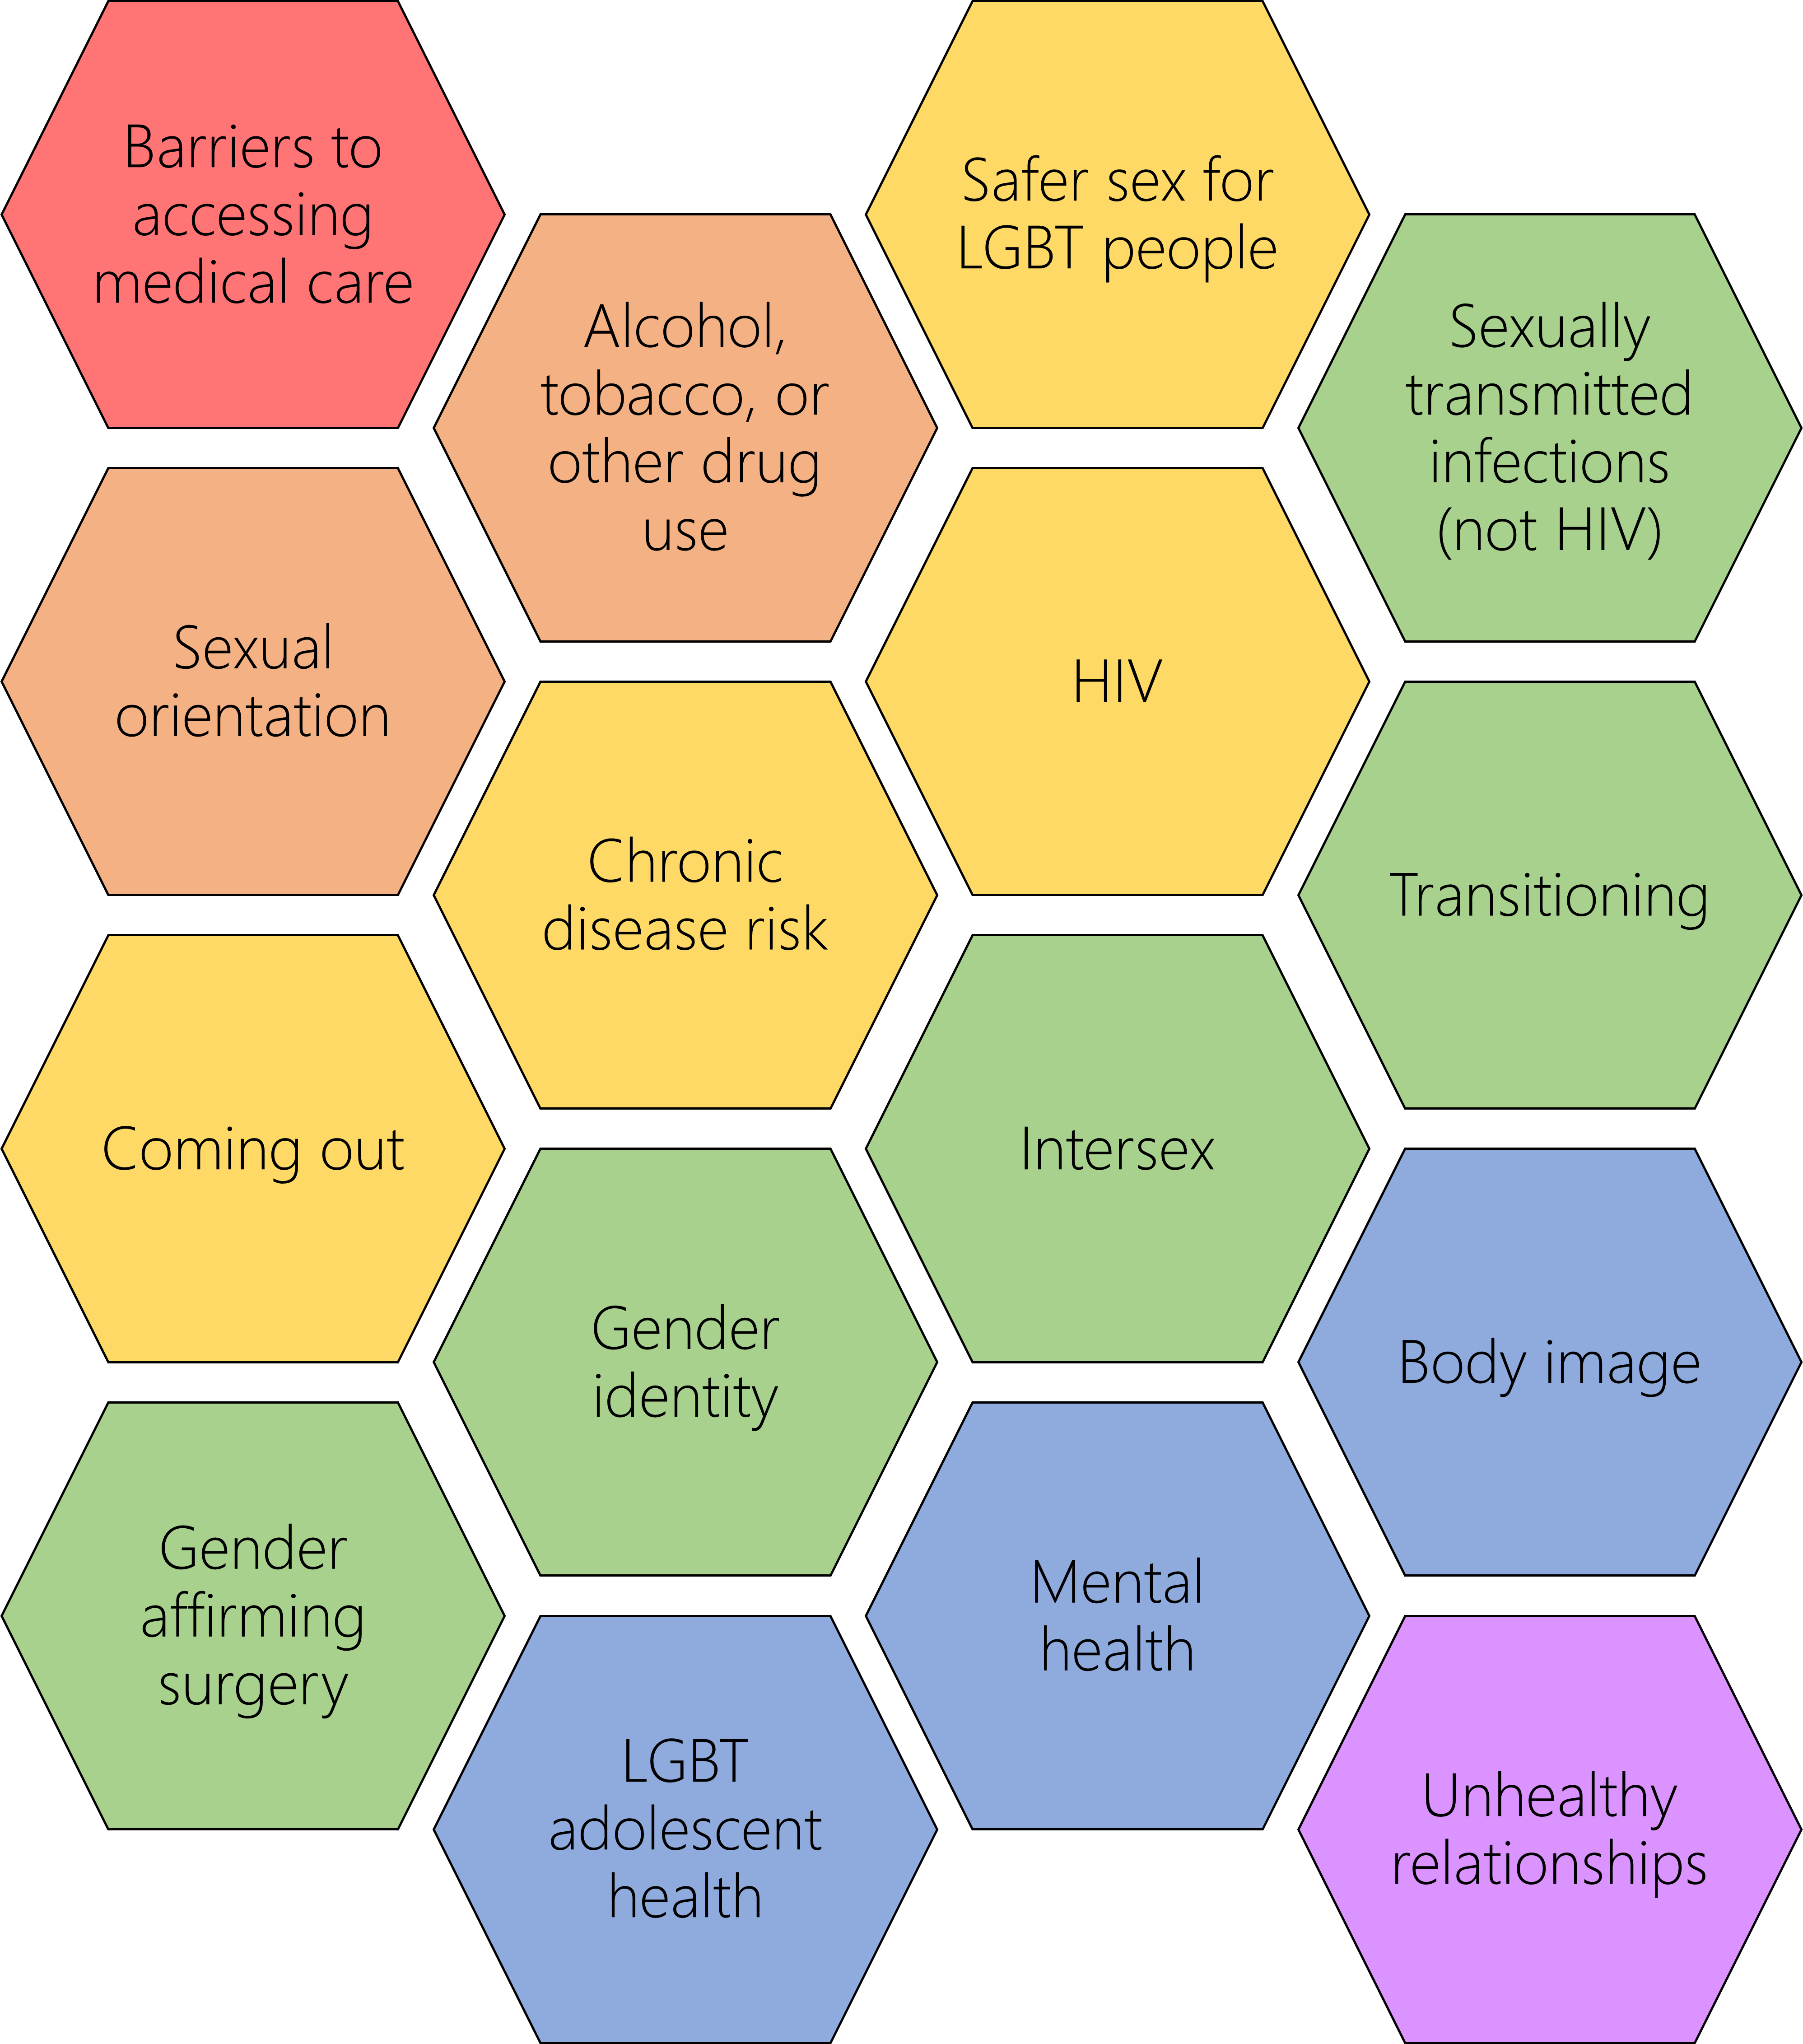





The Gay Agenda
Results & Future Directions
Fair representation and inclusion of LGBTQ+ people in the medical curriculum
Figure 1. Throughout the audited curriculum the majority of material contained neither representation or scope for inclusion. The main reason for is the focus on basic biomedical sciences in these years.
Introduction
Figure 4. Eleven of 16 topics in the framework were represented in the curriculum. The topic with the biggest representation was sexual orientation, followed by gender identity and intersex people. Five topics were not found to be covered which were; substance usage, safe sex for LGBTQ+ people, LGBTQ+ people with chronic diseases, LGBTQ+ and body image, and unhealthy LGBTQ+ relationships. However, some of these topics were also not discussed for cis-heterosexual people.
LGBTQ+ people face worse health outcomes [1].
On top of this LGBTQ+ students and practitioners are still likely to experience discrimination [2].
Improving medical education also improves care received by future patients.
Purpose of having an inclusive curriculum is to foster an open learning environment that benefits all students and enhances education.
Majority of teaching within year 1&2 BMBS is basic science. It can be difficult to insert EDI topics in a natural way, so need to make the most of opportunities.
Approximately 4% of UK adults identify as LGBTQ+ [5], clinical case material should reflect this at a minimum, as well as highlighting issues that cis-heterosexual students may be otherwise unaware of.
To insure learning, it may be necessary to implement learning objectives and assessment areas around LGBTQ+ issues.
Aims
Key Points
Figure 2. Educational blocks varied in their inclusion of LGBTQ+ people. The block with the most representation was the development block which discussed a range of topics including gender dysphoria, mental health, and sexual orientation.
Identify representation in the written materials.
There is a fair amount of representation across different LGBTQ+ topics in years 1&2 of BMBS curriculum
Identify areas where there is scope to add representation.
Aiming to move beyond representation and having a transformative curriculum [3]
Explore how we can integrate diversity topics into our curriculum seamlessly.
Inclusive education is beneficial to all students and needs to be performed carefully to ensure students’ learning.
Having a single lecture of educational day on LGBTQ+ topics does increase representation, but comes across as tokenistic.
Instead we are aiming to fully integrate it into the BMBS curriculum which is currently based on a spiral curriculum structure.
We are currently developing reflective tasks as part of the PBL cases, which will allow students to explore and discuss a variety of EDI issues.
Figure 3. Didactic methods are the majority of the curriculum. However, the more interactive workshops and PBL have plenty of inclusion opportunities in their discussion based activities.
Methods
References
Author
[1] Daniel, H. et al. (2015) “Lesbian, Gay, Bisexual, and Transgender Health Disparities: Executive Summary of a Policy Position Paper From the American College of Physicians,” https://doi.org/10.7326/M14-2482, 163(2), pp. 135–137. Available at: https://doi.org/10.7326/M14-2482.
[2] Anthea Mowat, F. and Taylor-Smith, B. (2016) “The experience of lesbian, gay and bisexual doctors in the NHS Chair of BMA Representative Body Co-Chair of The Association of LGBT Doctors and Dentists (GLADD),” British Medical Association [Preprint].
[3] Gale, N.K. and Ward, N. (2016) “LGBTQ-INCLUSIVITY IN THE HIGHER EDUCATION CURRICULUM: A BEST PRACTICE GUIDE.” Available at: https://intranet.birmingham.ac.uk/staff/teaching-academy/documents/public/lgbt-best-practice-guide.pdf (Accessed: June 21, 2022).
[4] Obedin-Maliver, J. et al. (2011) “Lesbian, Gay, Bisexual, and Transgender–Related Content in Undergraduate Medical Education,” JAMA, 306(9), pp. 971–977. Available at: https://doi.org/10.1001/JAMA.2011.1255.
[5] Office for National Statistics (2019) Sexual orientation, UK - Office for National Statistics. Available at: https://www.ons.gov.uk/peoplepopulationandcommunity/culturalidentity/sexuality/bulletins/sexualidentityuk/2019 (Accessed: June 23, 2022).
Dr Eleanor M. Townsend (she/her)
Associate Lecturer in Biomedical Sciences
University of Exeter Medical School
Written material/session types.
Obedin-Maliver [4] 16 point framework.
Written material from year 1 & year 2 of BMBS curriculum analysed
Against framework from Obedin-Maliver [4] Marked for inclusion, scope for inclusion, or neither
@E_M_Townsend
audio
e.m.t.townsend@exeter.ac.uk
Notes:
Hi I am Eleanor Townsend from Exeter Medical School and this is my poster which I am terming “the gay agenda” where I am looking at fair inclusion and representation of LGBTQ+ people in the BMBS curriculum
This is important as LGBTQ+ people face worse health outcomes and discrimination than their cis-heterosexual counter parts. Part of trying to improve our inclusion will help to improve doctor-patient relationships in the future, addressing this disbalance. However, it is also important to remember that for our LGBTQ+ students, this will also make a difference to them feeling welcome and included.
As this project is in it’s infancy I have begun with an audit of current representation, wherein I have looked at written material from a number of different session types through the first two years of the BMBS curriculum. This has been compared against an established framework which outlines 16 areas in which LGBTQ+ face unique challenges or issues.
What I have found going through this audit, is that there are a number of sessions that do include LGBTQ+ people. One of the big challenges is that in these first two years a lot of the material is very pure science focussed so it is not appropriate to include. That is why I have also scored for scope for inclusion, in which we also have more room for improvement.
What we are aiming to do is interweave inclusion, not only for LGBTQ+ people, into our curriculum to not only avoid it feeling very tokenistic but also to build on ideas as you would do with anatomy and physiology in this spiral curriculum design. One of the ways we are beginning to do this is by introducing more substantial reflective tasks into our problem based learning sessions which have various EDI themes.
We are excited to be working towards furthering inclusion and I am happy to take any questions.

