Slide 1



Evan Hancock
Associate Director of Careers and Graduate Success

Slide 2
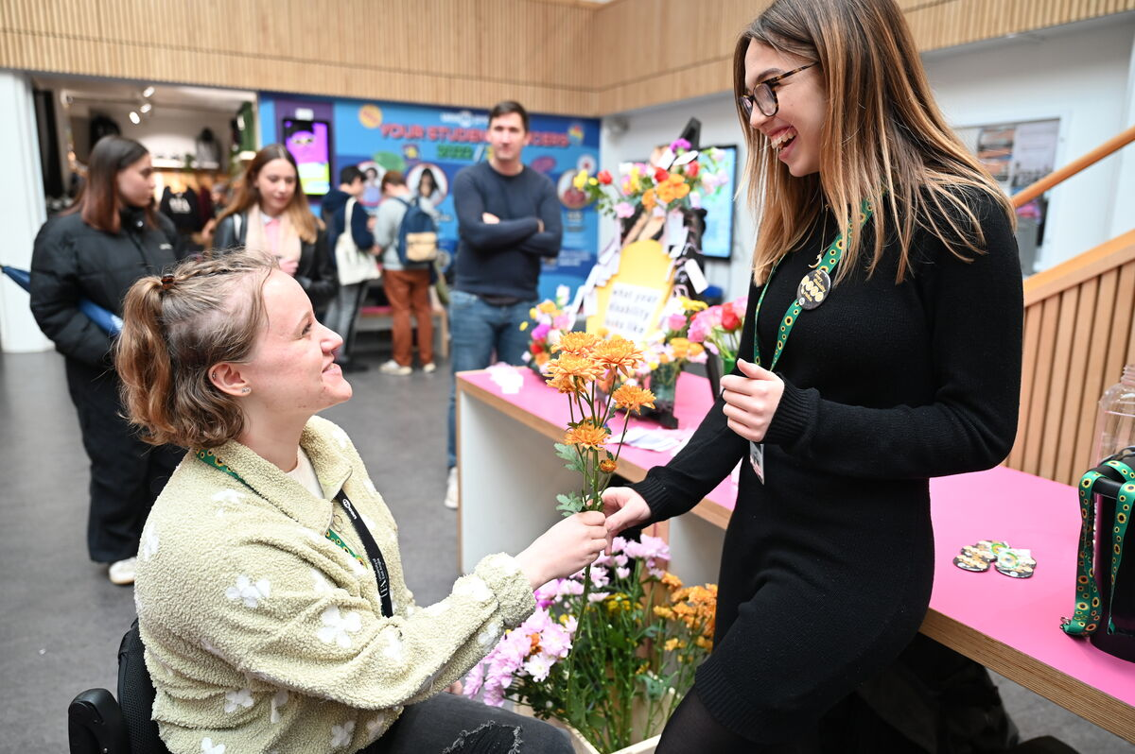
Progression Partnership
Groundwork
UEA Access and Participation Plan 2025-2029
Support for graduates with disabilities, mental health needs and neurodivergence
Support gap post UEA
Increasing confidence and support post-UEA - successful progression to employment
Collaborative local network facilitating knowledge sharing, best practice, employer networking and driving inclusive workplace cultures.

Slide 3

Progression Partnership
Our impact so far…
30+ Organisations involved
100+ Partnership members
50+ LinkedIn community
400+ students and graduates reached with Progression Partnership Hub at UEA GradFair
Signposted to 48 support services accessible in Norfolk and Suffolk (mental health and wellbeing, disability support, housing, financial insecurity, etc)

Slide 4
Progression Partnership
Future developments
Growth of employer involvement with the partnership, education, collaboration and action
Working with graduate employers to improve access and inclusion in recruitment for UEA graduates
Graduate peer support network – adjustments experiences, wellbeing support
Collaborative projects with UEA Civic
progression.partnership@uea.ac.uk

Slide 5
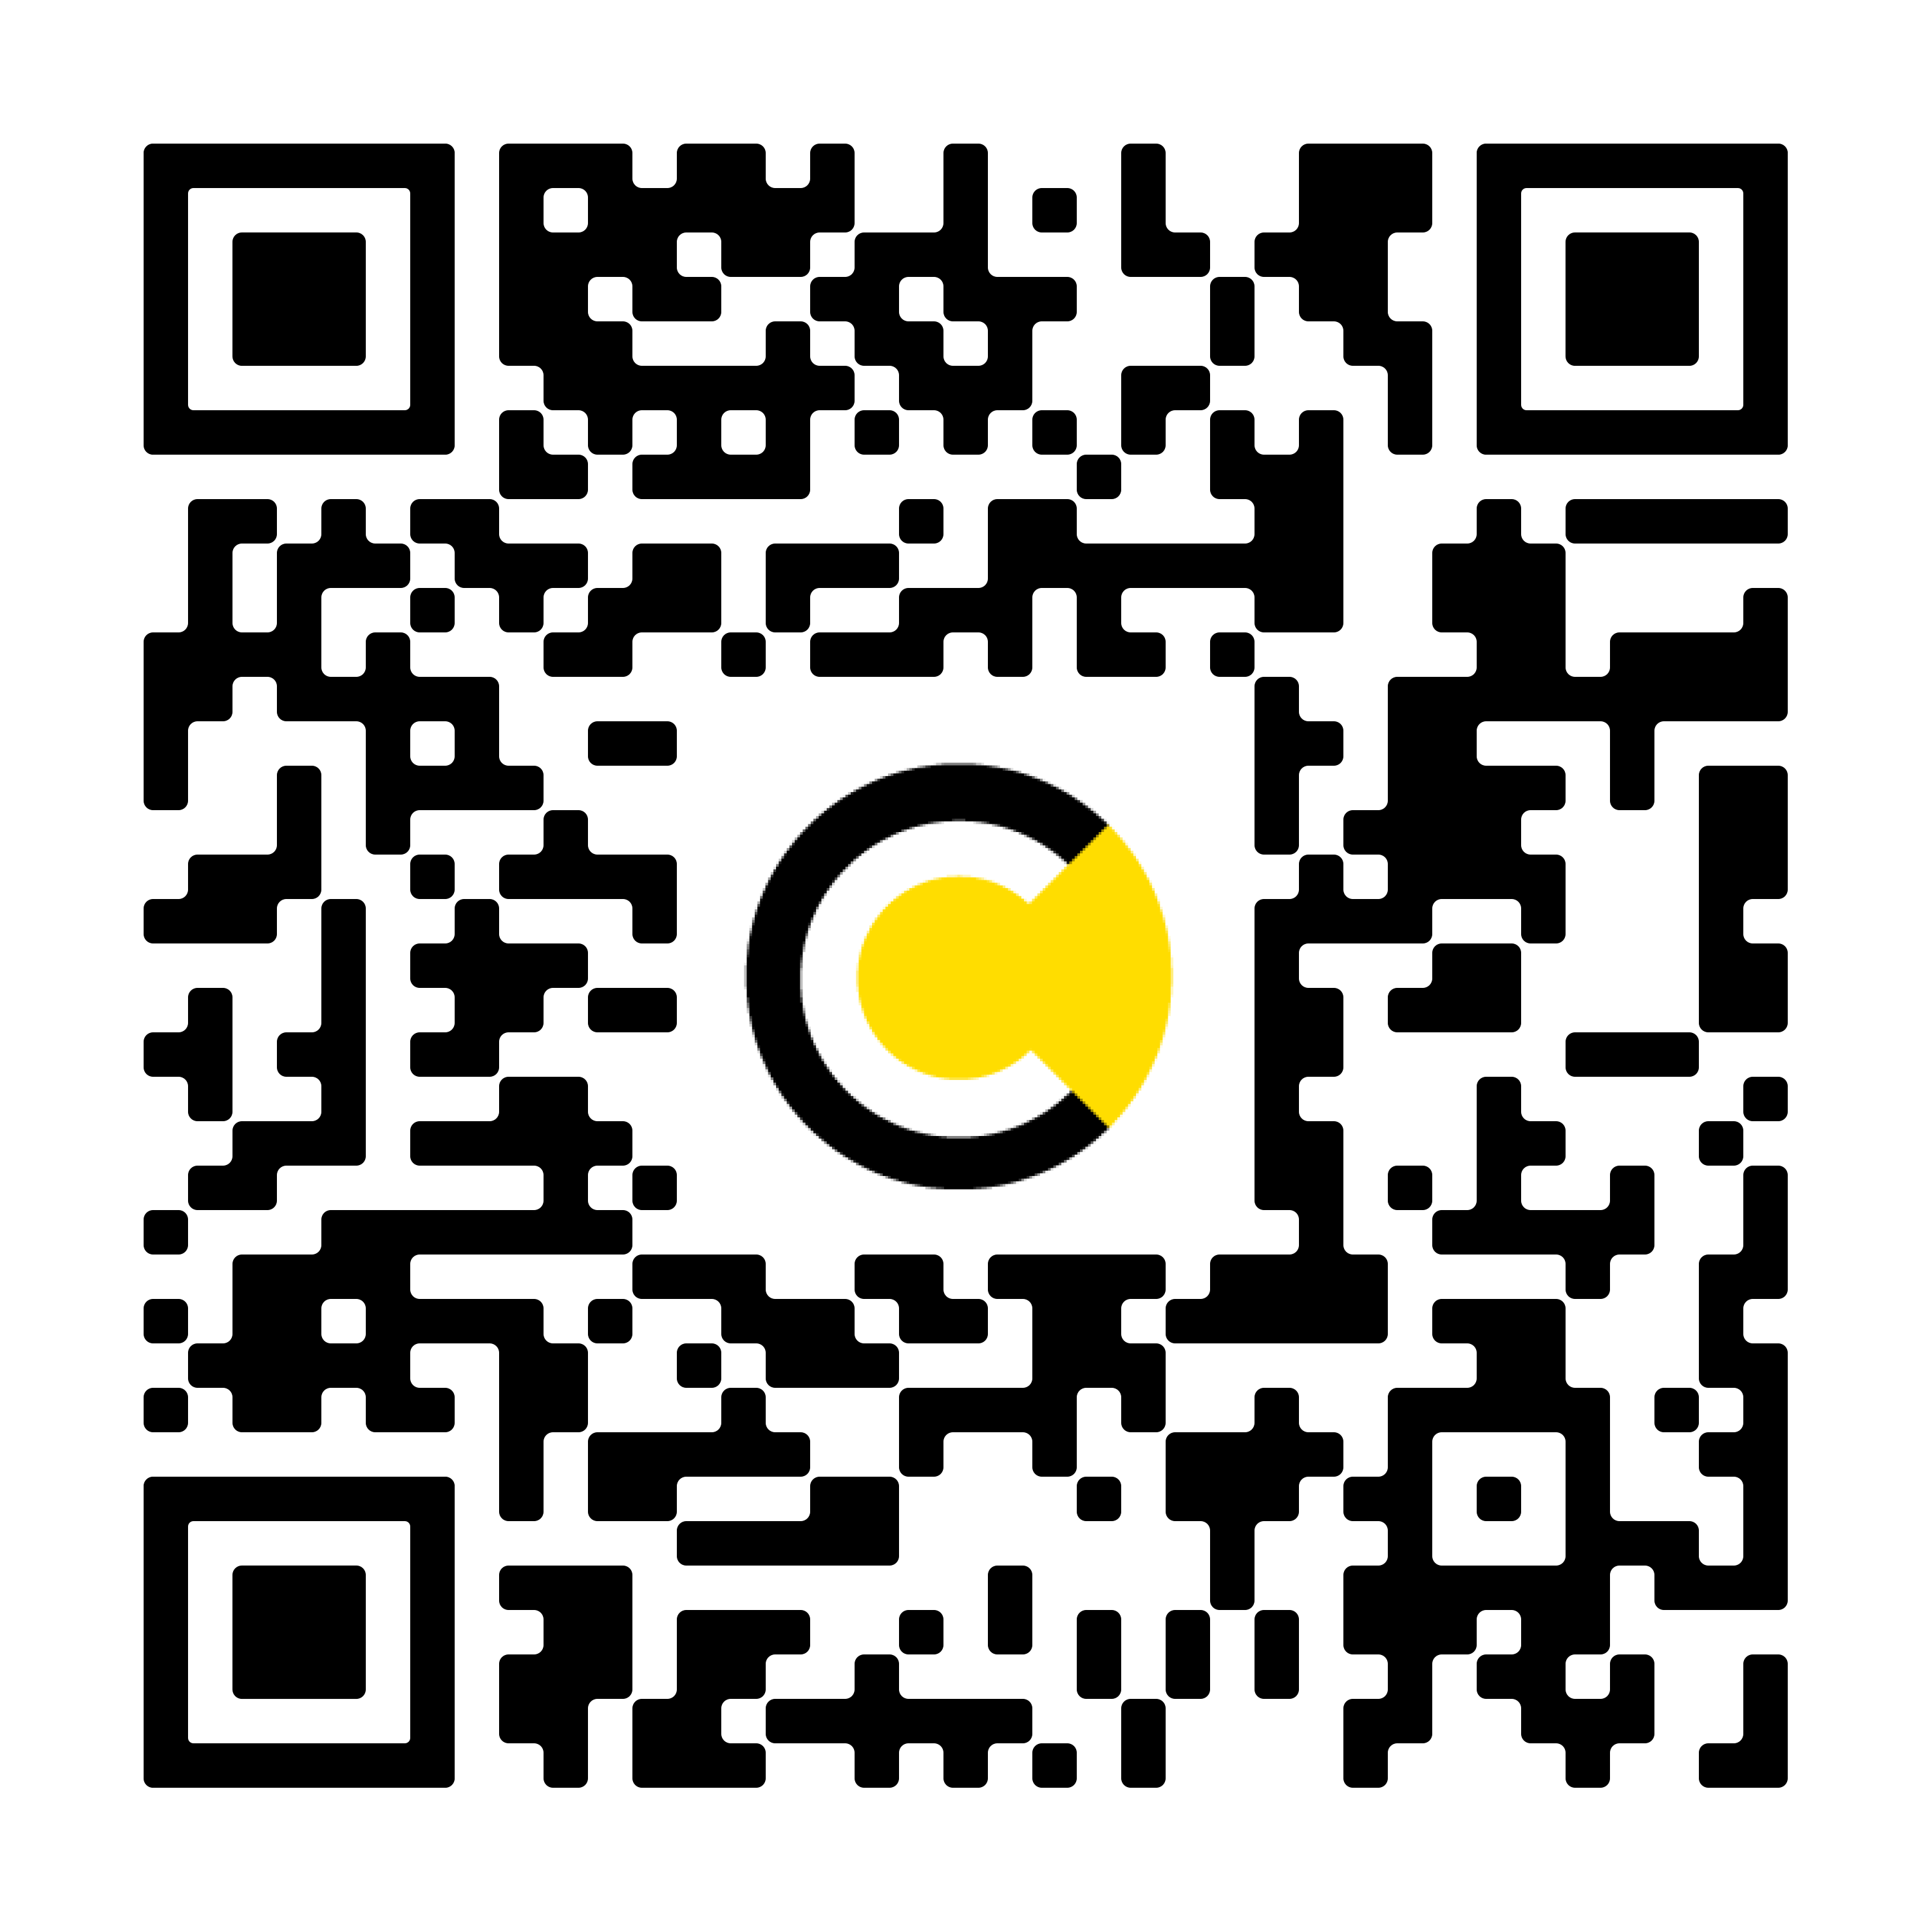
Progression Partnership
“Helping students break barriers after university.”
Join up and get involved
Make connections and collaborate with other organisations
Progression Partnership LinkedIn group
Progression Partnership Newsletter
progression.partnership@uea.ac.uk

