Slide 1

Widening Participation Through Partnership: The University of Kent’s Role in Sponsoring a Multi-Academy Trust
Dr. Marta Almeida Hill

Slide 2
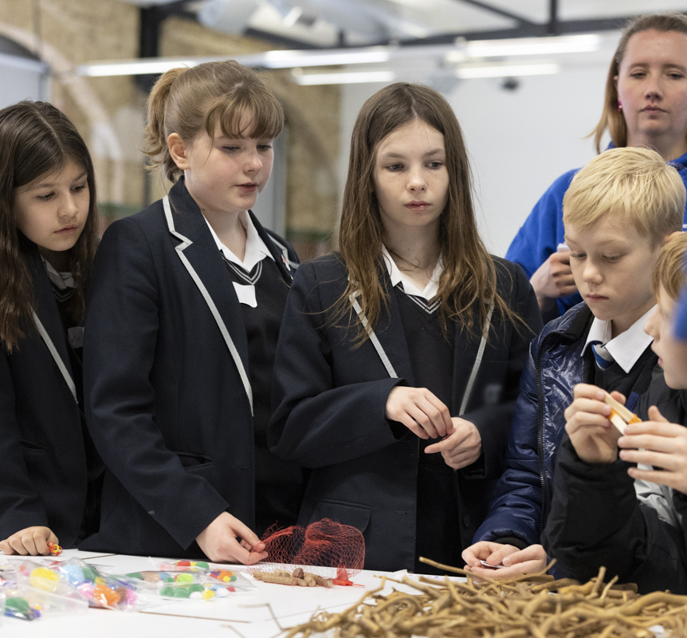
A 15-Year Commitment
Over 15 years of sustained partnership
Lead sponsor of University of Kent Academies Trust (UKAT)
Brompton Academy
Chatham Grammar
Not an external institution, but a trusted neighbour

Slide 3
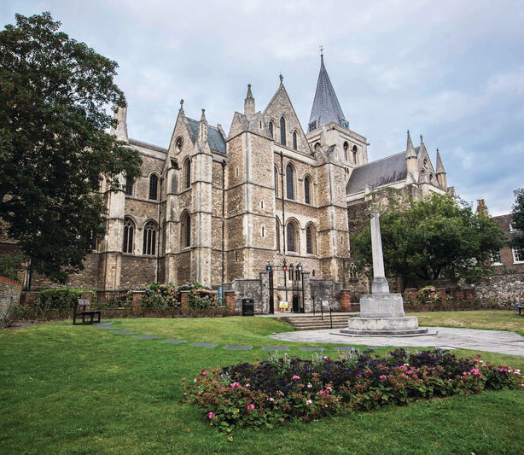
A Partnership Built for Medway
Shared Values, Local Identity, Real Impact
Designed with and for the community
Focused on students, families, and wider population
A model of sustainable, place-based transformation

Slide 4
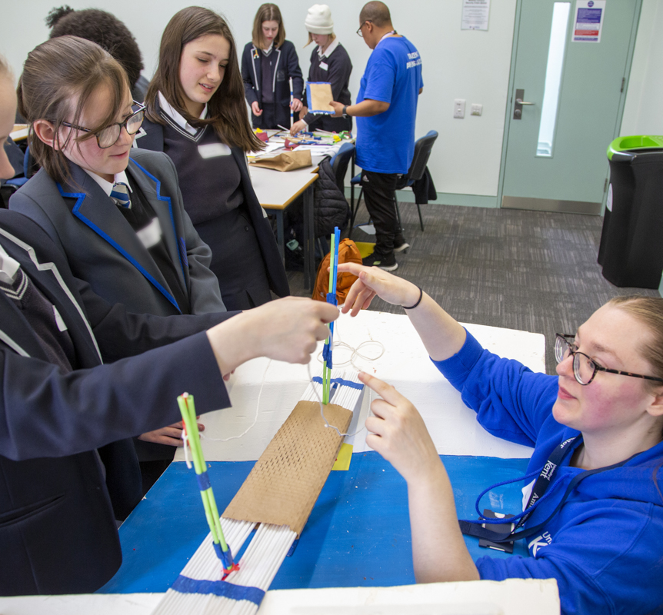
Strategic Role in UKAT’s Vision
Kent co-shapes educational ethos and priorities
Brompton Academy is the most oversubscribed school in Medway
Most oversubscribed school in Medway
Also…2nd hardest secondary to access in Kent (2023)
Fair Banding admissions ensure diversity
Chatham Grammar: 57.1% global majority students

Slide 5
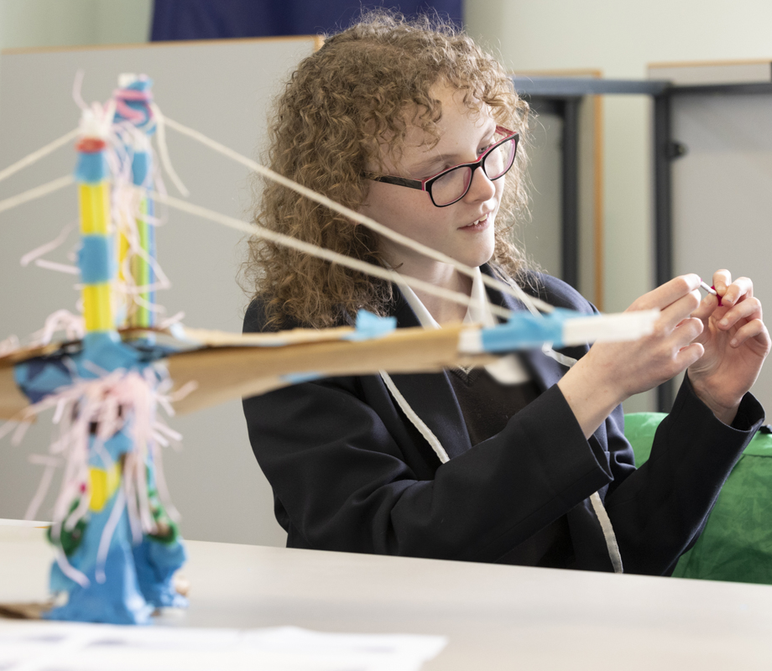
Enriching Young Lives
Annual project days on campus
Regular interaction with Kent staff and ambassadors
Literacy, oracy, STEM support
Extracurriculars: debating, science clubs, creative writing
Enrichment led by Kent academics
Notes:
Students aren’t just exam-ready—they’re empowered as thinkers and contributors."

Slide 6
Supporting Sixth Form Success
Campus visits to Medway & Canterbury
Progression courses, tasters, summer schools
Personal guidance on post-18 pathways
Early support for competitive routes (Oxbridge, medicine, etc.)
Research Skills Module introduced in 2019
Peer mentoring with Kent postgraduates

Slide 7
Strengthening the Whole Community
Parents/carers: short courses & tasters
Mid-Kent College partnership for FE students
CPD for UKAT staff co-designed with Kent
University staff learn from local schools
Kent students placed in UKAT schools

Slide 8
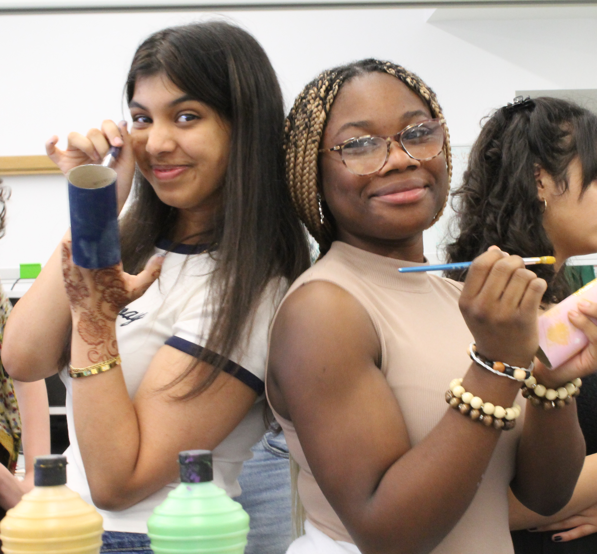
A Model of Place-Based Partnership
Not a pilot: this is long-term and embedded
Recognised by Office for Students as a case study
Co-designed with stakeholders
Locally rooted
Generational in scope
Sustainable year after year

Slide 9
Thank
you

