Slide 1


Continuation: exploring why HE students persist through their studies
Gemma Standen
University of East Anglia
Visit Padlet to continue the discussion
HEIR Conference 2025
Notes:
Introduce yourself and signpost to the research Padlet

Slide 2
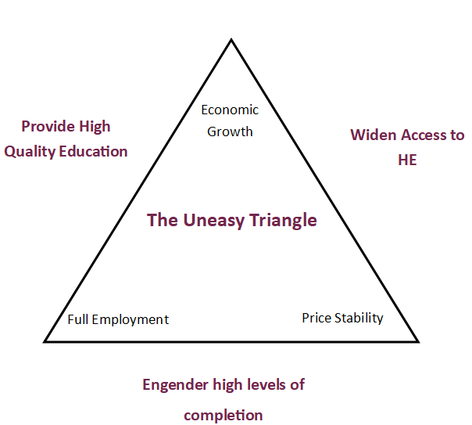
Retention is a ‘slippery context’ (Yorke, 1999)
HEI impact
Student impact
Retention vs. Recruitment Focus: Institutional strategies often prioritise outreach over retention, despite WP students being at higher risk of withdrawal.
Regulatory Pressures: OfS uses continuation rates as a proxy for course quality, placing pressure on HEIs to meet numerical thresholds.
Funding Constraints: Stagnating tuition fees and rising operational costs challenge HEIs’ ability to provide inclusive, high-quality support.
Data Limitations: Reliance on quantitative metrics (e.g., NSS, GOS) may obscure nuanced, contextual factors influencing student experience.
Structural Rigidity: Limited flexibility in course delivery and support structures can alienate students with complex lives or non-traditional pathways.
Financial Pressures: Cost-of-living crisis, debt aversion, and working alongside studies disproportionately affect mature and WP students.
Belonging & Identity: Lack of personal or institutional belonging, imposter syndrome, and difficulty integrating socially or academically.
Mental Health & Wellbeing: High prevalence of mental health conditions and limited access to tailored support.
Motivational Shifts: Changes in personal circumstances, disrupted expectations, and evolving career goals can impact persistence.
Navigational Barriers: Poor IAG, unclear timetables, and limited pre-entry support hinder planning and engagement.
The uneasy triangle, adapted from Yorke and Longden (2004).
Notes:
Context:
Retention is and continues to be a hot topic in HE. Many previous researchers have explored this phenomenon but focused on why students leave rather what inspires them to stay. My research sought to investigate this.
Putting it frankly, retention is tricky – described by Mantz Yorke as ‘slippery’ in 1999 due to its complexity. My own interest stems from my own educational experience as a young mature student with caring responsibilities and mental health challenges. It wasn’t until year 3 I felt I could no longer progress, and it was a member of professional services who intervened to get me over the finish line.
Due to times, I won’t cover the history of retention studies as this is covered well in articles from Aljohani, 2016 and Manyanga et al., 2017. However, I will cover the more recent considerations into the importance of retention in HE as it does affect us all.

Slide 3
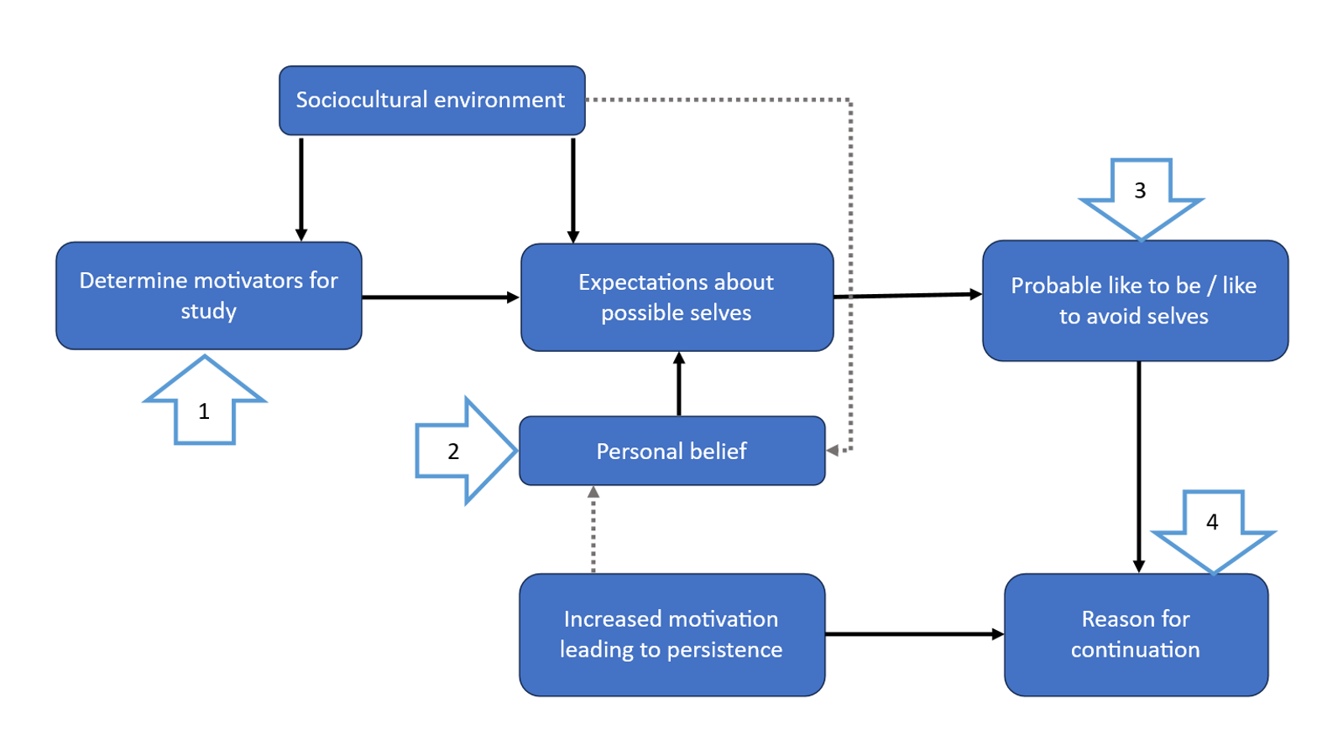
Why do students choose to persist in their studies?
Adapted from Harrison, 2018
Notes:
Main question: Why do students choose to persist in their studies?
Sub-questions: Challenges/enablers, changing motivations, contributing factors
Add some possible selves info – context into why it’s a useful theoretical framework to use to understand what does work in supporting students.
Discuss Harrison’s model, originally used to support and build understanding of aspirations in accessing HE for underrepresented groups. The same premise has been used but adapting the conceptual model to consider possible selves in understanding student persistence and driver toward completion.

Slide 4
Narrative literature review exploring continuation
Survey (n =52)
Interviews (n = 12)
Reflective thematic analysis
Qual
T-tests and ANOVAs
Explore latent meaning through themes
Quant
Kruskal-Wallis and Mann-Whitney U
Triangulation of analyses to amalgamate mixed method findings
Future possible selves concept model (adapted from Harrison, 2018) using Nurius and Markus theoretical framework

Slide 5
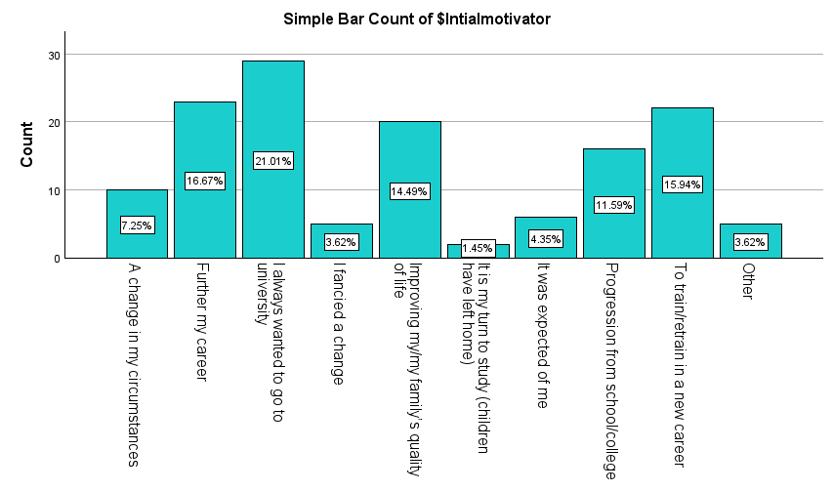
Motivations for study
‘You do your GCSEs; you do your A-levels, and the next step is university. It's kind of, that's just what you do’ (Interviewee 3)
Main drivers for study related to career, retraining, personal growth and family pride.
For younger students, university is a progression from school and for others, this alongside ‘expectations from family’ were selected as key factors.
For mature students, motivations strongly aligned to changes in personal circumstances, retraining or furthering career, and improving family's quality of life.
Didn’t have the chance to go to uni when I was younger as moved out young (survey respondent 39)
Notes:
Highlight key drivers and discuss where motivational change had occurred (i.e., course not fulfilling expectations or not achieving as hoped and changes in circumstances).
Motivations were challenged by pre-perceptions of university; particularly where erroneous information was provided to some students with caring responsibilities and/or commute to uni. This was an important consideration when reviewing whether students were being met.
Stress the importance of pre-entry as part of the continuation journey and establishing belonging from the offset.

Slide 6

Challenges to continuation
It's quite isolating I find. Because there's a lot of other people around, but you're not necessarily working with them or doing a lot with them… like you get to university and have 10 minutes to say hi to everyone before a lecture and then you go in and you're in silence for 50 minutes and then you come out and say bye to everyone and you're gone again (Interviewee 12)
Time restraints and balance with other responsibilities
Finances and the ongoing cost of living crisis
Mental health and changes in circumstances
Lack of structure or too few contact hours
It's virtually impossible to get a part-time job (interviewee 8)
Notes:
Read through each bullet and give examples:
Mature students particularly found balancing time challenging, and many described burning out or being restricted in engagement.
Finances were a huge indicator of challenge, with the quantitative part of this study finding that those on incomes of less than £35,000 per year felt less confident in their ability to engage. Students working found it tricky to find or balance paid employment, engaging in strategies that can exacerbate burnout.
Mental health challenges were found to be a challenge to continuation as well as graduate progression with some students explaining the difficulty in navigating options post graduation whilst balancing ongoing priorities (particularly for neurodivergent students desiring postgrad study). Feelings of isolation and imposter syndrome were also a driver of this.
Mature students particularly found some study programmes contained a lack of structure and too few contact hours. Some found the summer term too long and described starting a new year of study as ‘starting over’

Slide 7
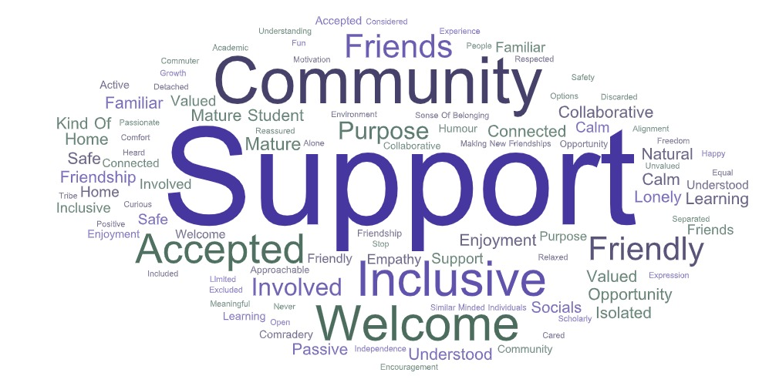
Enablers to continuation
I felt as a mature student I would be sitting in the corner but have had solid involvement with my peers from day 1. I have made friends for life and thought this was something that just happened to the young ones (survey respondent 19)
Peer networks
Feeling “seen”
Support from academics and members of professional services
Holistic information, advice and guidance and appropriate signposting
It was just knowing that they were thinking of me, that I wasn't just a faceless student in, you know, a big university (interviewee 3)
Notes:
Peer networks, where they have been formed, were described as a driving force behind continuation
Feeling “seen”, understood and accepted was important to many, particularly commuters and mature students who appreciate a certain level of understanding.
Support (as the word cloud shows) is fundamental for students. This study highlighted that many students regularly utilise staff as part of their ‘network’.
Holistic information, advice and guidance and appropriate signposting

Slide 8

You're more part of it, you know, and the trouble is, I found with being a mature student is knowing where you fit in because. Obviously, everyone pretty much is like 19 or 20 and some mature students like you know, in the 21 to 25 group and then you've got us which like, in our 40s. And like one of the good things about being PAL mentor was a lot of mature students came on with that (interviewee 6)
It was sent to all of us, but it was like it was sent to me, and it was the most beautiful, heartfelt email I've ever received from an academic person. And it kept me in the course… all these beautiful, wonderful things that he said that hit exactly what I needed to hear at that point, and I was like, OK, let's just see how far I can go (Interviewee 9)
That's a key thing. I felt like I matter… (interviewee 3)

Slide 9

Strategies for persistence
I do make a point of seeing my advisor regularly and she's been really good. And sort of just saying look, this is the important stuff, that isn't the important stuff. Don't worry about that and sort of… I think, as well, some of it is accepting that is good enough (interviewee 5)
If I do quit, then what am I gonna do? Go back to the same thing I did before? Like… it's not that I wasn't happy doing that, but I've done that, and I want more now. You know, there's no point and I think, well, I'm already doing it. It's really not that bad in the grand scheme of things (interviewee 9)
I've been talking to… lecturers and module leaders in their office hours and again, I'm a student Rep as well, so I've been to student meetings, so I kind of it's interesting seeing the background workings of how the course works as well so. I think talking to people has really helped (interviewee 6)
Routines, self-belief, support systems are central to help students find what works for them

Slide 10
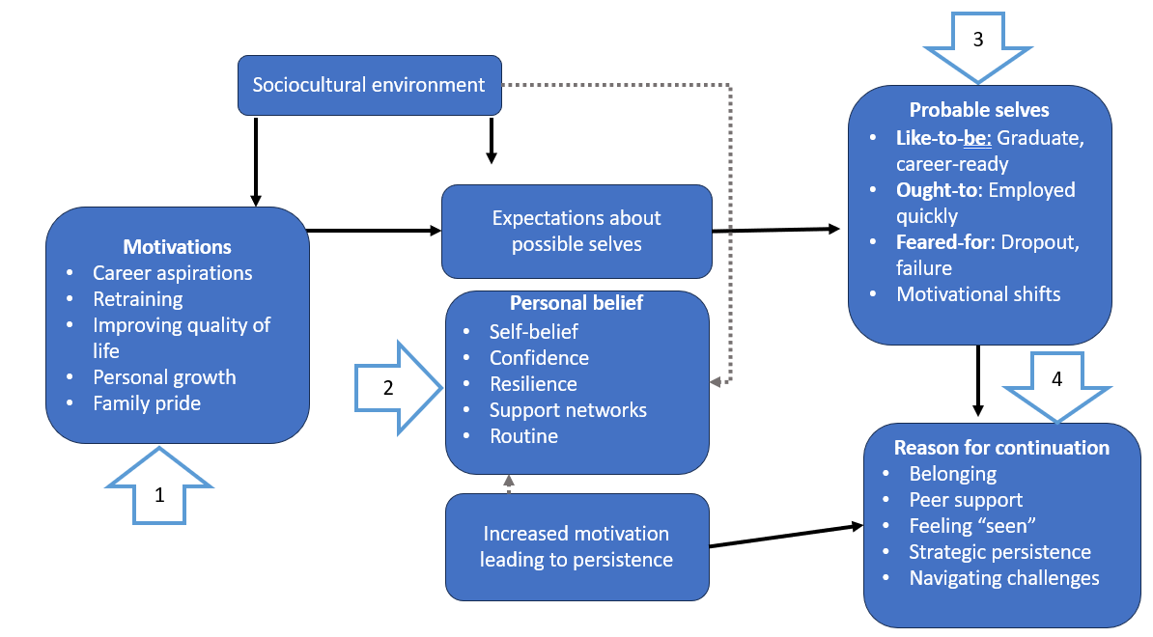
Applying Harrison’s Possible Selves conceptual model

Slide 11
Implications for Policy & Practice
Practice – supporting persistence
Policy – extending understanding beyond numerical thresholds
Current regulatory focus (OfS, TEF, GOS) uses continuation as a proxy for course quality — but this neglects individual context and lived experience. Furthermore, only considers year 1 continuation.
Numerical thresholds fail to capture the complex interplay of personal, social, and institutional factors that shape persistence.
Consider shifting toward contextualised continuation frameworks that integrate belonging, motivation, and student agency.
  Pre-entry IAG to shape realistic expectations and nurture belonging
  On-course support to reinforce self-belief and motivation
  Post-course planning to align graduate identity with career aspirations
Recognise the ‘ought-to’ vs ‘desired-for’ self tension — many students feel pressured to pursue employability over personal fulfilment.
Consider developing roadmapping tools (Oyserman et al., 2004) to help students visualise and plan toward their ‘like-to-be’ selves.

Slide 12
Discussion
Visit Padlet to add your thoughts, ideas and experience

Slide 13


THANK YOU
Baker, Ellis and Uddin (2025). Exploring Widening Access for Mature Age Students: International Data, Experiences and Practices.
Pre-order – release is 17th September 2025
Gemma Standen
Widening Participation Officer & Associate Tutor in the School of Education and Lifelong Learning
g.standen@uea.ac.uk

Slide 14
References
Harrison, N. (2018) ‘Using the Lens of “Possible Selves” to Explore Access to Higher Education: A New Conceptual Model for Practice, Policy, and Research’, Social Sciences, 7(10), pp.1-21.
Oyserman, D., Bybee, D., Terry, K., and Hart-Johnson, T. (2004) ‘Possible selves as roadmaps’, Journal of Research in Personality, 38(2), pp. 130–149.
Yorke, M. (1999) Leaving Early: Undergraduate Non-completion in Higher Education. Psychology Press.
Yorke, M. and Longden, B. (2004) Retention and Student Success in Higher Education. McGraw-Hill Education (UK).

