Slide 1
Julie Smith and Steph Copsey (she/her)
Pre-16 Outreach

Slide 2
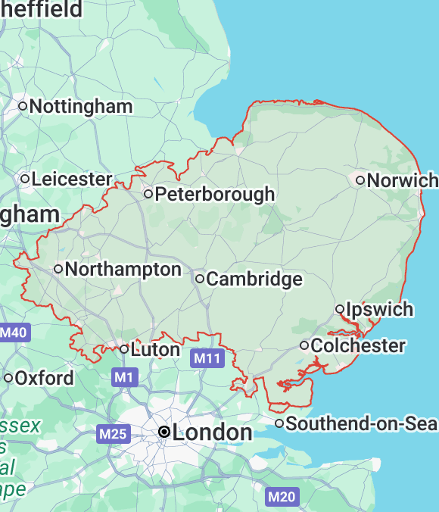
UEA Context
KS2 attainment consistently below national averages
Lower attainment 8 scores
Lower level 3 attainment
Higher rates of absence
Higher proportion of students in rural areas
Notes:
In Norfolk, we face a stark and uncomfortable truth: too many of our young people - particularly those eligible for free school meals - are being left behind when it comes to higher education. Only around a quarter of these students progress to university by the age of 19, compared with nearly half of their peers nationwide. And while students in Inner London are now progressing at record levels, often surpassing the national average for non-disadvantaged pupils, Norfolk’s children are missing out and not because of a lack of talent or ambition, but because of barriers deeply rooted in geography, opportunity, and circumstance.
These aren’t just statistics. They represent real lives, real futures curtailed before they’ve even had the chance to begin. We are talking about bright, capable young people who are every bit as deserving of a university education. So back in 2022, we appointed Julie based on her experience of teaching to design a metacognition programme

Slide 3

MIC Overview
Metacognition programme
Year 7s and Year 8s
Small groups
Non-subject specific (skills focus)
Delivered by Outreach Officers and HECs

Slide 4
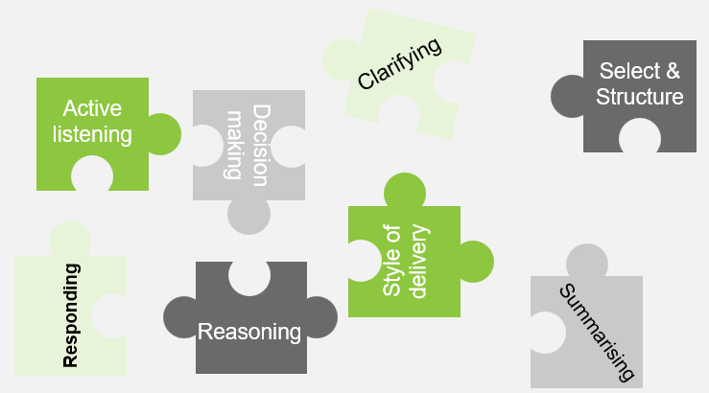
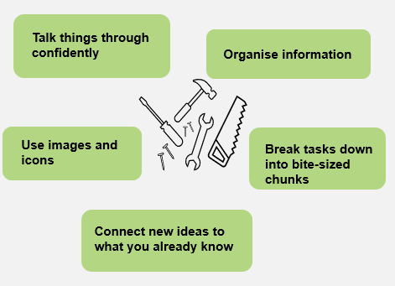
Year 7
Year 8
Notes:
These tools underpin the whole programme.

Slide 5

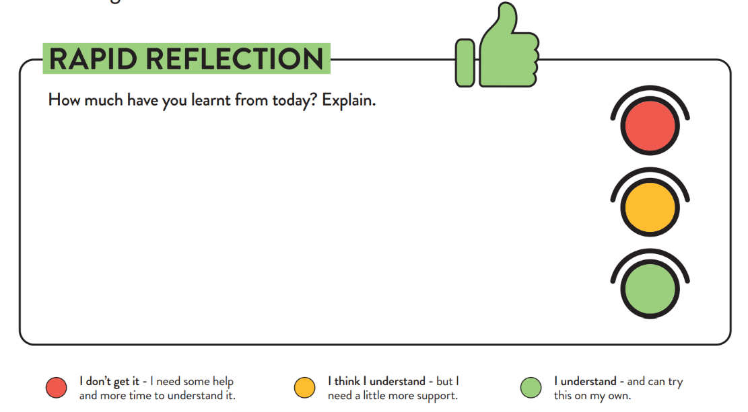
RAPID REFLECTION TIME

Slide 6
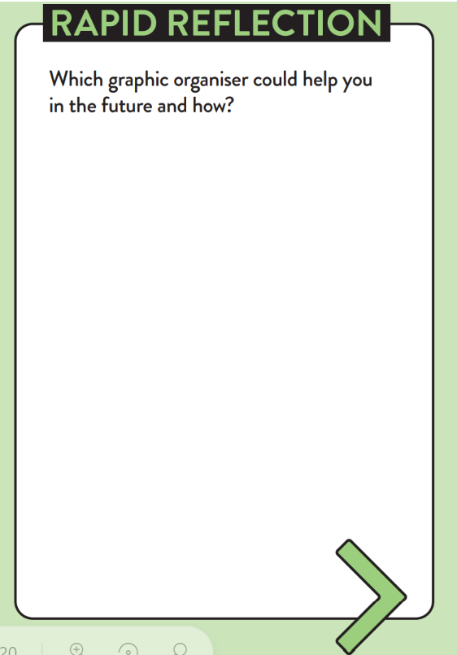
RAPID REFLECTION TIME

Slide 7

Evaluation
Pre- and Post- Survey
Journal scrutiny
Teacher Interview
Presentation feedback via facilitator

Slide 8
Evaluation Highlights
Year 7 positive increase of 30.4pp
Year 8 positive increase of 17.8pp
Journals and Reflection Sheets evidenced students using learning tools and developing reflection skills
Assessment of participants in final workshops rated ‘Good’ or ‘Excellent’ rather than still ‘Developing’
Teachers - more confidence, asking more questions in lessons and reflecting better on their work.

Slide 9
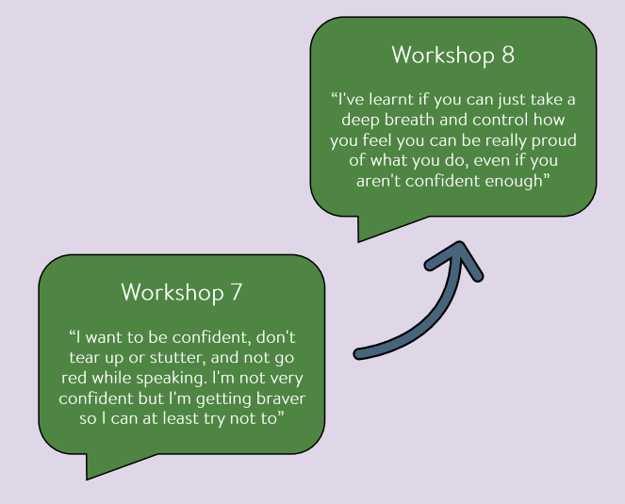
Evaluation Highlights
Notes:
One student’s comment

Slide 10

The Future for MIC…
Randomised Controlled Trial
Year 9 programme
Notes:
Year 9 – consolidate the use of learning tools

Slide 11

Any questions?

Slide 13
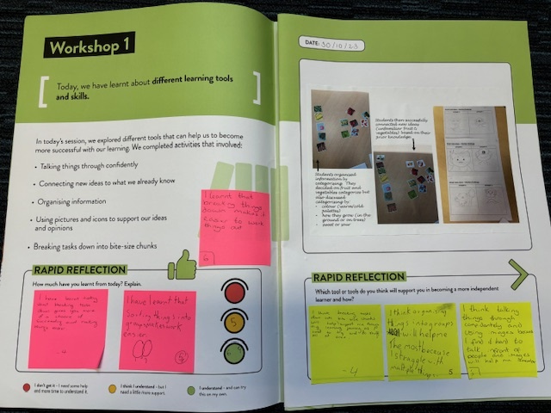
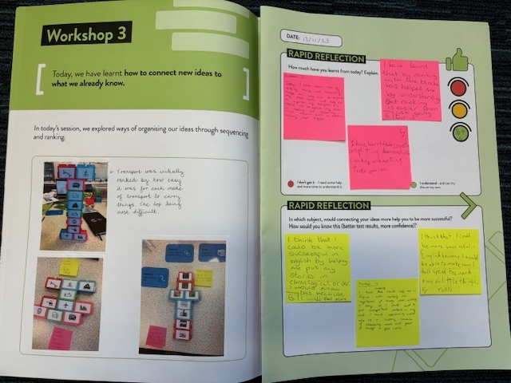

Slide 14
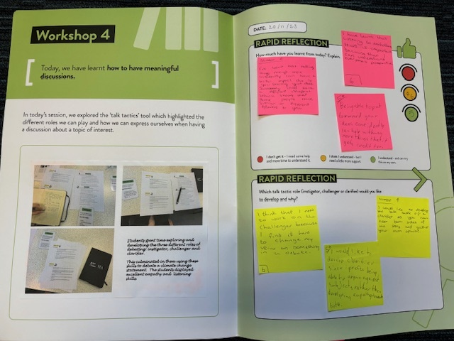

Slide 15
