Slide 1

Educational gains: an emerging case study
Kristyan Spelman Miller
PVC Education, Keele University
Notes:
Work in progress

Slide 2
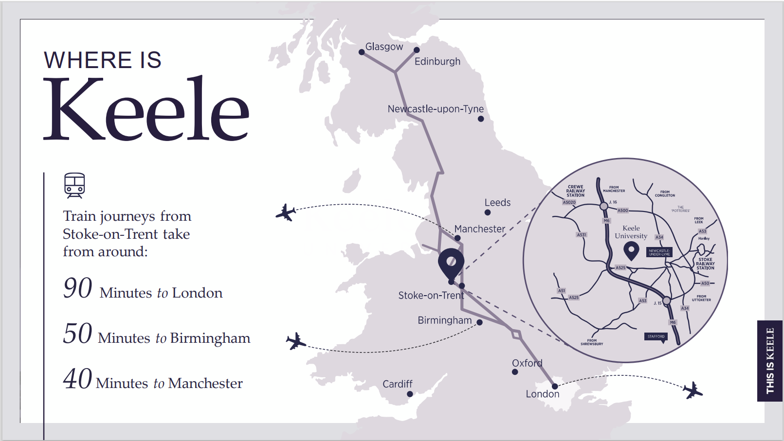

Slide 3
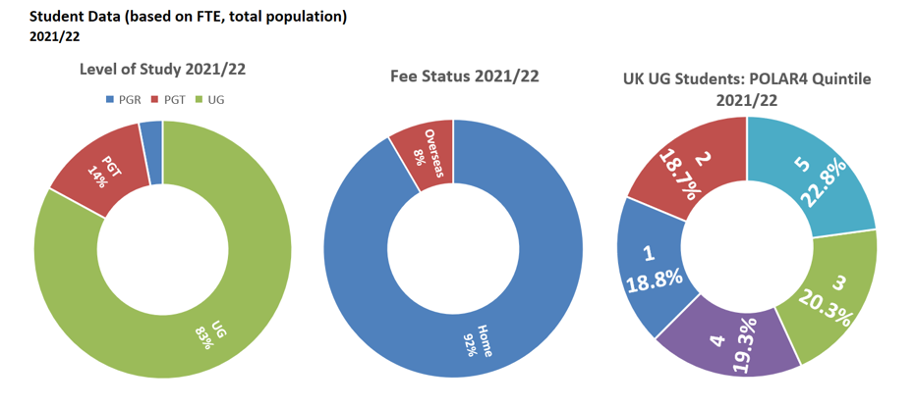
Student Population
Notes:
47% from West Midlands and 16% from North West - 14% very local from SoT, 16% from Staffordshire,

Slide 4
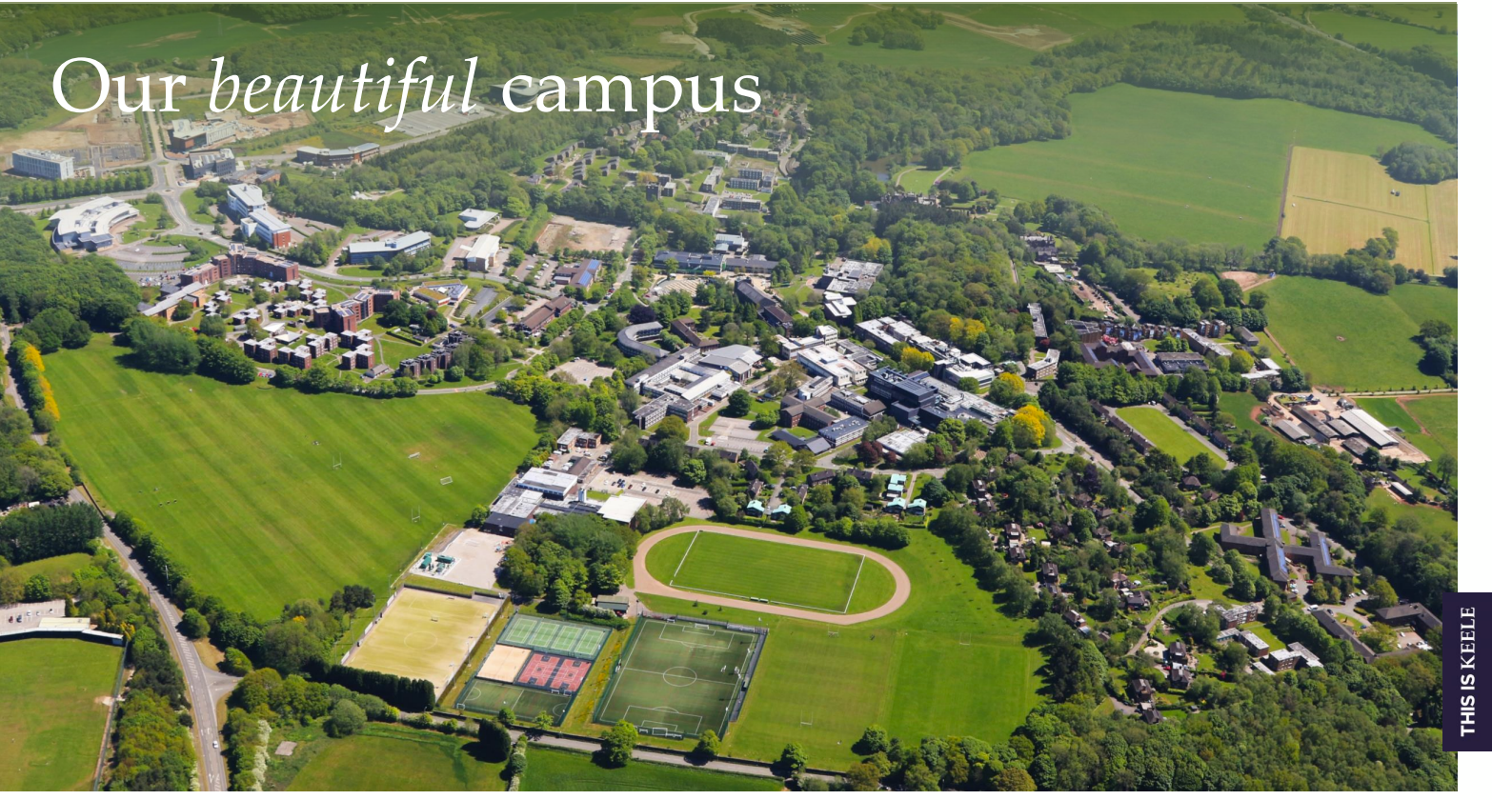

Slide 5


Slide 6

Notes:
Education for Sustainable development

Slide 7
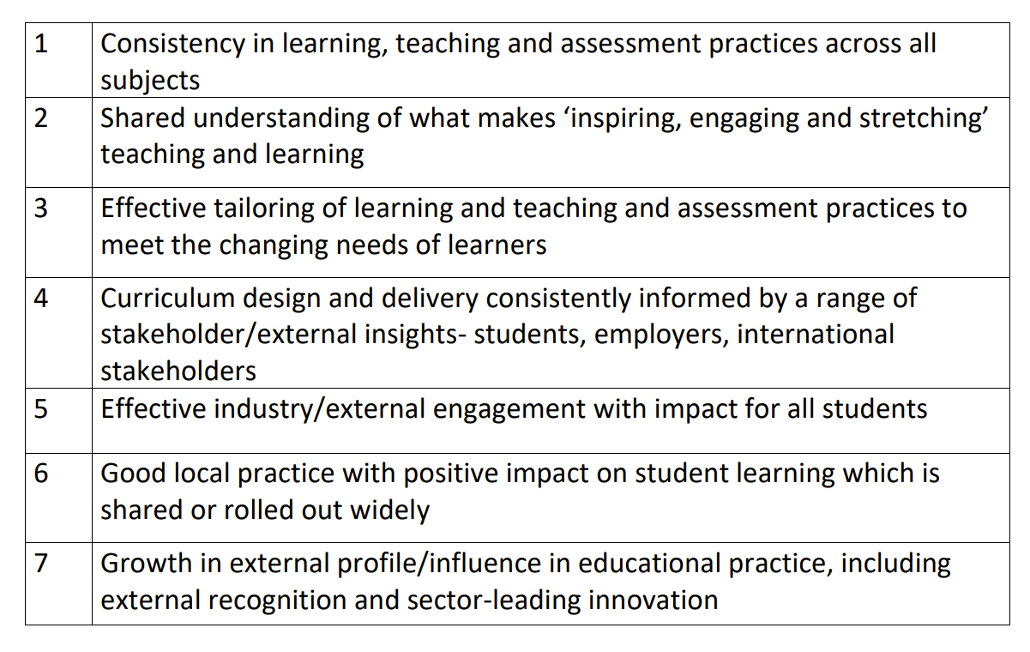
Our learning from TEF 2023

Slide 8
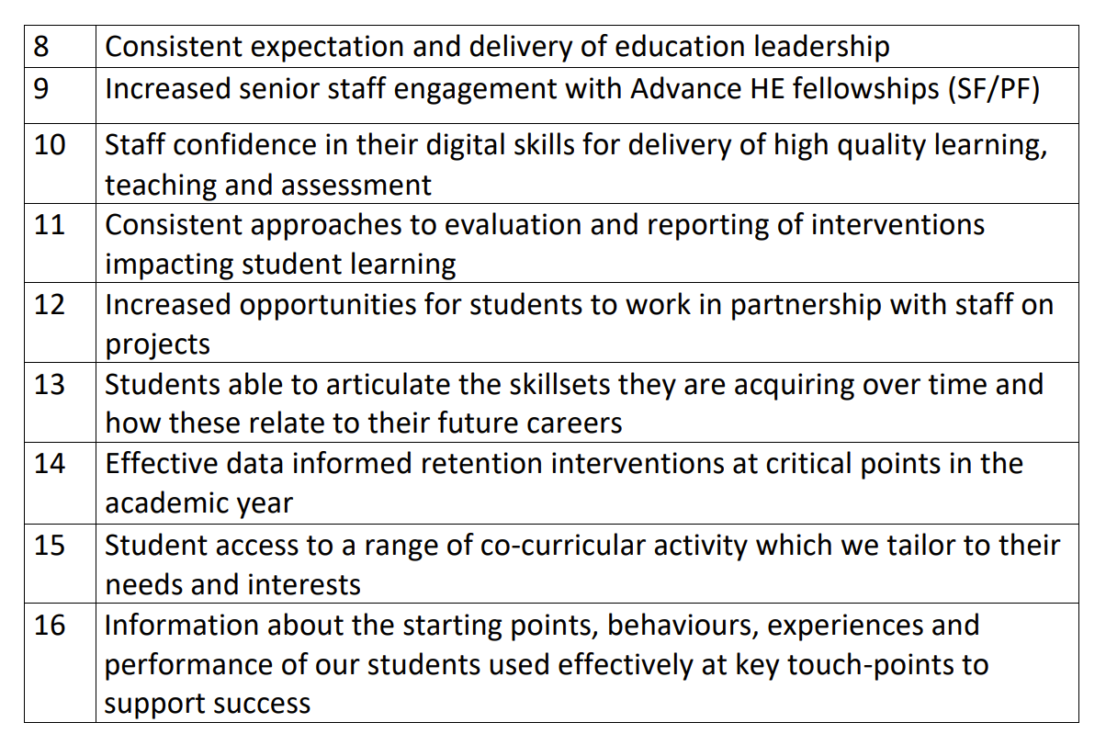

Slide 9
Educational gains as an articulation of success
our strategy commits us to “providing the opportunity for all students regardless of their background, circumstance, discipline, and course to succeed academically, in terms of personal development and future plans and ambitions”.

Slide 10
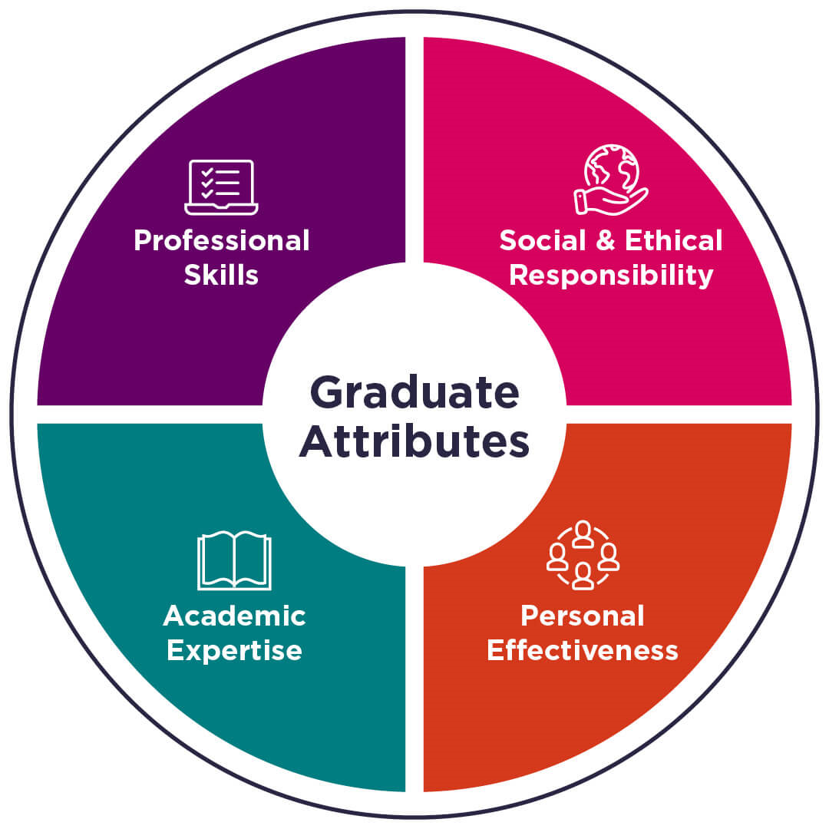

Slide 11
Professional readiness | Global and social awareness
Digital capability | Academic confidence and growth
Notes:
From our sets of attributes we have chosen specific attributes which are key to the educational experience at Keele – are meaningful, measurable and trackable
Accessed the system at least once since 1st August 2023 (our main launch point after a soft launch in January 23)
4434
b) Started their self evaluation
4625 overall
4427 since August
c) completed their self-evaluation
3482 overall
3338 started and completed since August

Slide 12
Professional readiness Career readiness and actions | Global and social awareness Global Challenge Pathways and language study
Digital capability Digital capability assessment and actions | Academic confidence and personal growth Academic skills assessment and actions
Notes:
From our sets of attributes we have chosen specific attributes which are key to the educational experience at Keele – are meaningful
Accessed the system at least once since 1st August 2023 (our main launch point after a soft launch in January 23)
4434
b) Started their self evaluation
4625 overall
4427 since August
c) completed their self-evaluation
3482 overall
3338 started and completed since August

Slide 13

Climate Change
Social Justice
Global Health
Digital Futures
Enterprise and the Future of Work
Language and Intercultural Awareness
Notes:
Some of the special things about keele

Slide 14
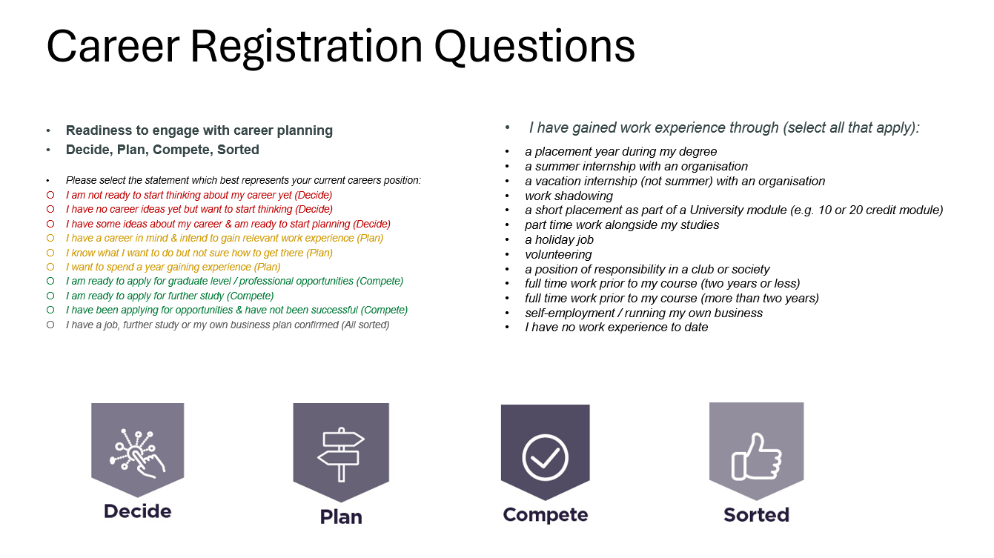

Slide 15
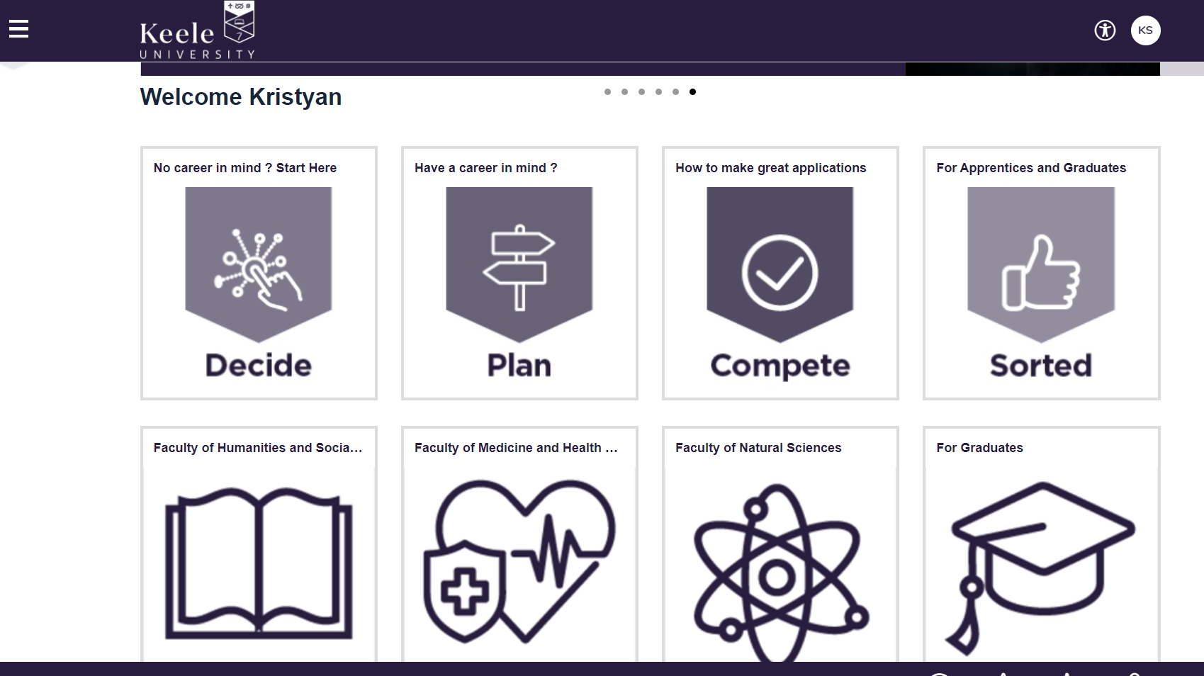

Slide 16
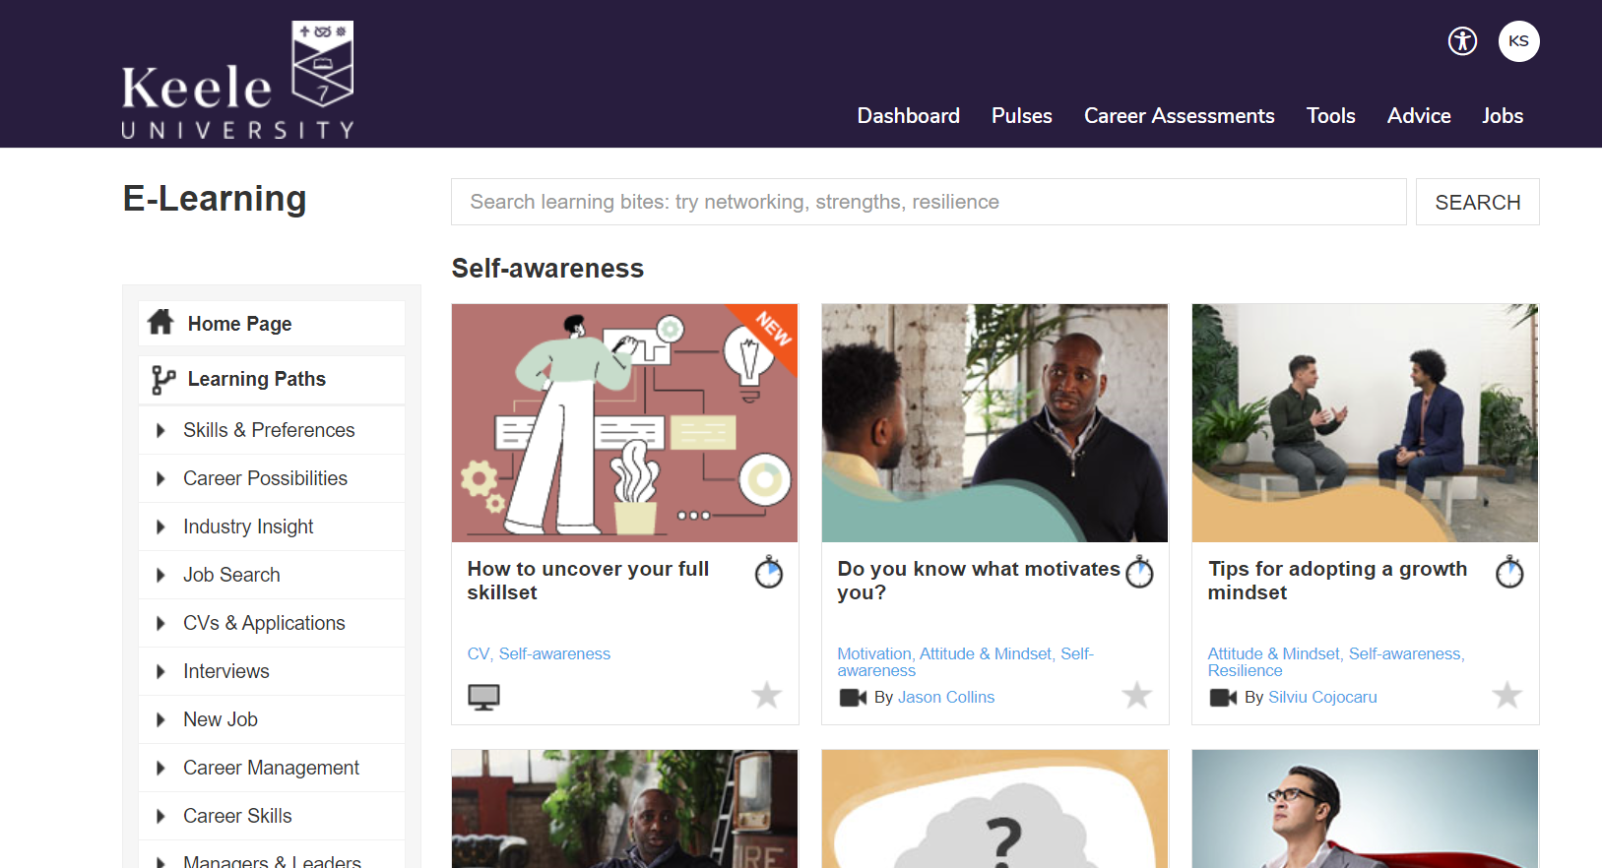

Slide 17
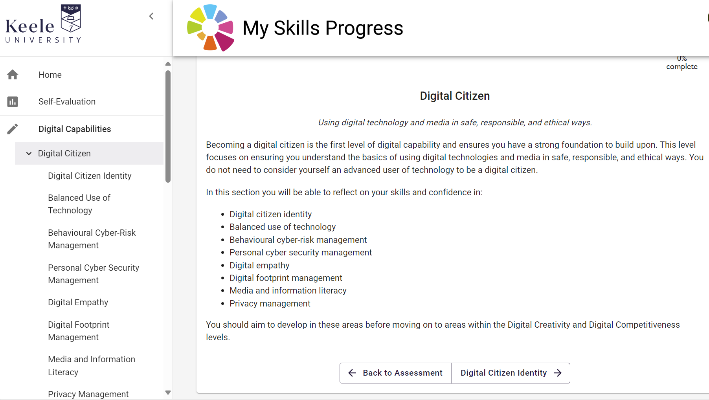

Slide 18
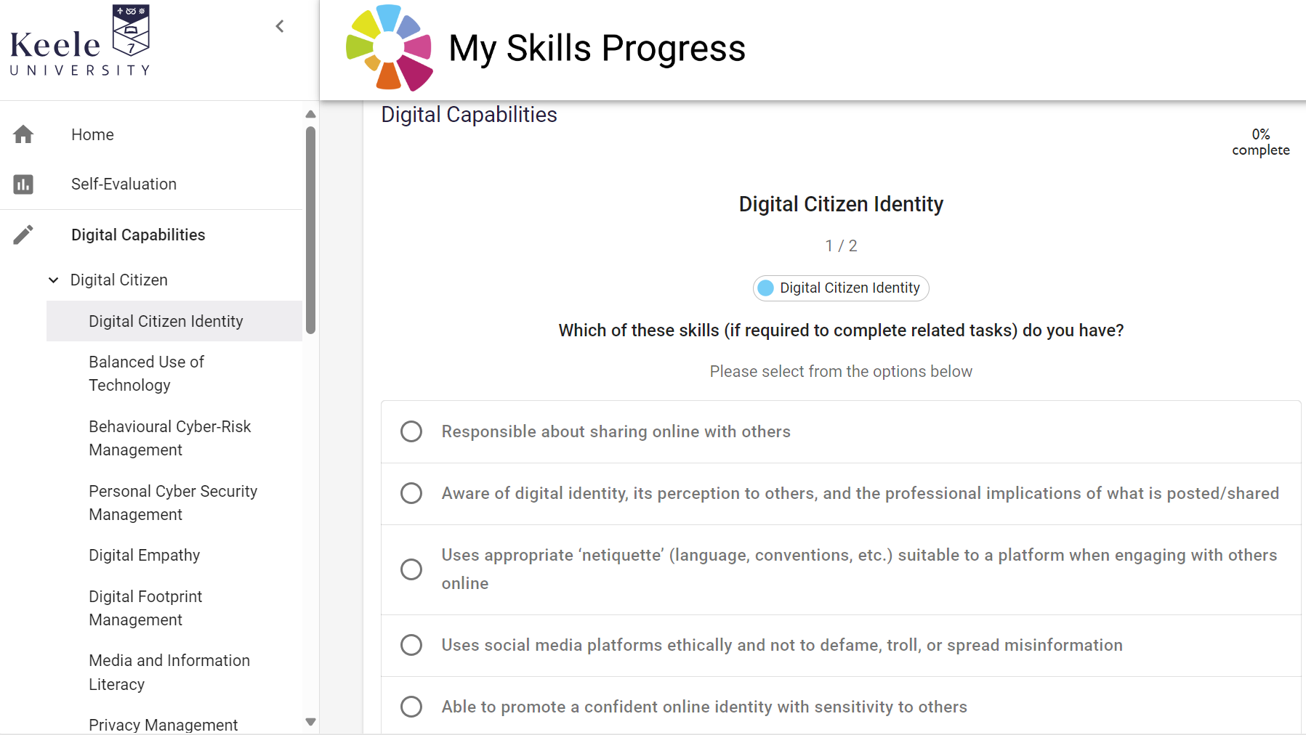

Slide 19
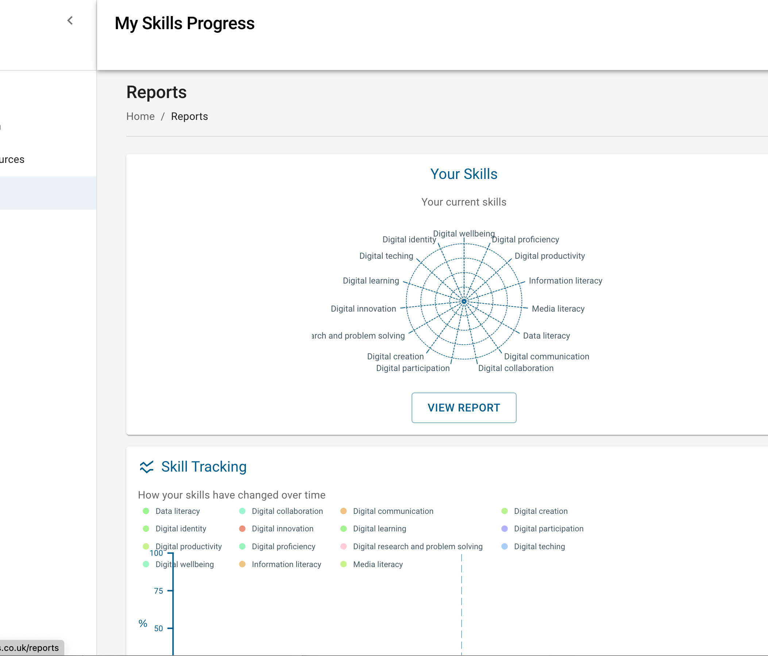
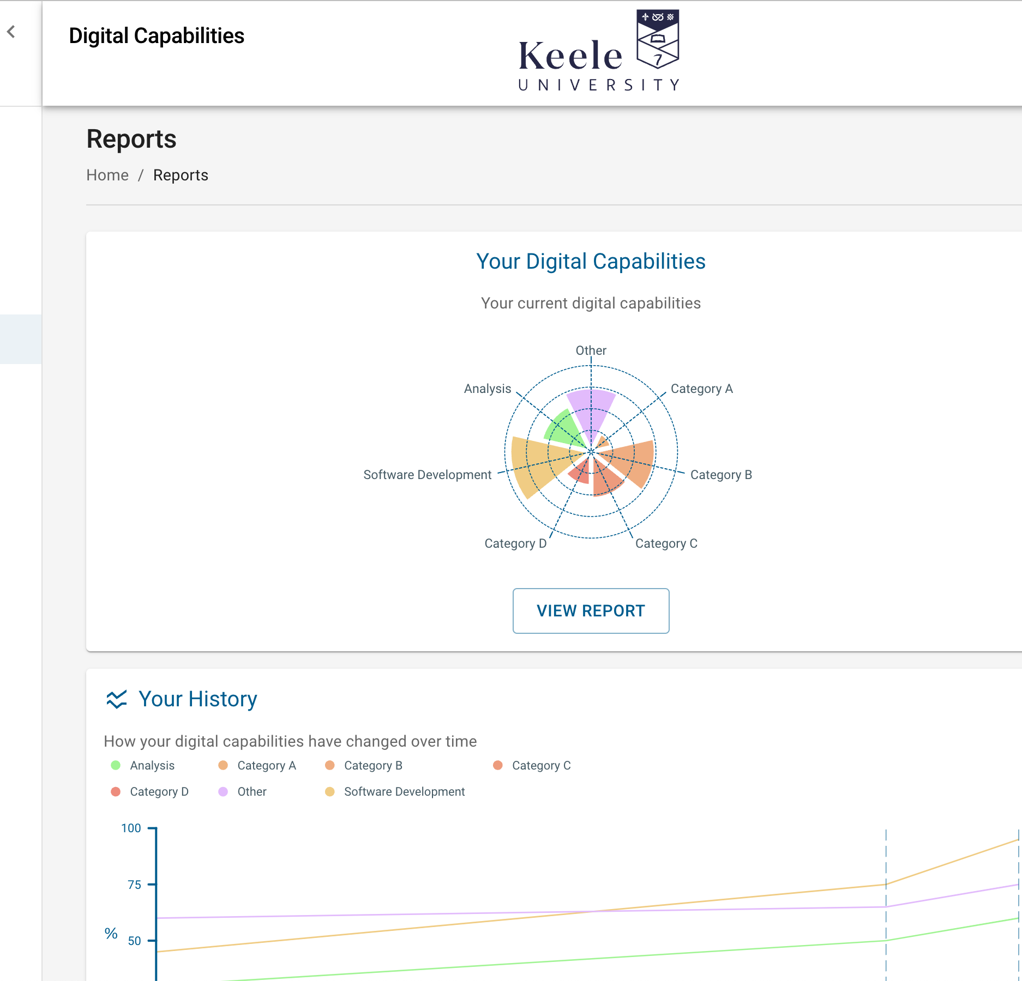

Slide 20
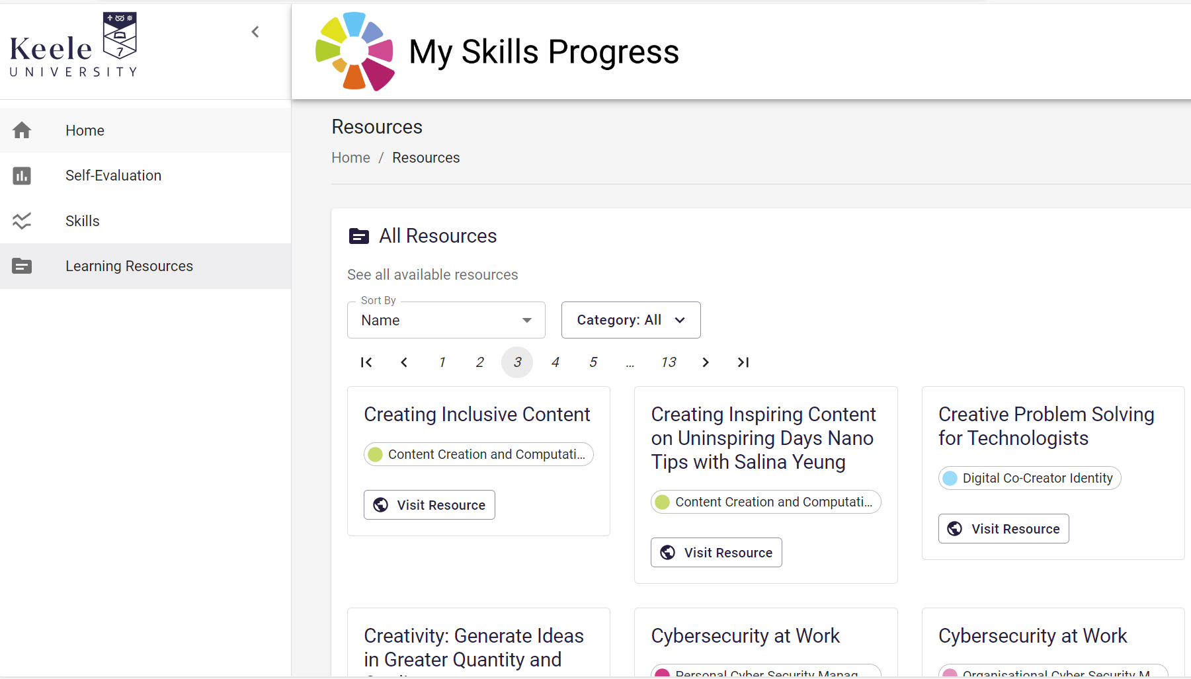

Slide 21
Reflections on educational gains
Focus on gains which are true to the institution’s educational mission, are meaningful and reflect our student’s goals;
Build on existing processes - with a plan to develop;
Ensure tracking is embedded in core student processes, such as learning and support (e.g. academic mentoring/ personal tutoring);
Use a range of complementary data sources such as internal and external surveys (e.g. NSS optional questions and UKES survey), records of engagement and activity, to support measurement of gains at institutional level.
Notes:
Risk of trying to do too much – start contained and focussed – emerging!

Slide 22
Thank you

