Slide 1

HEIR Network 2025 Annual Conference
4th– 5th September 2025
University of East Anglia
Lightning Talk
4th September
Advancing EDI at University:
Reflexive Practices in UK-Japan Higher Education Contexts
Tomoko Torii (Waseda University, Japan) &
Elena Zaitseva (Liverpool John Moores University, UK)

Slide 2
Background and Rationale
Equity, Diversity, Inclusion (EDI)
Institutional strategies and practice
Learning organisation as institutional approach (Senge, 2006)
Reflexive governance (Scott, 2020)
Transferable practice in international context

Slide 3
Comparative Insights
Japan context:
• Dual contexts of human rights and innovation aims (Torii et al., 2025）
• Experiential, multi-perspective, facilitated by staff Job rotation (Torii et al., 2023)
• beneficial side effect of rotation, Internal capacity building
  e.g. IR/EDI, HR→EDI, School Administrator→EDI
UK context:
Sector ambition for consistent and co-ordinated approach to staff and student EDI activities (Advance HE, 2024)
Access and Participation Plans (Office for Students)
• Structured, data-driven
• Inter-institutional collaboration

Slide 4
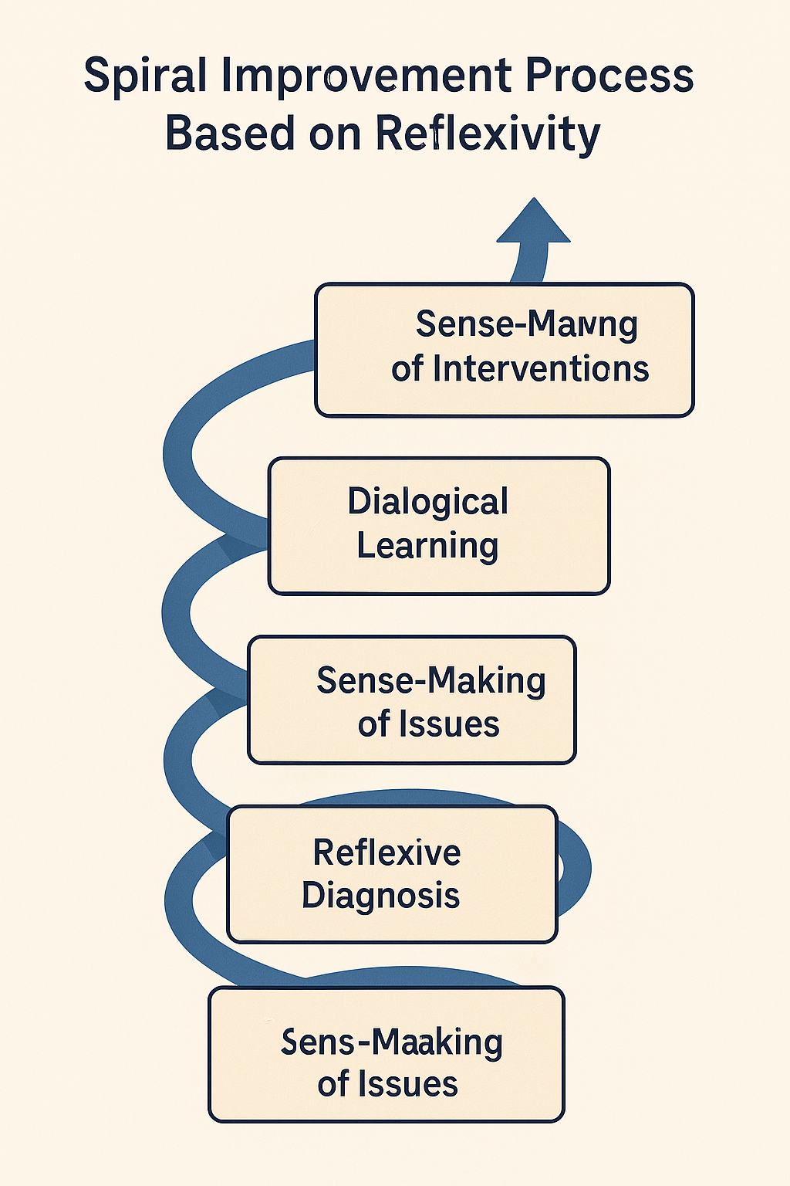
Emerging Themes
Key Concepts:
• Reflexivity
• Dialogue
• Institutional learning
Key Challenges:
• Structures for meaningful dialogue
• Enabling capacity
• Operationalisation
Figure 1. Reflexive and Dialogic Approach Model

Slide 5
Invitation to Collaborate
Join our international study project:
• What are your enabling environments for institutional EDI change?
How reflective institutional learning is operationalised?
What are successes and challenges of your approach?
• Let’s reflect and learn together

Slide 6
Thank You & Contact
Thank you
Please get in touch!
Tomoko Torii – Waseda University
ttorii@waseda.jp
Elena Zaitseva – Liverpool John Moores University
E.Zaitseva@ljmu.ac.uk

Slide 7
References
Gilligan, R. (2024) ‘Holistic approach to EDI’ Project update, Blog; https://www.advance-he.ac.uk/news-and-views/holistic-approach-edi-project-update-june-2024
Scott, C. (2020) “Managing and Regulating Commitments to Equality, Diversity and Inclusion in Higher Education,” Irish Educational Studies, 39(2):175-191.
Senge, P. (2006) The Fifth Discipline: The art and practice of the learning organization: Second edition, Random House Books.
Torii, T., Kondo, N., Yamamoto, K. (2023) “ Holistic Approach to Successful Institutional Research and Institutional Effectiveness Based on Local Intelligence in Japanese Universities: Required Conditions for Bridging IR and IE,” Asia-Japan Research Academic Bulletin, 4, 1-13.
Torii, T., Okada, Y., Sugitani, Y., Yamamoto, K., Murakami, M. and Tajiri, S. (2025) “Roundtable 13: Promoting Diversity, Equity and Inclusion (DEI) and the Use of Institutional Research (IR) in the Management of Teaching and Learning,” 47th Annual Conference of the Japan Association for College and University Education, 7 June [in Japanese].

