Slide 1




Research Culture Insights from
Differing Perceptions and Expectations at the University of Leicester
(Speaker) Chun Hao Wang
Genovefa Kefalidou
Notes:
Hello everyone! My name is Sebastian. I’m a research associate for the Wellcome-funded I-REACCH project. Today, I’d love to share some early findings from our Research Culture Survey 2025 and complementary research at the University of Leicester.

Slide 2




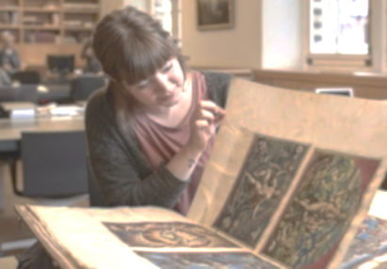


The University of Leicester
4 Colleges
Leaky Pipeline of Diversity
BAME Population
60%
Science &
Engineering
47%
Life Science
26%
Social Science,
Arts,
History
Business
Undergraduate
Postgraduate
Researcher
Staff
Notes:
To give more context about my uni and the I-REACCH project, university of Leicester have 4 college.
Leicester as a diverse city, our staff population does not reflect the diversity of the city. At each stage in researchers’ career progression, we see a reduction in diversity. This is the mission I-REACCH want to address. I-REACCH stand for

Slide 3


Wellcome-funded I-REACCH Project
Inclusive Research Environment Achieved through Culture CHange
Notes:
I-REACCH stand for
We are 1 of the 23 projects funded by Wellcome Trust.

Slide 4
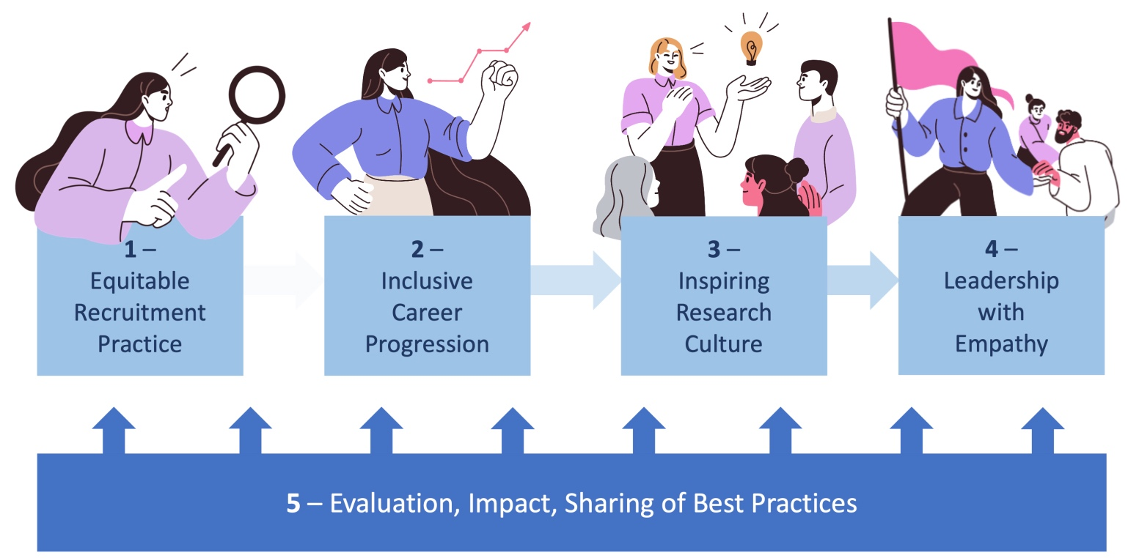


I-REACCH’s Definition and Workstreams
Notes:
Divided researcher’s journey into 5 workstream, recruitment, career progression, local environment engagement, leadership, and the evaluation.

Slide 5
Mixed-methods for the research culture
Target Audience
Research Culture Survey
Interview & Focus Group
300+
6
Professional
Service
Research-active
&
Research-enabling Staff
&
PGR
Responses
4
8
Colleges
Researchers
Notes:
This survey was launched in February and remained open for a month for all teaching and researching staff, professional services and PGR. We received around 300 responses from across all four Colleges at the University.
We also ran some interview and focus groups to understand more context about the survey findings, and there are more interviews upcoming.

Slide 6
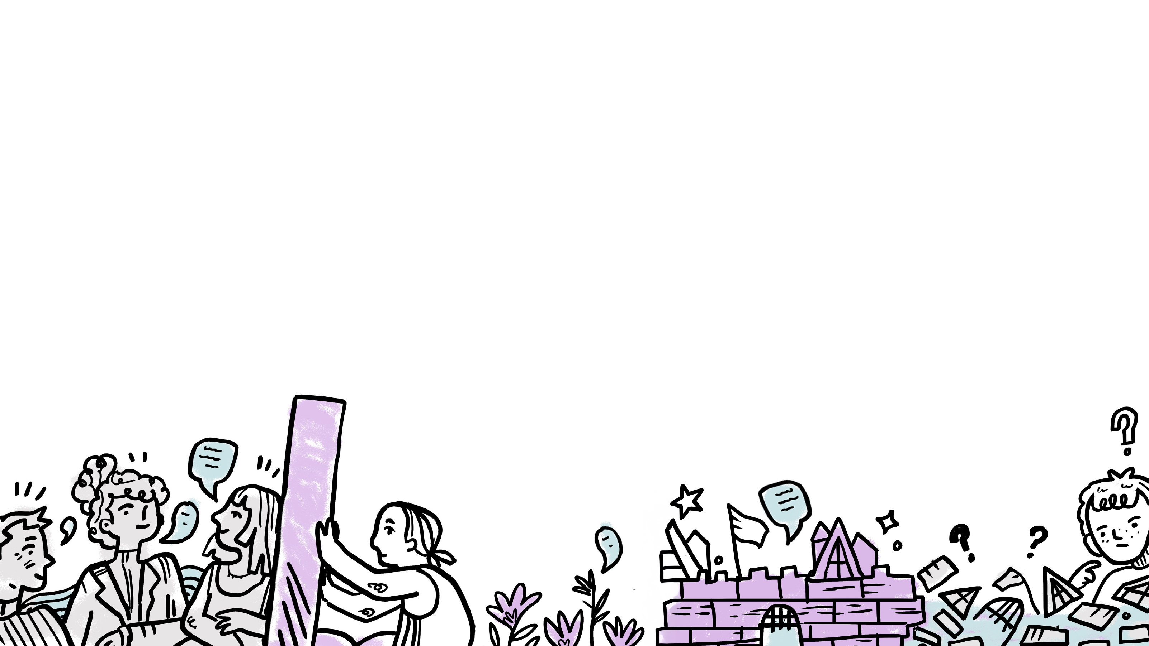
What is Research Culture?
Notes:
First, what is research culture?
If we ask ten people, we may get a hundred different answers.

Slide 7
“Research culture is a shared set of behaviours, values, expectations.”
Royal Society
Notes:
I-REACCH refer to the Royal Society definition, which describe research culture as a shared set of behaviours, values, expectations. We want to know how’s people’s perception and experience of RC.

Slide 8
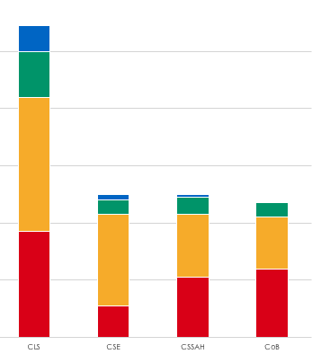
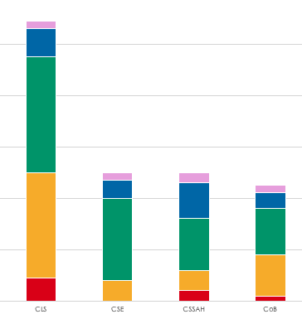
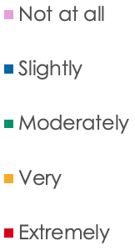
The gap between importance and current perception
How positive and inclusive do you perceive RC at the University to be?​
How important RC is?
🔥
🥶
Responses
Numbers
Life
Science
Science& Engineering
Social Science, Arts,
History
Business
Life
Science
Science& Engineering
Social Science, Arts,
History
Business
Notes:
So, how important is research culture to our community? 83% (226/272) of respondents told us it is very or extremely important
However, people felt less positive on the current situation. Only 35% (95/271) response extremely and very
So what exactly the gap is between these?

Slide 9
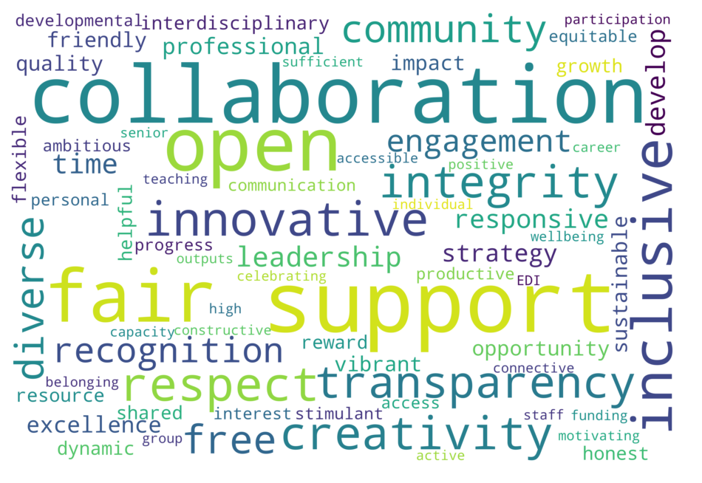
Keywords associated to a positive research culture
What three words do you associate with a positive and inclusive research culture?
1st Collaborat-
2nd Fair-
3rd Open-
4th Inclusiv-
5th Support-
16.9%
9.6%
6.4%
5.2%
5.1%
Notes:
Generally speaking, respondents want a research culture that is more collaborative, fair, open, inclusive, and supportive. which are all understandable and expected

Slide 10







Different keywords among colleges
Life Science
Science & Engineering
Social Science, Arts, and History
Business
Value-
Respect-
Creativ-
Excellen-
Compared to:
CSE (0.055)
CSSAH (0.059)
CoB (0.106)
Compared to:
CLS (0.068)
CSSAH (0.439)
CoB (0.674)
Compared to:
CLS (0.001)
CSE (0.025)
CoB (0.052)
Compared to:
CLS (0.001)
CSE (0.025)
CoB (0.052)
Notes:
What interesting is, when we dive deep in the responses by College, some significant differences show up.
Different colleges show obvious wording preferences when asking them to define what research culture is.
For example, people from life science use the word value more often, and science and engineering mention more about respect, social science focus more on creativity, and business mentioned excellent.

Slide 11

The discipline determines the RC definition.
Different Definitions (“Creativity” as an example)
“I think creativity is about what innovation we can develop with industrial partners.”
“For engineering, I feel it’s about having input from other discipline, like psychologist.”
- Participant C, Business College, Interview
- Participant A, Engineering and Science College, Interview
“I think creativity is about how to apply critical thinking to generate social impact…”
- Participant B, Social Science, Arts, and History College, Interview
Notes:
Different colleges not just have different priority for RC, they also have different definition to the elements of RC.
Take creativity as an example, people from social science reckon creativity is to have critical thinkings on social impact, people from business feel creativity is to innovate with industrial partners.
So here we can see the nature of the discipline affect how people understand research culture.

Slide 12



The discipline determines the RC perception.
Different Ways of Working
“I am at a very supportive environment where people are willing to work together towards common goals and to support each other…”
“Because I am at a distance I have struggled since the start to feel meaningfully included.”
“We’re a bit out on our own. I have to actively seek involvement.”
“I love working here, it has the best atmosphere and lab environment I have come across in many years.”
“What is research culture? I usually worked with my line manager only. I don’t think it’s necessary to engage with others (in other colleges)”
Positive Feeling
“As a part‑time, I have very little contact with the opportunities… My supervisors are my only real contact, and they are great.”
Negative Feeling
Work Type
Individual Work
Remote/
Individual
Lab-based/
Teamwork
Team Work
Notes:
Discipline not only shapes what individuals perceive and prioitise research culture.
Their different working styles also affect their sense of belonging and perception of research culture.
For example, we found that some engineering respondents—often working alone—expressed uncertainty about what research culture is, or reported a lower sense of connection.
By contrast, respondents from lab-based like life sciences, more frequently described supportive and positive environments.

Slide 13
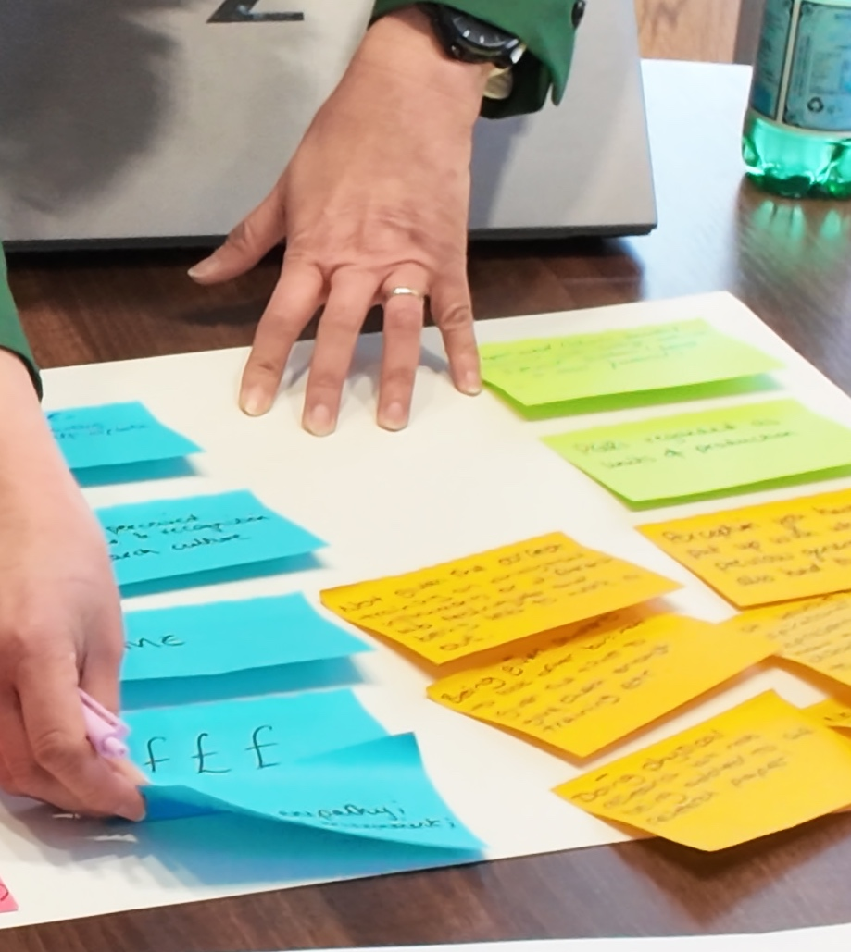
Culture has no single definition.
People and disciplines imagine an ‘ideal research environment’ differently. This is why a participatory approach is essential.
References
Newman, J. (2025). Cultural barriers to interdisciplinary research collaboration: Evidence from Australia. Humanities and Social Sciences Communications, 12, Article 795. https://doi.org/10.1057/s41599-025-03125-3
Cuesta-Hincapié, C. (2025). Discovering the meaning of creativity in instructional design: A co-creation and concept mapping approach. International Journal of Technology and Design Education. Advance online publication. https://doi.org/10.1007/s10798-025-09944-y
Notes:
So what is research culture, it really depends on what the person’s discipline and their nature of working style.
This is why I-REACCH is frequently involving people by workshops, interviews, and several events to co-develop and pilot our interventions.

Slide 14
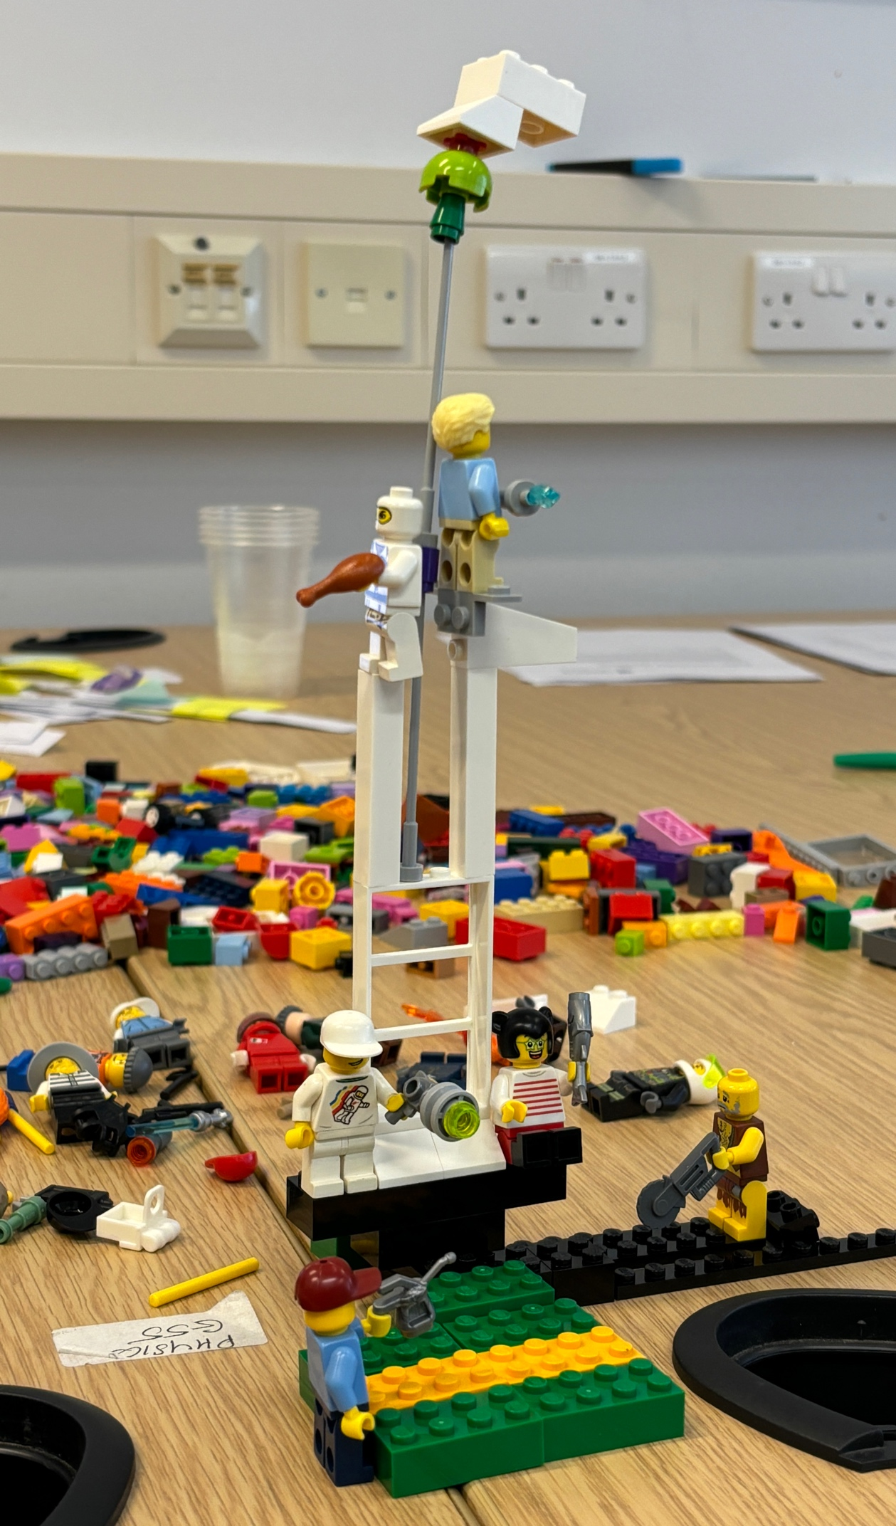
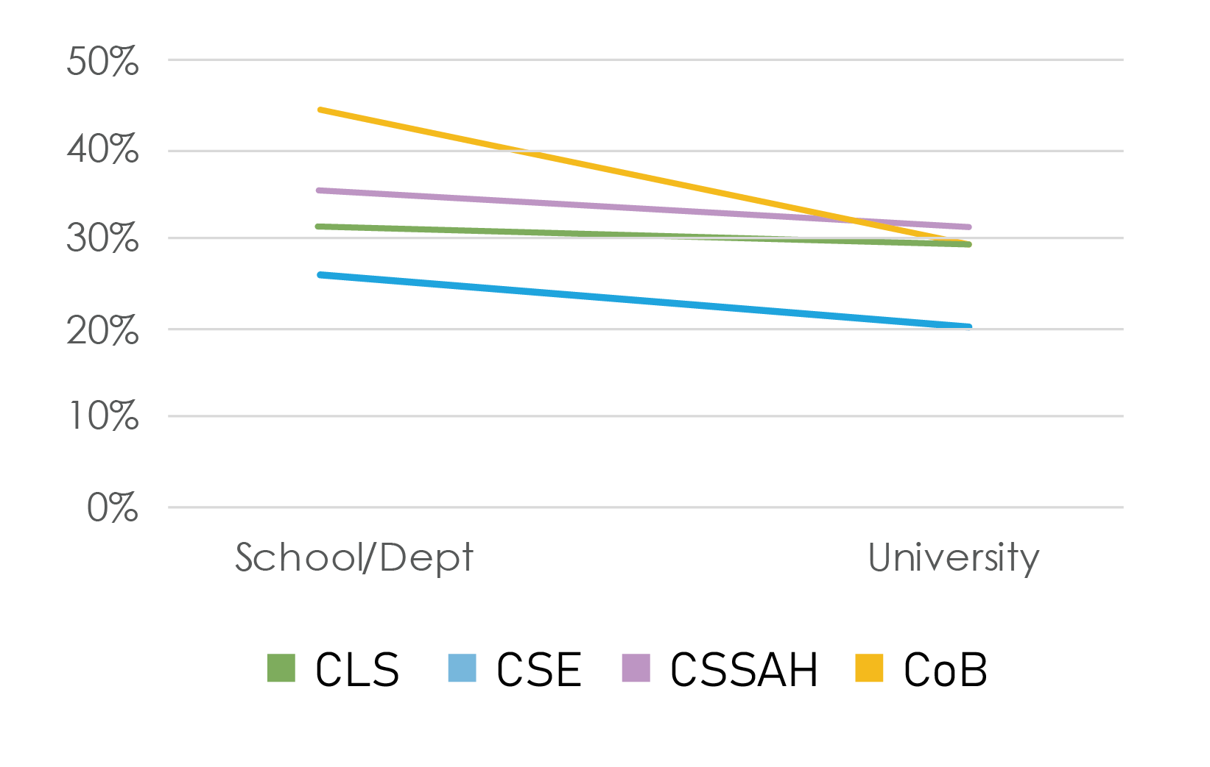
The locality affects the RC perception.
University
How much consideration of Research Culture given by ... in your opinion?
“My department is a great place to work, very supportive with strong EDI.”
- Participant A, Survey
“Despite not having the same academic background as my peers, I feel I have been accepted and am able to make a contribution to the research culture in my school.”
- Participant B, Survey
School
“My school is very collegiate, intellectually interesting, and positive. I have a genuine sense that we all cheer for one another.”
- Participant C, Survey
Themselves
Notes:
Besides disciplines, locality also matters.
When we asked how much consideration is given to creating a positive research culture—people gave more credit to their school/department than to the University.
This was also demonstrated in the complementary LEGO workshop.
One participant likened their research experience to a tower: closer relationships were formed at the level of the school, while the University leadership felt far more distant.

Slide 15
Insights for the uni-level strategy
Incentives for Research Culture
Cross-discipline Collaboration
Lack of incentives and real recognition
“Recognition & Reward Systems… often go unrecognised. Teaching duties, which are crucial to a thriving research environment, often go unrecognised.” - Participant B, Survey
“The collaboration across schools/departments/groups is overlooked. Not just about the opportunity but also the time.” – Participant D, Survey
Overfocus on quantitative measurement
Emphasise on Qualitative Methods
“Not everything has to be measurable… you need to qualitatively ask everyone to reflect.” – Participant E, Survey
“A lot of ”culture“ isn‘t something you could score on a scale or by agreeing or disagreeing with statements”
– Participant F, Survey
“An opportunity to write a free text section to be able to put across who I am as a person, so that the sole focus is not on metrics” – Participant G, Survey
Notes:
As for open-text comments of the survey, we can also see some recurring concerns and suggestion for the uni-level.
Such as the lack of incentives for research culture, people feel there's no reward systems for staff to engage with research-culture activities, teaching and research duties are heavy, and no time, no value to participate in.
and also the evaluation for research culture overly focus on numbers, agree or disagree. More real voices should be considered.

Slide 16

Cultural perception fades as environment scale grows.
When fostering a positive research culture, leaders should recognise the influence of local team cultures and work to overarching vision and values within each team.
References
Millward, L. J., & Haslam, S. A. (2013). Who are we made to think we are? Contextual variation in organizational, workgroup and career foci of identification. Journal of Occupational and Organizational Psychology, 86(1), 50–66. https://doi.org/10.1111/j.2044-8325.2012.02065.x
Borlaug, S. B., Tellmann, S. M., & Vabø, A. (2023). Nested identities and identification in higher education institutions—the role of organizational and academic identities. Higher Education, 85, 359–377. https://doi.org/10.1007/s10734-022-00890-8
Notes:
So, for the research culture strategy, the Uni level must establish more mechanisms of support and recognition, and incorporating qualitative voices into evaluation, then perhaps the tower gap can be reduced and positive experiences can be extended.

Slide 17


Takeaway Reflection
1. Research culture has no single definition.
People and disciplines imagine an ‘ideal academic environment’ differently. This is why a participatory approach is essential.
2. Cultural perception fades as environment scale grows.
When formulating research culture strategies from an institutional perspective, it is important to reflect on how these strategies would take shape across different discipline and environments.
3. Research culture needs to be incentivised, and practical.
Promotion and performance systems should not only reward outcomes, but also recognise opportunities/time/energy to engage with others, more than REF.
4. Research-inspired Education: Research Culture in teaching.
Teaching and research are not always separate. Research Culture influences not only research staff but also taught students.
Notes:
Overall, here are 4 takeaway insights.
1.
2. The locality matters. Central leaders have to consider how the strategy influence can reach to different local environments.
3. Research culture needs to be incentivized. How to provide opportunities, and to ensure people have time and energy for RC, are important.
There isn‘t always a clear cut definition between teaching and research. The awareness of research culture should be embedded in teaching. So one of the university of Leicester’s strategy is research-inspired education, we are creating opportunities in programmes for students to take part in research culture activities.
In the sciences, teaching can take place in research labs; all students do dissertations which are small research projects. But traditionally there's a distinction, so how can universities ensure that positive and inclusive research cultures are also embedded in teaching

Slide 18

Culture eats strategy for breakfast.
Culture eat strategy for breakfast.
Notes:
Research culture is undoubtedly a vast and multi-layered concept. But culture drives strategy. By using this survey and other complementary research to engage with staff and research students, we can have a more grounded understanding of how current strategies shape lived experiences, and what kinds of strategy shifts might be needed to drive cultural change, so we’ll be served up some different meal.

Slide 19

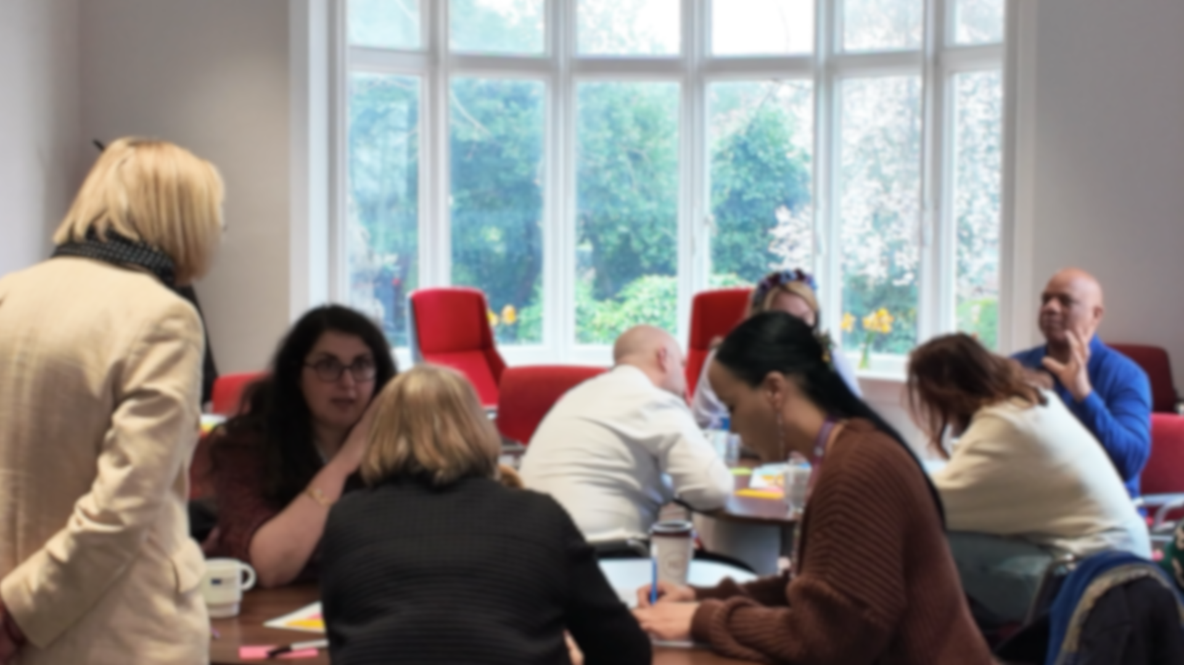
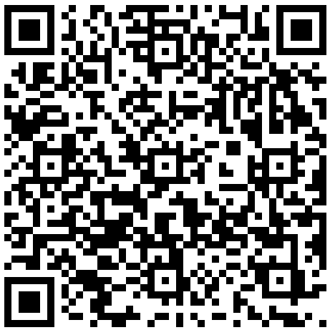



Project Website
Notes:
Thanks for listening, this is the link to I-REACCH project website. Is there any question?

