Slide 1
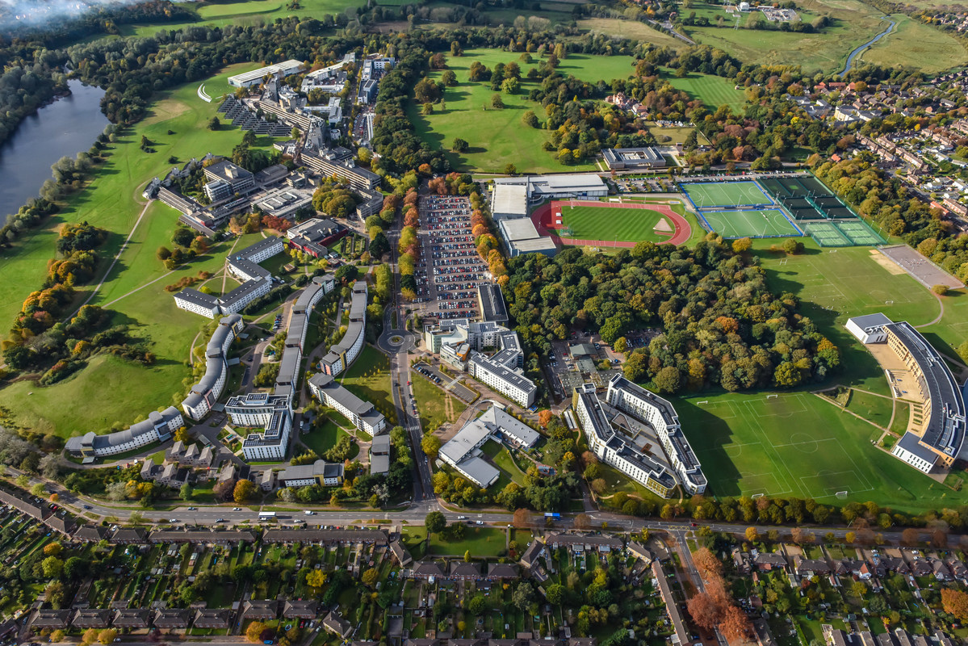
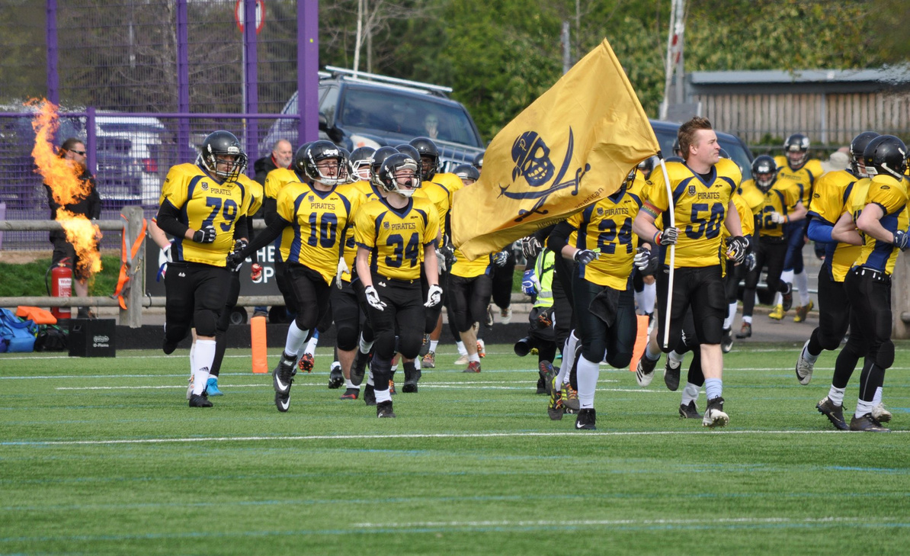



From sidelines to headlines: Sport & Physical Activity’s Role in Student and Institutional Success
Julia Robathan
Director of Admissions, Recruitment and Marketing,
Lecturer in Sport and Physical Activity Development
School of Education and Lifelong Learning
j.robathan@uea.ac.uk
Mark Heazle
Head of Sport and Physical Activity,
Sport and Commercial Services
m.heazle@uea.ac.uk
Notes:
What's the point of today - its to say that if your students engage more there's some impacts that can add critical value - reduced drop-out; retention to PG study and graduate outcomes

Slide 2

Background to the work...
‘The higher education sector is currently facing a huge range of challenges, but research has consistently shown that students who remain active at universities are happier, less anxious and have greater life satisfaction than their inactive peers.
Providing platforms for participation at every level, from beginners discovering the joy of being active, to elite athletes progressing to the Olympic stage. The depth of these contributions is key; reaffirming sport’s essential role in enhancing student wellbeing, creating a sense of belonging, and improving academic success. And it sets the scene for our ambition to support one million students and beyond to become active and reap the benefits of engaging in one of the largest higher education sporting pathways in the world!’ (BUCS, 2024)
UEA PES and the EDU Research Group developed the ‘The Value and Impact of Sport and PA Framework’- the impact of which we want to share with you today.
Notes:
JR

Slide 3
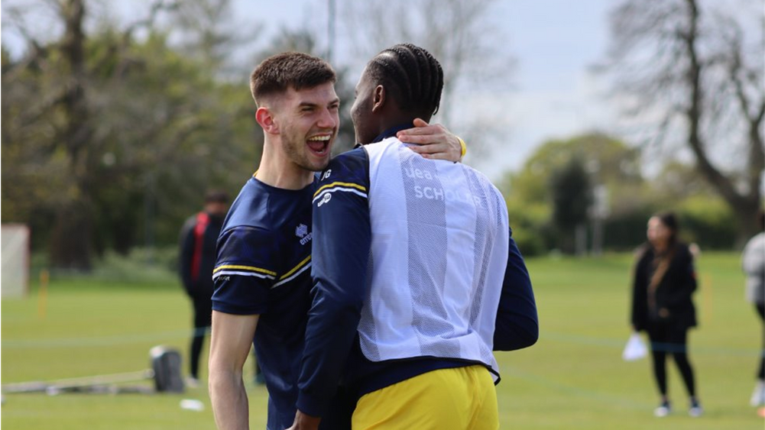
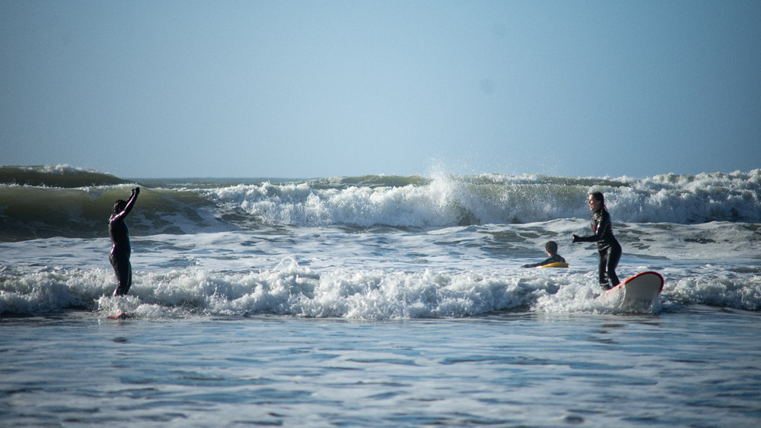
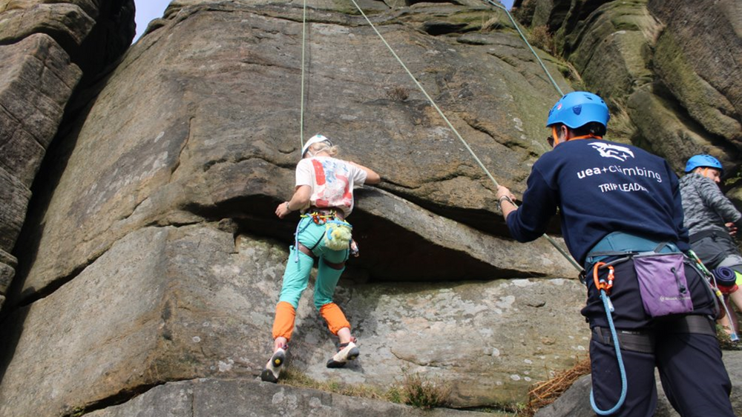
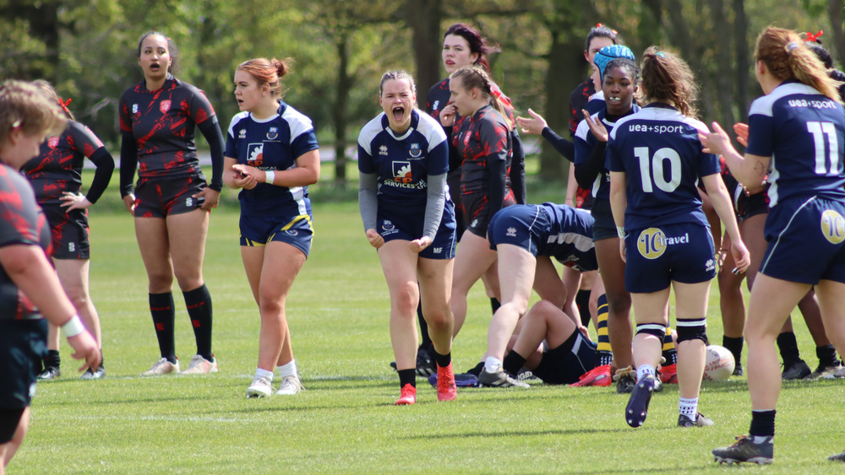
Notes:
JR
- Six themes strategically important to HE institutions in this country, and the report looked at the ways in which sport and PA can contribute to outcomes in these areas.
- Recruitment
- Transition and Retention
- Health and wellbeing
- Graduate Attainment
- Graduate Employability
- Univeristy Civic outcomes
- Work started about two years ago, and has resulted in a framework of indicators that we now monitor and track across each of the six themes.
- Evident through the process that some carry greater significance for the UEA, especially those that have a finincial impact.
- Leading the way nationally, have led first BUCS workshop into Value work.
- Julia to add context around increase in commuting students.
Pictures >

Slide 4
A typical university sport programme..
Performance Programmes
Competitive Club Sport
Participative Club Sport
Mass Participation Progammes
Notes:
MH
What a typical sport and physical activity programme will look like...
Sports dev pyramid (mass participation > club sport > performance)
Performance - e.g scholarships, incentives for talented athletes, links with local professional and semi-professional clubs
Competitive club sport - more 'traditional' sport, BUCS & local league participation.
Participative club sport - e.g. non-competitive opportunities that provide social networks, belonging and a chance to be active.
Mass participation programmes - e.g. Active Campus-type programmes, drop-in, casual in nature, commitment-free, Moves, dog walking
Think about what parts of the pyramid can impact on strategic aims e.g. recruitment, retention, wellbeing etc - Dog walking picture

Slide 5
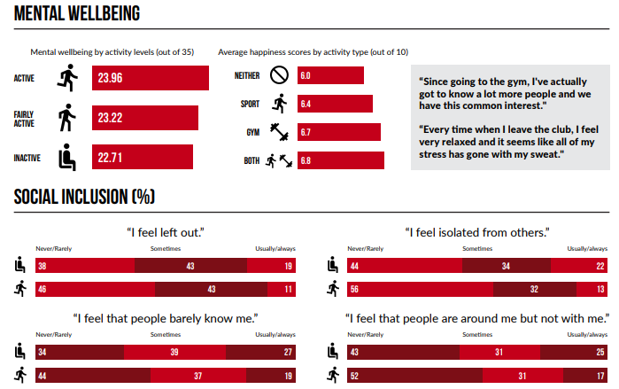
Wider benefits of university programmes..
2024/25 BUCS Student Active Wellbeing Survey:
Notes:
MH
- Graphic shows some of the data from national trends recent BUCS Survey, carried out last year...7,740 respondents from 145 different institutions.
- Active students more likely to report positively in the wellbeing and social inclusion metrics.
- SWEMWEBS used to measure respondents wellbeing.

Slide 6
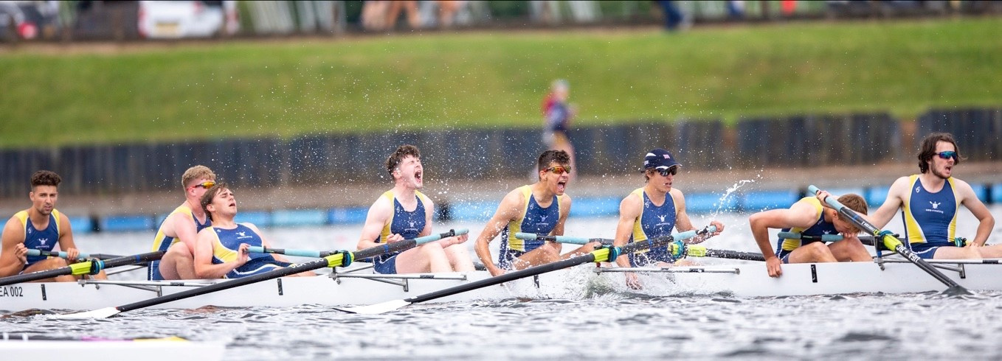
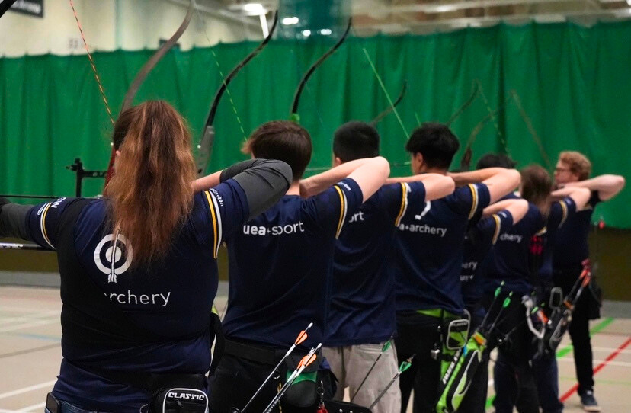
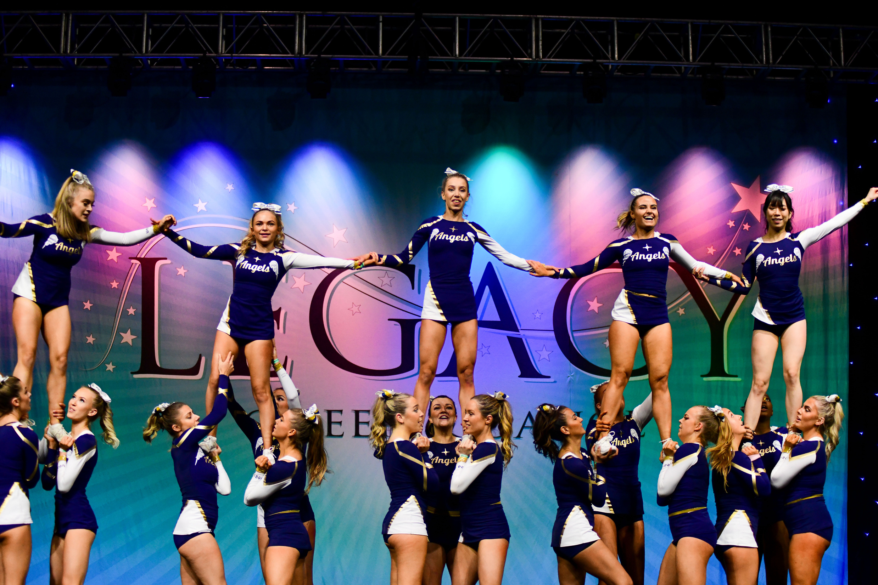

3784
21.5%
uea+sport memberships sold
of total student cohort with uea+sport memberships
19.5%, 20.3% PTY
4861
27.6%
club subscriptions sold
of total student cohort with club subscriptions
25%, 25.6% PTY
7447
42.4%
students engaged in all uea+sport programmes
of total students engaged in all uea+sport programmes
38.1%, 38.3% PTY
Notes:
MH
In 2024/25, over 21% of our total student cohort took out a uea+sport membership (the precursor to them joining a club) with 4861 individual club subscriptions then taken out, representing our best-ever set of results when considered against total student numbers.
42.4% of all students engaged at least once in our services, just under 7500 unique individuals.
The big question here is 'so what?'. That's what we set out to answer a couple of years ago, with the value of sport framework. Keep this figure of 7447 in mind.....

Slide 7
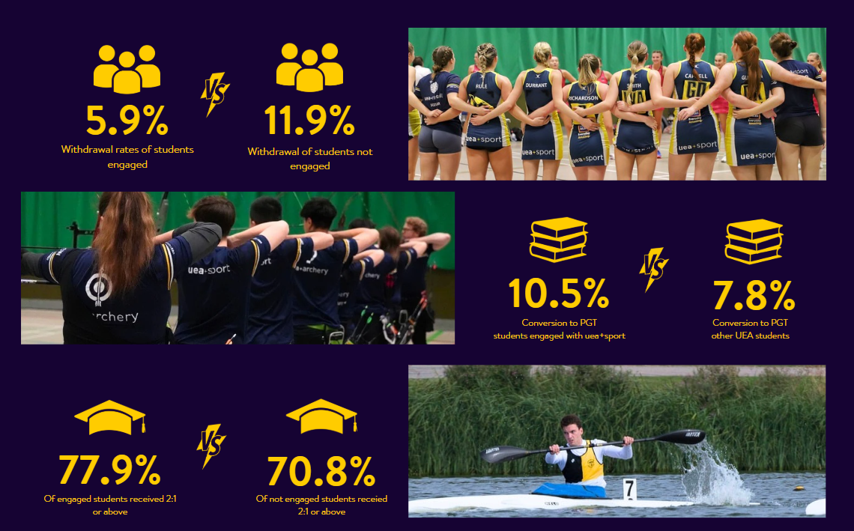
Notes:
MH -
These figures relate to the 2023/24 academic year, we're in the process of looking at the 24/25 figues and analysing those. Some KPIs that form part of our framework became evidently more important than others. e.g. those with a direct financial impact
But, for that year.....the figures kinda speak for themselves.
1st year completion.....5.9% compared to 11.9%
Conversion to PGT the September after graduation - 10.5% compared to 7.8%
Graduate attainment - 77.9% compared to 70.8% achieving 2:1s or above.
All of the above variances are statistically significant, having been tested by the PESH Research Group.
Importantly - now working with Fabio and Richie and incorporating engagement in our programmes into their eductaional gain research.

Slide 8
A typical university sport programme..
Performance Programmes
Competitive Club Sport
Participative Club Sport
Mass Participation Progammes
Recruitment : Retention : Wellbeing
Notes:
JR -
Think about what parts of the pyramid can impact on strategic aims e.g. recruitment, retention, wellbeing etc

Slide 9
University forces TRANSITION......
What is of particular interest (Wylleman and Lavelle, 2004; Schlossberg, 1981)is how this process of transition can be normative (expected) and non normative (unexpected).
Pummell at al., (2008) explore multiple transitions at the same time, for example acknowledging that whilst a person maybe moving educational environments, that this may correspond with moving away from home or changing supporting networks and employment at the same time
​
Brown et al. (2019) highlights that of particular interest are, challenges including complex emotions, negotiating shifts in identity, disruption to social networks and relationships, and that this process of adjustment can be long term.
Notes:
JR -
Let’s explore how sport can be a transformative tool beyond physical activity.
[Pause briefly to engage the audience.]
As Putnam (2000) highlighted, communal activities like sports are pivotal in building social capital. This means developing networks, norms, and trust that foster coordination and cooperation.
[Emphasize the word "trust" to underscore its importance.]
Sport acts as a dynamic space for cross-cultural dialogue. It challenges established gender norms and provides a level playing field—everyone, regardless of their background or ability, plays by the same rules. Jarvie (2011) emphasized this point, showing how sport can unite diverse groups.
[Pause to let the audience absorb the idea of unity.]
Moreover, participation in adaptive sports significantly enhances social integration and the visibility of people with disabilities, as noted by Collins (2009). This aspect is crucial for fostering inclusivity.
Lastly, Coakley (2021) beautifully described the team uniform as more than just fabric. It symbolizes collective identity, binding individuals into a community where personal differences dissolve. This highlights the power of sport in creating a shared purpose.
[Conclude with a reflective pause to let the audience consider how they view sports in their lives.]

Slide 10
Sport as a tool to aid that TRANSITION
Putnam (2000) argued that communal activities like sport can build social capital—networks, norms, and trust that enable coordination and cooperation. It can provide voluntary and paid work in addition to the obvious participation benefits.
Participation in adaptive sport enhances the social integration and visibility of people with disabilities (Collins, 2009)
"The team uniform is more than just fabric; it is a symbol of collective identity, binding individuals into a shared community where personal differences dissolve into unified purpose." (Coakley, 2021)
Sport serves as a powerful space for cross-cultural dialogue ,it challenges gender norms, creates clear common ground, and the same rules apply to all; regardless of background or ability (Jarvie, 2011)
Notes:
JR -
Let’s explore how sport can be a transformative tool beyond physical activity.
[Pause briefly to engage the audience.]
As Putnam (2000) highlighted, communal activities like sports are pivotal in building social capital. This means developing networks, norms, and trust that foster coordination and cooperation.
[Emphasize the word "trust" to underscore its importance.]
Sport acts as a dynamic space for cross-cultural dialogue. It challenges established gender norms and provides a level playing field—everyone, regardless of their background or ability, plays by the same rules. Jarvie (2011) emphasized this point, showing how sport can unite diverse groups.
[Pause to let the audience absorb the idea of unity.]
Moreover, participation in adaptive sports significantly enhances social integration and the visibility of people with disabilities, as noted by Collins (2009). This aspect is crucial for fostering inclusivity.
Lastly, Coakley (2021) beautifully described the team uniform as more than just fabric. It symbolizes collective identity, binding individuals into a community where personal differences dissolve. This highlights the power of sport in creating a shared purpose.
[Conclude with a reflective pause to let the audience consider how they view sports in their lives.]

Slide 11
A Sense of Belonging
‘Thank you for providing me with a University experience richer than I ever could have imagined. Three unforgettable years balancing University deadlines, jobs, footballs clubs and attempting to be an adult! This final year has tested me more than I could ever have imagined, but I am leaving a totally different person to the one that first arrived’
‘My club has become my family, I would have dropped out of first year without them, I wanted us all to finish together’
‘It’s been a great year of sport, and have learnt a lot, especially in my role as archery club president, I didn’t know I could balance and achieve so much in such a short time frame’
‘The growth from the shy girl moving home and county purely just to try something new and exciting, to now - leaving with a degree, friendships for a lifetime, and an even bigger passion for sport’
Notes:
JR -

Slide 12
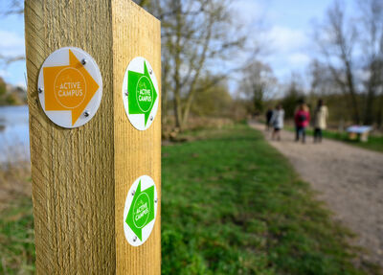
Calls to Action.....
How can you better utilise the power of sport and physical activity at your institution?
If you don’t already, get to know your Director and/or Head of Sport.
Improve your knowledge of what your institution’s sport and physical activity programme looks like and where you can signpost students to.
Connect your sport and physical activity department with an academic research group for further monitoring and evaluation.
Consider sport as a tool that can be employed to aid institution strategic aims around recruitment, retention and graduate outcomes as well as a teaching context!
For professional services colleagues, check out other networks that may be beneficial. e.g. CUBO
Notes:
MH - Back in Janaury when I presented this work to the BUCS network, I delivered an online workshop - over 100 institutions signed up, showing how much demand there is to start to build evidence bases for the value of sport. Those in my position would love to build stronger relationships with academic departments.

Slide 13

One final reminder why....
Notes:
MH - Milly was one of our Cheer club presidents from last year, pictured in the middle picking up her Colour. I think the quote speaks for itself in terms of what her experience of immersing herself in our programmes gave her.

