Slide 1



Understanding prior learning experiences and concerns on entry to ‘re-image’ the student experience for success
Michelle Morgan
Higher Education Institutional Research
8 September 2022
@it_se
Notes:
Hello everyone and thank you for inviting me to talk today. The slide deck I will be talking to will be an abidged version of the one you will receive after the conference. I will be talking about collecting the right data at the right time to help improve the experience of students and staff. And by doing this, we can re-image the student journey for success.
The focus will be understanding the prior learning experience and concerns on entry of our diverse student body. The data I will be presenting is from the pre-arrival academic questionnaire I pioneered a few years ago and that was formalised through a £2.7 m HEFCE research grant to understand how we could renerngise the PGT market back in 2013.
If an institution undertakes this research, they are better able to deliver the needs of an incoming cohort and bridge any gaps, which after the last 2.5 years of covid, is essential.

Slide 2

Notes:
The last 2 years has been a rollar coaster of a journey. Higher education has taken quite a battering from Government and areas of the media.
It has not reflected the extraordinary challenges faced by universities, nor the incredible and quite revoluntionary changes that have occurred.
Over the years, many of us have expressed our frustration in not being able to get real change in HE because the tanker that is HE struggles to not only speed up but change direction. However, Covid19 has changed this showing that we can adapt and evolve quickly.
Not only is it important to keep the momentum of change going but it is essential for us to find time to reflect on and really understand what worked and what didn’t.

Slide 3

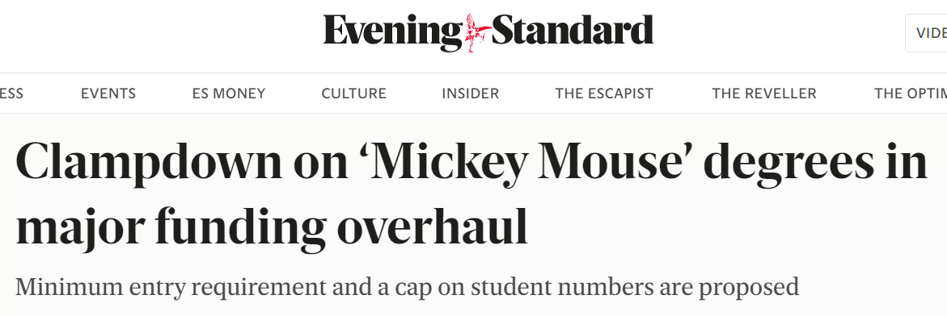

UK driven by metrics
Challenges for staff
TEF
REF
KEF
NSS
PTES
GOS (LEO)
The pressure on everyone is immense in this ‘brave new world’ of HE
Declining resources
High student expectations
Academic pressure to be a teacher, researcher, administrator
Increase in student numbers
Reduced funding
Increased administrative tasks
Notes:
These major changes have been delivered against a backdrop of increasing pressure on staff in HE. Some of them are listed here. And the coming months even more challenging as new ministers come into the education and higher education roles.

Slide 4
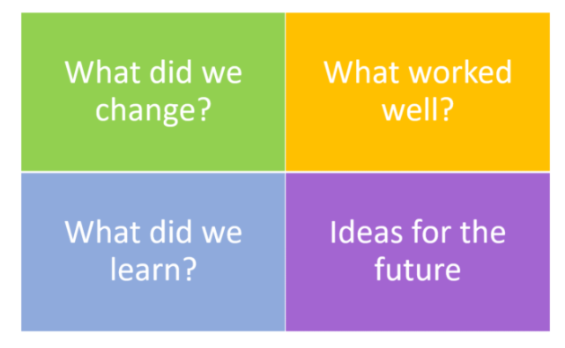
Aims and objectives
Where we are now
What we know
What we need to consider
Future challenges
Notes:
So today I have 4 overarching aims and objectives. These are …..
Where we are now
What we know
What we need to consider as a result of the past 2.5 years and
Future challenges

Slide 5
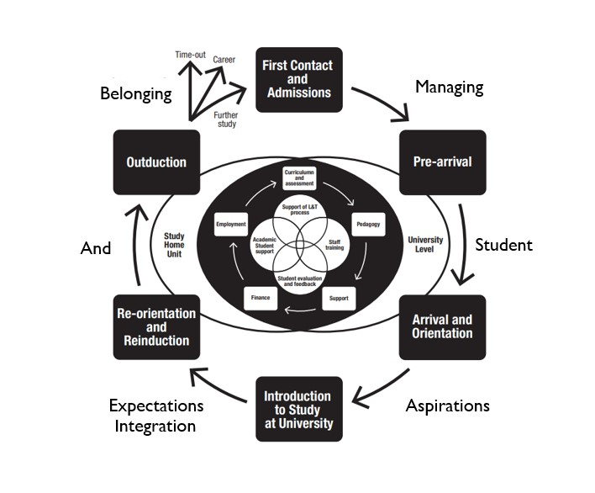
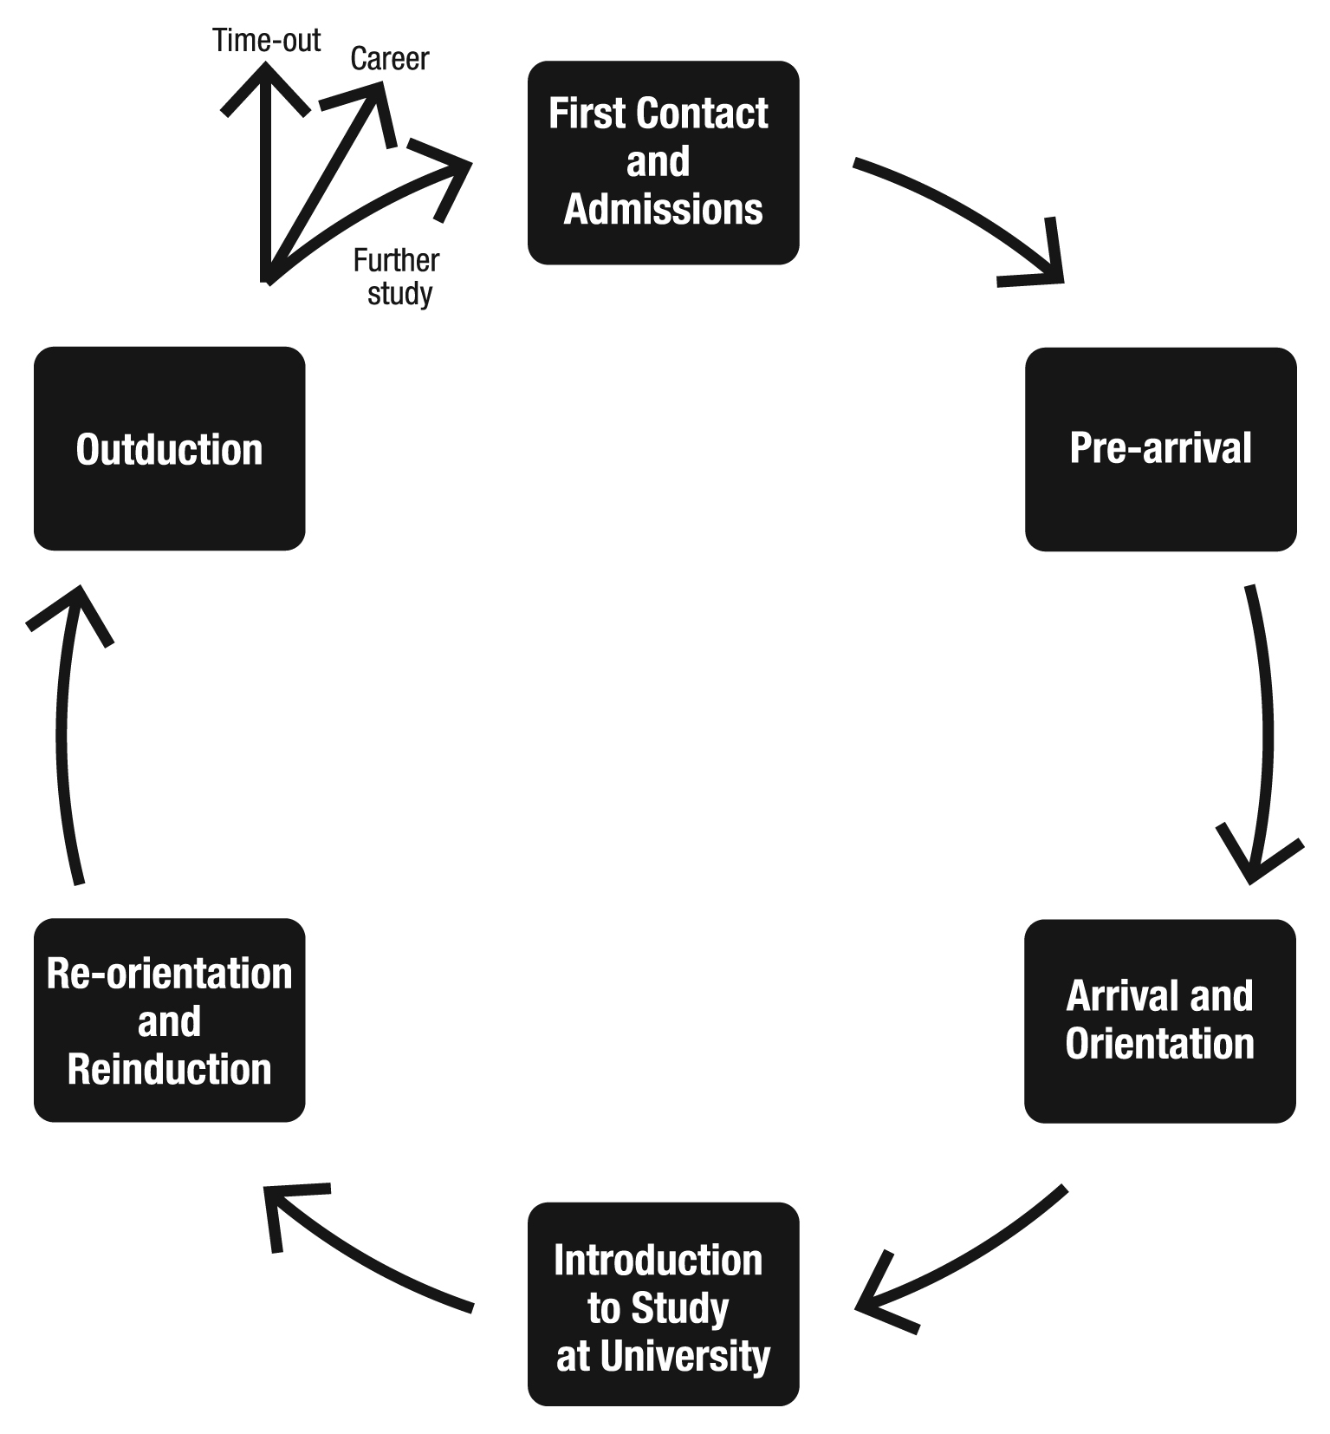
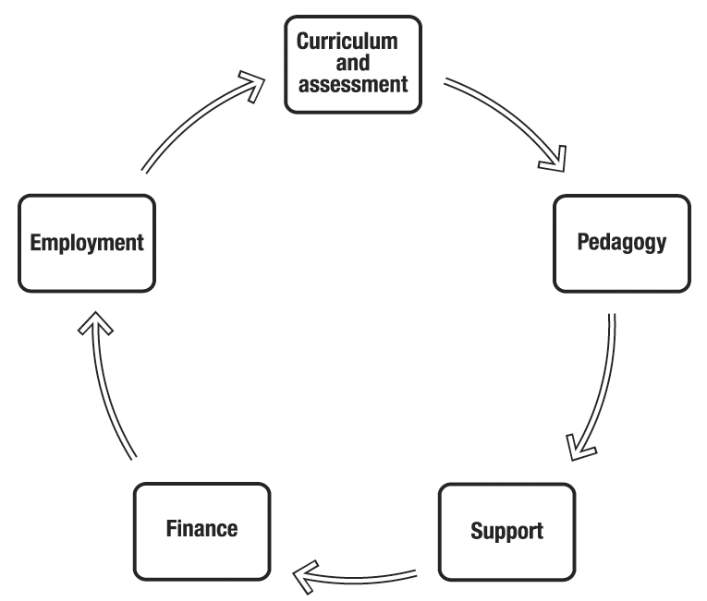
The Student Experience Transitions
study lifecycle
Stages
Themes
Improving the Student Experience by Michelle Morgan - Official Website
Notes:
I am going to use my student experience transitions model that I created back in the early 2000s as a framework. This was developed through my various roles and talking to students and staff. I am going to briefly cover the stages later on in my presentation CLICK but I want to focus specifically on the 5 themes when looking at the aims and objectives.
If you wish to understand more about the reasoning for the transitions, you can go to my free portal to read about it. But briefly, arrival and orientation in my model refers to the first 2-3 weeks when we welcome students and they start settling into a new routine and understanding where things are. Introduction to study takes place over a semester or academic year depending on if the course is modular across semesters or yr long. As with new students, reorientation and reinduction refers to the same activities for a specific level of study for returners but takes place over a shorter period of time. Mary has just talked about how UPP Student Futures have also suggested that every year should have an induction to that level along with similar key areas to address. And with so many universities signing up to the Student Futures initiative, hopefully this approach will get traction.
And just as we induct students so we need to outduct them.
The five themes cover the core areas of activity in the student journey ,but it is important to recognize they all interlink as I will highlight.
If a student is a direct entry into lev 5 or 6, they will still need to go through these stages.

Slide 6






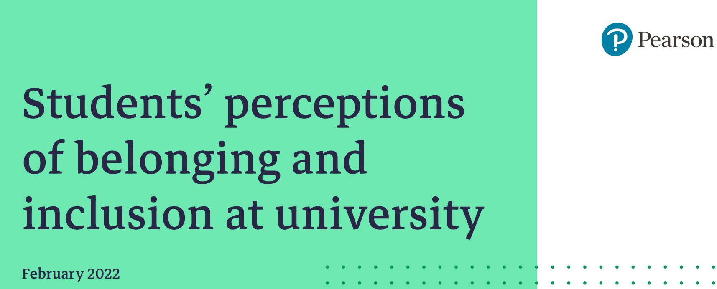
The Student Experience Transitions Model
Turbocharging the future (upp-foundation.org)
Student Surveys | Advance HE (advance-he.ac.uk)
Data and analysis | | UCAS
Paul Ashwin
Measuring the quality of university education: beyond the nonsense of university rankings
Matt Hiely-Rayner
changes in the 2023 Guardian University Guide
Covid (universitiesuk.ac.uk)
Belonging-and-inclusion-survey-Wonkhe-Pearson-Feb-22.pdf
Source: M Morgan (2011) Improving the Student Experience- the practical guide for universities and colleges, Oxon:Routledge.
Notes:
Hopefully, having been through the last 2 years, we should be able to better predict and be prepared for numerous eventualities especially with excellent reports from bodies such as advanceHE , Universities UK, UCAS, UPP, and Wonkhe and Pearson. Taso are also doing invaluable work in understanding what is happening across the HE landscape through bringing sector researchers, practitioners and evaluators with an interest in widening participation and student success together.
It is critical to think about students at every stage of the lifecycle, and in what environment they enter higher education.
As a sector so focused on exit metrics, I argue that if we want those all important metrics to improve at the end, CLICK
we need to go back to the start to understand a range of factors when students start their higher education journey.
NSS only tells us about the experience of students who have got to the end of their course. The incoming cohort could be quite different especially in student characteristic composition.
And I think many of us across the sector are frustrated that metrics are used in such a blunt way to weigh, measure and judge when they only tell one part of the story. CLICK
Paul Ashwin tomorrow in his session will be talking about Measuring the quality of university education: beyond the nonsense of university rankings. Also tomorrow Matt Hiely-Rayner will talk about the changes in the 2023 Guardian University Guide

Slide 7


Covid19 and the future ‘known unknowns’
There are known knowns. These are things we know that we know. There are known unknowns. That is to say, there are things that we know we don't know. But there are also unknown unknowns. There are things we don't know we don't know
Donald Rumsfeld, Secretary of Defense 2001-06, USA
Notes:
Many of you may recognize this quote by Donald Rumsfeld in the early 2000s. Covid created unknown unknowns and although many Covid19 issues are now known, we will have to still deal with the unknown unknowns as they occur.
We are still coming out of the pandemic, and already we can see that Covid19 will be with us this coming academic year.
However, we have another crisis to face which is likely to be even more problematic than covid 19…..CLICK

Slide 8
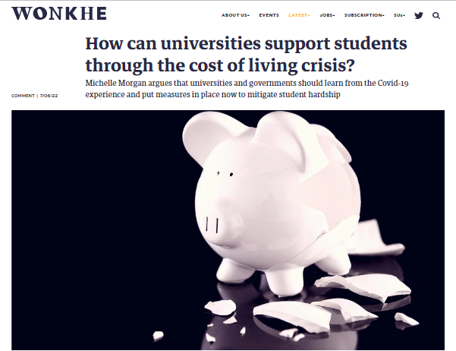

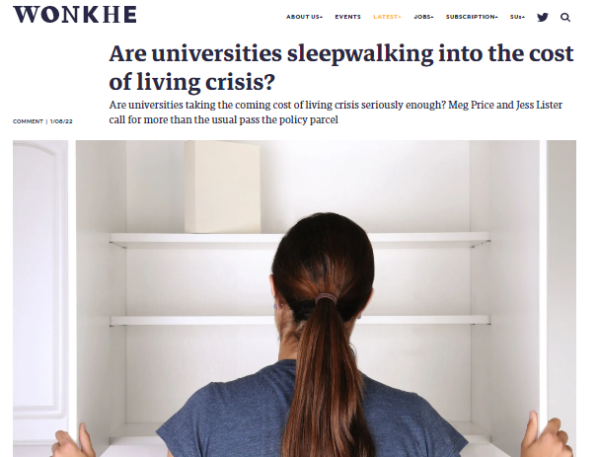
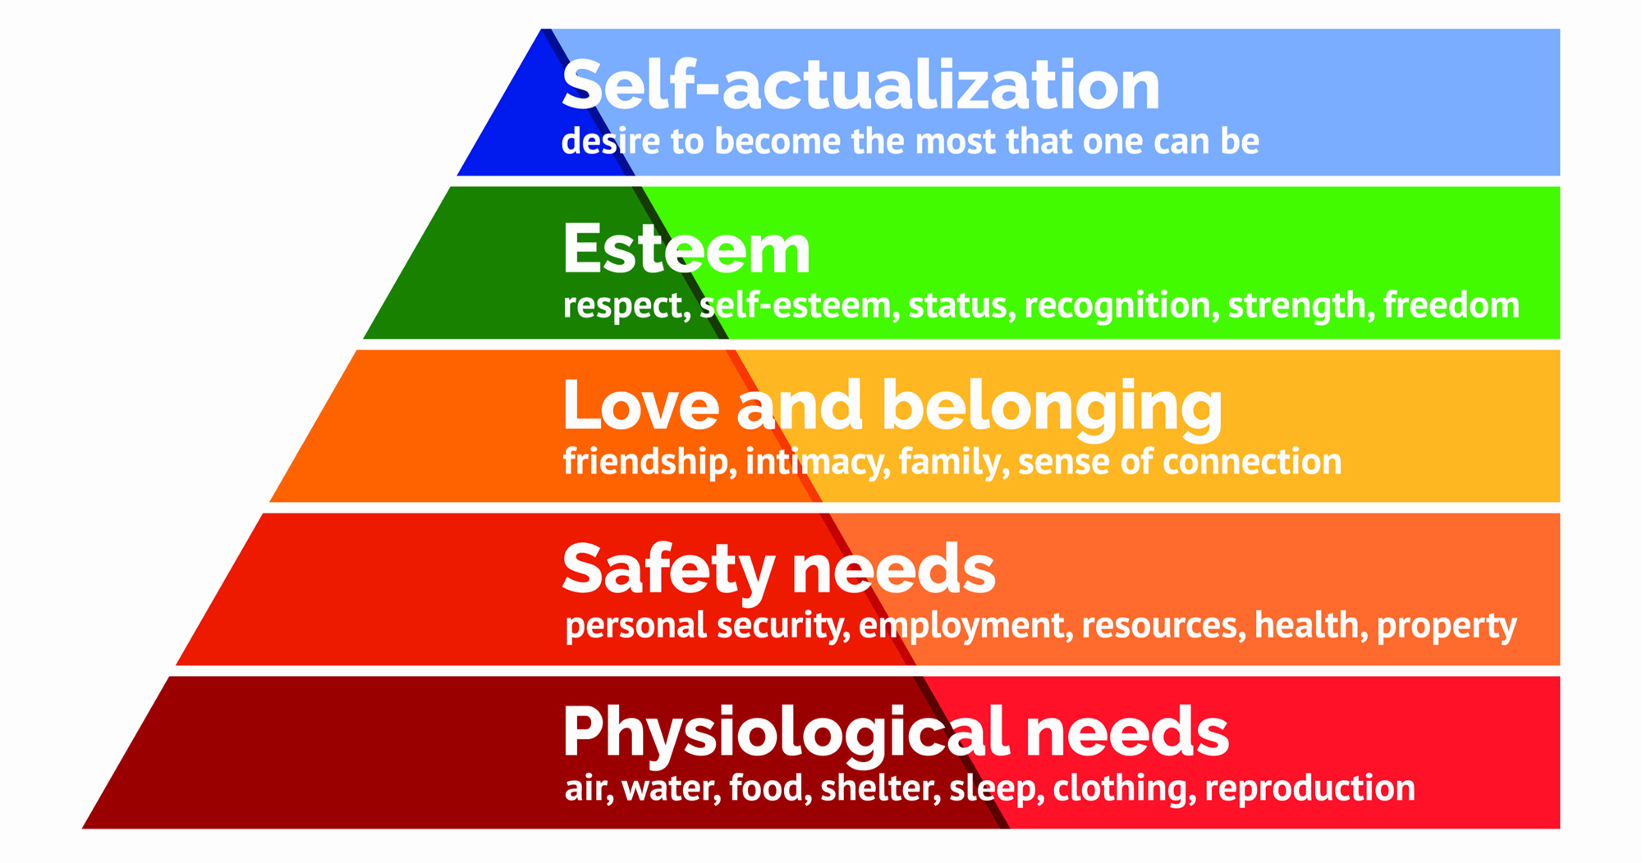
Cost of living crisis
https://wonkhe.com/blogs/how-can-universities-support-students-through-the-cost-of-living-crisis/
https://wonkhe.com/blogs/another-huge-rise-in-the-energy-price-cap-now-what/
https://wonkhe.com/blogs/are-universities-sleepwalking-into-the-cost-of-living-crisis/
Maslow’s Hierarchy of needs
Baseline life requirements to support learning success
Notes:
And that is the cost of living crisis.
If the basic living needs of students are not meet, we cannot expect them to be able to fully engage in their studies. And we need to be mindful of staff hardship as well.
The idea that students on entry and through their studies don’t worry about having sufficient funding or getting into debt is just not true as data I am about to show illustrates.

Slide 9

Where we are and what we know
5 broad learning experiences for new students in 2022/23
Pre-covid
2018/19
During covid
Phase 1 2019/20
During Covid
Phase 2 2020/21
‘New normal’
Phase 3 2021/22
?
Phase 4 2022/23
New entrants from school/college
GCSE – final year 2020
A-Level/BTECs – Yr 1 2021
Yr 2 2022
Notes:
So we have to be mindful of the 5 broad learning experiences, we now have, for new and returning students.
They are listed here. We know each Phase of Covid19 created a different experience. In the last year, we have been establishing a new normal but we have incoming and returning students with different learning experiences, so we need to be mindful of what happens in Phase 4 for those different groups. I will talk more about this later.
For our new entrants who completed their entry to university exams this year, they have experienced disruption at every major level of assessment so understanding their concerns and prior learning experiences on entry has never been more critical.

Slide 10
UG student concerns about starting university
Pre-Covid19 University 1 September 2019
During Covid19 University 2 September 2020
22 options
24 options
Concern | Aggregate
Coping with the level of study | 54.4%
Fitting in with new class mates | 45.2%
Lack of confidence about ability to study | 40.9%
Getting used to moving away from home for the first time | 39.3%
Lack of information about how to study at university | 36.1%
Getting on with fellow students | 33.2%
Concerns about getting into debt | 28.4%
Sufficient funding | 23.6%
Concern | Aggregate
Concerns about Covid19 and potential lockdowns | 53.5%
Studying online to start with | 52.9%
Lack of information about how to study at university | 44.2%
Coping with the level of study | 37.1%
Fitting in with new class mates | 33.0%
Lack of confidence about ability to study | 30.4%
Getting used to moving away from home for the first time | 26.3%
Concerns about getting into debt | 22.2%
Getting on with fellow students | 21.9%
Sufficient funding | 15.8%
Notes:
As I stated at the start, an area of my research is understanding prior learning experiences and how new entrants are feeling on entry which I do via a pre-arrival academic questionnaire. The questionnaire is completed as an academic activity. The basic results get sent to course leaders within a week of closing which is usually at the end of the welcome week. The information is used to help provide targeted support, how to manage student expectations and bridge skill and knowledge gaps. If you are interested, you can read more by reading the reports on the end slide of this presentation.
The findings on this slide tells us that ‘coping with the level of study’ is a major issue both pre-covid and during covid for those starting study. The first table of findings is from Bournemouth University, known as universty 1, in 2019 which is a post 92 institution. . There were 22 options to select from. As you can see, Confidence about study and fitting in with classmates were top of the list. All of these concerns impact on wellbeing. CLICK
The second table is from Sept 20 at Leeds Beckett University, known as University 2 which was a similar post 92 university. Understandably covid19 issues were top due to such uncertainty at the time, but after those two, the other concerns are pretty similar to university 1.

Slide 11
UG student concerns about starting university
University 2 September 2021
University 3 September 2021
Concern | Aggregate
Coping with the level of study | 48.0%
Lack of information about how to study at university | 38.0%
Mental health and wellbeing | 37.0%
Fitting in with new class mates | 37.0%
Having to potentially start online | 33.6%
Lack of confidence about ability to study | 33.0%
Concerns about Covid19 and potential lockdowns | 30.8%
Sufficient funding | 28.0%
Concern | Aggregate
Coping with the level of study | 53.3%
Mental health and wellbeing | 43.4%
Fitting in with new class mates | 37.0%
Lack of confidence about ability to study | 34.5%
Lack of information about how to study at university | 34.0%
Concerns about Covid19 and potential lockdowns | 30.8%
Concerns about knowledge gaps | 30.2%
Having to potentially start online | 25.5%
Concerns about knowledge gaps | 28.0%
Sufficient funding | 19.5%
Notes:
What came out of the pre-arrival academic survey data collected in September 2021 from 2 universities undertaking the PAQ (Leeds Beckett and UEL) is that, starting online and concerns about covid19 were still worries, but you can see are much lower down the scale this academic year.
And I suppose this is not a surprise as a degree of normality starts to come back. This finding can be due to a range of reasons including learning to live with Covid19, and time to provide better management of expectations that this is how learning will take place.
The data across all surveys also highlights the differences in concerns between those who identified as male and female. Probably not a surprise to you, but females were more likely to be concerned than males in all the areas.
There were also other differences in terms of entry qualification, age and domiciled status.
In 2021, mental health and wellbeing was added as an option. And you can see, across both universities it was high on the list of concerns. This issue is also very prevalent in the increase in UCAS applicant declarations as we will see.
All of these concerns come under the 5 themes I will talk about more in a moment.
.

Slide 12

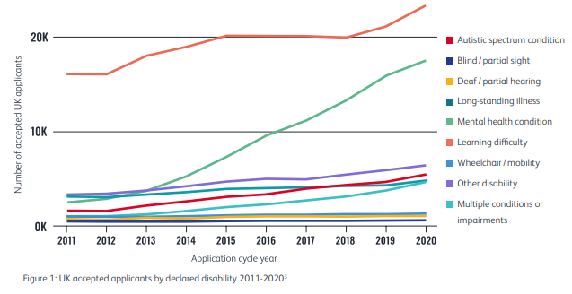
3.7% of all UK applicants now declare a mental health condition – up from 0.7% in 2011.
Women are 2.2 times more likely to declare a mental health condition than men.
Alongside engineering, medicine and dentistry courses have the lowest declaration rates with only 1.4% of accepted applicants sharing an existing mental health condition.
Some LGBT+ students - six times more likely to share a mental health condition
Care experienced students – almost three times as likely.
One in five students research support specifically for an existing mental health condition before they apply
More than one in four look at the provision of general mental health and wellbeing services
James Newham and Omar Khan
Mental Health Analytics: Using data to better support student wellbeing
450% increase in student mental health declarations over last decade but progress still needed to address declarations stigma | Undergraduate | UCAS
Notes:
Since 2011, there has been an 89 per cent rise in the number of UK undergraduate applicants sharing information about an impairment or condition with the highest year-on-year increases seen for mental health conditions
Some LGBT+ students - six times more likely to share a mental health condition
Care experienced students – almost three times as likely.
One in five students research support specifically for an existing mental health condition before they apply
As you know, there isn’t a UCAS equivalent for postgraduate students although myself and Paul Wakeling have been long calling for one so we can see patterns of application and engagement.
Tomorrow James Newham and Omar Khan will be talking how using Mental Health Analytics data can better support student wellbeing

Slide 13
PGT student concerns about start university
Pre-Covid19 11 University 2014
University 3 September 2021
Concern | Aggregate
Coping with the level of study | 44.2%
Difficulties in fitting study around existing work commitments | 24.1%
Lack of confidence about ability to study | 24.0%
Lack of sufficient funding | 23.7%
Concerns about committing more time to study | 23.2%
Concerns about getting into debt | 20.5%
Concerns about increasing my levels of debt | 17.3%
Lack of information about study opportunities | 16.2%
Concern | Aggregate
Coping with the level of study | 42.5%
Lack of information about study at this level | 37.4%
Difficulties in fitting study around existing work commitments | 30.2%
Concerns about Covid19 and potential lockdowns | 28.8%
Lack of confidence about ability to study | 26.6%
Having to potentially start online | 22.3%
Concerns about committing more time to study | 20.1%
Having a long commute to attend the course | 17.3%
http://www.improvingthestudentexperience.com/library/PG_documents/Postgraduate_Experience_Report_Final.pdf
Notes:
The postgraduate taught pre-arrival academic findings compare findings from Phase 1 of the HEFCE funded Postgraduate Experience Project undertaken between 2013-2016, and data from Sept 2021 from one of the universities who undertook the UG pre-arrival questionnaire. The HEFCE project I created and led was part of their desire to re-envigor declining UK postgrad participation. The PG loan scheme was introduced in 2016/17. I will be undertaking further analysis to compare similarities and differences between these different respondents.
The survey wasn’t run in Sept 20 for postgraduates so we have no comparative data. Also, in the survey in Sept 20, I did not explicitly list mental health and wellbeing as an option of concern as we did at undergraduate level. It has been added for this coming year.
As you saw with undergraduates, Covid19 is an issue for postgraduate taught respondents but again lower down the list top concerns. Interestingly, in the PGCE version of the survey undertaken at university 3, concerns about Covid 19 and potential lockdowns was an issue for 39% of respondents so much higher than for PGT respondents. This may well be due to PGCE students being required to be in schools.

Slide 14
What we need to think about Impact of changes due to Covid19
Increase in online learning and assessment
Changes to assessment
Reduced face to face teaching
Changes in ‘learning’ and ‘engagement’ behaviour
Notes:
Importantly we need to understand the impact of the changes made as a result of C19. Four are listed here. And as there is requirement to resume face to face teaching by the minister for higher education and regulatory bodies, we need to revisit these four areas to determine how they evolve, whether that is reverting back to pre-covid delivery, or they are retained, to provide flexibility. But all of these impact on policy so that needs to be revisited.

Slide 15
The experience of students
5 broad types of learning experiences in for returning students
Pre-covid
2018/19
During covid
Phase 1 2019/20
During Covid
Phase 2 2020/21
‘New normal’
Phase 3 2021/22
?
Phase 4 2022/23
1/2 of degree affected by C19
2/3 of degree affected by C19
Expectation in-person but started online 1/3 of degree affected
Started in-person but with C19 challenges
Challenges of change for returners
Impact= challenges of Covid19 Lockdown (isolation, mental health, financial challenges) and rapid changes in delivery of teaching, pedagogy and assessment.
Notes:
This slide shows the impact of the experience of our returning students depending on when they entered university. But it can also be applied to students in schools and colleges.
So for example, if we take a typical 3 year course where a student started in 2018/19, they would have progressed through year 1 and half of year 2 before the lock down. Their next year and half up to completion was dramatically affected.
For every single student, engagement will be different not just because every student’s journey is unique to them, but because of Covid19 and when they started, as this slide highlights. Any changes undertaken as highlighted in the previous slide will still need to be managed well especially if a cohort feel that their ‘normal’ is being taken away.

Slide 16
What we need to think about Impact of changes due to Covid19
Increase in online learning and assessment
Reduced face to face teaching
Changes to assessment
Changes in ‘learning’ and ‘engagement’ behaviour
Experience of prior learning and lived experience of incoming students
Notes:
The last 2 years has impacted on every level of study, but importantly we do need to think about prior experiences of our incoming students. So lets go back to the pre-arrival academic questionnaire to look at prior learning experiences.

Slide 17


Assumptions of what students ‘should’ know!’
Know how to live away from home
Know how to study at University – school study different
Notes:
It is essential we avoid assumptions.
As the pre-arrival data highlights, students enter higher education with varying experience and this is impacted on by different students characteristics. Let me give you an example……
The belief is that undergraduate students are experienced on accessing information online and in a library.

Slide 18
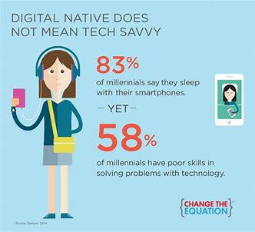
Example of assumptions made
Students are experienced in ‘digital learning’
Pre-Arrival Academic Questionnaire Cross institution sample n=1104 University 1 September 2019
Asked to tick all that apply
Access learning materials in previous study
Handwritten notes 82.7%
Course handbook 79.2%
Info outside of VLE 55.8%
Handouts from books 55.4%
Info on the school VLE 52.9%
18yr -46% 19yr- 28%
Books in the library 36.9%
18yr -40.8%
19yr- 28.3%
Submission of work
Hardcopy with a cover sheet 28.3%
Hardcopy without a cover sheet 44.4%
Via email 34.5%
VLE 35.8%
57% BTEC
23% A-Level
Being a ‘social’ digital experience does not
=
‘learning’ digital experience
http://www.improvingthestudentexperience.com/library/UG_documents/Bridging_the_gap_between_secondary_and_tertiary_education-Morgan_2020.pdf
Notes:
What you can see from a Pre-arrival academic questionnaire across all 4 faculties at Bournemouth university in September 2019 , which is a post 92, is how ‘traditional’ the learning experience was of new entrants. Hand written notes and coursebooks were the primary way of accessing material. Sue Williamson, Chief Executive, of The Schools, Students & Teachers Network (SSAT)says that these findings are common place across secondary education. Just as universities are measured for outcome metrics, so are schools and colleges. Dictating notes is still the number one delivery model. Many students limit their reading to the course textbooks and do not read more widely.
If you knew that use of library resource experience was limited, how would you change your first few weeks of teaching? CLICK
You can see that the use of a library was limited and this was before Covid19. We have to understand that space and costs have resulted in many school libraries being lost. Across the UK in the past 10 years, over 1000 public libraries have been closed. So why should students entering university automatically know how to use a library? This is why lessons on how to access resources should be built into the curriculum as part of the teaching experience. CLICK
And the submission of CW was done hardcopy. It is important to not make assumptions that these findings all changed as a result of covid19, because ‘schools and colleges ’ went online as I will show you in a moment. CLICK
It is also important to realise that just because a student may have a mobile phone, it does not make them Tech savvy especially knowing how to use Virtual learning environments for learning. And there are also differences by entry qualification. Lets jump forward to those in study in 20/21.

Slide 19
All learning material used of those in study in 2020/21
University 2 September 2021
Type of material | Up to Dec 2020 In-person | Jan-Mar 2021 Lockdown | After Apr 2021 In-person
Handwritten notes from classes | 72.1% | 54.5% | 65.5%
A course text book | 55.7% | 46.3% | 52.1%
Accessing information from electronic sources outside VLE | 55.7% | 73.7% | 62.3%
Information on the school/college VLE | 65.5% | 62.3% | 68.8%
Handout of book chapters and information | 44.6% | 32.0% | 39.3%
Books/materials in the school/college library | 22.9% | 11.0% | 18.4%
Notes:
This shows that before the 2021 January lockdown for schools, once again handwritten notes and a course text book were primary sources but use of information on the school VLE stayed consistent through the three periods. Interestingly, when comparing all sources used from the last slide from the previous year, course text book use went from 65.3% prior to lockdown to 54.8% post lockdown Last year’s finding correlates with the finding on this slide up to December 2020 of 55.7% which is the figure in the green font.
But again, look at the low use of libraries….
The Experience of 19/20, 20/21 and 21/22 entrants has not been the same so we need to look forward. It is so important for us to reflect on and understand the skills that were though achieved as a result of the pandemic that sadly are not assessed or recognised! This includes increased digital literacy and resilience.

Slide 20


Support for different levels of study
UG, PGT and PGR need focused support
Do not lift and shift initiatives from different levels
Artist unknown
Notes:
What ever we do we need to shape support for each level of study so mustn’t merely lift and shift approaches. QA processes need to adapt to understand that equality which QA processes try to deliver does not necessarily lead to equity. What we are after is liberation to enable students to succeed. The ambition must be to move from Quality assurance to Quality enhancement.

Slide 21
What we need to consider
Time to review what worked across all areas
Retain and evolve good initiatives
Look at impact within context
Avoid looking at themes in isolation
Be aware of current environment
The human impact of this pandemic has implications for policy and practice | Wonkhe By Julie Hulme
Notes:
In this part of the presentation, I want to look at what overarching principles we need to consider within each theme. I have listed them here. And don’t forget they do interlink. Again you can find more information on this on my free portal.
We really do need time to review what worked and what didn’t as well as looking at the impact in context. You saw the differences of experience I highlighted between the different cohorts earlier. This piece by Julie Hulme is an excellent read regarding the impact of covid19 on policy and practice. CLICK

Slide 22




Returning to campus in Sept 2022
Challenges
Emotional and physical adjustment
Be aware of pressure points
Recognise the complexity of monitoring engagement
Potential C19 ongoing ‘behaviour’ tensions
Awareness of and adjusting to the ‘new ‘ normal
Settling into a new routine
New delivery patterns
Safety
Managing ongoing impact of covid19
Collect the right data
Impact of student hardship on the student experience
Liz Bennett
Learner Dashboards can they support student agency and empowerment?
Alan Smeaton
Experiences of Students Using their Personal Data for their Wellbeing
Professor Peter Scott
Shifting Patterns of Governance in Higher Education
Notes:
We also need to be mindful in upcoming surveys, the mental health issues that may be experienced due to the pressures of returning to campus. These can include emotional and physical adjustment, and staff employed during the pandemic getting up to speed with in-persons systems. For final year students, they may have struggled to understand why they must attend in person when for the past 2 years they have, and been allowed to, study online. So we need to be supportive, kind and mindful. In the slides you will receive, there will be slides on classic pinch points at UG, PGT and PGR level for you to look at. CLICK
Collecting the right data is going to be important through taking temperature checks through the year of our students and triangulating across the uni the knowledge we are accruing from our students. Liz Bennet later today will be talking about how learner dashboards can support students agency and empowerment, and Alan Smeaton on Experiences of Students Using their Personal Data for their Wellbeing CLICK
It is going to be critical for us this year to understand is the impact of hardship on the student experience.
All of the issues I have raised so far require a whole approach university approach and Peter Scott will be looking at this area in his keynote tomorrow on Shifting governance in higher education,.
I want to focus on the impact of covid19 and student hardship when looking at the themes in this next section.

Slide 23
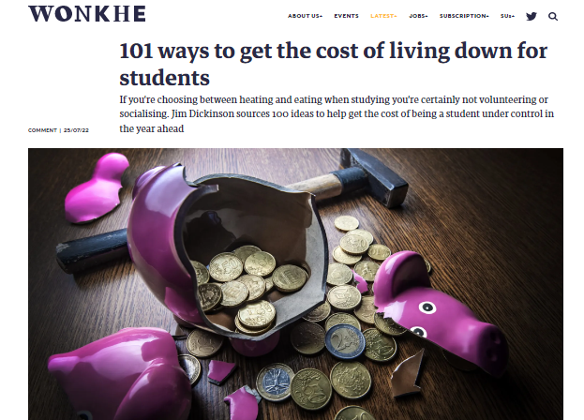
Cost of living crisis Impact on student hardship
Being able to afford food
Reduced heating to save money
Cost of IT resources including internet access
Potential increase is illness
Conflict with house mates who waste resources
Reduced PT work due to anticipated recession
Cost of travel impacting on attendance
Not able to participate in co/extra curricula activities
Students may spend more time on campus
Increase in university costs
Security issues
101 ways to get the cost of living down for students | Wonkhe
Notes:
The issue of cost of living for our students is not but it is going to be exacerbated beyond all realms this year. And the longer slide deck will highlight this in greater detail.
The cost of living for our students will become everyone’s problem because it will impact on continuation, retention and success. I have listed some here. They include affording travel to uni and not being able to participate in extra curricula activities that can contribute to employability skills.
Let’s briefly look at each of my themes through the lens of student hardship and see what we need to consider and what type of action we could take.

Slide 24


What we need to consider
Review of what worked across all areas
Curriculum
Impact of online/digital learning
Surface vs deep learning
Understanding prior learning assessment experiences
Managing ongoing changes – reverting to pre C19 curriculum delivery and assessments
Expectation of on-campus attendance
Benefits of flexible/hybrid learning
Bridging knowledge and experience gaps
Timetabling structure to support engagement in learning
Understanding and managing learning preferences
Notes:
Starting with Curriculum- here are some key areas to consider. They include the impact of online learning. Acquiring IT skills have become so critical in the past 2 years for students and staff. However, issues with IT access were reported as major issues for incoming students last year in the PAQ.
We also need to consider bridging gaps and understanding learning preferences that can managed. For example…click

Slide 25

What we need to consider
Review of what worked across all areas
Pedagogy
Teaching to effectively ‘blended’ learn
Understand differences in pedagogic approach between qualifications and domiciled groups
Impact on the curriculum and delivery
Impact of social media on student learning engagement voice
Notes:
Lets look at the pedagogy theme. They include teaching to know how to ‘blended learn’, and differences in pedagogic approaches between qualifications.
And with the increase in social media, what is the impact of it on students in the classroom? I was at the launch of the Educational Mental Health toolkit where a student representative was talking about social media making you feel voiceless because it is easy to be attacked for them. Could this affect students voicing ideas and different opinions in discussion groups during their learning?

Slide 26
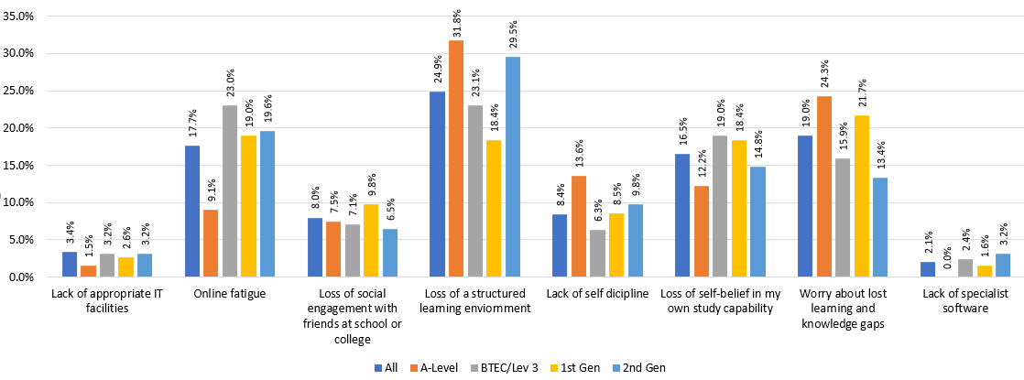
Issues relating to change in learning landscape
Those in school/college in 2020/21
University 3 September 2021
Notes:
These findings are from last Sept undertaken at university 3. here are the top learning concerns of respondents in study in school and college in 20/21. It shows the finding for the sample and by highest entry qualification and generational status. Sample sizes were similar.
The top 3 were loss of structured learning environment then worry about learning gaps then online fatigue.
For A level respondents concern with these 3 were notably higher than BTEC respondents whereas online fatigue was much higher for BTEC than A level.
First generation students were much more concerned than A level respondents about knowledge gaps.

Slide 27
Suggested action for ‘Curriculum and Pedagogy’ themes
Consolidate the teaching timetable to reduce the number of days on campus.
Continue to provide flexibility with online lectures where possible but have a requirement for in-person workshop, lab, seminar attendance.
Review mitigating circumstances and extension policies to encompass the impact of hardship on learning and assessment.
Explore, understand and bridge knowledge and skill gaps by entry qualification and the impact of Covid19 for incoming and returning students via Pre-arrival and Continuation Academic Questionnaires. Bridging_the_gap_between_secondary_and_tertiary_education-Morgan_2020.pdf (improvingthestudentexperience.com)
Make provision for the impact of digital poverty in the learning experience ‘Digital poverty’ risks leaving students behind - Office for Students
Start embedding mental health and wellbeing into the curriculum where pedagogy underpins its design and practice. Education for Mental Health Toolkit | Advance HE (advance-he.ac.uk)
Notes:
So some ideas for suggested action include consolidating the teaching timetable, review mit circs and extension polices, understand prior learning experiences and start embedding mental health and wellbeing into the curriculum.
Lets look at the support theme.

Slide 28

What we need to consider
Review of what worked across all areas
Support
What support worked well or did not online?
Academic
Health and wellbeing
Co and extra-curricula
What were prevalent and ongoing issues?
Differences by student characteristic and discipline by level of study?
Know what services students expect to use on entry
Suicide-safer universities (universitiesuk.ac.uk)
Notes:
We need to understand what support has been developed as a result of the pandemic, what the prevalent issues are and how they differ by student characteristic. This includes understanding what university support services students think they will use.
Knowing what services students expect to use on entry can help us prompt them. Here is an example.

Slide 29
Expected use of services by undergraduates
Notes:
We can get an idea about expected use of services from the pre-arrival questionnaire across 3 universities over the last 3 years.
You can see that academic support followed by health and wellbeing is very high across the 3 universities. If we look at university 2 that did the survey in 2020 and 2021 (those in the red boxes), you can see the similarities and differences between years.
Lets look at the differences by those who identified as male and female.

Slide 30
Expected use of services by undergraduates
Notes:
For comparison and simplicity, I have used university 2 who did the survey in 2020 and 2021 but these findings are reflected in the other universities.
Housing, financial advice and Tech support are similar in anticipated use by males and females.
But females (blue arrows) are notably more expecting to use health and wellbeing than males (green arrows).
However, the use of sport is substantially higher for males than females. So, the question is, as we know males are noticeably more likely to do sport and less likely to use health and wellbeing services, how can we raise the profile of this service via sport to help support males?
Lets look at the postgraduate taught findings

Slide 31
Expected use of services by postgraduates
Notes:
As you can see health and wellbeing for respondents at both institutions is the 3rd most expected service to be used. It is 49% at university 2 and 53% at university 3.
In previous surveys, expected use amongst PGT students has been much lower and around 30%. So has the pandemic heightened awareness about the importance of looking after health and wellbeing? If it has, that is no bad thing.
We may find that more housing advice will be sought moving forward due to the fact we know that rent will substantially increase due to rises in utility costs and property repayment interest rates.

Slide 32
Expected use by level of study
University 3
11 services to choose from- Top 6
Health and wellbeing
Notes:
At UEL, we did the survey across UG, masters and PGCE students. This was the first time I have been able to do this.
For PGT respondents, the top 3 services expected to be used were academic support, careers and employment followed by health and wellbeing.
For Undergraduate and PGCE it was academic support , health and wellbeing then careers and employment.
So understanding nuances by level of study and student characteristic is important.

Slide 33
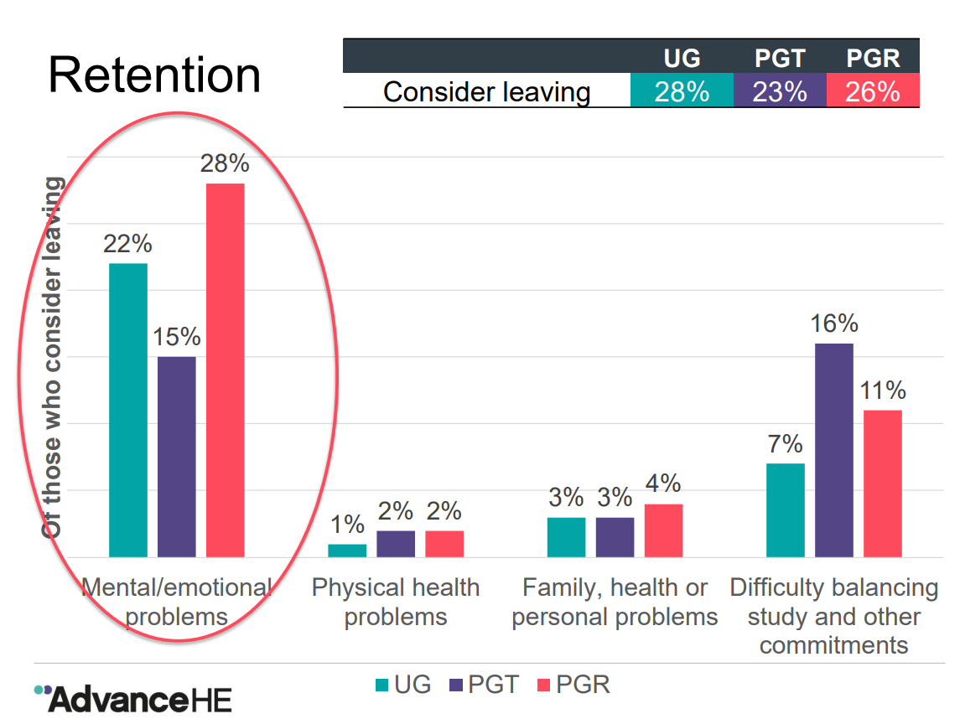
Notes:
And we know that mental health and wellbeing issues are major factors in withdrawal.
If we can understand these concerns on entry then we are better placed to manage expectations, understand the needs of the incoming cohort and hopefully reduce the numbers that withdraw or think about withdrawing. So lets look at suggested action for support.

Slide 34
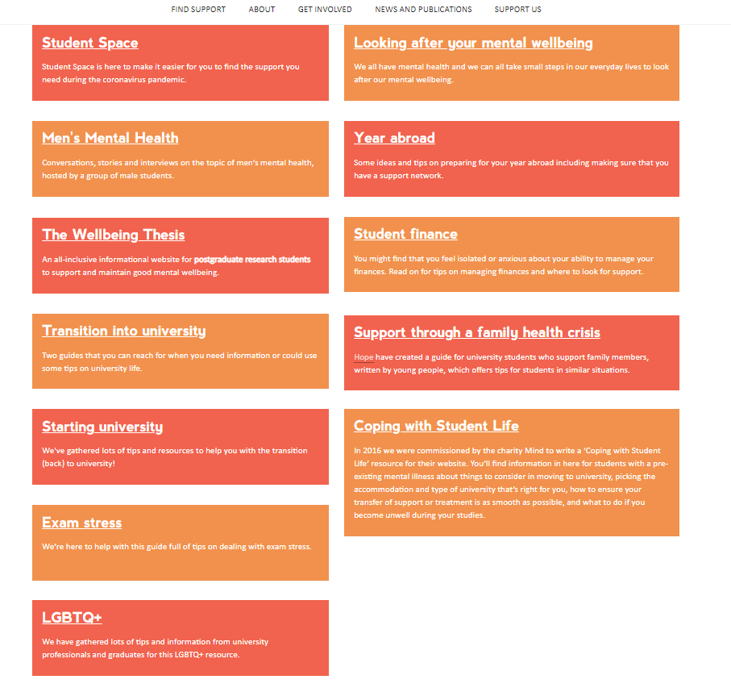
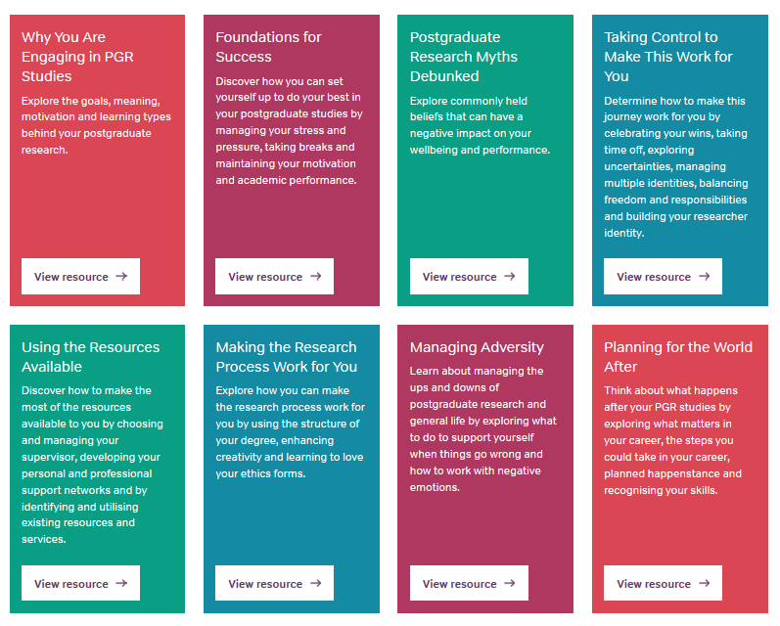

Suggested action for the ‘Support’ theme
University management teams, staff and students engage with the University Mental Health Charter and Student Minds – Home resources.
https://thewellbeingthesis.org.uk/
https://www.studentminds.org.uk/charter.htm
https://studentspace.org.uk/
https://www.studentminds.org.uk/charter.htm
Notes:
We know from Office for Students data that suicide amongst higher education students has slightly decreased in England and Wales between 2017 and 2020. However, we need to consider prevalent factors such as males suicides are statistically significantly higher than females (which in is inline with the national pattern), and first year undergraduate males have a significantly higher suicide rate compared with those studying in other years.
My concern is that stress, anxiety and pressure caused by the rise in cost of living and an increase debt could lead to an increase in suicide especially amongst known groups. Engaging with these resources would be invaluable.

Slide 35
Suggested action for the ‘Support’ theme
University management teams, staff and students should engage with the University Mental Health Charter and Student Minds – Home resources.
Begin the production of accessible self-help information on health and wellbeing, and the management of expectations about the study pressure points throughout the study cycle.
Provide free co- and extra- curricula activities to support health and wellbeing, create a sense of belonging and encourage engagement- all of which help with student success!
Understand the expected use of student services on entry and through the study journey so support can be effectively targeted.
Train staff to identify the warning signs of student hardship and ask the right questions in helping to provide support. There is surprisingly little guidance available for HE.
Notes:
Here are some more suggestions. They include providing free co and extra curricula activities, understanding who intends using what services during the study journey, and training staff to identify students experiencing hardship. As I put here, there is relatively little guidance available.

Slide 36

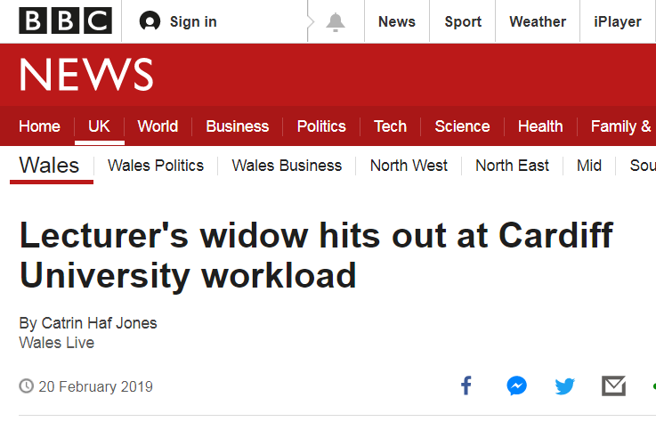
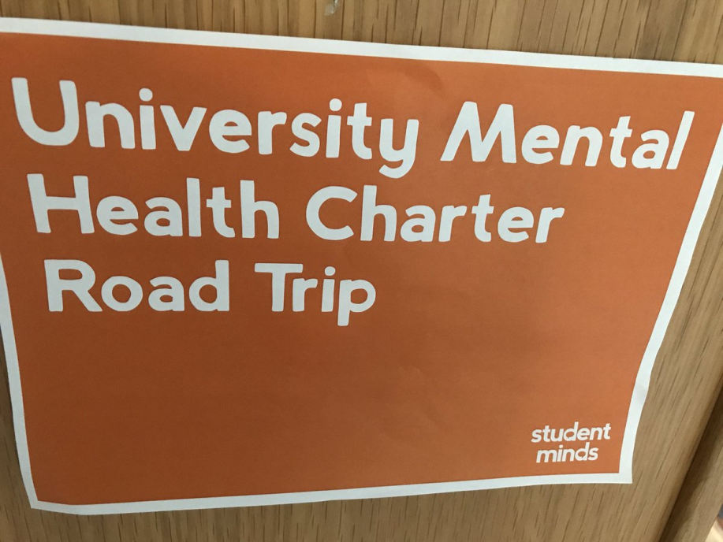
Supporting staff wellbeing
Notes:
And just as well as looking after students, it is essential that we look after ourselves through the study lifecycle. This powerful paper by Liz Morrish is a must read.
Life in academia for all staff is highly pressurized. There are no troughs anymore just peaks and as a colleague of mine says, there is limited time to hit the ground walking.
So please take time to look after yourselves.

Slide 37

What we need to consider
Review of what worked across all areas
Finance
Understanding debt concerns of students on entry and through study cycle
Impact of C19 on student finances
Increase in cost of living = Hardship (fuel and food)
Impact of finance issues on learning and engagement
Need to work
Travel to university costs
Impact on participation extra curricula
https://www.blackbullion.com/
Notes:
Let's briefly look at what we need to consider regarding the finance and employment themes.
The pre-arrival survey highlights that students are worried about debt on entry at all levels. The suggestion that they don’t is a myth.
We know the cost of living is going to increase so expect more claims for hardship. Cost of travel may well impact on
in-person learning and extra curricula activities.
We know that the cost of travel will become more expensive and we know the price of food, which has been on the increase in the past year, will continue to rise due to global issues including the war in Ukraine.
For international students, who made up 12 per cent of all first year enrolments for first degrees and 63 per cent of masters enrolments in 2020-21, the costs of flight and accommodation could have a severe detrimental impact.

Slide 38

Suggested action for the ‘Support’ theme
Increase the provision of university hardship funds by both government and universities.
Provide free travel cards to enable attendance on campus if no university transport is provided or accessible.
Provide financial advice and support on budget management especially for new students before they arrive, and advice on how to reduce utility costs especially in shared accommodation where bills are not included in the rent (like managing gadgets and appliances), and effective cheap ways to stay warm during winter and stay well.
Production of cheap, healthy and tasty recipe cards, and on-campus cooking lessons where students can eat the meals they have cooked together.
Introduction of a community university larder and freezer (do not call it food bank to avoid stigmatisation) where students can access basic provisions. Items could be sourced from bulk buying and the Fare Share Scheme.
Weekly meal plan: 28 cheap and healthy ideas - Save the Student
Notes:
Suggested action includes increasing the hardship budget, advice on financial budget management advice, and setting up a community university larder.
Lets look at the last theme before I finish this presentation which is employment.

Slide 39
What we need to consider
Review of what worked across all areas
Employment
Securing a placement/work experience
Identifying and articulating
employability skills in the curriculum
at each level of study
Expectations on completion
Impact of Covid19 on post study employment
Increase in paid work impacting on study
Notes:
Importantly we need to manage expectations in terms of outcomes and clearly articulating what skills students have acquired through their course. With the increase in cost of living, the need to work may become even more essential for students. CLICK

Slide 40

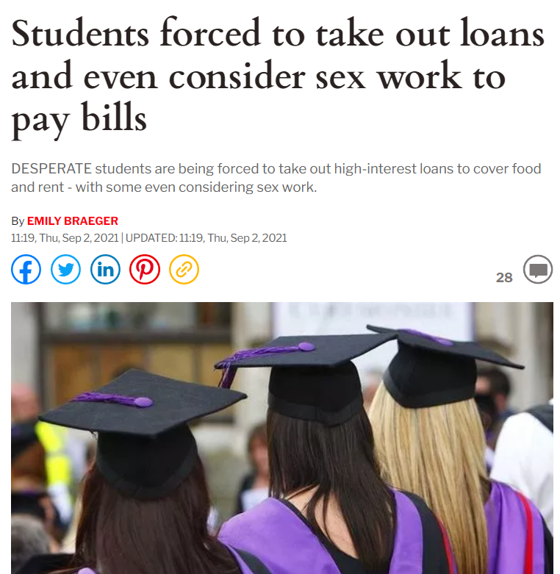
Suggested action for the ‘Employment’ theme
Pay students for voluntary roles.
Make policy provisions for difficulties in securing placements/work experience that are a course requirement, especially those unpaid.
Be aware of the impact on the need to undertake paid work on attendance, learning and assessment.
Be aware of students making difficult decisions around their income which may involve working in informal and unregulated markets such as in-person or online sex work.
Provide paid ways for university unemployed alumni to provide support and mentoring to current students.
Notes:
Suggested action includes paying students for voluntary roles and providing paid ways for unemployed alumni to mentor current students.

Slide 41

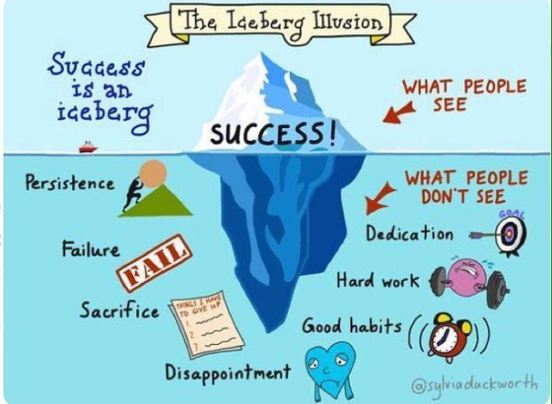

The journey is never easy
Notes:
Whether UG, PGT or PGR the study journey is not easy. Covid19 and cost of living hardship has and will just exacerbate it. We need to be honest with students about their journey . As I said at the start, our students need real models not just role models. As with staff, student lives are multifaceted. Having a good life balance will help with wellbeing but that seems hard to achieve in higher education whether you are a student or member of staff at the moment.

Slide 42


Manage student and staff expectations
Actions for staff and students:
Plan for potential conflicts, issues and problems
Provide stakeholders with regular updates
Set milestones
Set boundaries
Be optimistic with schedules
Build in a discovery period
Notes:
So as I conclude, more than ever, we need to provide explicit information and adhere to some basic rules of engagement in order to deliver expectations. Some are listed here. They include planning for potential conflicts, setting boundaries and milestones and building in a discovery period.
Identify the prior learning experiences of our students, whether new or returning to inform planning and support.
Recognise how pre-university qualifications were achieved and summatively assessed during this period and bridge any gaps in students’ assessment experiences accordingly.
Provide targeted and scaffolded support to bridge the skill differences for all students.
Avoid a one-size-fits-all approach to learning and support, acknowledging diverse experiences.
Avoid overwhelming new and returning students within the first two weeks with excessive information. Returners may feel like new students all over again when they return to campus.
Build in an effective introduction (for new students) and reinduction (for returners) across the first semester or term on how to practice being effective students at their new level of study.
Think about the 3 Ts of student information: Type of information needed, appropriate Targeting and Timeliness.
At all times, remember the importance of compassion for students and colleagues for whom this episode has been gruelling and challenging, making allowances for honourable exceptions from time to time, while still maintaining standards.

Slide 43

Key areas
Be aware of concerns of students on entry to university and compare to exit results
Prepare students for differences between school and university
Prepare them for online learning at university
Manage their expectations and remember the ‘pressure points’
Look after yourselves!
Notes:
As I conclude it is important to address these key areas.

Slide 44
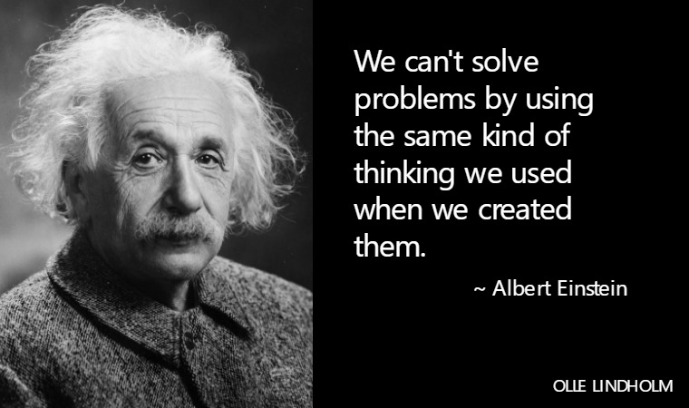
Last thoughts…………..
Notes:
So we need to Keep building on the amazing work we have achieved
We need to Keep reflecting and evolving
And as Einstein said………………………..
CLICK

Slide 45
Thank you for listening Any questions?
Dr Michelle Morgan
mgmorgan8@hotmail.com
Author and Editor of www.improvingthestudentexperience.com
Creator of the Student Experience Transitions Model
Editor and Contributor to Improving the Student Experience-A practical guide for universities and colleges (Routledge, 2012) and Supporting Student Diversity in Higher Education (Routledge, 2013)
Forthcoming publications
Morgan, M. (2022) The Retrospective/Prospective PhD by Publication Journey in Chong, S.W and Johnson, N. (ed) Landscapes and Narratives of PhD by Publication, Basingstoke: Springer Nature
Morgan, M. (2022) The student Experience Transitions Model- integrated practice to inspire staff to support students in Nutt, D. and McIntosh, M. (ed) The Impact of the Integrated Practitioner in Higher Education Studies in Third Space Professionalism, Abbingdon: Routledge
Most recent publications:
Morgan, M. (2020) An exceptional transition into higher education, York: AdvanceHE
Morgan, M. (2020) inancial concerns and working intentions of incoming Level 4 students -The potential implications for applicants and students in 2020/21 due to Covid19. Available online at: http://www.improvingthestudentexperience.com/library/covid19/Financial_concerns_and_working_intentions_of_incoming_Level_4_university_students-_implications_of_C19.pdf
Morgan, M. (2020 Bridging the gap between secondary and tertiary education. Available online at: http://www.improvingthestudentexperience.com/library/UG_documents/Bridging_the_gap_between_secondary_and_tertiary_education-Morgan_2020.pdf
Morgan, M. (2018) Fostering engagement in higher education of all stakeholders in the delivery of a high quality student experience-PhD by Publication, Bournemouth:Bournemouth University
Morgan, M. and Direito, I. (2016) Widening and sustaining postgraduate taught (PGT) STEM study in the UK: a collaborative project. Creating change through understanding expectations and attitudes towards PGT study, experiences and post-study outcomes from the perspective of applicants, students, universities and employers. Available at: http://www.improvingthestudentexperience.com/library/PG_documents/Postgraduate_Experience_Report_Final.pdf
Creator and author of http://www.improvingthestudentexperience.com
Editor/Chapter and Case Study Author of Improving the Student Experience- a practical guide (published by Routledge 2011)
Editor/Chapter and Case Study Author of Supporting Student Diversity in Higher Education- a practical guide (published by Routledge 2013).
Notes:
Thank you listening
Stay well
Stay safe
And take care

