Slide 1

HEIR Network Annual Conference 2025
Using AI to unlock actionable insights from student free-text feedback
Market-leading supplier of survey and evaluation solutions

Slide 2


+

Slide 3
Student Voice
AI trained to analyse feedback, only trained on university comments from surveys such as NSS, PTES/PRES etc…
44 categories across 9 themes for taught courses
For postgraduate research programmes, there are 26 categories under nine high-level themes. Each comment and sentence is allocated an overall sentiment.
Each comment and sentence allocated an overall sentiment.
If NSS data is provided Student Voice AI can benchmark your responses against the sector.

Slide 4

Commissioned by Advance HE to process PTES/PRES open text comments
Those who have opted in will receive access to Dashboard next week

Slide 5
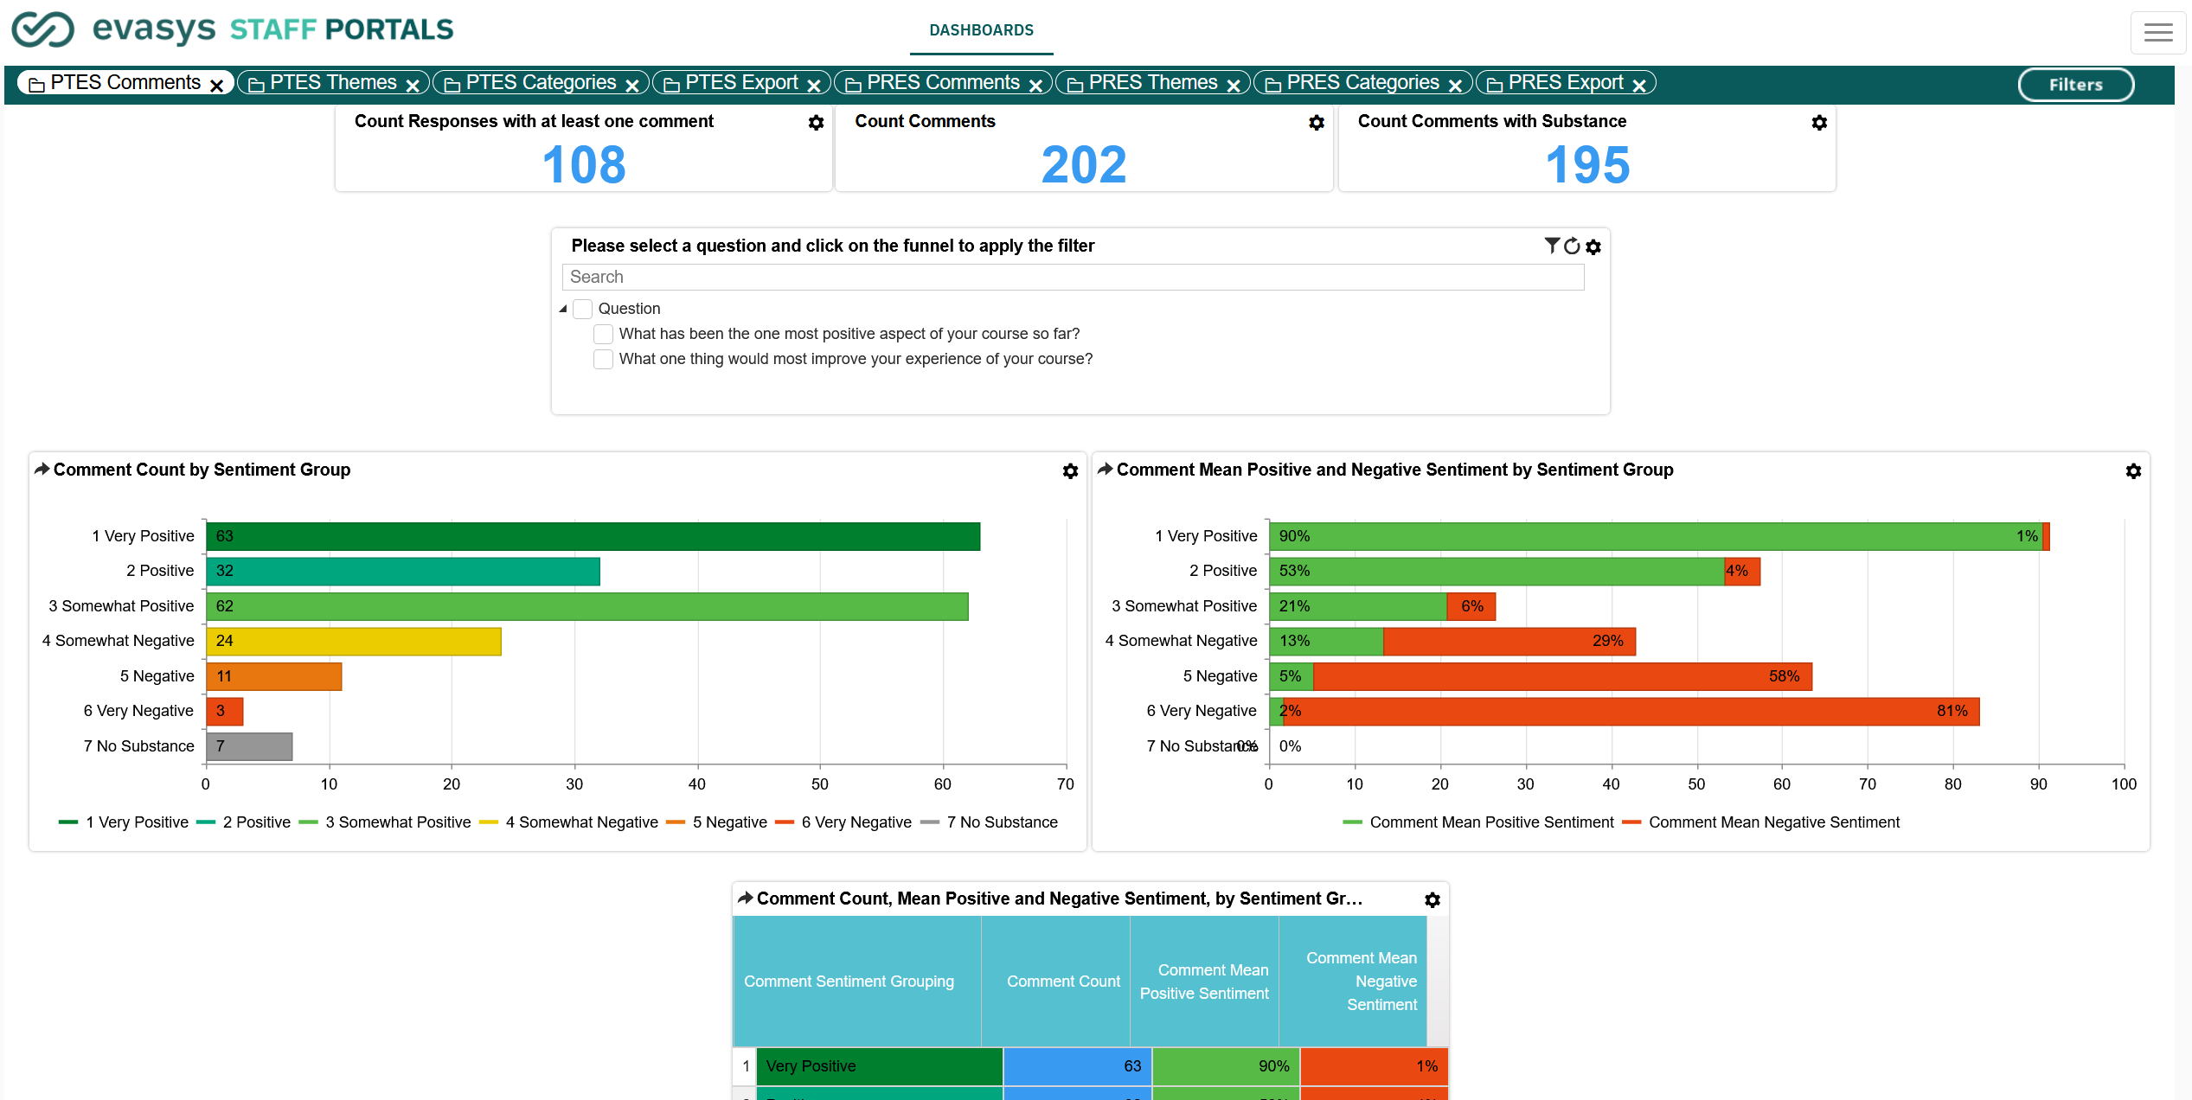

Slide 6
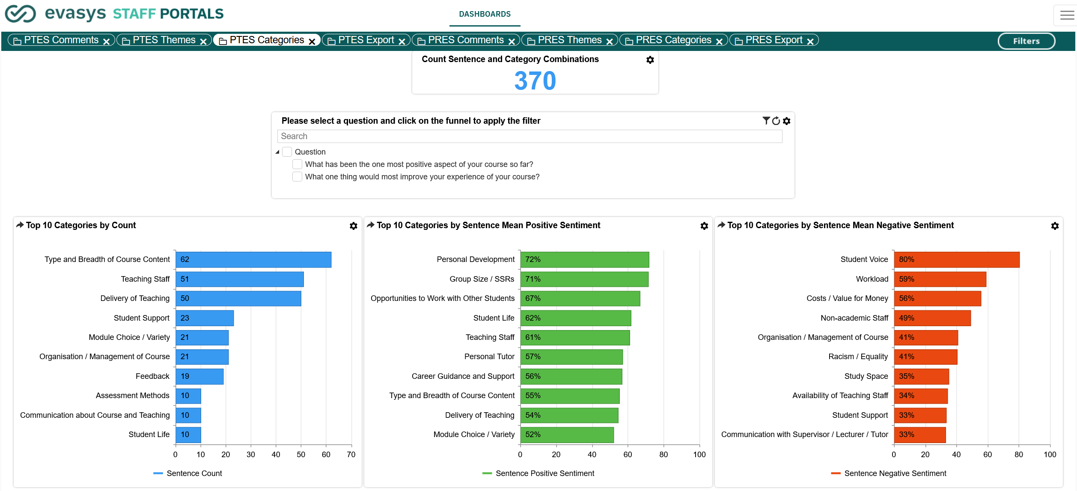

Slide 7
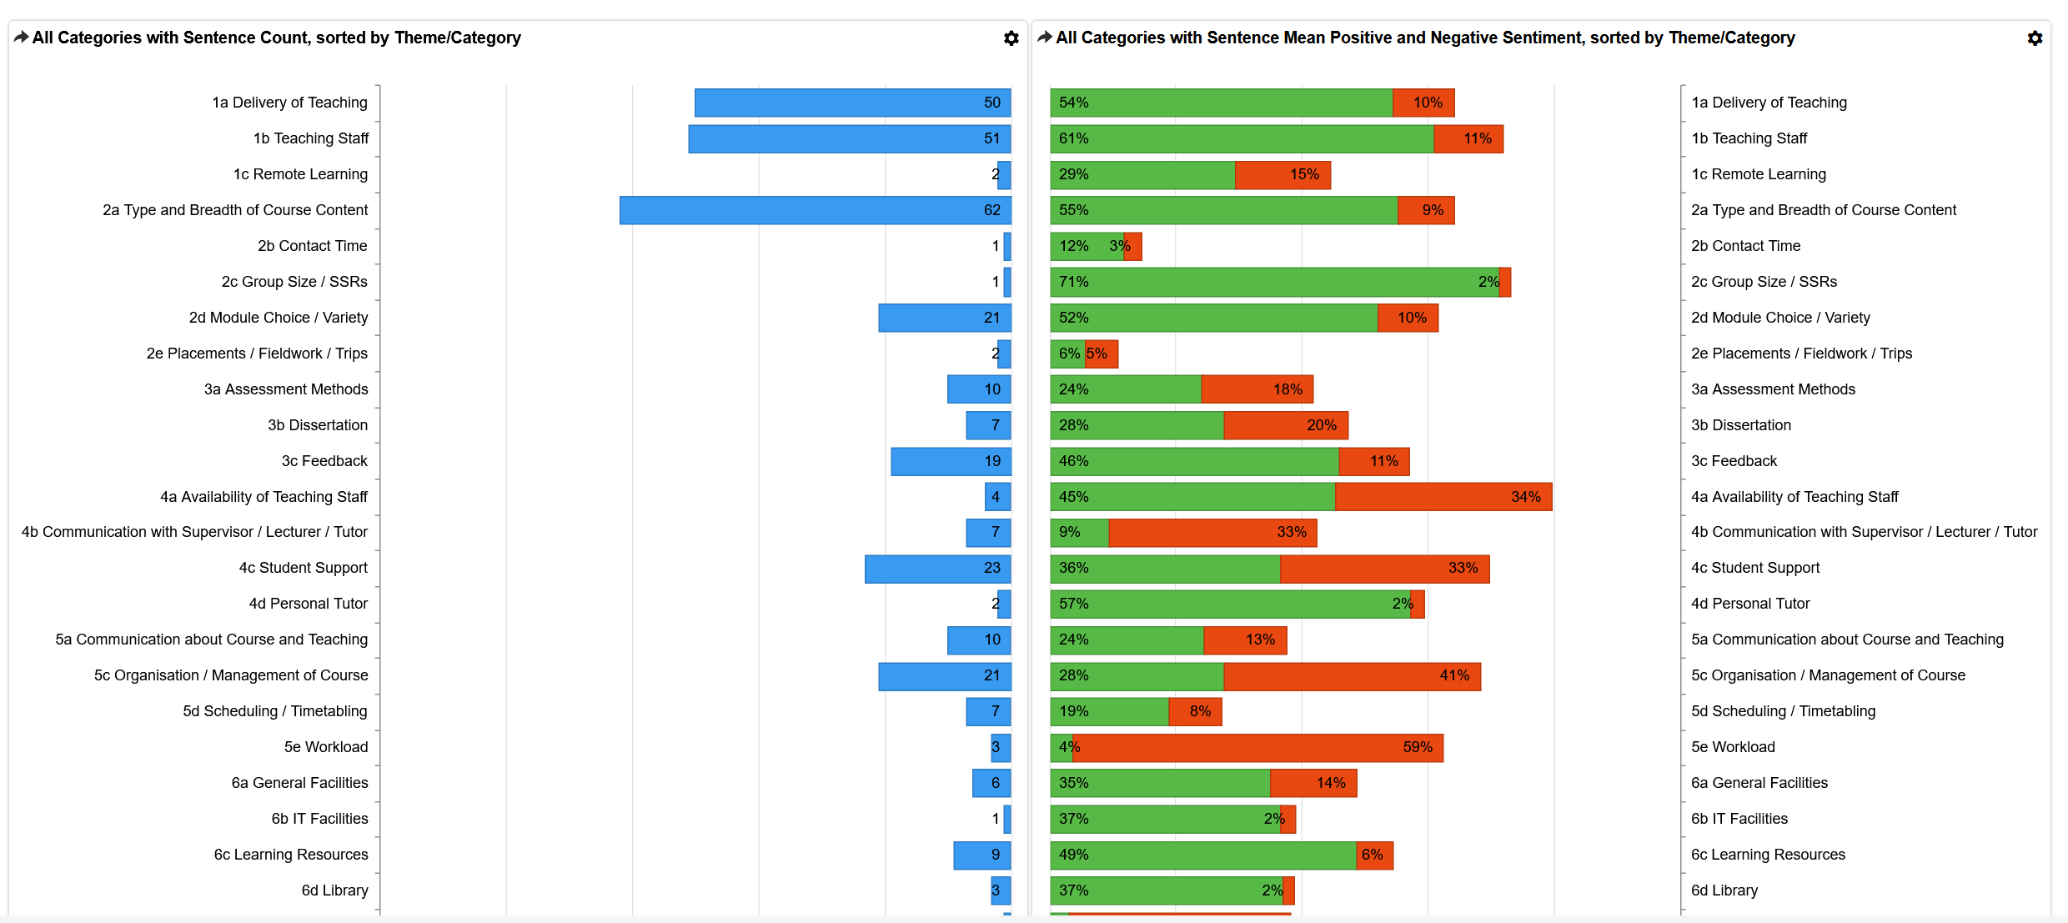

Slide 8
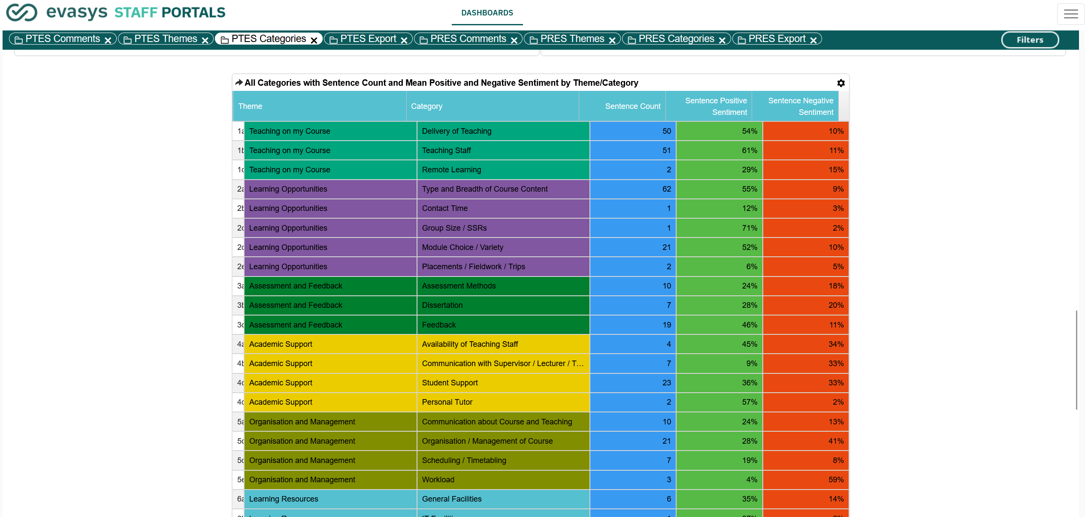

Slide 9
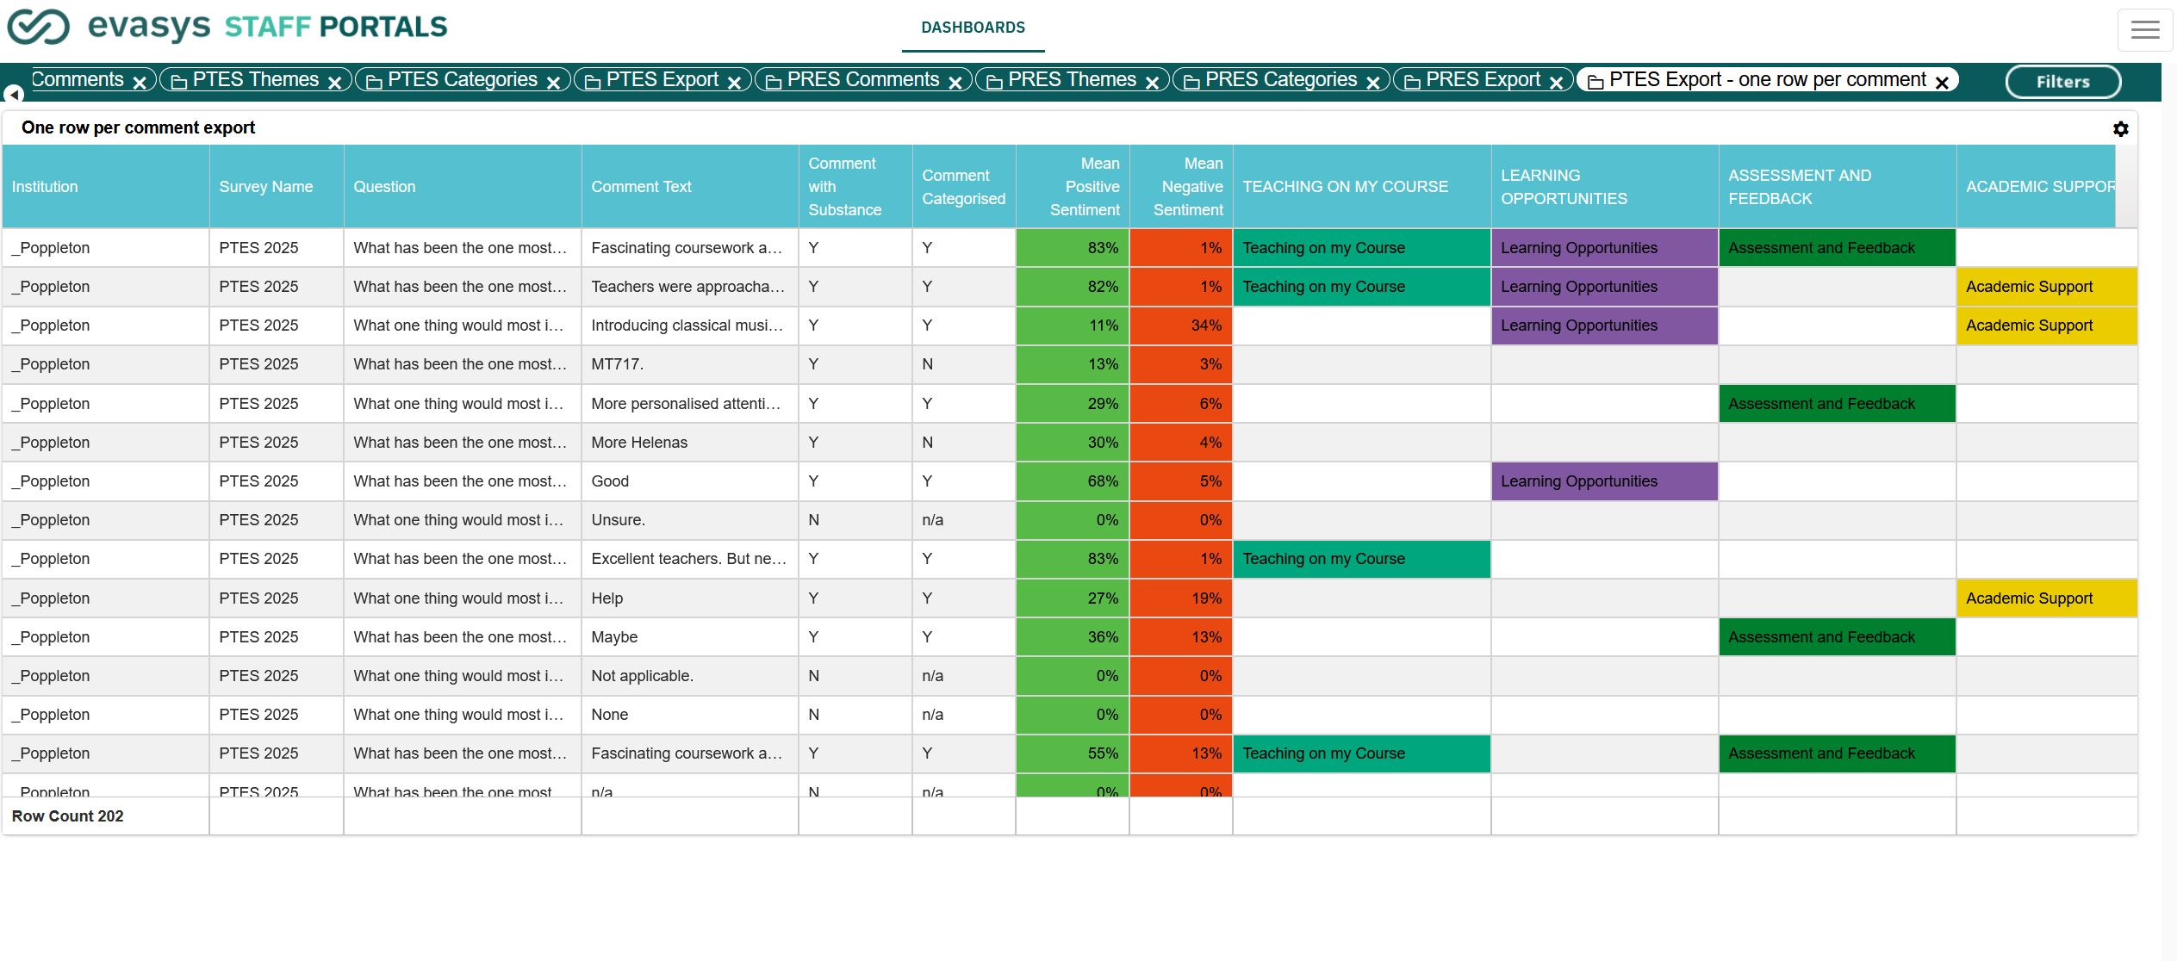

Slide 10
AI Narrative Report
Depending on the dataset, narrative reports can be produced.
We presented Dr Nicola Watchman Smith one for PTES at institutional level
Depending on the data set (NSS, Module, Programme) narratives could be given at School/Faculty/Department/Course level too.

Slide 11
Try it yourself
We’re welcoming all interested to run your free text comments through it and see the wealth of insights gained.
Access to our dashboards.
Data could be accessible as early as next week.

Slide 12

Let’s Connect
Joe Mahon | Implementation & Account Manager, evasys UK
+44 (0)131 285 7970
Joe.mahon@evasys.co.uk
evasys.co.uk
linkedin.com/company/evasys-uk

