Slide 1
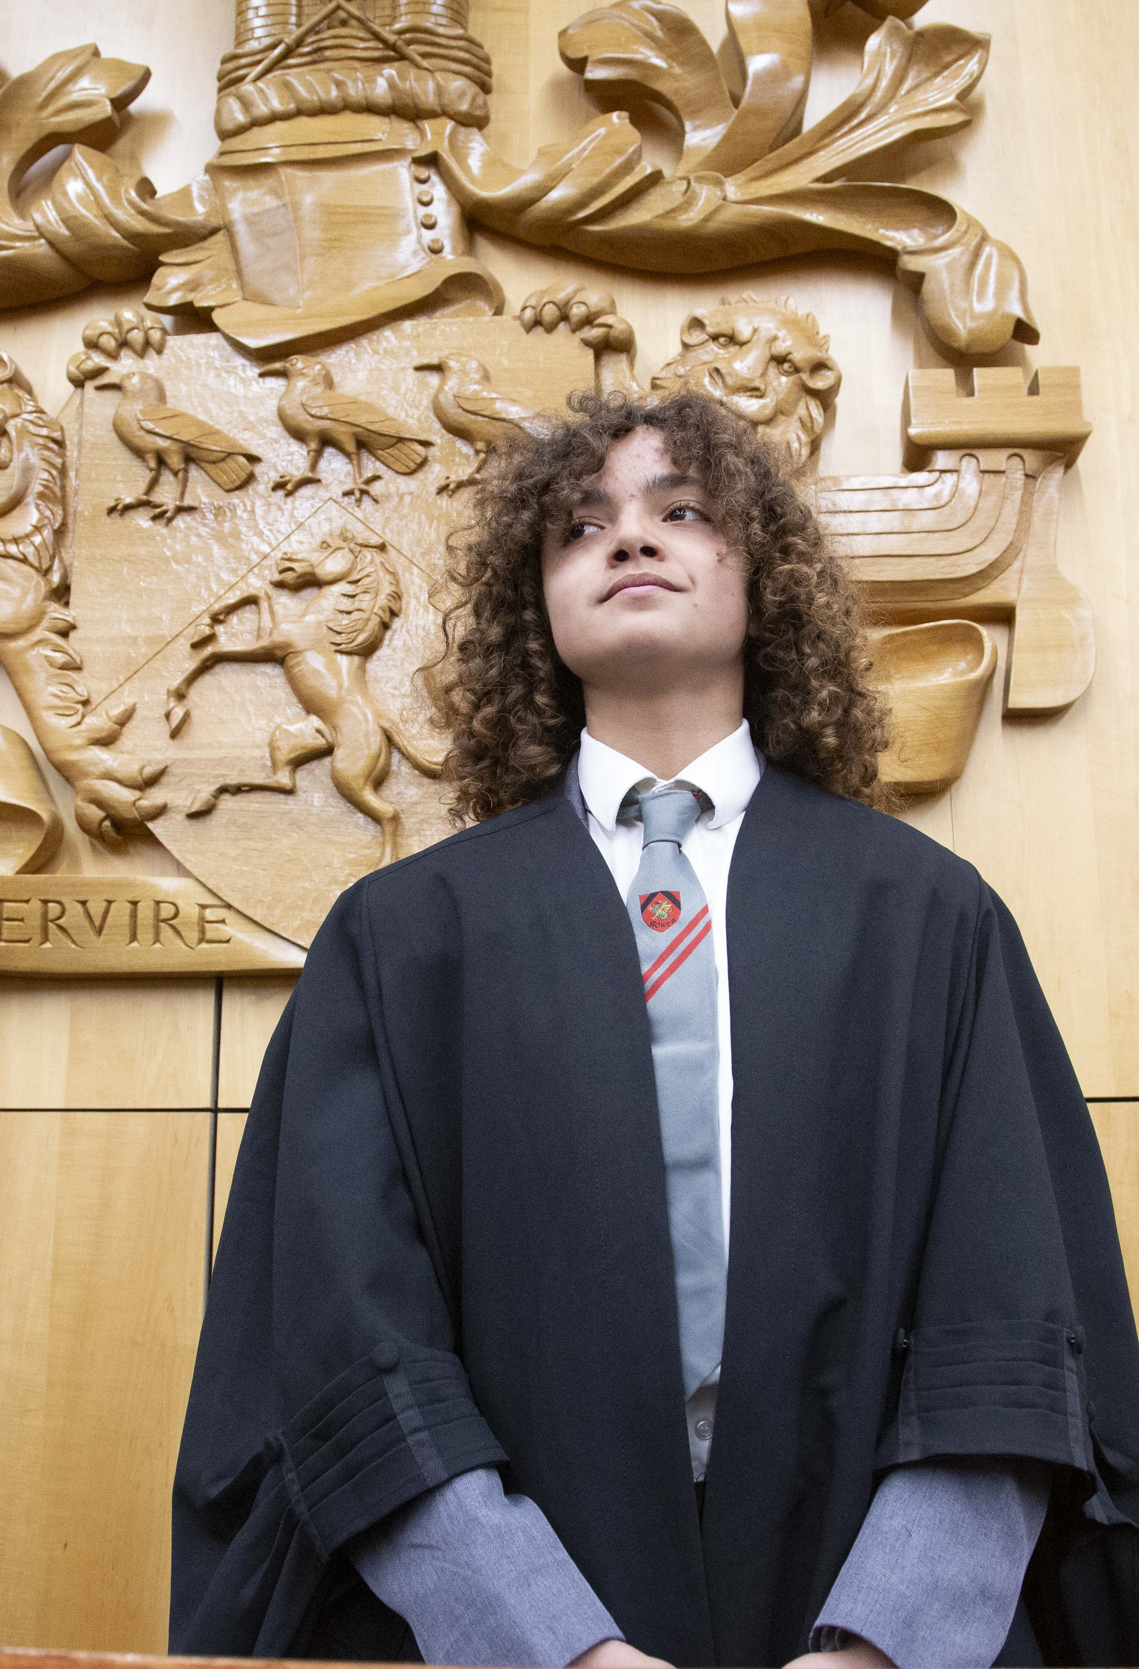
Championing Boys
Supporting boys to find their voice & increase engagement in school

Slide 2
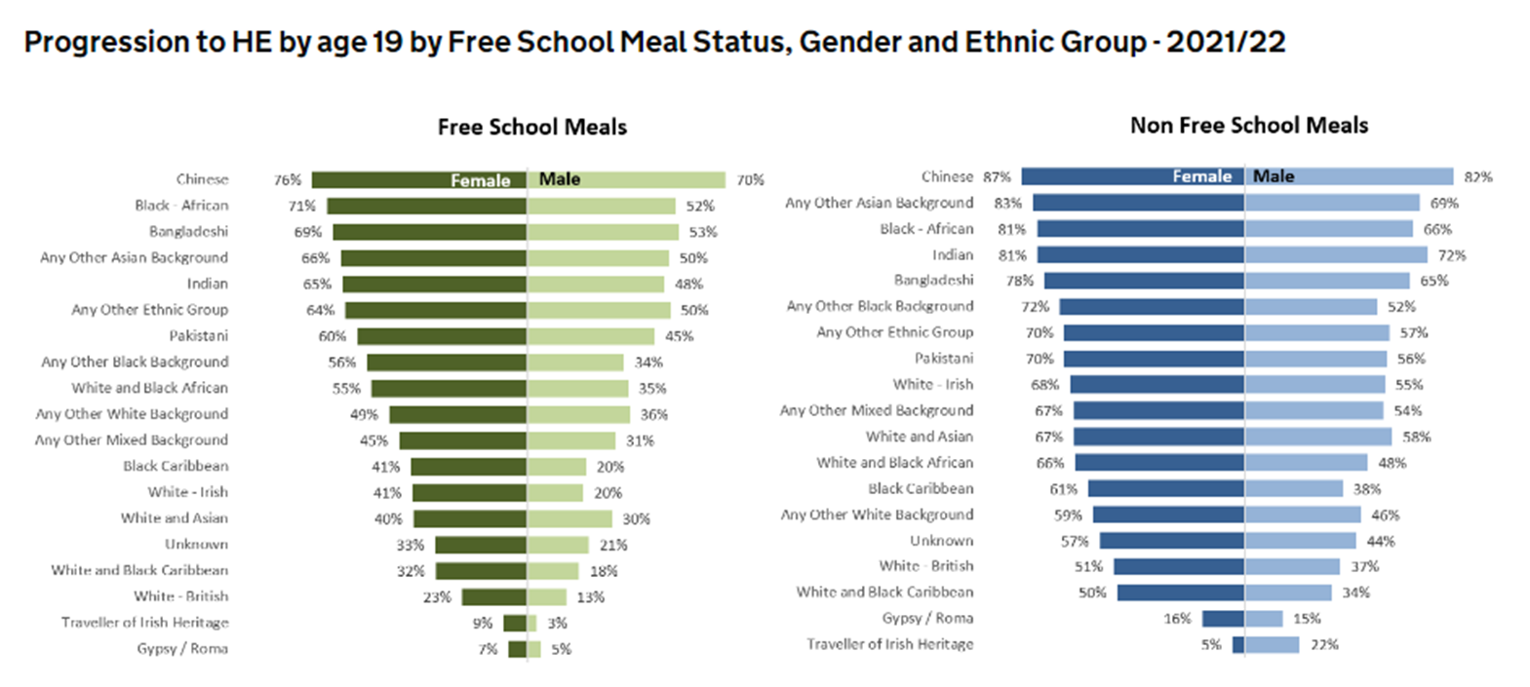
Why target boys?
Notes:
“Boys underperform at all key stages of primary and secondary education compared to girls. Boys are more likely to be excluded from school. Boys are less likely to go to university: boys are less likely to become apprentices: boys are less likely to find paid work between the ages of 22 and 29. And when these boys become young men, they are three times more likely than women to be victims of suicide. They also belong to the gender that makes up 96% of the UK Prison population” (Pinkett & Roberts, 2019).

Slide 3
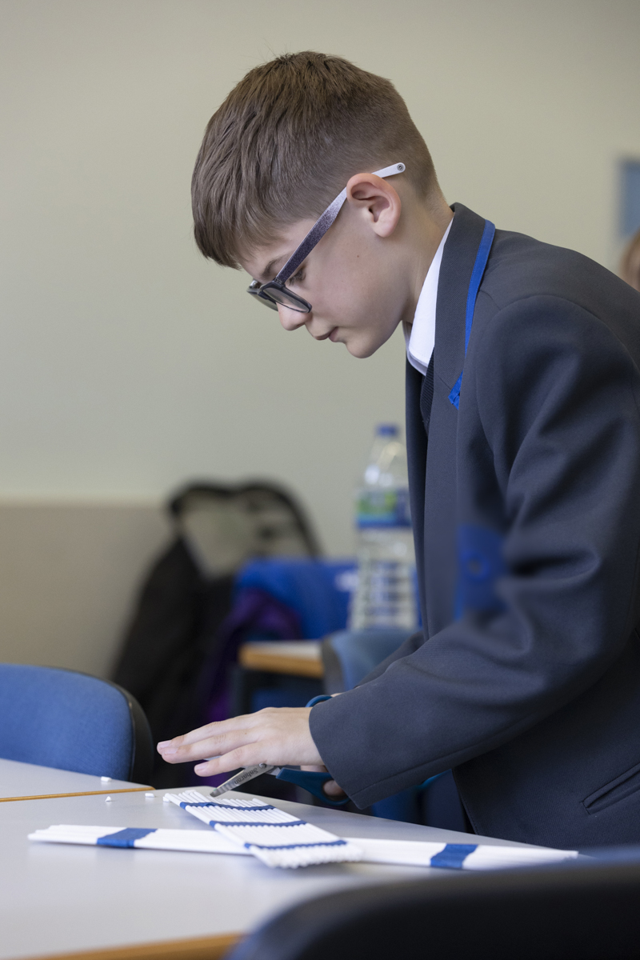
Championing Boys – An Overview
Year 8: Express Myself
Enables boys reflect on their identity and explore what it means to be male in today’s world.
Year 9: Find My Voice
Empowers boys to develop their voice, confidence, and critical thinking through structured debates on real-world social issues.
Year 7: Future Me
Encourages boys to envision their future selves.
Notes:
Championing Boys is a school-based programme which is designed to increase engagement in education. It aims to accomplish this by helping students explore potential identities, future educational opportunities as well as giving a platform for their voices to be listened to. The programme plans to work with students from Year 7 to 10, with students participating in a different 6 week module each year. The programme is evidence-based and grounded in the taking boys serious principles.

Slide 4

Programme Aims
Explore potential identities
Build confidence in skills & abilities
Explore masculinity & it’s potential
Increase familiarity with higher education
Foster agency in shaping futures
Value the voice of boys
Utilise a ‘strengths-based approach’ to learning
Challenge & affirm masculine identities
Engage meaningfully with boys
Enable creative learning environments
Value the voice of boys
Enhance and sustain a positive engagement with education
Notes:
Proud advocates on the taking boys seriously principles – our programme features as a case study on the UoU educational ecosystem.
Consciously action the tTBSP

Slide 5
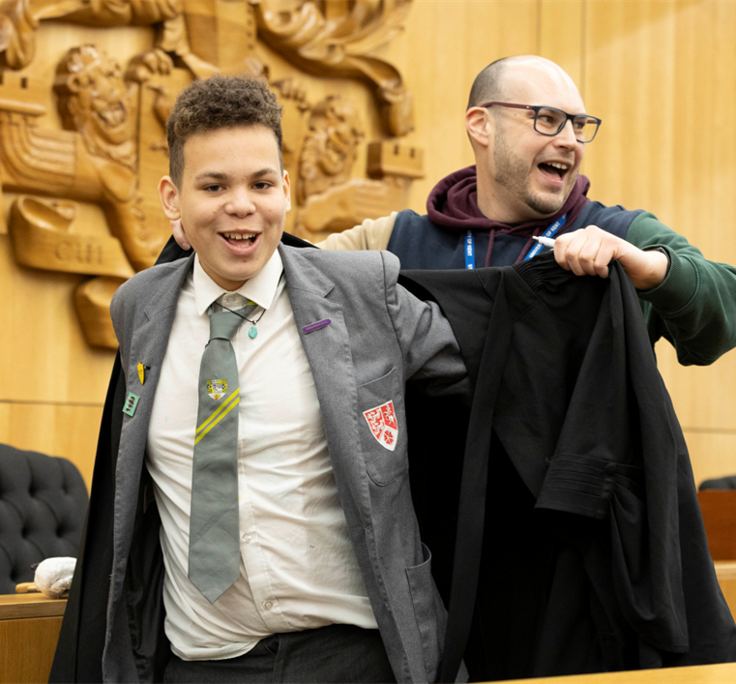


Possible Selves Theory (Markus and Nurius 1986)
Foster reflection on who they want to become and building agency in shaping their futures.
Challenge students to step outside their comfort zone and try something new to them.
Notes:
Pinkett, M. and Roberts, M., 2019. Boys Don't Try? Rethinking Masculinity in Schools. Routledge.
Possible Selves Theory advises that individuals hold mental representations of their hoped-for and feared future selves. These guide motivation and behaviour by encouraging the pursuit of positive outcomes.
Based on this theory, the programme aimed to encourage students to "try on" different versions of themselves, fostering reflection on who they want to become and building agency in shaping their futures.
Pinkett & Roberts (2019) critique the myth that education should be made “relevant to boys’ interests”. They argued that this can reinforce stereotypes, lower expectations, and limit opportunities to build social capital.
Provide opportunities for students to participate in activities that they maybe haven’t experienced and challenge them to step outside their comfort zone. Recognising that they aren’t going to enjoy every activity and that’s ok because it is still exposing them to new ideas.
For example, using poetry as a form of creative expression was an intentional choice when designing the ‘express myself’ module. We didn’t want to shy away from difficult challenges and wanted to challenge students to step outside their traditional comfort zones. We wanted to have a flexible form of creative expression, one that also seemed manageable for the students in a relatively short timeframe. Based on assumptions, we felt that this might be a challenging way of engaging with students (which it was), but equally wanted to embrace that this was an intentional element of the programme.
Put the gown on and they take on a different persona

Slide 6
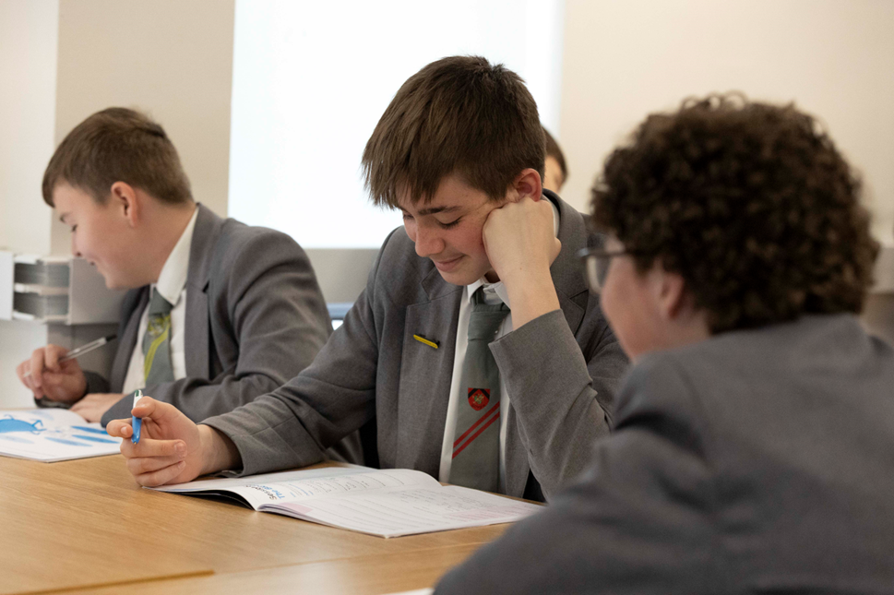
Adopting a strengths-based approach
Taking Boys’ Seriously Principle #3: adopt an approach that acknowledges the strengths that exist within each boy as opposed to focusing on deficits
Develop confidence
Enhance student agency
Support collaboration
“When you got the round of applause at the end, it shows that people actually enjoyed it, and they felt it was actually good and you’re proud of yourself.”

Slide 7
Celebrate positive masculine identities
Taking Boys’ Seriously Principle #4: Challenge narrow and potentially harmful gender stereotypes and intentionally communicate and affirm positive masculinities.
Exploring identity
Challenging gender-based stereotypes
Role models
“Yeah because you could communicate with fellow boys and see their perspective of masculinity and about being a boy.” - student
“At first, I was a bit reluctant but then, once we started talking and getting through the lesson, I felt more comfortable to talk about all of it.” – student
People put lots of, like, stereotypes on men that shouldn’t be real.
Notes:
Talked about the abassadors being vulnerable and discussing these topics with them was helpful

Slide 8
Engage meaningfully with boys
Taking Boys’ Seriously Principle #8: Boys need to be seen as individuals and thrive when their individuality and difference is recognised and responded to.
Students talked positively regarding the active and collaborative approach taken by facilitators
One student reported that he valued being able to “build trust in them,” whereas another liked that “could easily get to know them.”
Students’ also expressed an appreciation of the space they were afforded to ask questions, a space in which information did not only flow down from facilitators or ambassadors but could move freely among students.
“We could relate to them because obviously, like you said, they could- some of them are from a similar background.”- student
“It didn’t feel like he was a teacher though, it felt like he was a close friend.” - student
Notes:
Ambassadors – one session noticed they weren’t there. Connected

Slide 9
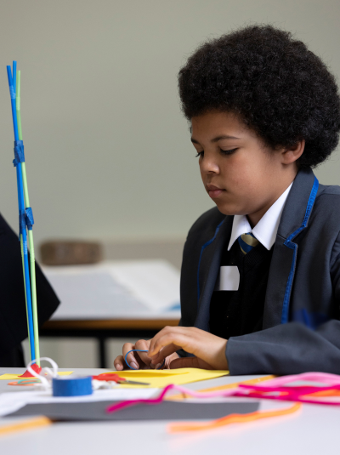
Enable creative learning environments
Taking Boys’ Seriously Principle #9: Informal education methodologies have been highly successful at re-engaging boys who have completely disengaged from school-based education.
“For me, it’s just being able to have conversation and just have fun whilst I’m doing something. It makes people more interested in what I’m doing, when I can have a laugh whilst doing it.”- student
Yes. Because you’re in groups and if you don’t know but someone next to you does, you can ask them for information about it. – student
"…we did not know anything about it [a task in a session] until the ambassadors helped us then we found it more interesting and more inclusive“- student
Notes:
Informal education methodologies have been highly successful at re-engaging boys who have completely disengaged from school-based education.
Came out most strongly that this has resonated most with the boys.
Embrace it and sometimes embrace the chaos that may come with it
“Many of the boys are playful and energetic, and it needs to be channelled rather than stifled. To my mind, it looks as if holding space for, and allowing (to an extent), their playfulness has a positive, disarming affect. It validates an important part of how these boys are and how they interact with the world, and it builds a level of trust with the ambassadors, which in turn will allow those boys who are less likely to engage to get back to work. It also challenges the idea that learning is boring and restrictive, which to my mind is an crucial part of the intervention. [The facilitator] is good at this, too, but he knows how to firmly draw boundaries on the playfulness” – Researcher Observations
It is also notable that the words that cropped up most frequently in the focus groups to describe the programme and individual workshops were “interesting” and “fun.”
Also having university lecturers come in and run sessions in completely different ways based on the subjects.

Slide 10
Value the voice of boys
Taking Boys’ Seriously Principle #10: When boys are encouraged and facilitated to actively contribute, they
feel more affiliation to the environment and a greater sense of ownership and belonging.
Model of Child Voice
(Lundy 2007)
1. Space
2. Voice
3. Audience
4. Influence
It was important to incorporate and to value the voice of boys throughout every step of the programme.
Ensure that student voices were not only heard but also acted upon.
As well as adequately communicating these actions back to students to ensure they can see the impact their voice is having.
For the next iteration of the programme, we have the ambition of one step incorporating their voice into the evaluation design.
Notes:
When boys are encouraged and facilitated to actively contribute, they
feel more affiliation to the environment and a greater sense of ownership and belonging.
It was important to incorporate and to value the voice of boys throughout every step of the programme.
Ensure that student voices were not only heard but also acted upon.
As well as adequately communicating these actions back to students to ensure they can see the impact their voice is having.
For the next iteration of the programme, we have the ambition of one step incorporating their voice into the evaluation design.
Pre & post focus groups
Asking for reflections at the end of each session
Feeding back what they say – teachers, reports but also to them
My experience is they value this opportunity to be listened to and to have a say.
For the next iteration of the programme, we have the ambition of one step incorporating their voice into the evaluation design. by holding focus groups with some of the boys to ensure that the language we are using in surveys makes sense
Use of
Lundy (2007) Model of Child Voice:
Space (creating environments where students feel comfortable expressing themselves),
Voice (ensuring they have opportunities to share perspectives),
Audience (ensuring their views are actively listened to),
Influence (ensuring their insights contribute to meaningful change).
Lundy, L. (2007). ‘“Voice” is Not Enough: Conceptualising Article 12 of the United Nations Convention on the Rights of the Child’. British Educational Research Journal, 33(6), 927-942.

Slide 11
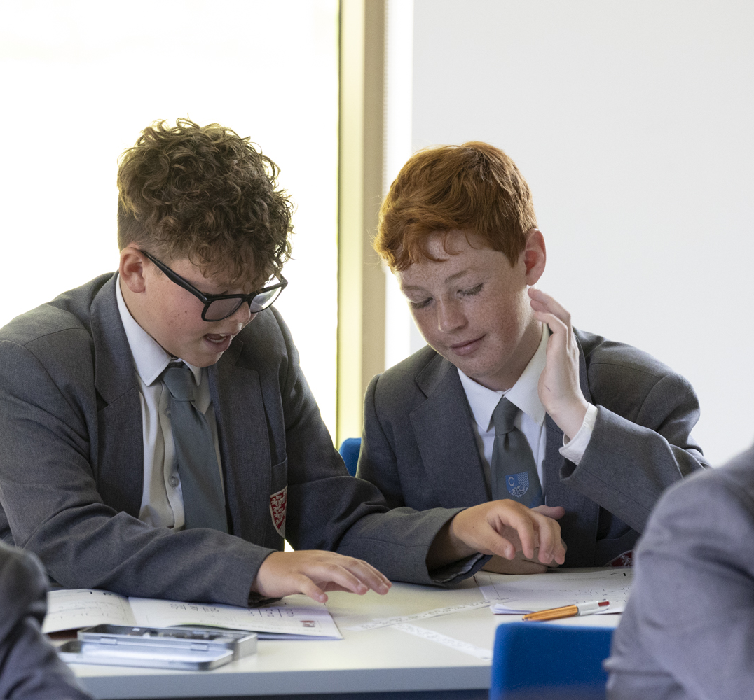
Methodology
Quantitative
Pre & post attitudinal surveys
School data
Qualitative
Student focus groups
School staff interviews
Reflective journals
University staff & ambassador surveys
Parent surveys (1 response)
Evaluation sample: 82 pupils

Slide 12
Survey Results
Evaluation sample: 82 pupils
Notes:
Saw small increases in attitudes to learning, familiarity in HE.
I want to try my best at school – average increase from 7.62 to 8.43
When I find school work hard, I do not give up easily – average increase from 5.96 to 6.92
I know what studying at university would be like – average increase from 5.34 to 6.13
Despite using validated questions, we have found the use of attitudinal surveys, particularly with younger audiences challenging and raise the question as to whether this methodology is appropriate. For example, university is for people like me. Next academic year, we will be moving to using the Boy Quadrant
Will be moving to the Boy Quadrant surveys moving forward.

Slide 13
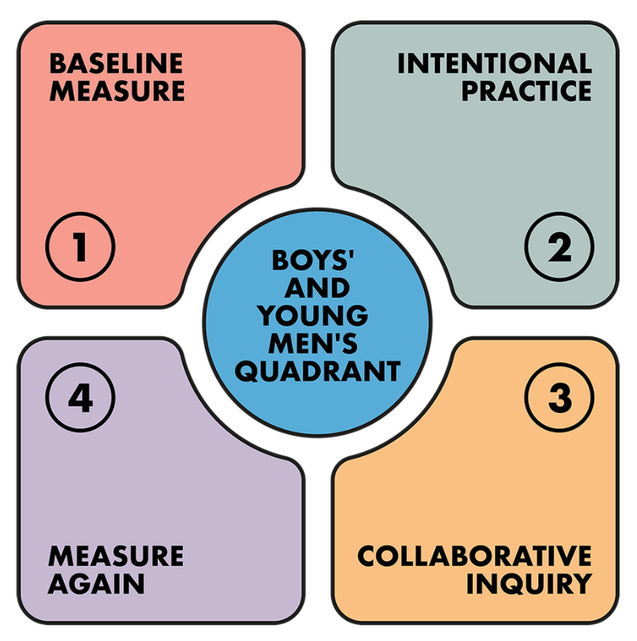
The Boy Quadrant
Developed as a result of the Taking Boys Seriously research from the University of Ulster
Questions are framed as questions as opposed to statements, making them easier for students to understand.
There are twenty-five questions that boys are asked to respond to on a five-point scale.
Boy Quadrant — The Boy Quadrant

Slide 14
Fostering agency
“Some people say like, when a door is shut, and it opens another one. So, it opens a door for you to think about your education and what you’re going to do after school. Like, I need to pay a bit more attention in classes to actually get me somewhere.”- student
“I could do designing if I wanted to. It seems quite fun. It explores so many things that I know I’ve never really thought of doing before.” - student
"On the tour when we were walking around, I was actually in my head thinking, I could actually go here.“ - student
Notes:
We are seeing anecdotal evidence that students are feeling more confident in taking ownership of their own decisions. However, we did not see quantitative shifts in surveys. Whilst this remains an integral long-term aim of the programme, we believe this is not something we will be able to truly measure until the students complete all 4 years of the programme.

Slide 15
Positive Engagement with Education
“Yeah, I’ve been more confident at school. Like, in English, I’ve answered a lot more questions, and I’ve been giving a lot more detailed answers.”- Year 9 student
“It’s just made me work harder. I don’t know how. I don’t know why. As I've mentioned maths and English already, in English I've been more focused, and I've written a lot more. I used to write about half a page in an English lesson. Now I write a page and a half, maybe two pages. And then in maths I used to just mess about. And now I actually do my work.” – Year 7 student
“It’s made me change my thoughts about a lot of different things. Like, education, university and what university really is. Like, I didn’t know what a university is. I thought it was just like a school like this, just bigger.” – Year 7 student

Slide 16
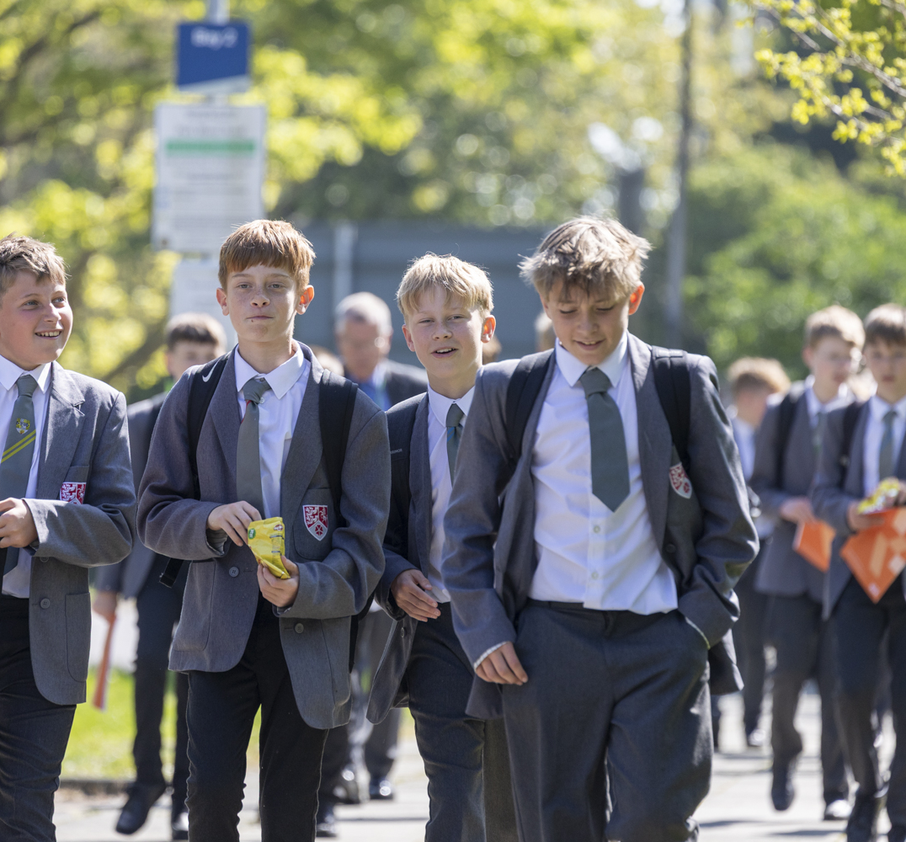


School Observations
In the short-term, the following changes were observed by the school:
Increased participation in classes
Decreased behavioural points received
“I used to be getting four signings a week, like four or three signings a week. I now am on zero.” - Student
Notes:
However, as each module is only 6 weeks, it was also observed that students reverted back to old habits the further away from the programme they became. As such next year, we will be looking at school data at specific time points. We are also working with the school to ensure there is ongoing support between modules and the school are considering how they can utilise the momentum of the programme to continue to develop progress within school programmes, policies and procedures.

Slide 17
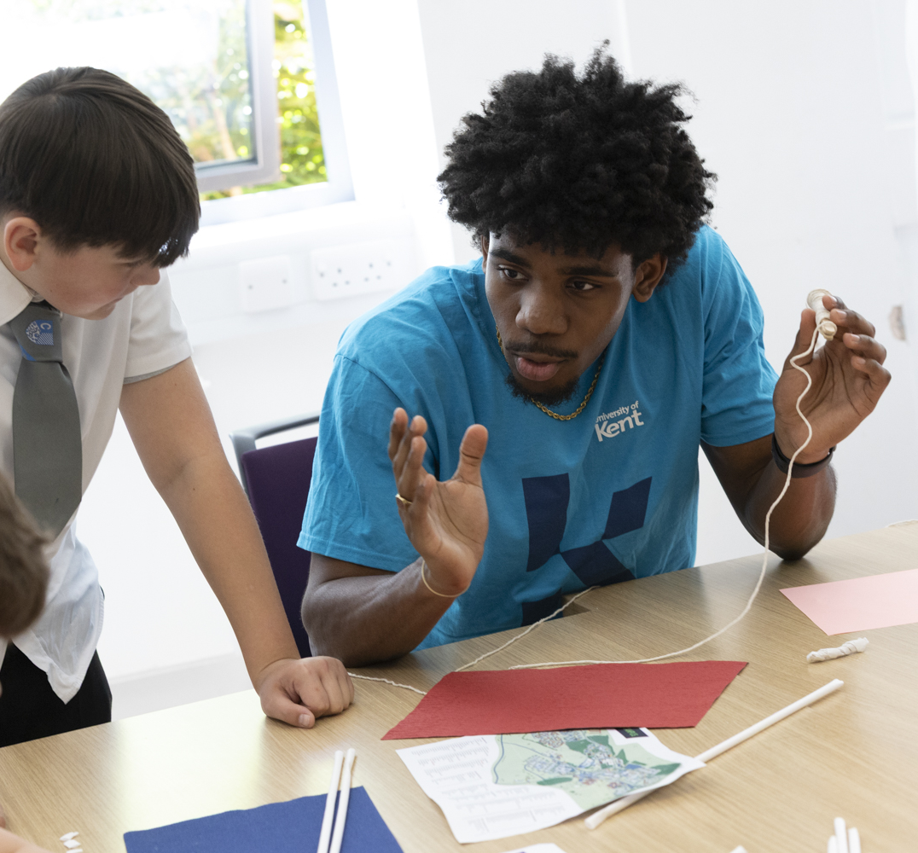
Interim School Data
English | Effort Grade Improvement | Maths | Effort Grade Improvement
Year 7 | 56% | Year 7 | 55%
Year 8 | 46% | Year 8 | 48%
Year 9 | 41% | Year 9 | 41%
Average | 48% | Average | 48%
Effort grades are awarded by the school termly on a 4 point scale (1 = Inadequate, 2 = Requires Improvement, 3 = Good, 4 = Outstanding)
Table shows increases in effort grades by at least 1, at the end of the programme module.
Notes:
Comparator group

Slide 18
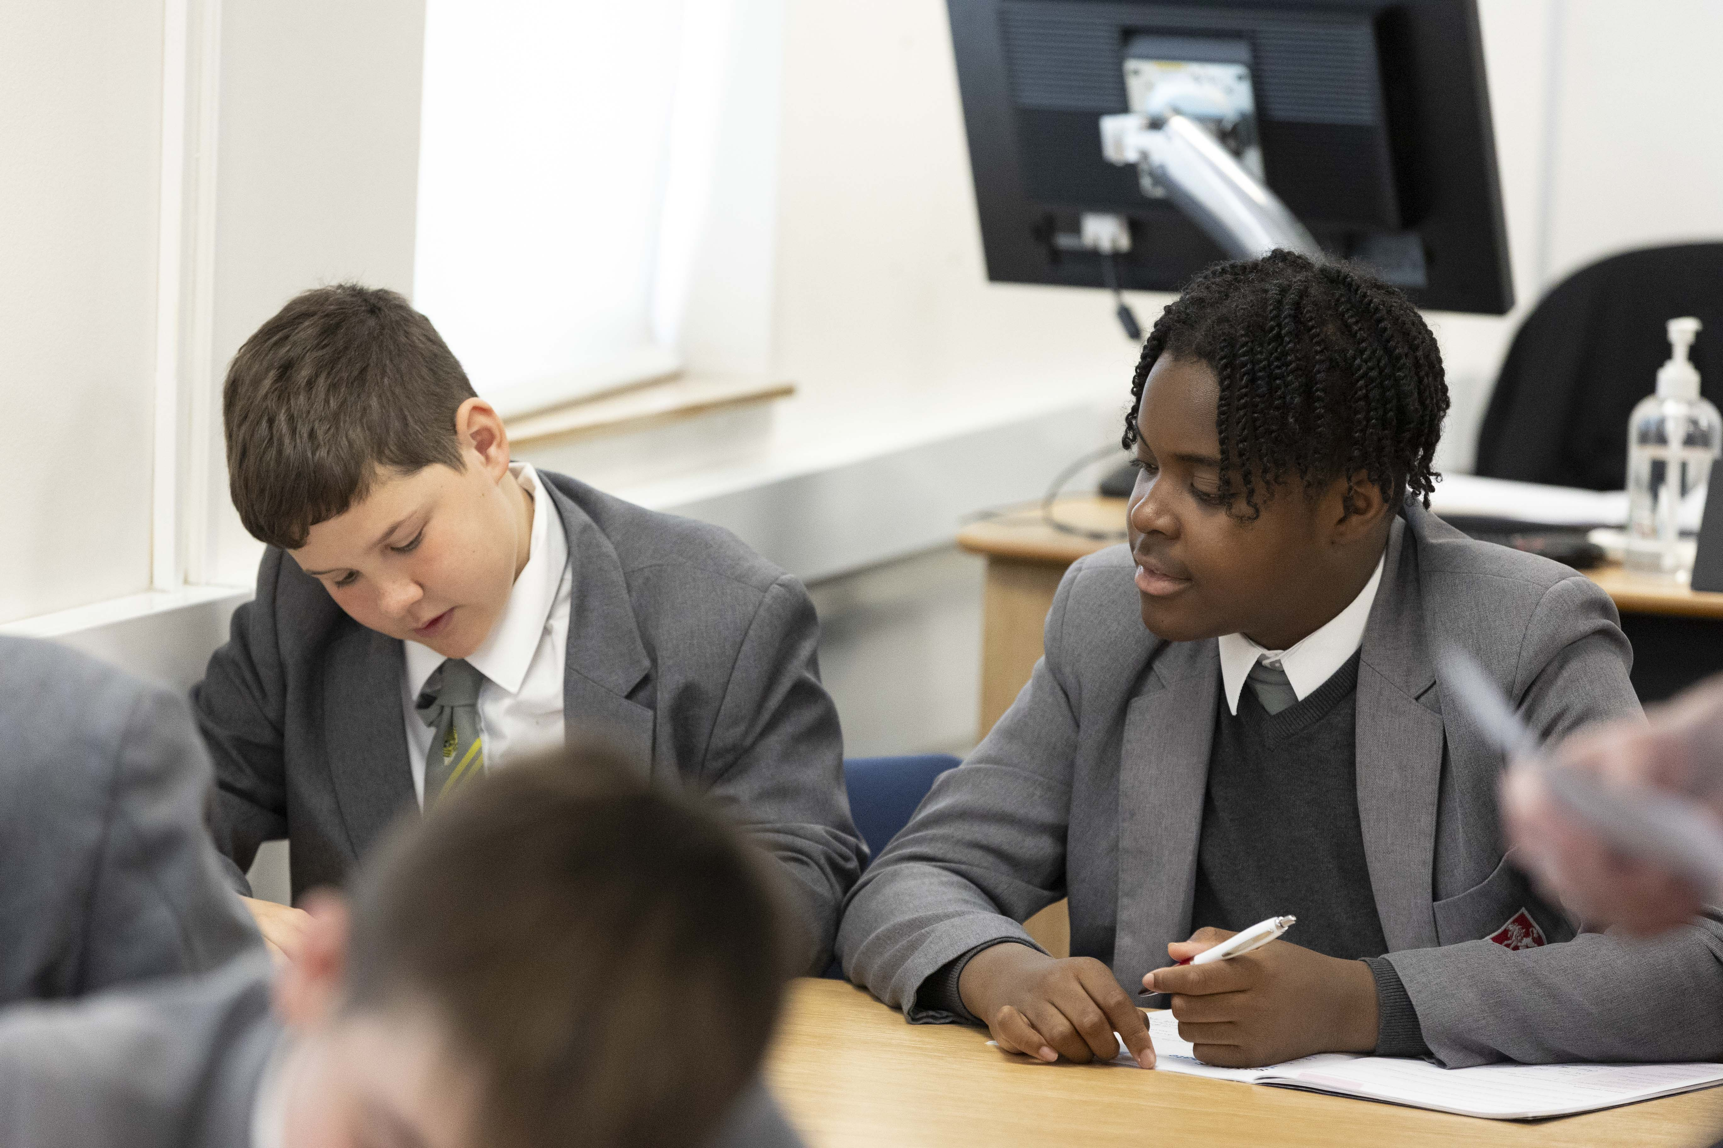
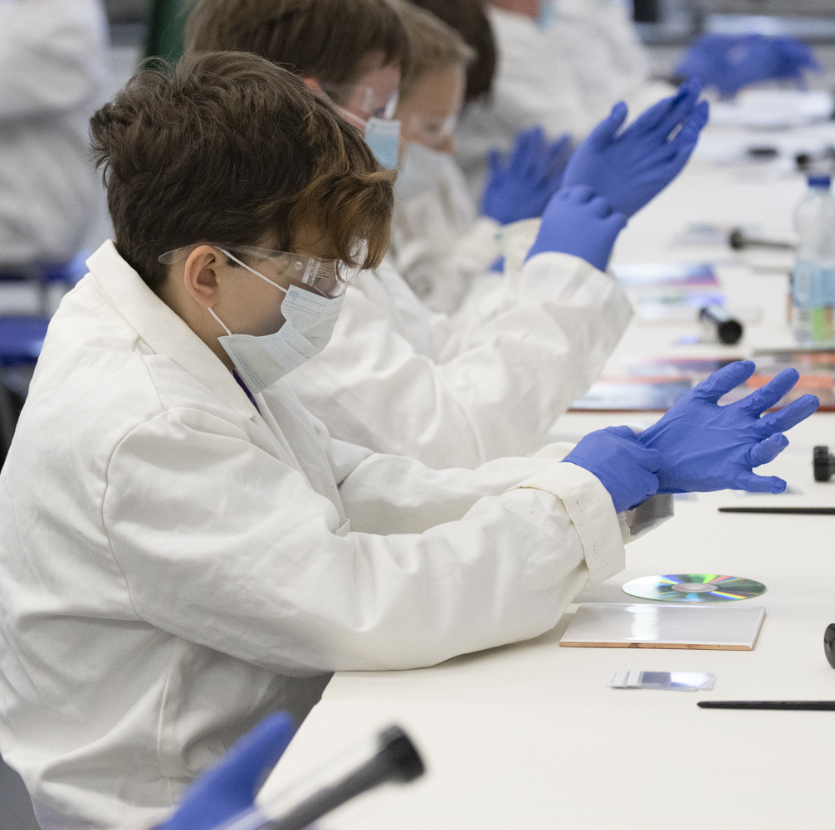
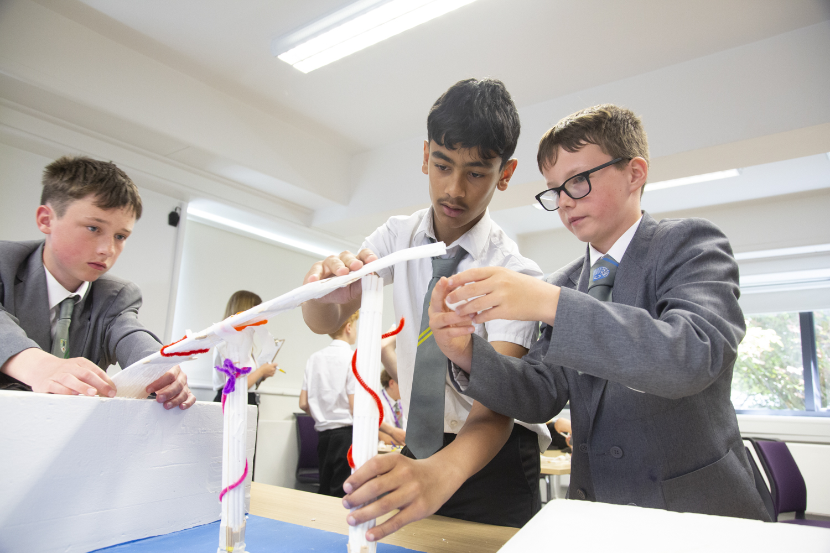
Educational ecosystem
“I have had multiple emails from parents and conversations with students raving about yesterday’s session.”- teacher
“This is exactly what I needed when I was at school” - parent
“My parents took a photo of [my poem]” - student
Notes:
The exhibition was a great way of fostering pride in students. Many parents showed a lot of pride in the students work and wanted to keep it. This was also referenced in some of the focus groups.The meaningful interactions between students, the school, and parents during the exhibition highlight the importance of creating a connected and supportive learning environment. When students see their work being valued not only by teachers but also by their families, it reinforces a sense of belonging and develops confidence and motivation.
However, we have had limited contact with the parents/guardians outside of the launch event and the celebration event. This shows in engagement in the survey whereby we only had one response. This response was positive. However, we need to look at new ways of engaging parents/guardians. We intend to write a newsletter to update parents on the findings and changes made by the students. We will also look at alternative methods for collecting parent feedback.
When I first started this, my mum was like, “Oh, I don’t want you taken out of lessons.” I said to my mum, “It is good. Trust me and then we’ll do the celebration and it will tell you more information about it.” And after, I spoke to her in the car about it and she was like, “You did it and I wanted you to do it now. Like, it’s worth you actually doing it, because it was actually quite good and opened you up a little bit.”And some of my work was up on the display and she was, like, really proud, yeah.

Slide 19
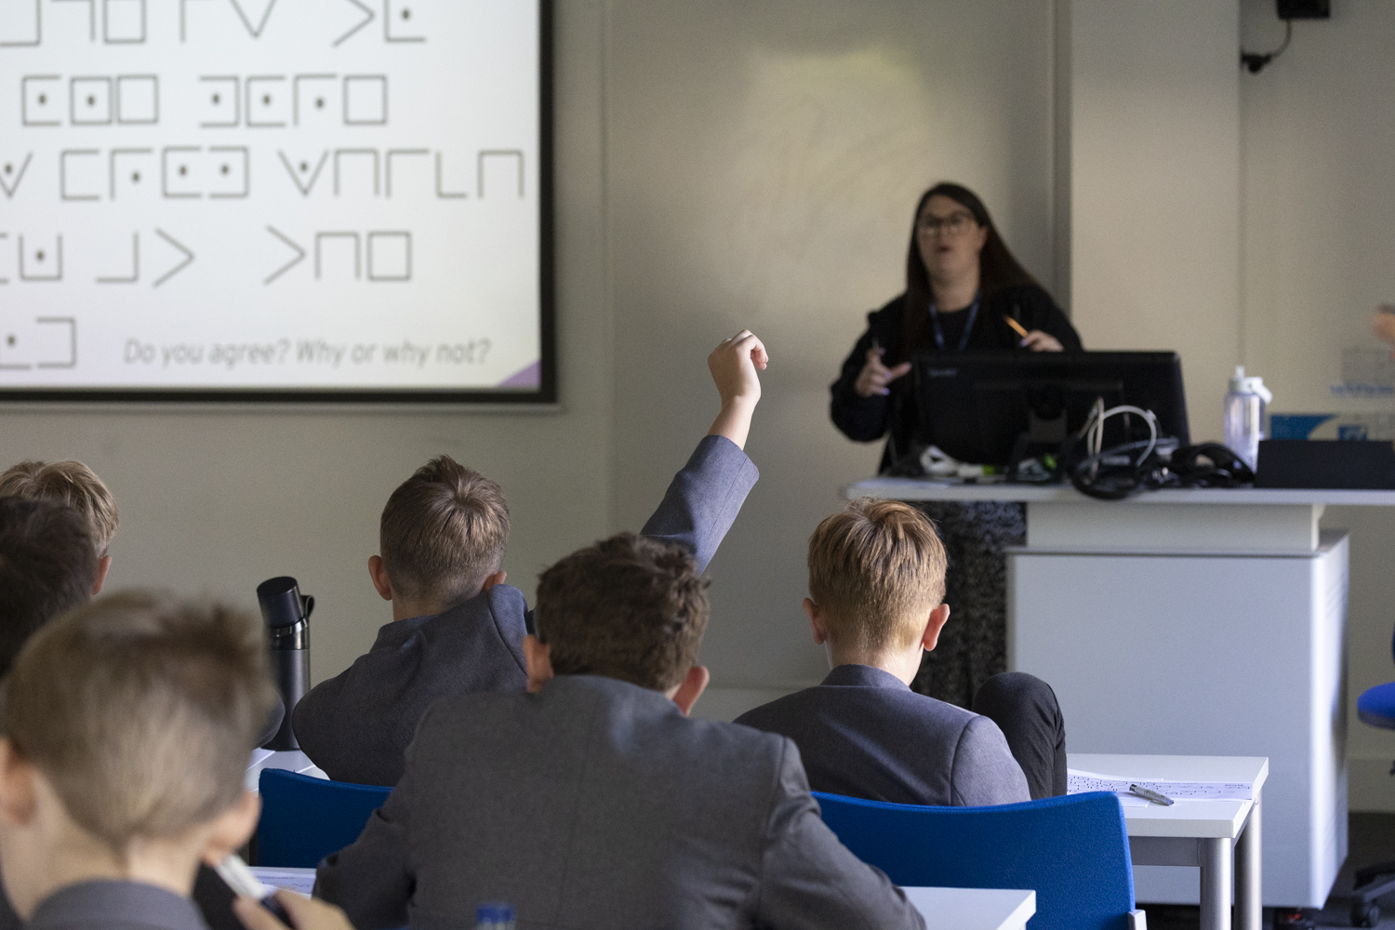
The School Perspective
“We have seen drastic improvements in their confidence and oracy skills, based on the sessions they have completed. This has been commented on by a number of teachers who have seen this grow in the classroom… We are only at the beginning of our journey as part of this programme, but I can already see the foundations of what is going to grow over upcoming years thanks to the skilled way they work with our pupils. The pupils within the groups are developing strong bonds and friendships and developing a deeper understanding of who they are.”
Notes:
The school noted that this

Slide 20
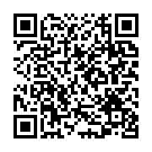
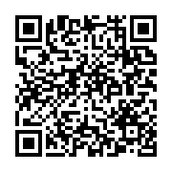
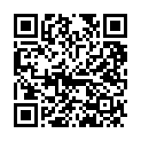
Reports
Evaluating the effectiveness of outreach targeting boys from low socio-economic backgrounds: A case study of Championing Boys
Championing Boys: Exploring masculinity, identity and expression through creativity
Parliamentary Enquiry: Boys’ attainment and engagement in education

