Slide 1


Learner Dashboards can they support student agency and empowerment?
Dr Liz Bennett, Principle Investigator
University Teaching Fellow
School of Education and Professional Development

Slide 2
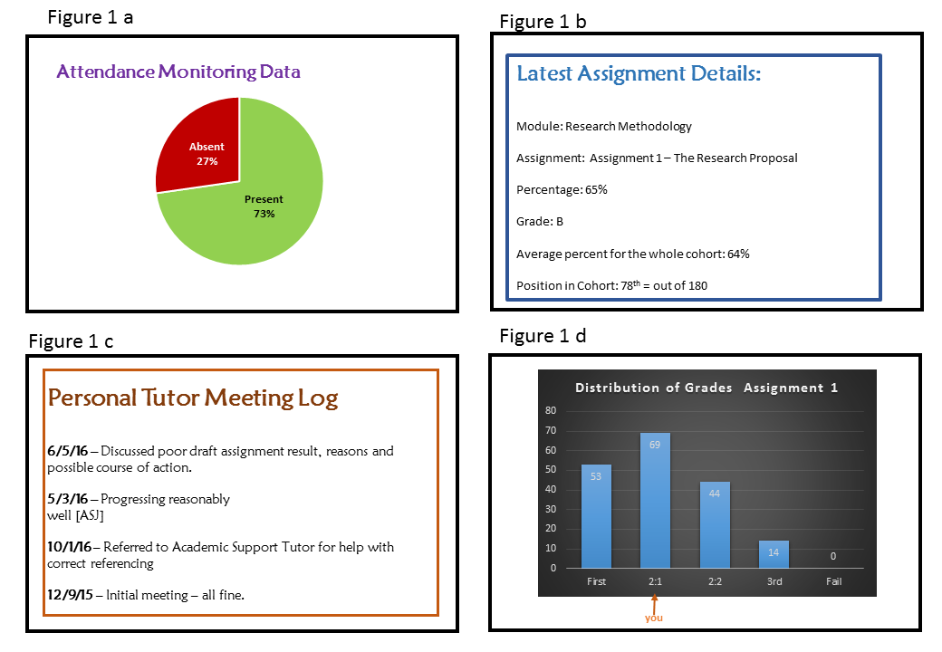
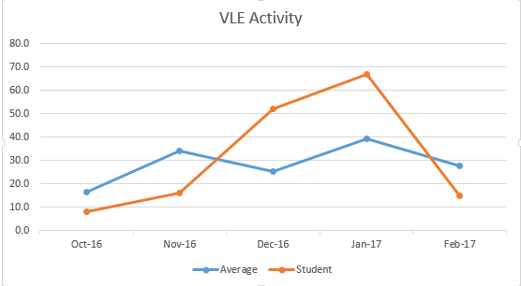
Learning analytics and dashboards
Average
You
You are currently on track for:
Fail Third 2:2 2:1 First
Notes:
Learner analytics is the collection and manipulate of data about students’ learning behaviours (attendance, visits to the library, which books they take out, their attainment etc, fine grained data from VLE).
Figure 1 is pie chart where behaviour about attendance is displayed
Figure 2 is graph where behaviour in relation to the cohort is displayed

Slide 3
Nascent: under theorised
Research has tended to see dashboards as technical artefacts, to pay insufficient attention students’ views (Bodily & Verbert 2017) and instead to focus on institutional perspectives and priorities such as student retention (Kitto et al 2017).
Gap in relation to understanding of student behaviours qualitatively
Notes:
The project examined students’ perspectives in terms of their feelings, experience and response to learner dashboards and thus took a small scale qualitative approach which fills a gap in the literature which has tended to focus on quantitative approaches to understanding dashboards
LA community tends to take quantitative approach looking at algorithms
qualitative data was needed to answer the questions raised by the quantitative studies

Slide 4

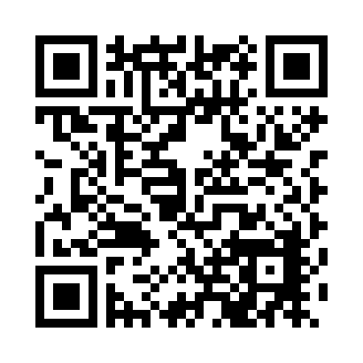
SRHE Scoping Study Methodologically
Aimed to develop a theoretically informed and critical understanding of undergraduate students’ response to receiving feedback on progress via a dashboard
With 24 undergraduates from across the cohort (1st to last)
Interviews
Notes:
Aim to understand, to scope the terrain of LA dashboards form student perspective, to take a critical perspective
To help to ensure the representativeness of the findings, data was gathered from nearly a whole cohort which prevents the distortion that arises from self-selecting samples. ( focus group followed by 2 rounds of data gathering)

Slide 5
Case study: Justine
High attaining student: got 75% in the most recent assignment
On-track score: 71% (first)
This assignment was pulling her ‘on-track’ score up
Came 15th out of 180 students in the assignment
How do you think she responded?
14 other people have still done better than me...I had thought I'd really, really topped it, I’ve maxed out here. And it’s taken away a bit from that feeling of elation…
I’m happy with that [mark of 75%] but I don’t think I need to know what position I’m in. Because I know that I’ve done better than the majority, so that’s fine… I was happy with the grade and I’ve done better than the majority I still think that [positional data] makes me feel I could’ve done better.
Notes:
(Justine 15th out of 178)
This case study illustrates the personal interpretations that people place on data
Thus shows the being… emotional work

Slide 6
Case study: India
58% in the assignment
On-track score: 61% (low 2:1)
This assignment was pulling down her on-track score
Came 16th out of 16 students in the assignment
How do you think she responded?
I think it gives me motivation to try harder
Me You pointed out straight away to the on-track slider
India Straight away, yeah. This is what I’m more focused on…I want to see the overall, where I am working at the moment.
Notes:
So we can see that dashboards are individually interpreted
Studies have shown that individual’s responses confound algorithm predictions

Slide 7


Models of feedback (Winstone & Carless 2019)
Old Paradigm New Paradigm
Turnaround time
Actionable comments
Detailed comments
Timed to enable application to subsequent tasks
Delivery of feedback
Consistency between modules
Opportunity for students to seek and generate feedback
Impact on student satisfaction
Impact on students’ learning
This Photo by Unknown Author is licensed under CC BY
This Photo by Unknown Author is licensed under CC BY-SA
Notes:
Old paradigm sees feedback as something that is given to students metaphor of post tray
Connectivity across modules

Slide 8
Models of feedback (Winstone & Carless 2019)
Old Paradigm New Paradigm
Turnaround time
Actionable comments
Detailed comments
Timed to enable application to subsequent tasks
Delivery of feedback
Consistency between modules
Opportunity for students to seek and generate feedback
Impact on student satisfaction
Impact on students’ learning
Notes:
Old paradigm sees feedback as something that is given to students metaphor of post tray
Connectivity across modules

Slide 9
Models of feedback (after Winstone & Carless 2019)
Old Paradigm New Paradigm
Values:
Efficiency
Timeliness
consistency
Values:
Impact on students’ learning
Student agency
Student empowerment
Notes:
Connectivity across modules

Slide 10
Next steps in SEPD: Principles and Practice
Four principles that enhance student agency and empowerment using dashboards
Customisable
Sensemaking
Actionable
Embedded
Notes:
Customisable by student
Foreground students’ sense making eg visualisations that help them, some liked graphics, some preferred narrative
Helps students to identify actionable insights eg drilling down into the data
Embedded ie need to be part of other dialogic processes

Slide 11

Customisable
Provides students with a sense of agency through enabling them to choose how they see their data displayed.
“The average of everyone else, doesn’t really mean anything to me personally. As long as I’m doing what I need to do.” (Malcolm)
Notes:
Justine too

Slide 12

Sense making
Making sense of the dashboard element.
“That was a thrown in essay. I knew it was going to be [lower than my average]” (Malcom)
“Students don’t want is ‘that tools are not personalized, “bloated ( = zillions of features we do not need), badly designed (features we need are not streamlined, easy to use, intuitive), and cumbersome [system]” (Dahlstrom et al., 2014, p. 10)
Notes:
Involves its clarity and purpose.
Also involves the students understanding what the purpose of the data is and that it is telling them something that they think is relevant. This involves relating the dashboard element to the student’s understanding for instance is the data correct, how should I interpret its meaning, Students have a wealth of knowledge about lives as students to bring into the interpretation process.

Slide 13

Actionable insights
Helps students to make informed decisions about their learning behaviour ie to identify things that they might do.
“On my average. I’d want to get that up a bit, because I don’t really like being where I am. “ (Lydia)
Notes:
Tells them something but not what to do

Slide 14

Embedded
the extent to which the element supports a quality relationship between students and tutors (Ajjawi & Boud 2017, p.254)
“we usually do tutorials when we have assignments due, to talk about drafts and things like that. …you’ve got that time to prepare yourself for whatever questions you know they’re going to ask you. And then the feedback is good as well.”
Notes:
Educational alliance from psychotherapy
Of course this isn’t really clear from a display as it is about the relationships that underpin the LD. However making it a criteria for the LD emphasises the socio cultural dimension of LD design.
Strong sense of relationship and working together with tutor evident (small cohort)

Slide 15

Summary
Dashboards were
Welcomed by students
Showed potential to be motivating
Not predictable
So foreground the human aspects eg agency, empowerment, dialogue

