Slide 1
Creating a new university student success strategy: Using Jisc Beyond Blended Resources
Julie Blackwell Young
Head of Teaching Quality and Learning Enhancement (Abertay Learning Enhancement Academy) &
Luke Millard
Dean of Learning and Teaching

Slide 2
Context
Previous strategy was Learning Enhancement Strategy
2020-25
Needed a new one to also align with new institutional Strategic Plan
Changes in landscape since 2020 (2019 when strategy was actually written)

Slide 3
Consultation themes
Transitions & Outcomes
Articulation and College alignment through partnerships
Curriculum Enhancement & Quality
Curriculum Design & Structure
Themes – EDI, Sustainability, Global, AI
Designing the Learning Environment
Purpose of Physical Estate
Retention
Student Experience, Purpose and Community
Academic and Pastoral Support
Employability, jobs and mentoring
Social impact and CPD
Assessment and Feedback
Students as Partners
Wellbeing and compassion
Staff Development and Scholarship
Community Engagement (International and local)
Equity and Purpose of Digital Estate

Slide 4
Consultation
Two consultations per theme
One online and one in-person
Also an asynchronous consultation created using Adobe and Padlet
Curriculum Enhancement & Quality/Learning Environment
Used Jisc Beyond Blended resources to gain evidence
Part of pilot of 17 universities using resources
Jisc Pilot Aims
Understand how higher education providers (HEPs) are using the materials that make up the rethinking curriculum and learning design guide to support their strategic goals
Gather information about different approaches to developing institutional strategies for blended learning
Facilitate the sharing of approaches to curriculum and learning design
Find out what further support and guidance HEPs need from us to further develop their practice
Develop case studies and briefings of the learning from the pilots to inform sector understanding on designing blended learning

Slide 5
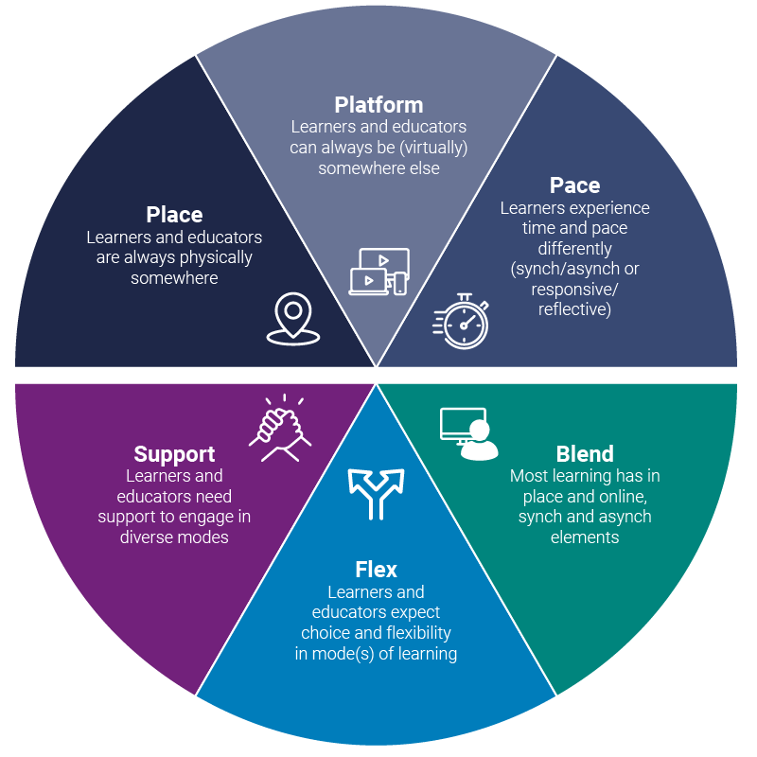
Based on the six pillars for designing ‘beyond blended’ learning

Slide 6
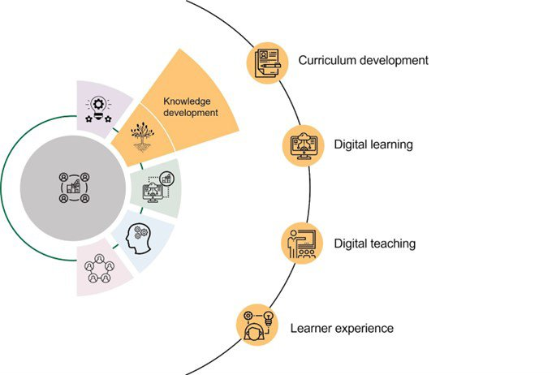
What did this look like
Prompts from Strategic and Curriculum Lenses, aligned to Jisc’s Framework for Digital Transformation in Higher Education

Slide 7
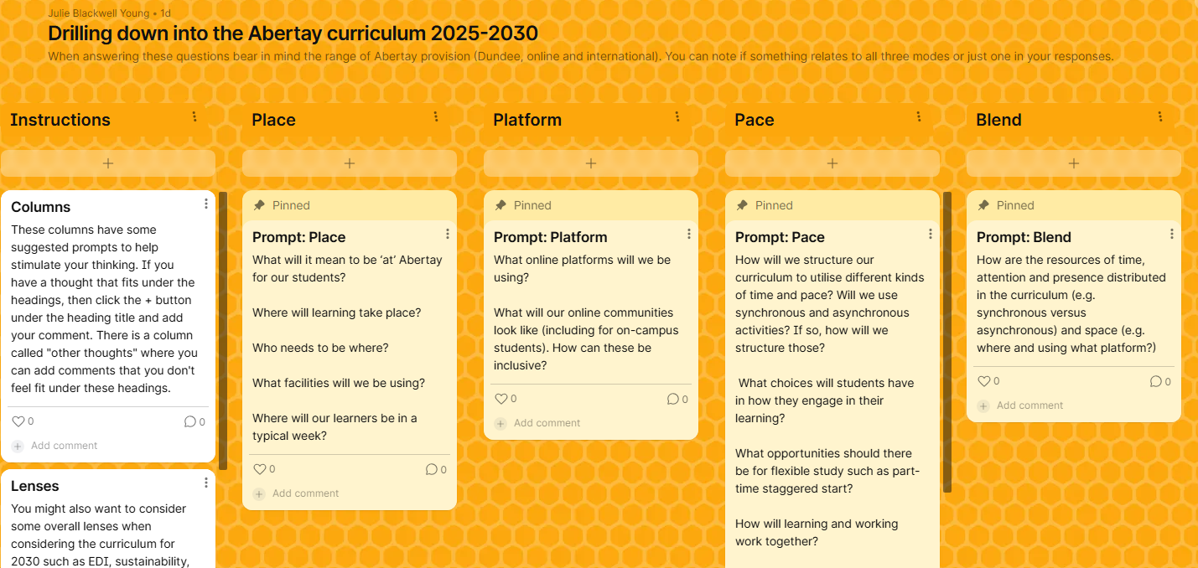

Slide 8
Outcomes
Made my life much easier!
Structured approach aligning with institutional priorities and sector resources
Rich set of data from consultation
due to ease of prompts
And relatability of prompts
Would recommend for similar exercises

Slide 9


j.blackwell-young@abertay.ac.uk

