Slide 1




Data-Driven Insights and Cross-Comparisons into Student Perceptions of Reflective Practice
Alison Cullinane, Sarah Gretton, Ruth Deighton, Niccolo Tiango and Nigel Page
HEIR Network Conference 2025 | Norwich
Notes:
1

Slide 2
Overview
🎓 We focus on credit-bearing reflective portfolios in four science programmes across three UK universities
🔍 Our case study 1) evaluates the effectiveness of different portfolio formats in bioscience programmes for skills development and 2) explores student perceptions of reflective practice
📊 We provide insights, challenges and recommendations for future practice

Slide 3
Importance of Reflective Portfolios in Student Development
🔍 Limited Skills Awareness Many students are unaware of the skills they develop in higher education and how these relate to their future careers.
🧠 Reflection Enhances Learning Reflecting on experiences helps students learn more effectively.
🎯 Confidence Through Reflection Reflection supports well-being and goal-setting and turns professional development into action.
📊 Progress Tracking Tool Need for a shared tool to help students and tutors monitor progress especially when working with large numbers of students.
Limited research in the biosciences sector – Portfolio project

Slide 4
Case Study Populations
 | University of Edinburgh (Biological Sciences) | University of Edinburgh (Medical Sciences) | University of Leicester (Natural Sciences) | Kingston University London (Biosciences)
Students | 1st year undergraduate (n=340/300) | 4th year undergraduate (n=45) | 1st year undergraduate (n=15) | 1st year undergraduate (n=330)
IMD* Q1 & Q 2 | 3% | 3% | 42% | 58%
BAME students | 37% | 20% | 60% | 86.3%
First in family | 9% | Unavailable | Unavailable | 45%
Age <21 | 99% | 40% | 93% | 93%
Portfolio (%) | 25% | 16% | 3% | 8%
Assignment type | Solo assignment | Solo assignment with guidance | Solo assignment | Solo & peer assignment supported with tutors
Delivery | Scheduled curriculum embedded portfolio workshops | Scheduled informal drop-in sessions (optional) | Scheduled portfolio workshops & individual personal tutor meetings | Scheduled curriculum embedded workshops with tutor support

Slide 5
Project Methodology and Data
Questionnaires and interviews investigated perceptions of reflective practice & skills mastery and how it changed over time
Questionnaires | Edinburgh (BS) | Edinburgh (MS) | Leicester | Kingston
Pre-Questionnaire | 172 (51%) | 20 (44%) | 15 (100%) | 80 (24%)
Post-Questionnaire | 56 (18%) | 11 (24%) | 5 (33%) | 15 (4%)
Interviews | Edinburgh (BS) | Edinburgh (MS) | Leicester | Kingston
Interviews | 3 | 2 | 2 | 3
Analysis: Questionnaires used qualitative and quantitative analysis techniques.
Interview transcripts were coded using content and thematic analysis to develop themes that were general to all student experience and specific to each institution.
Notes:
5

Slide 6
p = 0.0357
*
p = 0.0496
*
p = 0.021
*
p = 0.0003
*
Pre-
Pre-
Pre-
Post-
Post-
Post-
Pre-
Pre-
Pre-
Post-
Post-
Post-
1. Yet to develop, 2. Developing, 3. Proficient, 4. Mastery
Most skills improved across all institutions
ED showed the most consistent improvement across all categories. Four were significant using Mann-Whitney U test
LR had notable declines in Tolerance for Stress and Creativity, but a strong gain in Organisation.

Slide 7
p = 0.0014
*
p = 0.006
*
1. Totally disagree, 2. Disagree, 3. Agree, 4. Totally agree
KU: All statements declined slightly.
ED: Mixed results, with some improvements (e.g., reflective capabilities, reflecting on learning, which were both significant using Mann-Whitney U test).
LR: Mostly declines, with two slight improvements.

Slide 8
Student Portfolio Ratings by Institute
Institution | Edinburgh (BS) | Edinburgh (MS) | Leicester | Kingston
Portfolio rating | 5.54 | 7.64 | 5.60 | 5.93
Average student ratings (out of 10) on their institutions’ portfolios in supporting their development.

Slide 9


Interview findings
General findings
Specific findings
The portfolios help students to develop a sense of self-awareness (skills development | strengths and limitations | self-regulation and problem-solving skills).
Reflecting becomes easier over time/more experience.
Clear guidelines on the purpose of the portfolio.
Facilitates future/career –thinking/progress tracking.
Challenges with mind-set towards the portfolio and building community around the portfolio
Emotional journey
Builds staff & student community as portfolio sessions are a primer for discussion.
Edinburgh
(BS)
Leicester
Challenges with team-work/peer reliability
Cultural background plays a role in mind-set.
Kingston
Edinburgh (MS)
Capstone assignment provides perspective on skills accumulated over time.
Desire for more experience with reflection in earlier years.
Notes:
9

Slide 10
Working conclusions
Key Findings
Skill improvements were observed at each institution, with ED showing the most consistent rise.
Reflective attitudes declined post-questionnaire at KU and LR, while ED responses remained more stable.
Each institution showed reduced engagement with deeper reflection (e.g., self-awareness, empathy and strategy evaluation).
Challenges
Inconsistent engagement and response rates across pre- and post-questionnaires.
Institutional differences may have influenced response patterns and data reliability (e.g. the weighting of reflective portfolios across courses).
Varied mindsets toward reflection, shaped by cultural backgrounds and differing understanding of its purpose.
How best we can learn from each other.

Slide 11
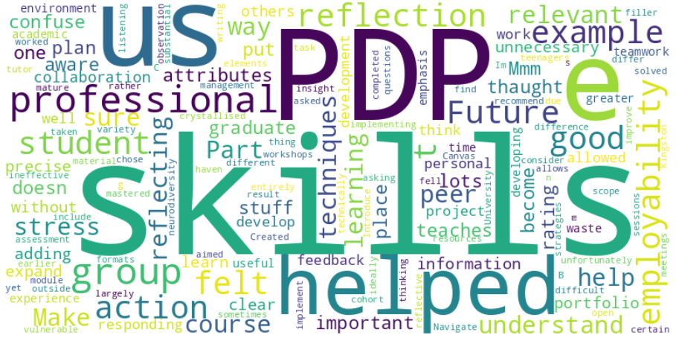
Thank You and Questions
Nigel Page | Kingston London University| n.page@kingston.ac.uk
This research was funded with a PTAS award from the IAD at University of Edinburgh

