Slide 1
Beyond awarding gaps: developing a value-added metric to understand graduate outcomes in UK Higher Education
Matt Hiely-Rayner (University of Sussex)
Mohammed Yakub (Buckinghamshire New University)
Benedict Watling (Buckinghamshire New University)
Notes:
Who is speaking to this slide?

Slide 2



Introduction
Who are we?
Mohammed Yakub
Buckinghamshire New University
Data Analyst
Matt Hiely-Rayner
University of Sussex
Director of Strategic Planning & Performance
Benedict Watling
Buckinghamshire New University
Business Intelligence Manager

Slide 3

Introduction
Background to Value Added
Methodology
Findings
What next?
Notes:
Background to value added – talking through what’s come before and how we got here
Methodology – we’ll be talking you through exactly how to understand our scoring and why it is relevant
Findings – we’ll be looking at the key findings within both demographic groups and when applying our methodology to individual Universities
What next? – where do we go from here? There’s always improvements to be made and we’ll also be talking about the key take-aways from our presentation

Slide 4
Introduction
Background
Value added scores – the origin story
  Guardian University Guide
  Degree awarding gaps
HEIR 2023
  Concept of VAGO: Value Added scores for Graduate Outcomes
HEIR 2024
  The domino effect
HEIR 2025: introducing....... VADO, DOGO and VA Impact
Notes:
3 mins
Designed in 2006 for the Guardian University Guide, value added scores were introduced as an improvement on good honours rates, which reward the awarding of firsts and 2:1s – the highest degree classifications in the UK – even though the qualifications that students enter University with are by far the greatest determinant of this measure of success. Value added scores take entry qualifications and tariffs into account to give each student a latent probability of success and, when the students are successful, they score according to this likelihood.
Subsequently, at Kingston University, we adapted these value added indices to also account for subject mix and then used them to express the degree awarding gaps that are apparent in UKHE. Kingston was especially keen to address the awarding gaps between white students and black students, and using value added scores acknowledged the benign factors that contributed to this. But crucially, instead of allowing these factors to be used to dismiss the challenge, value added scores showed that only about a quarter of the gap was attributable in this way, and three quarters was a challenge that the University needed to solve.
Next stop BNU, a University in High Wycombe that has a strong focus on delivering vocational courses that prepare graduates for entry into the professions. With a naturally diverse student population and an Impact strategy that made transforming lives of students the focal point of the University, what measure would capture the difference the University was making? Value Added scores showed that BNU has its challenges with disparities as well, particularly an Asian attainment gap, but frankly, even if our graduates secured good classifications, they were coming to us to transform their prospects from being locked out of professions to having the keys to enter.
The Office for Students had attempted something that went further than VA scores with its proceed metric, and Rachel Bowden and I were convinced we could do better, coming up with the idea of VAGO: Value Added scores for Graduate Outcomes. Wouldn't this be marvellous as a concept of educational gain in future TEF submissions? Might it serve as a tool for institutional research that acknowledges different prospects at the point of entry, targeting interventions and providing a foundation from which impact is studied? Could we get some really powerful marketing messages, saying that students who come to BNU are more likely to break into the professions than if they go anywhere else?
At the 2023 HEIR conference in Kingston we unveiled the VAGO scores. Acquiring data for the entire sector had been very difficult, and what we received had some issues, but it was enough to realise the concept. And sure enough it showed many of the disparities that you would expect: students who reported that they had autism or issues relating to social communication had very low VAGO scores, students from neighbourhoods with low participation, with indices of multiple deprivation in deciles 1-4, from socio-economic groups 6-8 all had low VAGO scores, as did students of Bangladeshi heritage. It was interesting, but did not reveal much about where the disparity was happening.
At the 2024 HEIR conference Mohammed stepped up with his domino effect presentation, showing how disparities at different stages in the student journey compound into one another. This was key to understanding where we wanted to take VAGO next: an examination of interim stages to show where disparities take place and their severity. We think this is important to understanding where institutions are addressing and amplifying disparities.

Slide 5
Methodology
Methodology
Similar methodologies for all of these concepts:
  Define a population with a binary success outcome
  Assign each member of that population with a probability of success
  Express the extent to which subpopulations exceed expectations
 | VADO | VAGO | DOGO
Population | FT first degree qualifiers with classified degrees | Respondents to Graduate Outcomes Survey | Respondents to Graduate Outcomes Survey
Binary success outcome | Good honours (first or 2:1) | Positive career prospects | Positive career prospects
Determinant of probability (in addition to subject) | Entry qualifications and age on entry (qualtype, tariff, grades) | Entry qualifications and age on entry (qualtype, tariff, grades) | Degree Classification
Notes:
2 mins
Define VAGO and note addition of interim VADO score
Note use of entry qualifications and subject in expectation
Combination of VAGO and VADO into one score and impactful number and letter
How to read this with 1 or 2 examples on a new slide
Define VAGO and note addition of interim VADO score
Note use of entry qualifications and subject in expectation
VADO scores aren’t the same as value added scores because they are only for respondents to GOs surveys

Slide 6
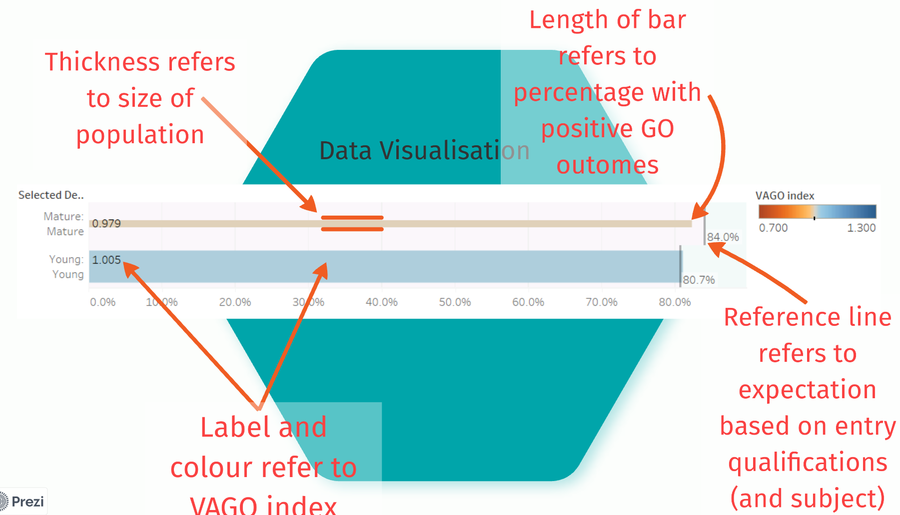
Visualising value added indices

Slide 7
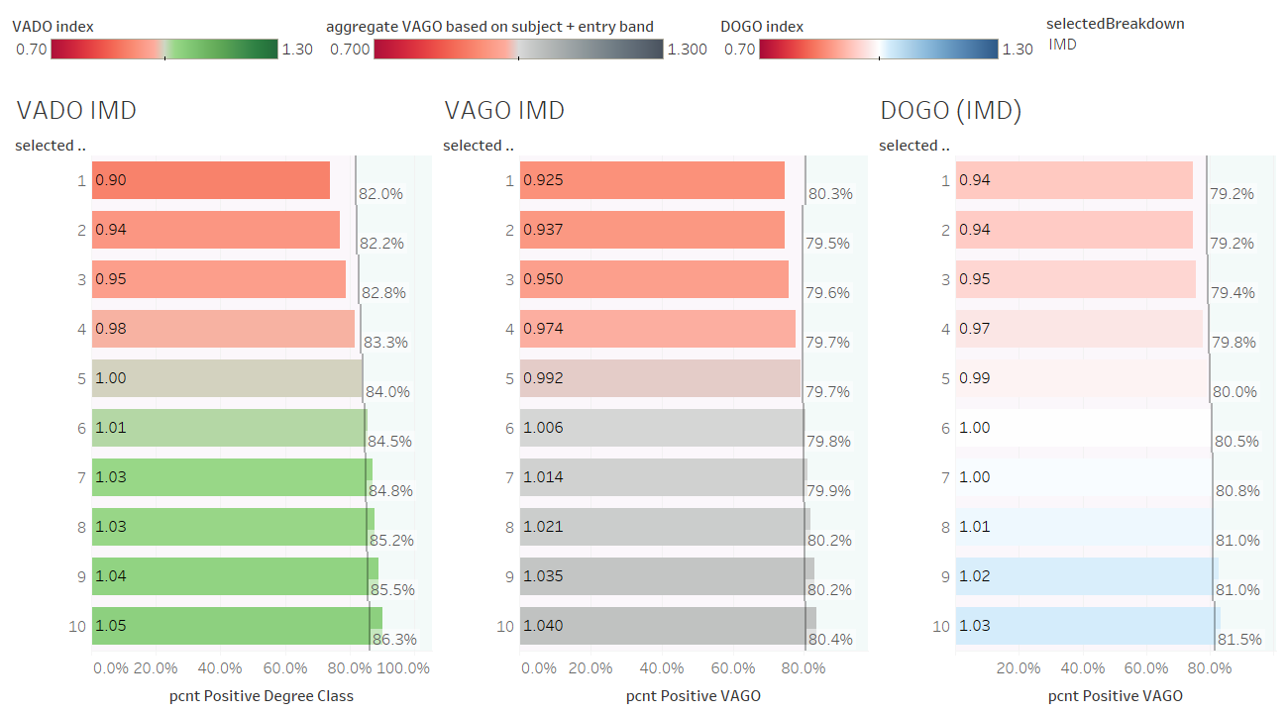
Understanding where disparities take place
Notes:
This slide is very revealing with regards to the outcomes for students from different types of neighbourhood. The indices of multiple deprivation vary in definition across the nations of the UK but here all are depicted according to the decile of relative deprivation in the neighbourhoods that students come from. There aren't many students in HE from decile 1 – there is an access and participation problem there – but for those who do enter HE, do they get the same transformative outcomes as students from less disadvantaged neighbourhoods. The central column here says no: a VAGO index of 0.925 indicates that this group of students are falling short of expectations in terms of graduate outcomes, given the subjects they take and the grades they enter with. But why is this? Is it that this group of students perform well while in HE but then suffer disadvantage when taking the first steps into their careers, due to comparative lack of mobility, social capital or due to prejudice? Or do they perform less well in HE and see the consequences of this carry through beyond their time in HE? In this case, there are indications of the latter: the index in the column on the left, at 0.901, is lower than the one on the right, at 0.937. The index on the left is VADO, so these students are falling shorter of expectations while in HE than they are after HE, when their degree class and subject is determining their likelihood of success.

Slide 8
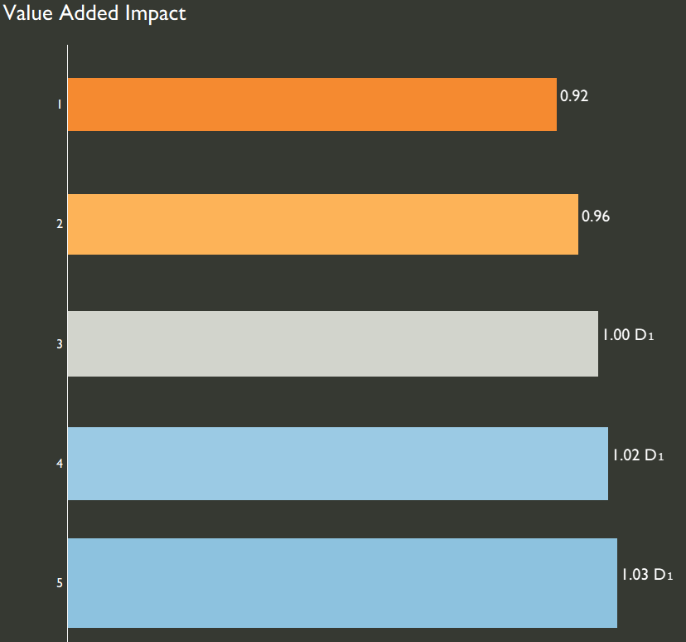
IMD
Value Added Impact Score produced to simplify
Average of VADO and DOGO
Letter and number denotes which part has more impact
  D shows that the time at University had the most impact on the score (either positive or negative)
  G shows that the time after the student left University had the most impact (either positive or negative)
  No letter means similarly impactful
The number beside the letter shows the extent of the impact, on a scale of 1-5
Notes:
Idea that it creates one score to simplify the process
Takes the average of VADO and DOGO where VADO represents the impact of the student’s time at University (difference between expectation based on tariff and actual)
DOGO is impact of the 15 months after graduating. Student receives a new expectation based on degree outcome and subject and a new outcome based on graduate outcomes.
Graph:
Clearly a gap between IMD1 and IMD5. This is not a surprise based on what we’ve just seen and what we know of APP in the sector.
For IMD1 and 2 there is no letter beside them. This shows that they are disadvantaged all the way through their time as shown in Mohammed’s domino effect presentation last year;
Students from more deprived areas are have lower tariff when they join University, they get lower results when they finish University, and even after recalibrating expectations based on their degree outcomes, they get lower graduate outcomes.
It is not one of these in particular that impacts these students
Students in IMD 3, 4 and 5 are exceeding expectations as represented by their score being above 1. The reason for this is shown in the ‘D’ next to their name, D1 shows that their degree outcomes were slightly above expectation and this had a positive impact on their overall Value Added Impact Score.
We will go through a few more examples of this now that the core concept is explained.

Slide 9
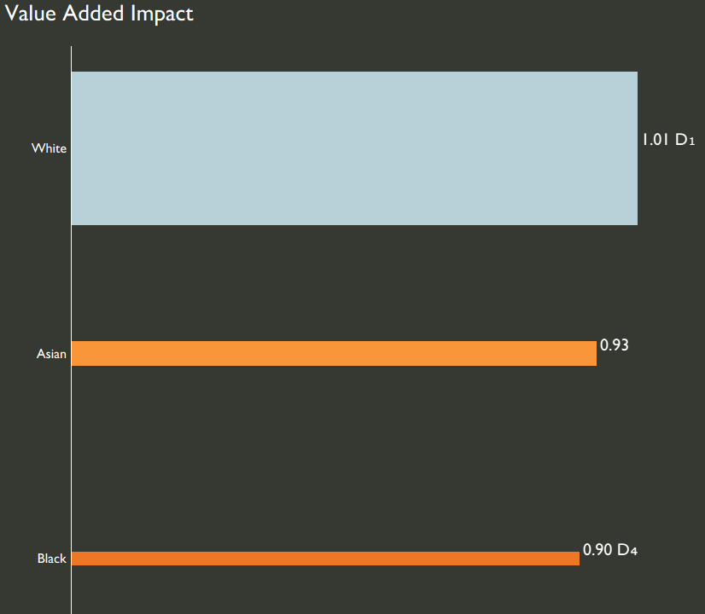
Findings
Ethnicity
Value Added Impact split by Ethnic Group
White students exceeded expectation slightly due to their Degree Outcomes
Asian students fell quite short of expectation with 0.93 Value Added Impact.
Black students fell even further from expectation with 0.9 D4 Value Added Impact.
The gaps seen are more meaningful as they account for subject mix and tariff.
Notes:
We’ve already started to go through the findings as part of the methodology. We’re now going to go through a few more interesting aspects that we’ve found, covering both demographic characteristics followed by sector specific information.
All findings in this presentation are looking at FTFD across a 4 year aggregate from 18/19 to 21/22
Asian students fell quite short of expectation. They fell equally short of expectation in both degree outcome and in their graduate outcome given their degree outcome.
Black Students fell even further from expectation but whilst Asian students were equally affected, the D4 shows that Black students were especially disadvantaged.
This means that despite comparing students on the same subject and starting University with the same qualifications, there is still a gap and this is more meaningful to policy because we should be helping all students achieve expectations.
This information is useful especially for an individual institution because we can understand the areas to focus on and more specifically where the University is contributing to the disadvantage seen among student groups. There is nothing to hide behind in terms of subjects or tariff.

Slide 10
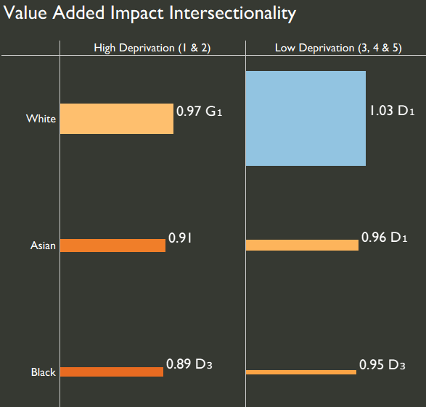
Findings
Ethnicity and IMD
Intersectional split with IMD is revealing
Across all ethnic groups, students from low areas of deprivation (IMD 3, 4 & 5) are much closer to their expectation or exceeding.
Still a gap within IMD groupings but has shrunk
There is a 14% gap between Black students from areas of high deprivation and white students from areas of lower deprivation.
For both high and low deprivation areas, Black students are disadvantaged by their degree outcome.
Notes:
Comparison to Awarding gaps and Progression gaps
Intersectional split with IMD is revealing
Across all ethnic groups, students from low areas of deprivation (IMD 3, 4 & 5) are much closer to their expectation or exceeding.
Worth noting that there is still a gap between ethnic groups within the IMD groupings but this has shrunk.
There is a 14% gap between Black students from areas of high deprivation and white students from areas of lower deprivation.
For both high and low deprivation areas, Black students are disadvantaged by their degree outcome.

Slide 11

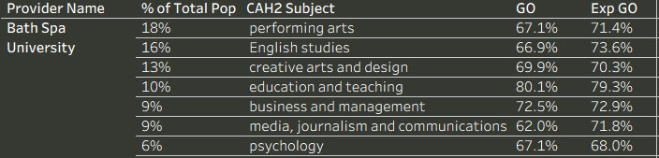
Findings
Provider Examples – Varied Subject Mix
Universities with relatively varied subject mixes clearly show the effect of GO performance on VA Impact.
University of Strathclyde - 27th out of 133 major Universities for GO, but 55th for VA Impact.
  High GO (84.9%)
  Medium VA Impact (1.00 G₂)
  Lettering shows GO is pulling the score up as expected
Bath Spa University - 126th out of 133 major Universities for GO but 75th for VA Impact.
  Low GO (68.5%)
  Medium VA Impact (0.98 G₃)
  Lettering shows GO is significantly pulling the score down as expected
Notes:
Explain Bullet points – 3 each
Both these examples show a very varied subject mix, with the top 3 subject areas making up less than 50% of the total population.

Slide 12

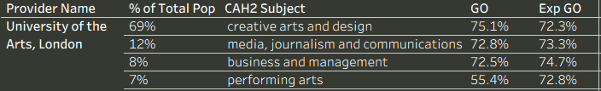
Findings
Provider Examples – Specialist Subject Mix
On the other hand, Universities delivering subjects that typically have extreme GO scores (e.g. medicine with high GO or arts with low GO), see this reflected in their VA Impact score, levelling the playing field.
St Georges - 3rd out of 133 major Universities for GO, but 46th for VA Impact.
  High GO (94.1%) - focussed on health-related subjects.
  GO subject expectations are very high though so results in Med VA Impact (1.01).
University of the Arts, London - 103rd out of 133 major Universities for GO, but 37th for VA Impact.
  Lower GO (73.6%) – focussed on arts subjects.
  GO subject expectations are low so results in med-high VA Impact (1.02).
Notes:
Contrasting this with specialist universities that consist of mostly one subject that either has very low or very high Grad outcomes, such as medicine with 99% Grad Outcomes. Thes universities are typically at either end of the league tables for Grad outcomes, but we will show you how they are treated in the VA Impact metric.
Explain Bullet points: 2 each
Universities focussing on medicine such as St-Georges with 99% studying health related subjects, typically perform top in the league tables for Grad Outcomes. Arts universities, such as U of the Arts London with over 75% studying arts subjects, end up at the bottom of the league tables for graduate outcomes, under no fault of their own, .
This score incorporates expectations based on subject and entry tariffs, levelling the playing field and approximating institution’s impact on performance.

Slide 13
Summary
What next?
At BNU
  We will use this data to better understand where we need to focus support
For the sector
  The sector can use this metric for both APP and TEF analyses
Further analysis – improved entry qualification calculation
  Found that Scotland is outperforming the whole UK due to differences in tariff profile.
  Other issues with qualifications that can be improved
  Incorporate age into model alongside subject and tariff as in current model
Key take-aways
  Value Added Impact as a new metric
  When the playing field is levelled there are still significant gaps between demographic groups
Notes:
At BNU We do often have very different outcomes depending on subject or entry qualification so this is a valuable tool to evidence the gaps that need closing and where we are not enabling students to their full potential. For us, playing around with it, it comes as no surprise that students are impacted most by their degree outcome rather than their graduate outcome, this is something which we are working to improve.
For the sector – APP and TEF analyses. To better target and evaluate for APP and to fully appreciate excellence in TEF – your institution may only just be meeting the baseline for Progression but if your students were all expected to miss the baseline then this is a real achievement! This ties in with what Mohammed was showing.
Further analysis – improved entry qualification calculation
Key take-aways
To round off – we’ve developed VAGO one step further to show the expectation given the degree achieved. This has been combined into a single VA impact score for readability.
This has been shown both through demographic examples and through provider examples where providers change position when taking into account the expectation based on tariff and subject grouping
If you take away one thing from this presentation, it’s that even when the playing field is levelled, when all other factors are removed from our analysis, we are still seeing significant gaps between ethnic groups and deprivation quintiles and for the most part this is the result of their time at University. If we needed any additional call to action to make improvements here then this is it.

Slide 14
Thank you for listening.
Any questions?

