Slide 1
Inclusive Admissions, Recruitment, and Marketing: the importance of a co-ordinated approach
Scott Knight- Head of Outreach
Notes:
.Intro
We'll be giving an overview of the Inclusive ARM strategy, which is how we intend to raise recruitment and reputation of UEA amongst disadvantaged and underrepresented groups, and therefore create a more diverse student body and support our ambitions for growth.

Slide 2
Regional context
Norfolk is the 8th lowest county in England for HE progression amongst disadvantaged students (3x less likely than a student in Westminster)
Consistent gaps in attainment from Primary school for all students AND disadvantaged students, the biggest predictor of HE progression
Higher proportion of students in rural areas – 36% in Norfolk and Suffolk vs 14% nationally
Notes:
Universities not for everyone: levelling up and who is missing out on higher education in England (educationopportunities.co.uk)
Norwich- rank 388 out of 543 on opportunities index
21.4 month gap at KS4 attainment for disadvantaged pupils, and 4.4 grades at 16-19

Slide 3
APP Access targets - our mission is to…
Increase the proportion of students eligible for free school meals in our region accessing higher education with the ultimate goal of achieving the sector average.
Ensure that care experienced and estranged students have equal opportunity to apply to UEA.
Remove barriers to successful outcomes to applications from underrepresented student groups, including mature students and students with vocational qualifications.

Slide 4

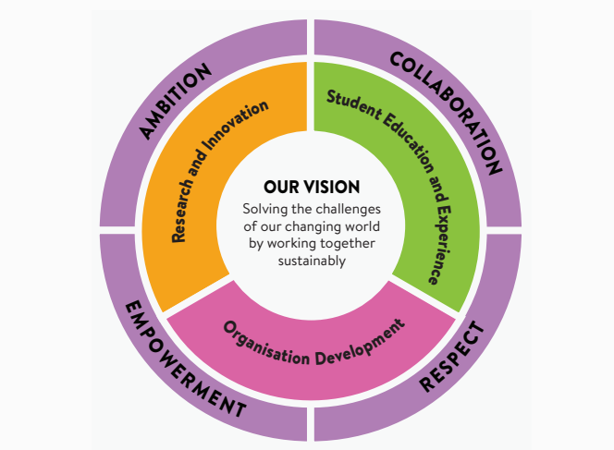
Student education and experience
Raise outcomes
Widen access and success
Grow student numbers
New teaching model
Invest in staff
Notes:
We are fully committed to serving the needs of our regional community and want to do everything we can to raise local aspirations and skills, and through them deliver economic advantage. We will enhance our widening participation activities to recruit more students from diverse backgrounds and deliver inclusive opportunities and support, enabling success for all throughout their learning journey.

Slide 5
The inclusive ARM strategy will…
Target those hard to reach
Recognise potential through accessible courses
Champion diversity
Principles
Interventions are evidence led and will be evaluated year on year
Collaboration, not duplication
Inclusive and exclusive activities
Fixed term funding to support embedded inclusive interventions as BAU
Notes:
The plan ensures:
Hard to reach potential students from underrepresented groups are reached by UEA’s recruitment and marketing approaches
Admissions, Recruitment and Marketing strategies represent and champion the diversity of UEA’s student body and local/regional recruitment market
UEA courses are accessible to all potential students with the potential to succeed and remove unexplained offer making gaps for specific student groups
s

Slide 6
Operational plan at a glance
Focus areas | Geo-targeted recruitment and marketing | Integrated UG awareness & recruitment campaigns | Inclusive admissions | Applicant support | Inclusive clearing strategy
Projects | Inclusive school liaison | Diverse UG campaign proposition | Contextual admissions and conversion | Post-application outreach programmes | Pre-clearing campaign development
 | APP target group market share opportunities | Tailored resources and activity for specific underrepresented groups | Offer making gap analysis & toolkit | Inclusive welcome and arrival events | Inclusive clearing and confirmation
 | Post-16 outreach delivery | Pre-awareness campaign | Inclusive CRM & comms | Application journey analysis by priority subject

Slide 7
How have we implemented the strategy?
All projects embedded in strategic plan
e.g. Underrepresented student targets across reputation raising, recruitment and conversion activities
Inclusive by design, with data & insight to support decision making
Quarterly reporting
Progress and headline statistics reported widely for shared accountability
Budget allocation
Budget provided to support activities where needed
Notes:
How does my activity
- Champion and reflect diversity at UEA?
- Reach a broad audience, where data shows greater ROI for WP students?
- Reflect the breadth of our offer at UEA and our flexible routes to and through UEA (e.g contextual admissions)

Slide 8
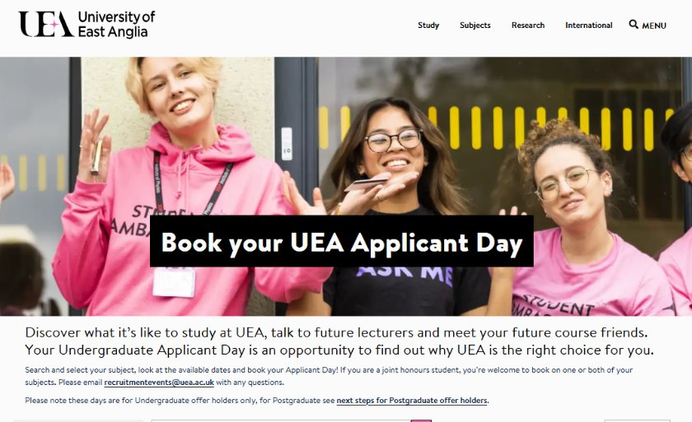
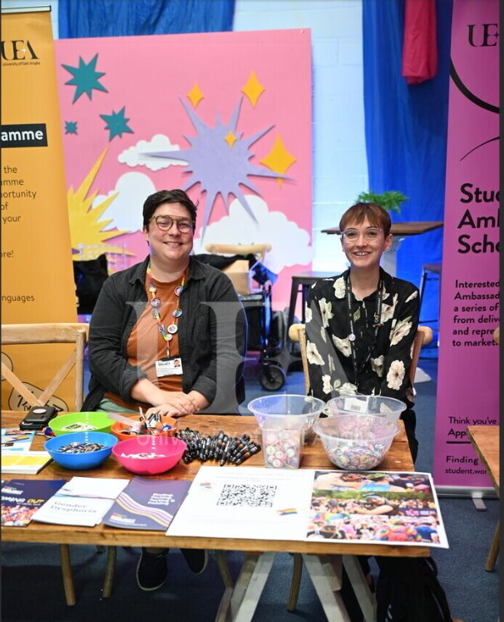


Impact so far
Increase in applications, offers and intake for focus APP groups (previous and new APP)
Increased conversion for underrepresented groups from offer to acceptance year on year
Contextual offers have risen from 9% to 26% of all Home Undergraduate offers
On track to meet first year intake milestones for new APP (clearing & confirmation pending!)
Notes:
FSM acceptance gaps moved from 0.9% to 5.5%

Slide 9
Successes
Greater collaboration across teams & departments
Increased profile of the APP and widening access strategy
Shared understanding of the APP and why it’s important
Sharing expertise and creative thinking across the university e.g Pre-awareness media campaigns, subject focused applicant support programmes
Challenges
Still work needed to ensure understanding across the institution
Moving away from APP leading inclusive discussions, how can we foster a culture of inclusivity by design?
New process development e.g new forms of data capture & reporting for colleagues
Notes:
Colleagues outside of outreach and recruitment to better understand that outreach is a good recruitment tool
These students have great continuation and progression while at UEA, so why not recruit them?
Conversation shouldn’t need to be led by Outreach
All colleagues should feel confident in understanding the APP targets and how they can impact the outcomes
Better embed with external groups, such as teachers – i.e. built in throughout nurturing bright futures teachers conference
Ensure key stakeholder groups know UEA is an inclusive and supportive environment for all.

Slide 10
Initial questions for planning similar approaches
What do you know about your student body and their student journey?
How can you demonstrate the value of integrated strategy for both APP and student recruitment & admissions?
What are the key metrics used across teams, and how can these support tracking progress?
E.g if cost per click acquisition is lower for x group of students, how can this shape a particular marketing activity?
How can you ensure senior stakeholders understand the value of collaborative activity?
How can they help create shared accountability?
What areas of your institution could have the greatest impact on reducing risks to equality of opportunity? How do you work with them already?
The academic body, student recruitment & admissions teams etc.

Slide 11
Any questions?
Notes:
.

