Slide 1


Data-led interventions to improve BAME representation
Kirsty Webb
Associate Director of Organisational Development

Slide 2



Data-led interventions to improve BAME representation
Lack of meaningful data
Assumption-led interventions
Little impact on recruitment outcomes

Slide 3
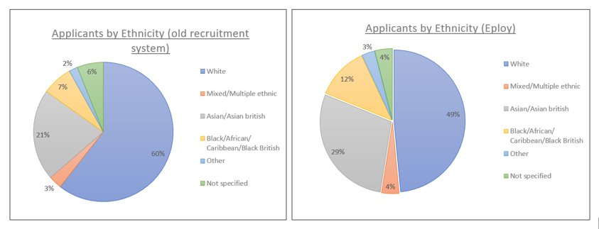
Data-led interventions to improve BAME representation
Interventions were successful at increasing the number of applications…

Slide 4
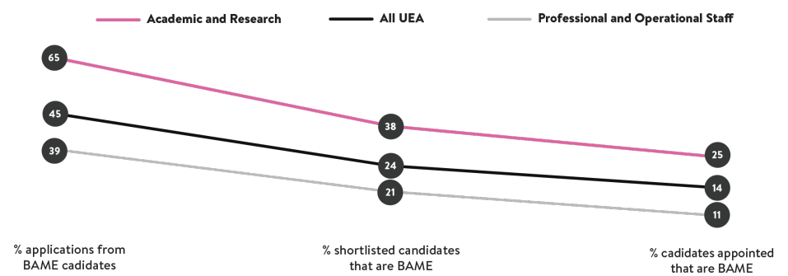
Data-led interventions to improve BAME representation
… but this did not translate into recruitment outcomes.

Slide 5







Data-led interventions to improve BAME representation
DASHBOARD
INBUILT TOOLS
SAMPLING
Poor quality applications?
Patchy knowledge of UK employment law?
Bias within systems and practices?
GUIDANCE & TRAINING
ONBOARDING
ANONYMISATION

