Slide 1
Tackling inequalities in higher education: an overview of TASO’s work one year on
Omar Khan
Director

Slide 2



Who we are
TASO is an independent charity and part of the UK Government’s What Works Movement.
A hub for HE professionals to access research, toolkits, evaluation techniques and more to help widen participation and improve equality within the sector.
Funded by the Office for Students from 2019 to 2023.
Notes:
Important to stress independence from OfS.

Slide 3
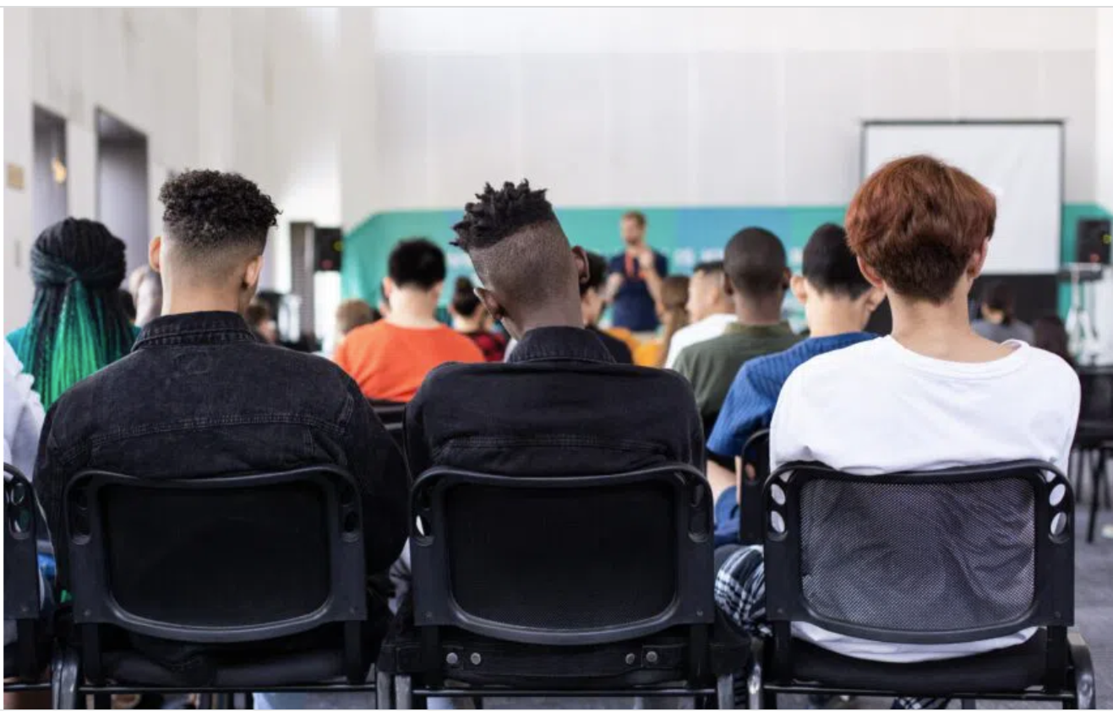
Our vision and mission
Our vision is to eliminate equality gaps in higher education.
Our mission is to improve lives through evidence-based practice in higher education.

Slide 4
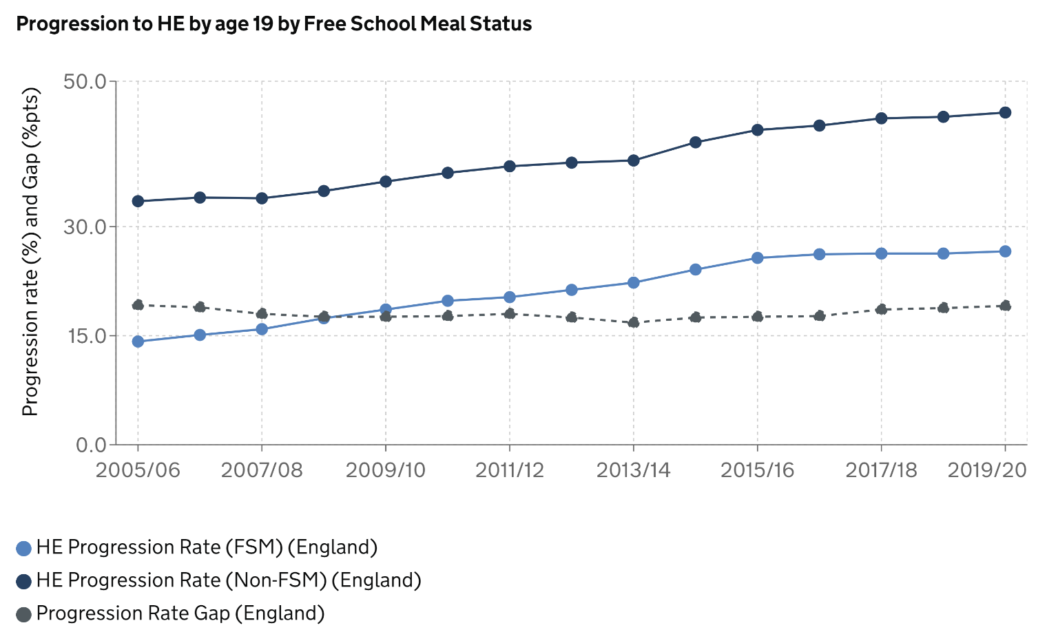
What works matters… and we have work to do
Source: DfE
Notes:
In 2020, the gap in progression to HE between Free School Meal and non-Free School Meal pupils increased to 19.1 percentage points, representing the largest gap since 2005/06.
This gap persists even though ~40% of AAP funding (£550 million) is spent on interventions to support widening participation.
We know the sector is making considerable effort to reduce equality gaps - we see effective evaluation ss crucial to success. TASO’s role is to help.

Slide 5
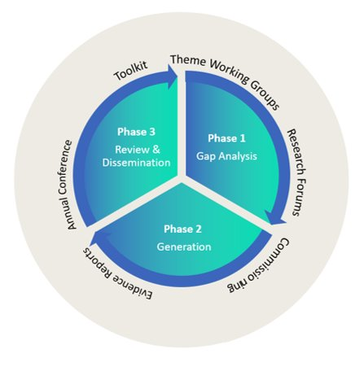
Using evidence to address gaps

Slide 6
How we work: Standards of evidence
Our approach to classifying evidence is aligned with the OfS ‘Standards of Evidence’:
Type 1 – Narrative: there is a clear narrative for why we might expect an activity to be effective. This narrative is normally based on the findings of other research or evaluation.
Type 2 – Empirical Enquiry: there is data which suggests that an activity is associated with better outcomes for students.
Type 3 – Causality: a method is used which demonstrates that an activity has a ‘causal impact’ on outcomes for students.
Notes:
TASO’s role is to help the sector produce more Type 3 evidence as this provides us with the best possible understanding of which activities and approaches are most effective.

Slide 7



Demonstrating causality (RCTs)
  Treatment group
  (allocated a place)
  Target population
  (students who apply to summer schools)
  Control group
  (not allocated a place)
Notes:
RCT’s and QEDs are the best methods for determining whether an intervention causes an outcome, allowing the evaluator to isolate the effects of an intervention from other factors that may have occurred simultaneously.
As we will discuss in a minute, TASO is currently using the RCT method to assess the impact of HEP outreach interventions (summer schools + MIOM).
This illustrates our approach to randomisting students into treatment / control groups in our summer school evaluation - where places are oversubscribed.

Slide 8





Our work spans 5 key areas
 | Theme 1: Effectiveness of Widening Participation Outreach
 | Theme 2: Gaps in the Student Experience
 | Theme 3: Employment and Employability
 | Theme 4: Mental Health and Disability
 | Evaluation guidance

Slide 9
Overview of TASO’s work
Notes:
From now until Spring 2023 we will be publishing a number of outputs that will help the sector build evidence and evaluation into their work.

Slide 10

Theme 1: Access and participation activities
  Summer schools RCT. Year 1 first results published in Summer 2022, with full Year 2 results published in late 2024.
  MIOM: 3 pilot impact evaluations (2 RCTs and 1 QED) on the efficacy of multi-intervention outreach programmes and how to evaluate them (published March 2023)
Notes:
In our gaps analysis summer schools and multi-intervention outreach and mentoring programmes showed the most evidence of promise, but had not been subject to impact evaluations with behavioural outcome measures.
TASO is filling this gap to enable the sector to learn how effective these programmes are at changing student behaviour (in relation to enrollment). This will help HEPs to better assess the extent to which resources allocated to these outreach activities are having the desired impact.

Slide 11
Attainment raising typology (Theme 1)
The latest guidance from the Office for Students (OfS) has called on HEPs to focus their widening participation activities on raising the academic attainment of school students.
TASO is developing a:
  Rapid review of the literature on interventions carried out by HEPs to raise the attainment of school-age students.
  Typology of attainment raising interventions/activities, this currently includes:
Information, advice and guidance
Developing study skills and other soft skills
Tutoring and other academic support
School governance and teacher training
Multi-intervention outreach and mentoring

Slide 12

Theme 2: Student Experience
Race Equality Gaps: TASO is working with 2 HEPs to use evaluate whether reforming the curriculum to make it more diverse will help close race equality gaps in attainment (QED).
A research project to understand the impact of shifting to online T&L during the COVID-19 pandemic on disadvantaged learners. .
Both findings will be published in Autumn 2022.
See our webinar on quasi-experimental design: https://taso.org.uk/evidence/resources-hub/introduction-to-quasi-experimental-designs/

Slide 13
Themes 3 and 4
In July 2021, we published our Sector Consultation Report, detailing the scoping exercise TASO conducted with the sector to determine the focus of our two newest themes (Employment and Employability; Mental Health and Disability).
Three Gap Analysis reports for these areas will be published in Summer 2022.
In May, we plan to invite HEPs to submit examples of the activities / interventions they are delivering to reduce equality gaps within these thematic areas. We will support the evaluation of selected interventions by matching HEPs with representatives from our evaluation panel.

Slide 14
Evaluation projects
Survey validation, a review of existing scales used across widening participation and student success teams, cumulating in the design of a multi-scale questionnaire that can be widely used.
A validated survey will be available for HEPS to use from Winter 2022.
Small n, the development and piloting of guidance to support causal evaluation with small cohorts. HEPs recently applied to participate in TASO’s pilots.
Ethics, guidance for the sector on how to design ethical research and evaluation. See our newly published online guidance and webinar.

Slide 15



Evaluation guidance
Monitoring and evaluation framework (MEF): Diagnose, Plan, Measure, Reflect
Evaluation webinars: survey design & validation, correlation versus causation, pre and post-test design
Evidence toolkit

Slide 16
Look out for
Summer publications (3x Gap Analysis reports, Summer School evaluation, Race Equality Gaps evaluation, Teaching and Learning report), each with launch event
Further support for the sector on
  Understanding and responding to the challenges in delivering RCTs
  Raising attainment activities better able to identify intermediate outcomes that are predictive of higher attainment through the survey validation project
Opportunities to collaborate with TASO:
  Piloting interventions in Theme 3 + 4, by being matched with an evaluator paid for by TASO (ITT out now)
  Learning analytics type 3 evaluation (ITT closing)
Total paid:£62.00
Booking reference:974338046835

Slide 17
Lessons learned: operations and R & E
Operationally: try not set up a charity during a global pandemic
Research and evaluation:
  the real world is messy, but it is possible to deliver RCTs and QEDs!
  needs to be flexible and responsive, especially where delivery changes, in different institutional contexts or for different cohorts
  move to online will have wider and long-lasting implications for HE as in society, offers opportunities to address inequalities alongside risk of exacerbating existing ones
Inequalities are persistent and extensive, but also vary substantially, across populations, geographies and institutions

Slide 18
Introduction to the summer schools evaluation

Slide 19
TASO’s approach to research
Phase 1 – gap analysis
Phase 2 – evidence generation
Phase 3 – review and dissemination

Slide 20
Summer schools – what do we currently know?
Associated with:
an increase in confidence/ aspirations
in some cases, applications and progression to HE
But, limited evidence that:
  provides a causal link
Notes:
TASO’s evidence review published in 2020 found that summer schools are associated with an increase in confidence/aspirations related to HE.
Type 2 rather than Type 3 evidence

Slide 21

Filling the gap – summer schools evaluation
Randomised Controlled Trial – Type 3 evidence
Collaboration:
  University partners
  Pre- and post-16
  Behavioural Insights Team
Summer schools delivered (online) during summer of 2021
Notes:
We have multiple university partners, some of which run summer schools at students aged under 16 (Year 9 or 10) and some which target Year 12 students (post-16).

Slide 22

Summer schools evaluation
By measuring the difference in outcomes between those who attended the summer schools and those who didn’t:
Causal evidence on the effect of summer schools.
Outcome data:
Primary – enrolment in HE
Secondary – which HEP
Exploratory – self-reported applications to HE, and attitudes towards HE

Slide 23



Mixed methods evaluation
Impact evaluation
Implementation and process evaluation
Alternative evaluation
Notes:
IE – whether the summer schools works
IPE – how and why the summer school works (or doesn’t work) – qual interviews/focus groups
AE – for summer schools not oversubscribed so couldn’t participate in the RCT

Slide 24
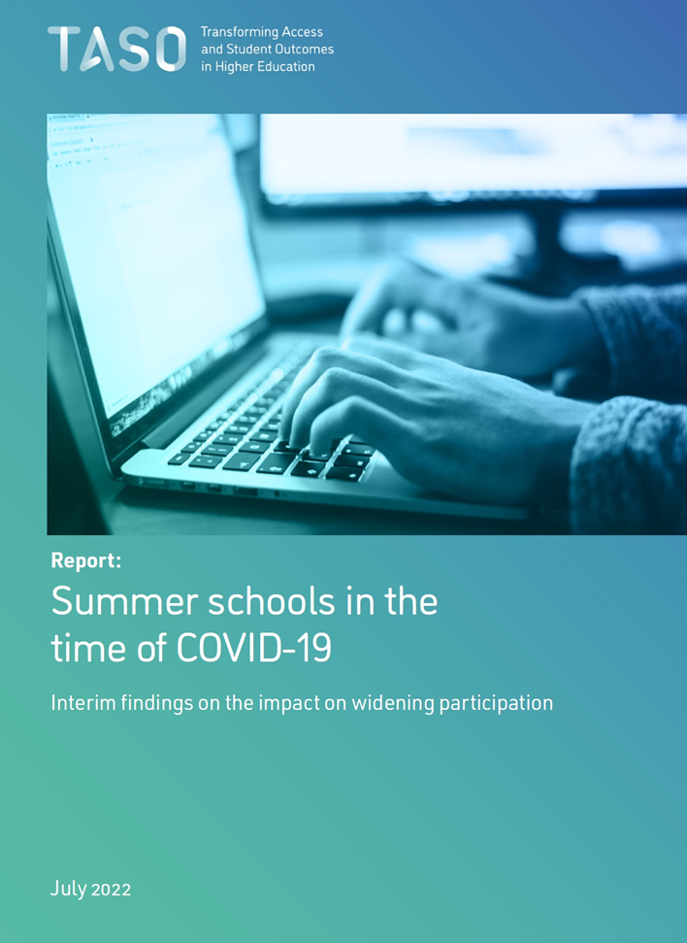
Notes:
Today we are releasing the interim findings from this evaluation which can be accessed on our website, alongside a technical analysis report carried out by BIT. I’ll now pass over to Paddy to talk through the RCT and interim findings.

Slide 25
Lessons learned: partner and policy context
What works approach requires consensus on the aim or vision: widespread agreement that inequalities in HE are too large
Having strong partners at the outsets (eg KCL, NTU, BIT) helps with setup, reputation, reach
Communications important for promoting and disseminating work, but also building and consolidating relationships (including regionally/ country-wide)
Strong commitment across the HE sector to tackling inequalities and evaluation
Some ‘buts’:
  less agreement on which inequalities matter or how to tackle them
  evidence isn’t the only or sufficient way to change policies and practice, but WWCs aren’t and can’t be a ‘campaigning’ organisation (target partners, policymakers)

Slide 26
How should TASO’s work inform planning?
TASO has so far worked more with access and participation teams, and with evaluators in such teams, especially for Theme 1
Our themes 2, 3 and 4 have also involved us working with student success teams, as well as those working on employability, disability and mental health
We also have a meetings with senior leaders in HE to understand their priorities, and to highlight the value and importance of TASO’s work to delivering on both regulatory and student outcomes
How could we ensure we better engage with those planning in HE, to ensure it includes evaluation of access, participation and student outcomes?

Slide 27
Questions?

