Slide 1

Exploring Educational Gain as a Metric to Tackle Attainment Gaps and Promote Inclusion in Higher Education in England
HEIR 2025, UEA, Norwich
Fabio Aricò, Ritchie Woodard, and Laura Harvey

Slide 2
Milestones in Recent English HE Policy
Year
Fees
1998
£1,000
2006
£3,000
2012
£9,000
2015
£9,000
2018
£9,250
2023
£9,250
Policy
Metric
KIS
Satisfaction
Employment
Learning Act.
Course Design
Cost …
KIS Review
HEFCE
Learning Gain Pilot
TEF
OfS
Benchmarks
- Gold
- Silver
- Bronze
TEF
Educational
Gain

Slide 3
Teaching Excellence Framework (TEF)
Establishes quality standards of UK Higher Education Providers (HEPs)
Periodically submitted to Office for Students (OfS)
Based on benchmarked metrics of student learning, experience and outcomes
Educational Gain (EG) recently added
→ HEPs are free to define in line with their missions and values
Educational Gains framing (Fung, 2023)
  Comprehensive for all students, in addition to subject-specific learning
  Targeted for specific groups/demographics
  Tailored shaped for individual students

Slide 4
Defining Educational Gain at UEA
Standing Principle: UEA is an access institution
→ core mission of inclusion across dimensions of disadvantage
→ targeting attainment gaps is paramount at our institution
→ a baseline is established for the whole sector - Access and Participation Plans
Educational Gain at UEA
  “the narrowing in attainment gaps between students from disadvantaged and
  non-traditional backgrounds with respect to their peers”
Learning Gains
→ dynamic operationalisation for attainment gaps
→ difference in stage averages between Year 3 and Year 1 - ‘distance run’
→ can be split by dimensions of equality, diversity and inclusion:
gender, ethnicity, disability, age (mature), and socio-economic deprivation (IMD)

Slide 5

Data and Methods
University records
data protection and ethics cleared
39K observations, summarising the experience 13K home students
7 cohorts of around ~2K students each, who completed their degree
start years between 2014-2021.
Regression analysis
explaining the variance in Learning Gain across academic, demographic and university intervention data from student records
simultaneous modelling of correlation across all available variables
addresses concerns associated to co-correlations (intersectionality).
Notes:
Fabio came and asked if I wanted to be part of tackling this problem. The gauntlet had been thrown down – UEA had its definition of EG and it was up to us how to measure and analyse it. Fabio managed to wrestle this dataset, which was hard-fought. Much more liberal in the past, but after data protection act, became more about risk elimination than risk management. Now, we are finding that balance of access to data to inform insights while retaining anonymity and privacy – and a third factor that has been revealed during our work.

Slide 6

Key Variables
Main Variables of interest
Control Variables
Dependent
Stage marks / learning gain
Explanatory
Gender: not female, female
Ethnicity: white, black, Asian, other
Disability: none, learning, mental, physical
Age: not mature, mature
Deprivation: IMD3-5, IMD1-2
Access and Support:
clearing, bursary, foundation year
Previous qualifications:
A-level, BTEC, Int Bacc, Access, other
Previous Attainment:
tariff
Course Variants:
Year Abroad, Year in Industry
Faculty / School
Academic Year

Slide 7
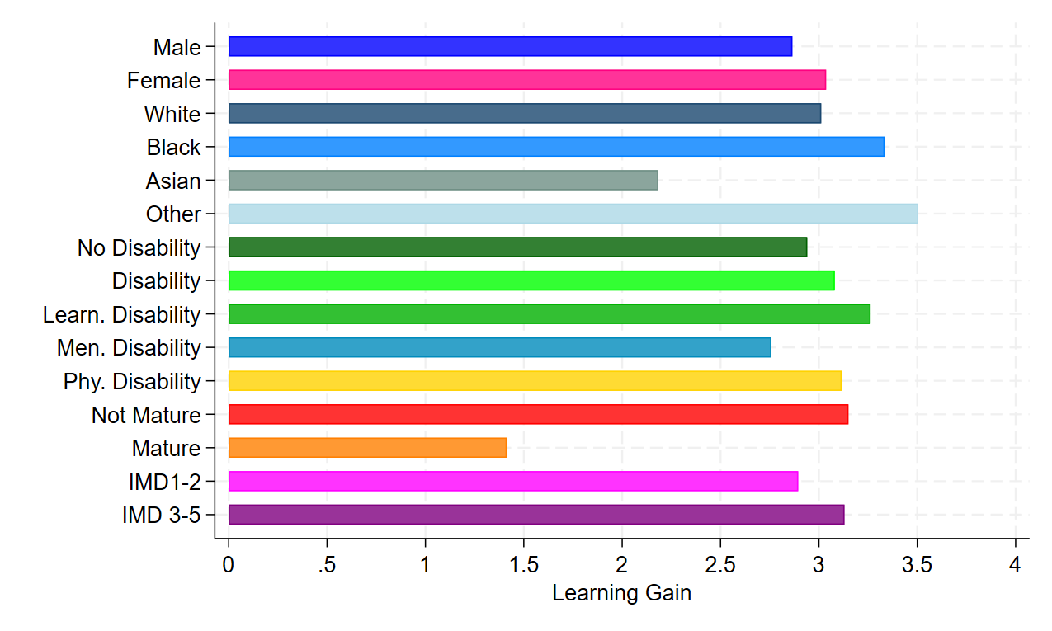
Replicating 2023 submission
Gender
Ethnicity
Lower than white ***
Higher than white *
Disability
Age
Lower than not mature ***
Deprivation
* p < 0.05, ** p < 0.01, *** p < 0.001

Slide 8
Correlations (intersectionality)
 |  |  | Ethnicity |  |  | Disability
 |  | Female | Black | Asian | Other | Physical | Learning | Mental | Mature | IMD | Stage Mark
Female |  | 1.000 | 0.000 | -0.033 | -0.015 | 0.040 | -0.019 | 0.097 | 0.031 | 0.000 | 0.076
Ethnicity | Black | 0.000 | 1.000 | -0.062 | -0.059 | 0.000 | -0.011 | -0.029 | 0.000 | 0.198 | -0.111
 | Asian | -0.033 | -0.062 | 1.000 | -0.070 | -0.019 | -0.044 | -0.032 | -0.033 | 0.142 | -0.065
 | Other | -0.015 | -0.059 | -0.070 | 1.000 | -0.012 | 0.000 | 0.015 | -0.011 | 0.057 | -0.038
Disability | Physical | 0.040 | 0.000 | -0.019 | -0.012 | 1.000 | -0.072 | -0.061 | 0.025 | -0.013 | 0.000
 | Learning | -0.019 | -0.011 | -0.044 |  | -0.072 | 1.000 | -0.079 | 0.059 | -0.021 | -0.044
 | Mental | 0.097 | -0.029 | -0.032 | 0.015 | -0.061 | -0.079 | 1.000 | 0.038 | 0.000 | -0.017
Mature |  | 0.031 | 0.000 | -0.033 | -0.011 | 0.025 | 0.059 | 0.038 | 1.000 | 0.053 | 0.061
IMD |  | 0.000 | 0.198 | 0.142 | 0.057 | -0.013 | -0.021 | 0.000 | 0.053 | 1.000 | -0.095
Stage Mark |  | 0.076 | -0.111 | -0.065 | -0.038 | 0.000 | -0.044 | -0.017 | 0.061 | -0.095 | 1.000

Slide 9
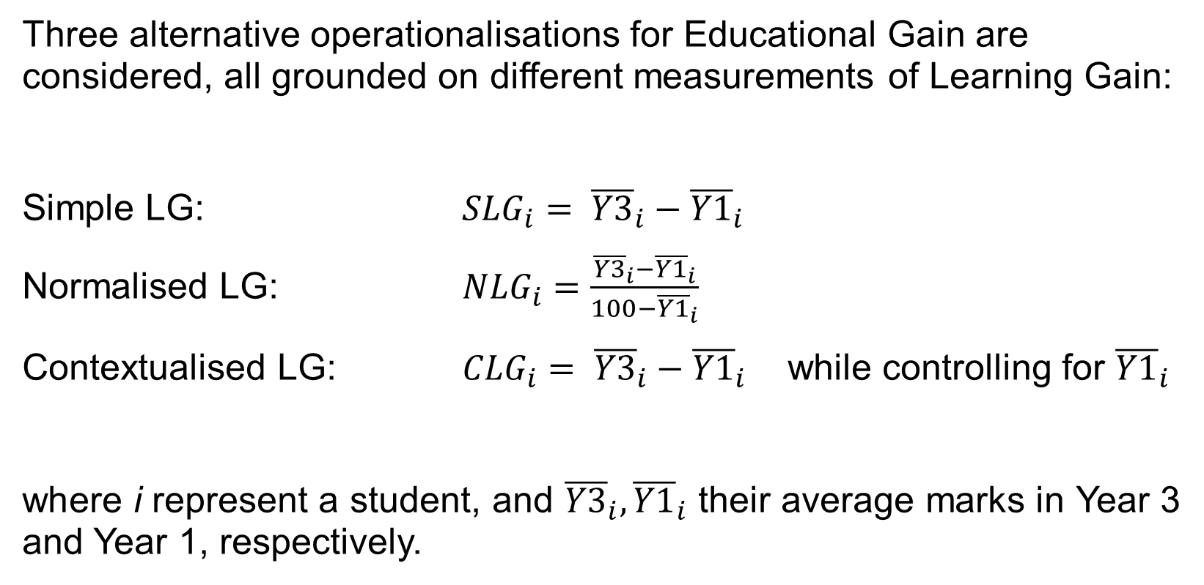
Learning Gain (LG) Metrics
Three alternative operationalisations for Educational Gain are considered, all grounded on different measurements of Learning Gain:
Simple LG: ${SLG}_{i}= {\overline{Y3}}_{i}−{\overline{Y1}}_{i}$
Normalised LG: ${NLG}_{i}=\frac{{\overline{Y3}}_{i}−{\overline{Y1}}_{i}}{100−{\overline{Y1}}_{i}}$
Contextualised LG: ${CLG}_{i}= {\overline{Y3}}_{i}−{\overline{Y1}}_{i}$ while controlling for ${\overline{Y1}}_{i}$
where i represent a student, and ${\overline{Y3}}_{i}, {\overline{Y1}}_{i}$ their average marks in Year 3 and Year 1, respectively.

Slide 10
Learning Gain (LG) Metrics (Cont.)
Simple LG
equality
0
40
50
60
70
100
Normalised LG
capability
0
45
65
100
Contextualised LG
equity
0
100

Slide 11
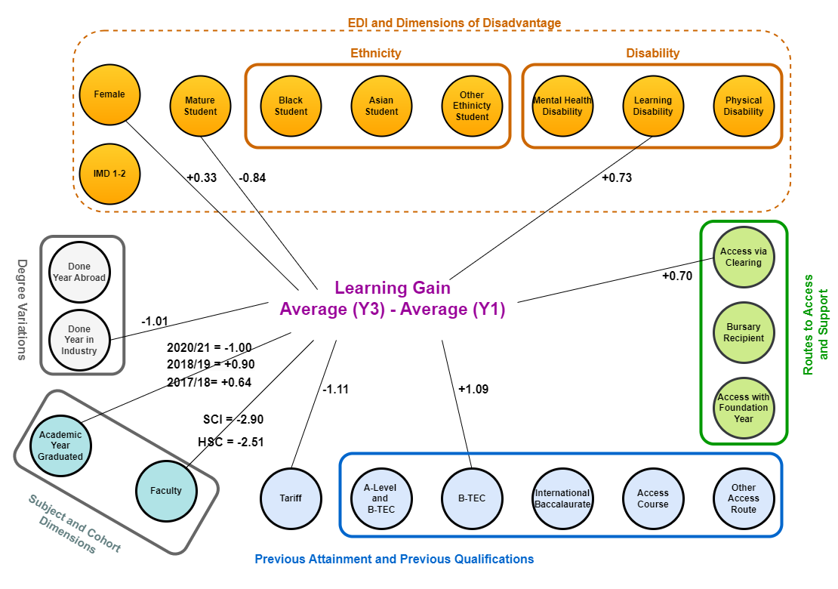
Simple Learning Gain Regression

Slide 12
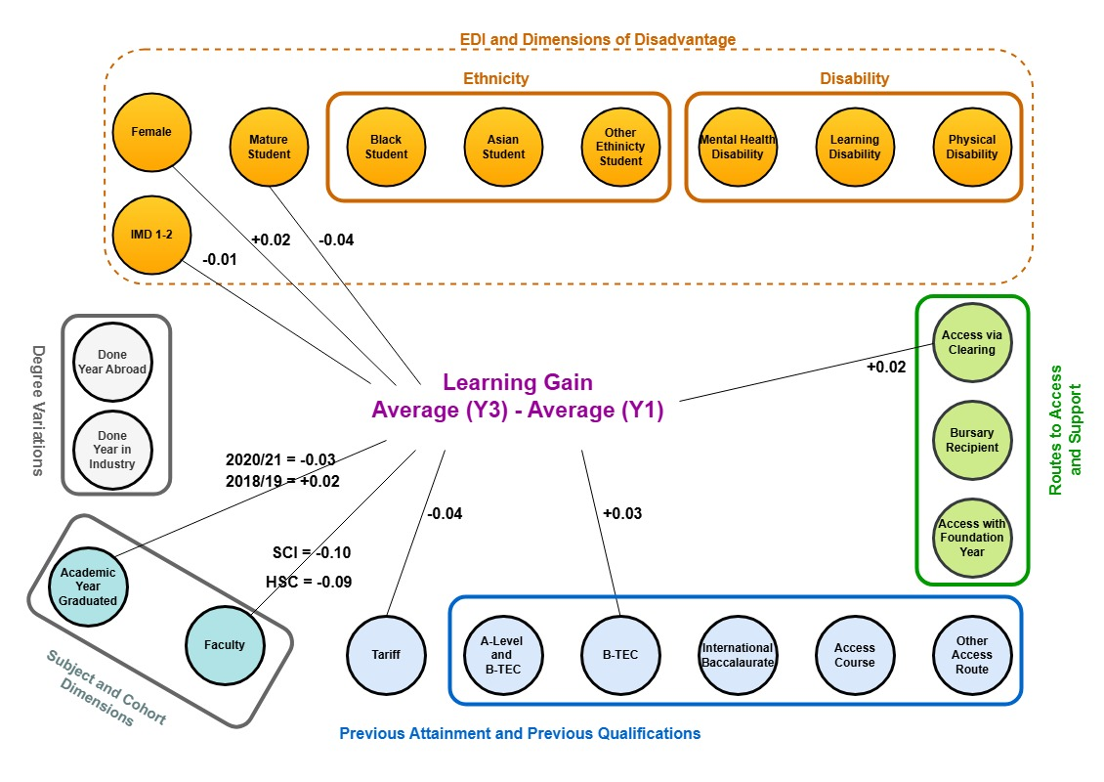
Normalised Learning Gain Model
Notes:
Edit centre (dep var)

Slide 13
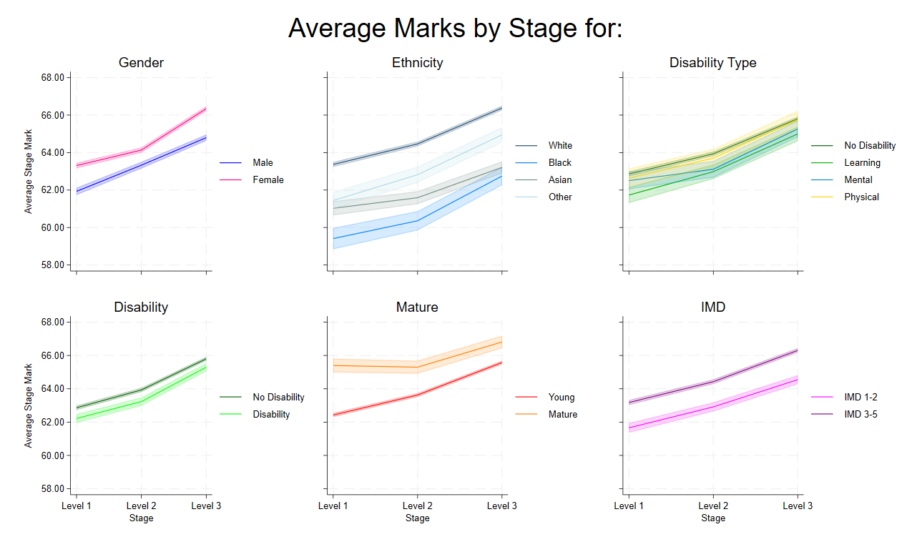

Slide 14
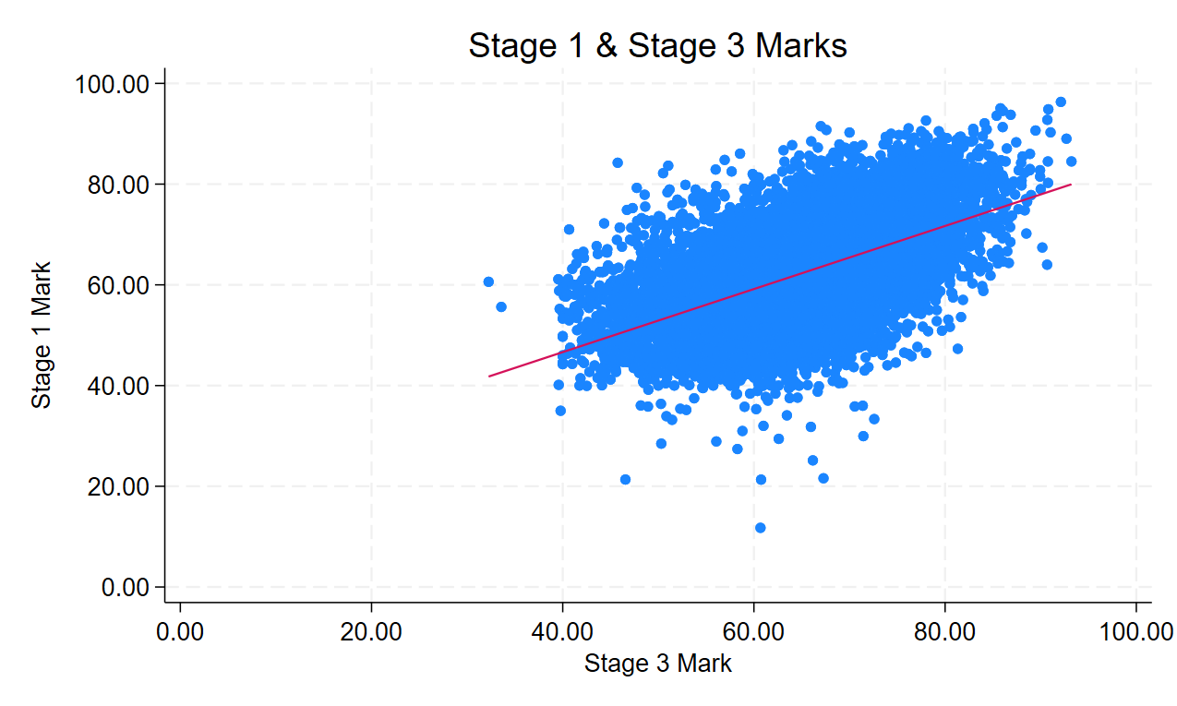
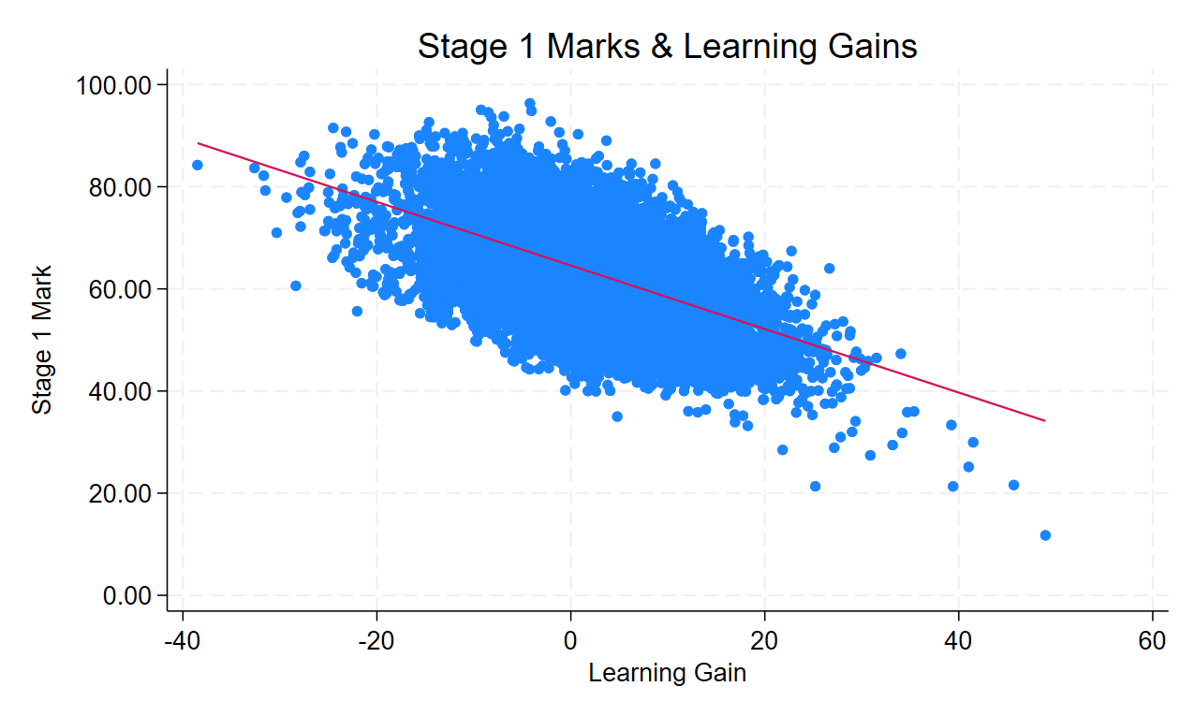
Importance of Starting Point

Slide 15
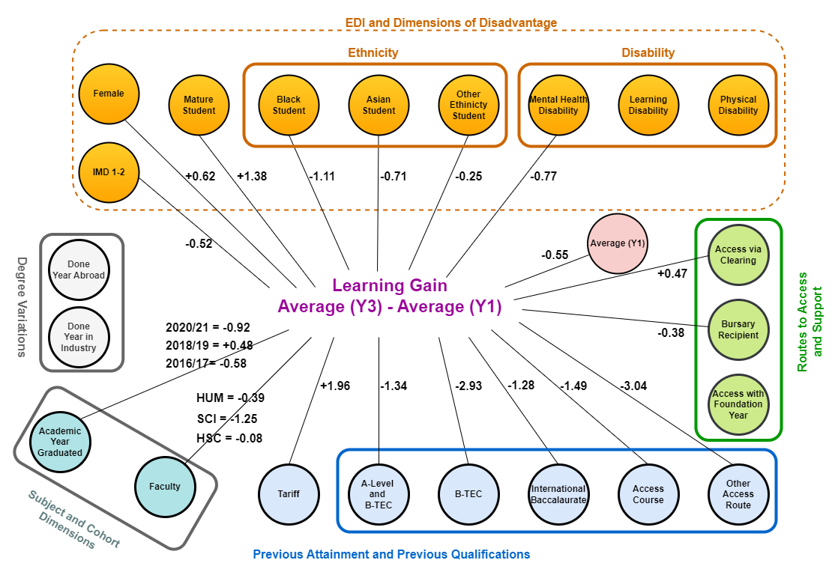
Contextualised Learning Gain Reg.

Slide 16
Summary
Educational Gain (EG) – narrowing attainment gaps
Learning Gain (LG) has issues as an absolute measure, but can be used as a relative measure to capture Attainment Gaps
Importance of statistical testing and controlling for other factors
Also controlling starting points
The choice of measure (SLG, NLG, CLG) alters what we are capturing and policy conclusions that might be drawn
These measures can be monitored over time and to evaluate the effects of policy changes.
Notes:
Opportunity to use this type of data to inform policy, but if there is not an understanding of what is being measured, it may be pointing at the wrong thing, and incorrect conclusions may be drawn. Proliferation of metrics in sector.

Slide 17
Thank you for your attention
We welcome any questions and feedback

Slide 18
Summary Statistics
Variable |  | N | Mean | Std. Dev. | Min | Max
Mark (stage 1) |  | 13152 | 62.69 | 7.918 | 21.35 | 96.33
Mark (stage 2) |  | 13151 | 64.017 | 7.432 | 39.92 | 92.38
Mark (stage 3) |  | 13152 | 65.856 | 7.189 | 32.25 | 93.22
Mark (overall) |  | 39455 | 64.188 | 7.63 | 21.35 | 96.33
Learning Gain |  | 19062 | 2.966 | 7.359 | -38.5 | 48.94
Female |  | 39455 | .577 | .494 | 0 | 1
Ethnicity | White | 39455 | .819 | .385 | 0 | 1
 | Black | 39455 | .05 | .218 | 0 | 1
 | Asian | 39455 | .068 | .252 | 0 | 1
 | Other Ethnicity | 39455 | .062 | .241 | 0 | 1
Disability | None | 39455 | .799 | .401 | 0 | 1
 | Physical | 39455 | .052 | .222 | 0 | 1
 | Learning | 39455 | .086 | .28 | 0 | 1
 | Mental | 39455 | .063 | .243 | 0 | 1
Mature |  | 39455 | .065 | .246 | 0 | 1
IMD 3-5 |  | 39455 | .226 | .419 | 0 | 1

Slide 19
Summary Statistics - Controls
Variable | N | Mean | Std. Dev. | Min | Max
Clearing | 39455 | .11 | .313 | 0 | 1
Bursary | 39455 | .197 | .398 | 0 | 1
Foundation Year | 39455 | .088 | .283 | 0 | 1
A-Level | 39443 | .795 | .404 | 0 | 1
A-Level and BTEC | 39443 | .058 | .234 | 0 | 1
Access | 39443 | .033 | .179 | 0 | 1
BTEC | 39443 | .086 | .281 | 0 | 1
Int Bacc | 39443 | .013 | .114 | 0 | 1
Other | 39443 | .014 | .119 | 0 | 1
Tariff (in 100pts) | 39455 | 1.378 | .33 | .06 | 3.8
Year Abroad | 39455 | .058 | .233 | 0 | 1
Year in Industry | 39455 | .018 | .133 | 0 | 1

Slide 20
Sample across faculties/years
Academic Year | Faculty
 | FMH | HUM | SCI | SSF | Total
2015/6 | 206 | 739 | 346 | 713 | 2004
 | 0.52 | 1.87 | 0.88 | 1.81 | 5.08
2016/7 | 404 | 1492 | 798 | 1438 | 4132
 | 1.02 | 3.78 | 2.02 | 3.64 | 10.47
2017/8 | 684 | 2066 | 1205 | 2089 | 6044
 | 1.73 | 5.24 | 3.05 | 5.29 | 15.32
2018/9 | 781 | 2105 | 1444 | 2262 | 6592
 | 1.98 | 5.34 | 3.66 | 5.73 | 16.71
2019/0 | 927 | 1960 | 1563 | 2463 | 6913
 | 2.35 | 4.97 | 3.96 | 6.24 | 17.52
2020/1 | 965 | 1808 | 1569 | 2602 | 6944
 | 2.45 | 4.58 | 3.98 | 6.59 | 17.60
2021/2 | 660 | 1122 | 1047 | 1645 | 4474
 | 1.67 | 2.84 | 2.65 | 4.17 | 11.34
2022/3 | 343 | 570 | 515 | 924 | 2352
 | 0.87 | 1.44 | 1.31 | 2.34 | 5.96
Total | 4970 | 11862 | 8487 | 14136 | 39455
 | 12.60 | 30.06 | 21.51 | 35.83 | 100.00

Slide 21
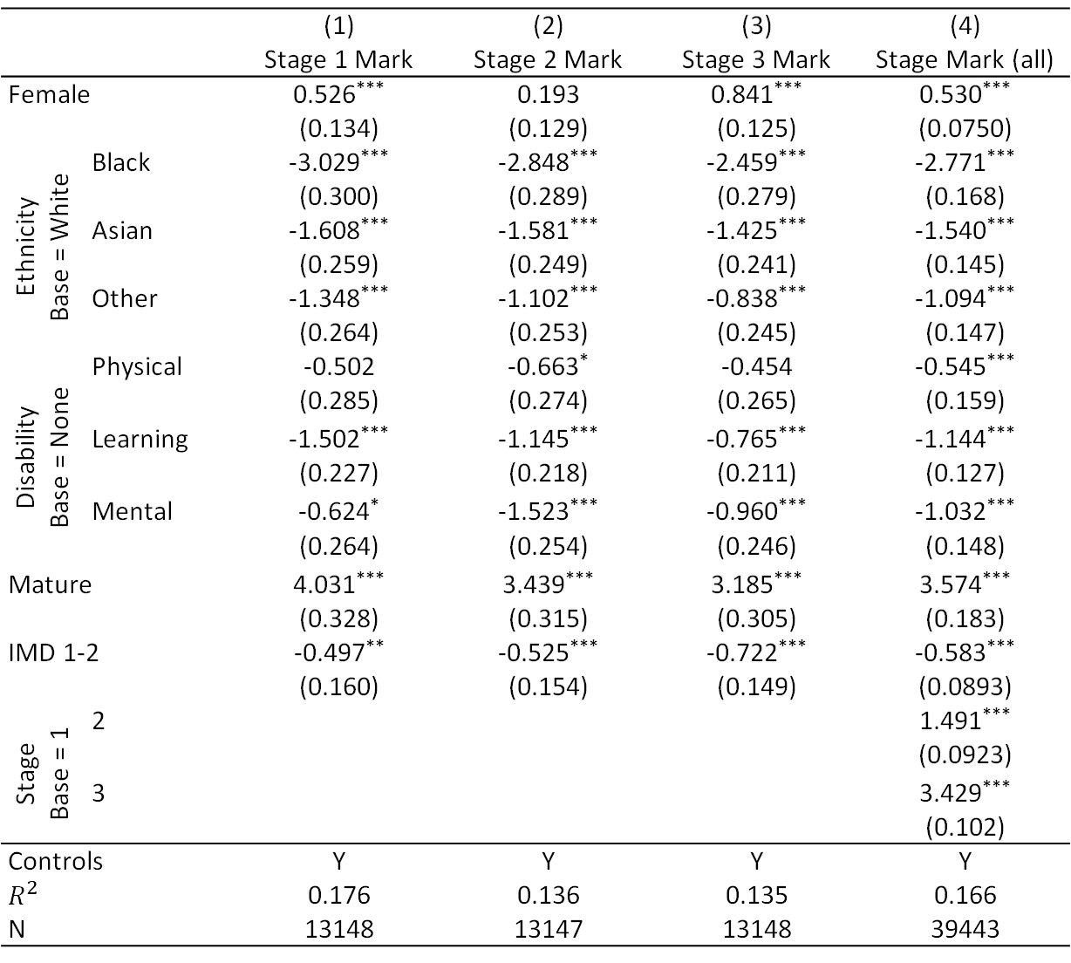
Stage Mark Regressions
 |  | (1) | (2) | (3) | (4)
 |  | Stage 1 Mark | Stage 2 Mark | Stage 3 Mark | Stage Mark (all)
Female |  | 0.526*** | 0.193 | 0.841*** | 0.530***
 |  | (0.134) | (0.129) | (0.125) | (0.0750)
Ethnicity Base = White | Black | -3.029*** | -2.848*** | -2.459*** | -2.771***
 |  | (0.300) | (0.289) | (0.279) | (0.168)
 | Asian | -1.608*** | -1.581*** | -1.425*** | -1.540***
 |  | (0.259) | (0.249) | (0.241) | (0.145)
 | Other | -1.348*** | -1.102*** | -0.838*** | -1.094***
 |  | (0.264) | (0.253) | (0.245) | (0.147)
Disability Base = None | Physical | -0.502 | -0.663* | -0.454 | -0.545***
 |  | (0.285) | (0.274) | (0.265) | (0.159)
 | Learning | -1.502*** | -1.145*** | -0.765*** | -1.144***
 |  | (0.227) | (0.218) | (0.211) | (0.127)
 | Mental | -0.624* | -1.523*** | -0.960*** | -1.032***
 |  | (0.264) | (0.254) | (0.246) | (0.148)
Mature |  | 4.031*** | 3.439*** | 3.185*** | 3.574***
 |  | (0.328) | (0.315) | (0.305) | (0.183)
IMD 1-2 |  | -0.497** | -0.525*** | -0.722*** | -0.583***
 |  | (0.160) | (0.154) | (0.149) | (0.0893)
Stage Base = 1 | 2 |  |  |  | 1.491***
 |  |  |  |  | (0.0923)
 | 3 |  |  |  | 3.429***
 |  |  |  |  | (0.102)
Controls |  | Y | Y | Y | Y
$$R^{2}$$ |  | 0.176 | 0.136 | 0.135 | 0.166
N |  | 13148 | 13147 | 13148 | 39443
Standard errors in parentheses, * p < 0.05, ** p < 0.01, *** p < 0.001

Slide 22
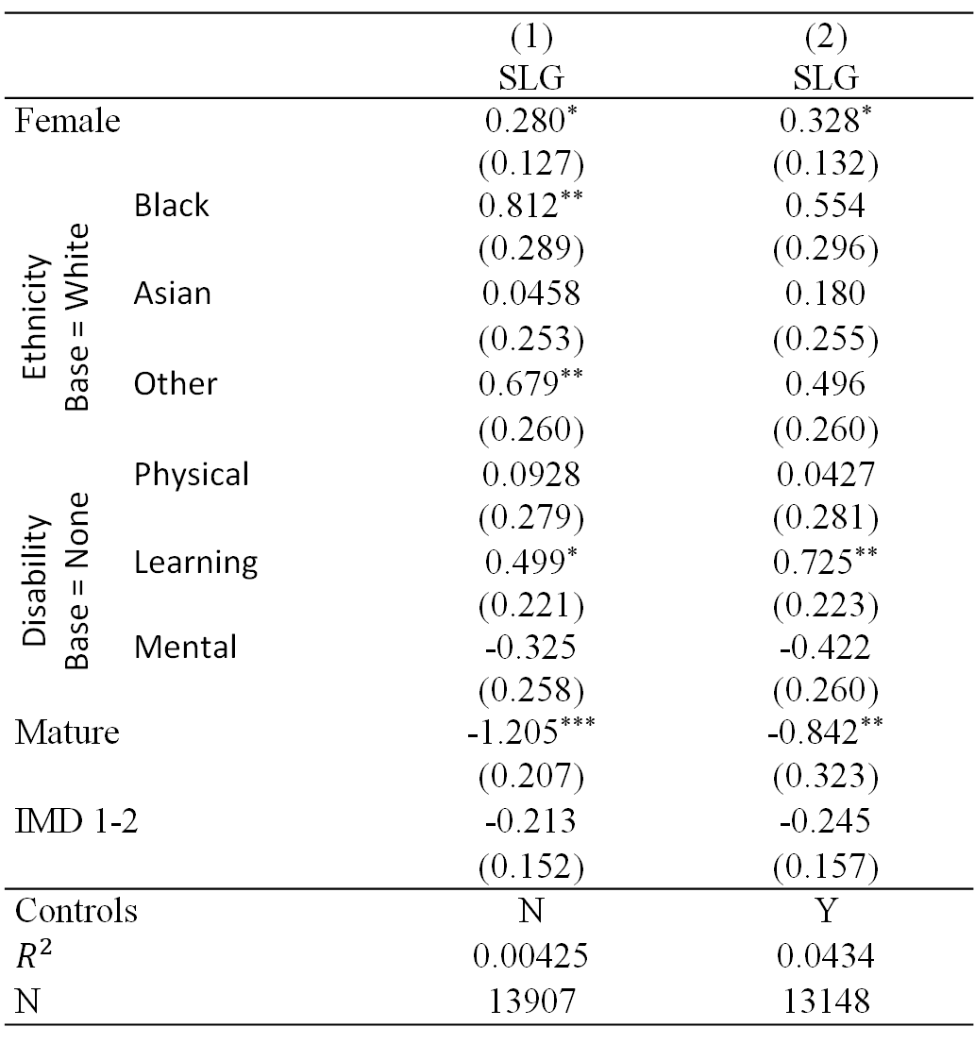
Simple Learning Gain Regression
 |  | (1) | (2)
 |  | SLG | SLG
Female |  | 0.280* | 0.328*
 |  | (0.127) | (0.132)
Ethnicity Base = White | Black | 0.812** | 0.554
 |  | (0.289) | (0.296)
 | Asian | 0.0458 | 0.180
 |  | (0.253) | (0.255)
 | Other | 0.679** | 0.496
 |  | (0.260) | (0.260)
Disability Base = None | Physical | 0.0928 | 0.0427
 |  | (0.279) | (0.281)
 | Learning | 0.499* | 0.725**
 |  | (0.221) | (0.223)
 | Mental | -0.325 | -0.422
 |  | (0.258) | (0.260)
Mature |  | -1.205*** | -0.842**
 |  | (0.207) | (0.323)
IMD 1-2 |  | -0.213 | -0.245
 |  | (0.152) | (0.157)
Controls |  | N | Y
$$R^{2}$$ |  | 0.00425 | 0.0434
N |  | 13907 | 13148
Standard errors in parentheses, * p < 0.05, ** p < 0.01, *** p < 0.001

Slide 23
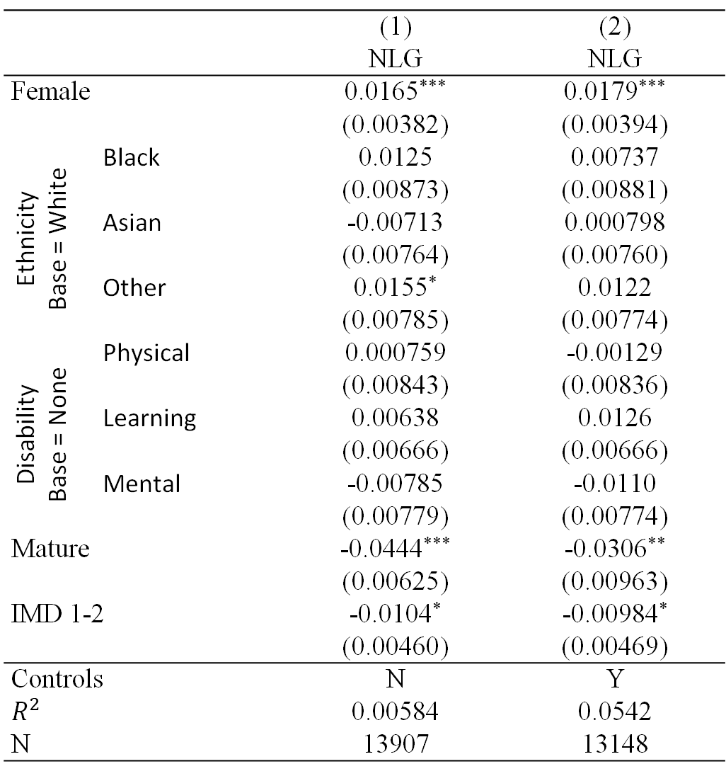
Normalised Learning Gain Regression
 |  | (1) | (2)
 |  | NLG | NLG
Female |  | 0.0165*** | 0.0179***
 |  | (0.00382) | (0.00394)
Ethnicity Base = White | Black | 0.0125 | 0.00737
 |  | (0.00873) | (0.00881)
 | Asian | -0.00713 | 0.000798
 |  | (0.00764) | (0.00760)
 | Other | 0.0155* | 0.0122
 |  | (0.00785) | (0.00774)
Disability Base = None | Physical | 0.000759 | -0.00129
 |  | (0.00843) | (0.00836)
 | Learning | 0.00638 | 0.0126
 |  | (0.00666) | (0.00666)
 | Mental | -0.00785 | -0.0110
 |  | (0.00779) | (0.00774)
Mature |  | -0.0444*** | -0.0306**
 |  | (0.00625) | (0.00963)
IMD 1-2 |  | -0.0104* | -0.00984*
 |  | (0.00460) | (0.00469)
Controls |  | N | Y
$$R^{2}$$ |  | 0.00584 | 0.0542
N |  | 13907 | 13148
Standard errors in parentheses, * p < 0.05, ** p < 0.01, *** p < 0.001

Slide 24
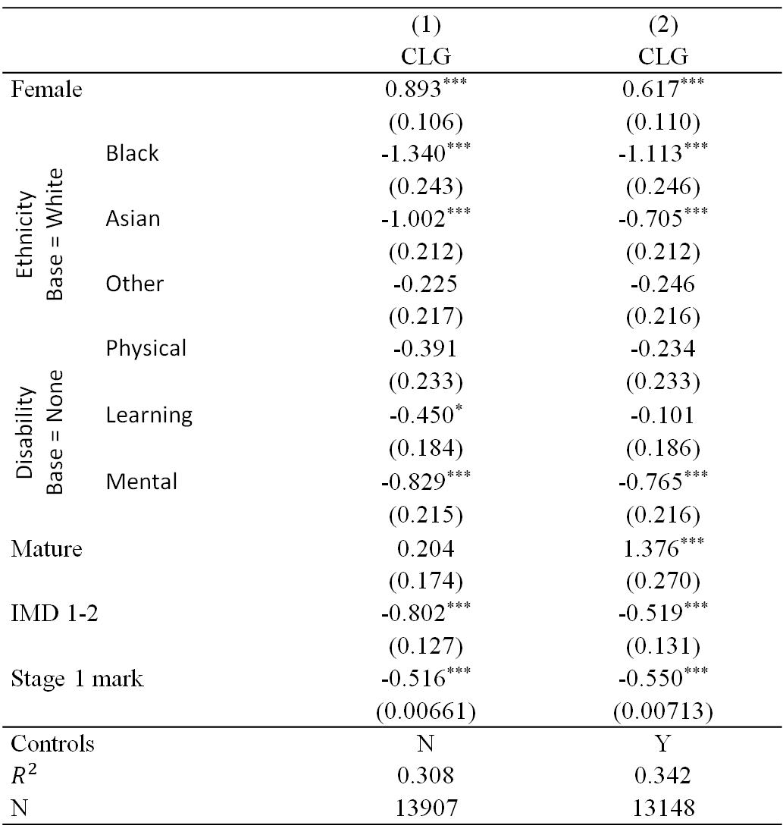
Contextualised Learning Gain Regression
 |  | (1) | (2)
 |  | CLG | CLG
Female |  | 0.893*** | 0.617***
 |  | (0.106) | (0.110)
Ethnicity Base = White | Black | -1.340*** | -1.113***
 |  | (0.243) | (0.246)
 | Asian | -1.002*** | -0.705***
 |  | (0.212) | (0.212)
 | Other | -0.225 | -0.246
 |  | (0.217) | (0.216)
Disability Base = None | Physical | -0.391 | -0.234
 |  | (0.233) | (0.233)
 | Learning | -0.450* | -0.101
 |  | (0.184) | (0.186)
 | Mental | -0.829*** | -0.765***
 |  | (0.215) | (0.216)
Mature |  | 0.204 | 1.376***
 |  | (0.174) | (0.270)
IMD 1-2 |  | -0.802*** | -0.519***
 |  | (0.127) | (0.131)
Stage 1 mark |  | -0.516*** | -0.550***
 |  | (0.00661) | (0.00713)
Controls |  | N | Y
$$R^{2}$$ |  | 0.308 | 0.342
N |  | 13907 | 13148
Standard errors in parentheses, * p < 0.05, ** p < 0.01, *** p < 0.001

Slide 25
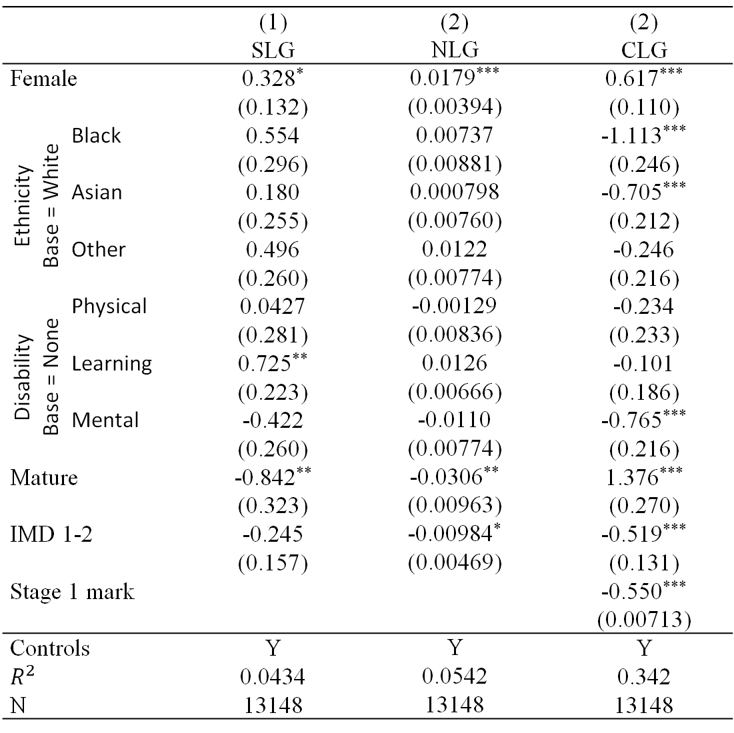
Learning Gain Regressions Overview
 |  | (1) | (2) | (2)
 |  | SLG | NLG | CLG
Female |  | 0.328* | 0.0179*** | 0.617***
 |  | (0.132) | (0.00394) | (0.110)
Ethnicity Base = White | Black | 0.554 | 0.00737 | -1.113***
 |  | (0.296) | (0.00881) | (0.246)
 | Asian | 0.180 | 0.000798 | -0.705***
 |  | (0.255) | (0.00760) | (0.212)
 | Other | 0.496 | 0.0122 | -0.246
 |  | (0.260) | (0.00774) | (0.216)
Disability Base = None | Physical | 0.0427 | -0.00129 | -0.234
 |  | (0.281) | (0.00836) | (0.233)
 | Learning | 0.725** | 0.0126 | -0.101
 |  | (0.223) | (0.00666) | (0.186)
 | Mental | -0.422 | -0.0110 | -0.765***
 |  | (0.260) | (0.00774) | (0.216)
Mature |  | -0.842** | -0.0306** | 1.376***
 |  | (0.323) | (0.00963) | (0.270)
IMD 1-2 |  | -0.245 | -0.00984* | -0.519***
 |  | (0.157) | (0.00469) | (0.131)
Stage 1 mark |  |  |  | -0.550***
 |  |  |  | (0.00713)
Controls |  | Y | Y | Y
$$R^{2}$$ |  | 0.0434 | 0.0542 | 0.342
N |  | 13148 | 13148 | 13148
Standard errors in parentheses, * p < 0.05, ** p < 0.01, *** p < 0.001
Notes:
Female – positive throughout. Black students - SLG & NLG positive (insig), while CLG negative (sig) – some catch up but not nearly enough. Learning disabilities – positive (sig), then insig – catching up and no sig difference controlling for starting point. Mature – negative (sig), then positive (sig) – younger students catching up, but not enough given starting point.

Slide 26
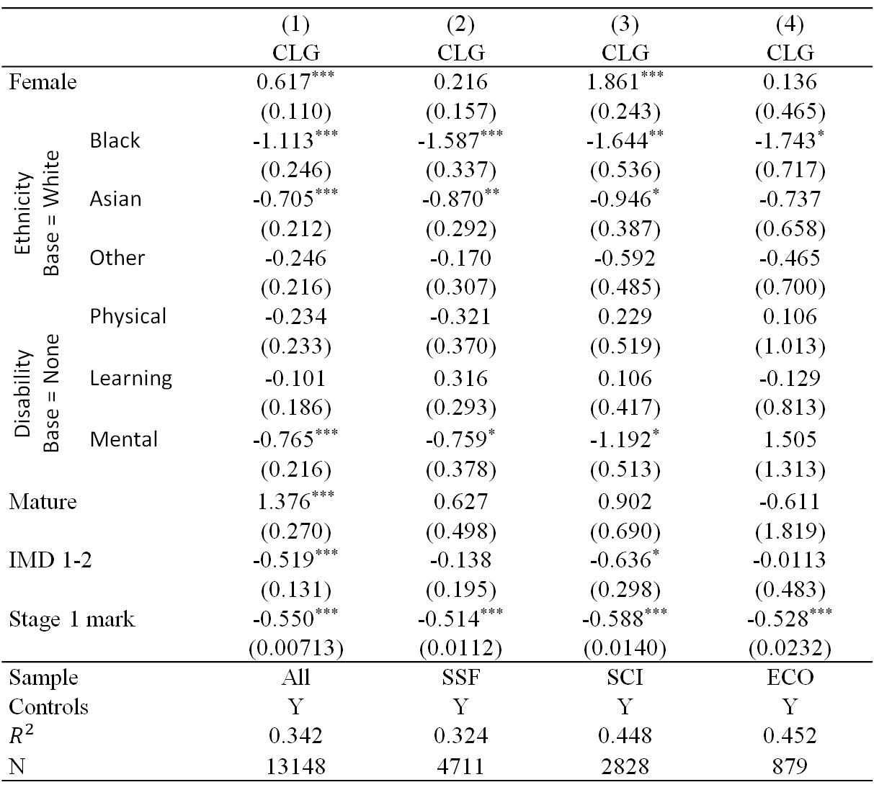
Contextualised Learning Gain Regression by:
SSF, SCI, ECO
 |  | (1) | (2) | (3) | (4)
 |  | CLG | CLG | CLG | CLG
Female |  | 0.617*** | 0.216 | 1.861*** | 0.136
 |  | (0.110) | (0.157) | (0.243) | (0.465)
Ethnicity Base = White | Black | -1.113*** | -1.587*** | -1.644** | -1.743*
 |  | (0.246) | (0.337) | (0.536) | (0.717)
 | Asian | -0.705*** | -0.870** | -0.946* | -0.737
 |  | (0.212) | (0.292) | (0.387) | (0.658)
 | Other | -0.246 | -0.170 | -0.592 | -0.465
 |  | (0.216) | (0.307) | (0.485) | (0.700)
Disability Base = None | Physical | -0.234 | -0.321 | 0.229 | 0.106
 |  | (0.233) | (0.370) | (0.519) | (1.013)
 | Learning | -0.101 | 0.316 | 0.106 | -0.129
 |  | (0.186) | (0.293) | (0.417) | (0.813)
 | Mental | -0.765*** | -0.759* | -1.192* | 1.505
 |  | (0.216) | (0.378) | (0.513) | (1.313)
Mature |  | 1.376*** | 0.627 | 0.902 | -0.611
 |  | (0.270) | (0.498) | (0.690) | (1.819)
IMD 1-2 |  | -0.519*** | -0.138 | -0.636* | -0.0113
 |  | (0.131) | (0.195) | (0.298) | (0.483)
Stage 1 mark |  | -0.550*** | -0.514*** | -0.588*** | -0.528***
 |  | (0.00713) | (0.0112) | (0.0140) | (0.0232)
Sample |  | All | SSF | SCI | ECO
Controls |  | Y | Y | Y | Y
$$R^{2}$$ |  | 0.342 | 0.324 | 0.448 | 0.452
N |  | 13148 | 4711 | 2828 | 879
Standard errors in parentheses, * p < 0.05, ** p < 0.01, *** p < 0.001

