Slide 1




Student International Travel related to Higher Education:
Carbon costs and potential solutions
Howard-Jones, P.A, Davis, C., Lopez Castellanos, F., McCarthy, L., Parker, M., Ralph, T. Tilling, L, Wade, K., Wenham, L. and Williams, J.
Notes:
Hello – my name is Professor Paul Howard-Jones from the University of Bristol. I’m here to tell you about some interesting research we’ve undertaken at our university that has implications for any higher education institution, but particularly those with a significant proportion of international students. This research has been undertaken with the help of many colleagues at the Universities of Bristol, Cardiff and Exeter, and with some funding from the Sustainability Team at the University of Bristol.

Slide 2
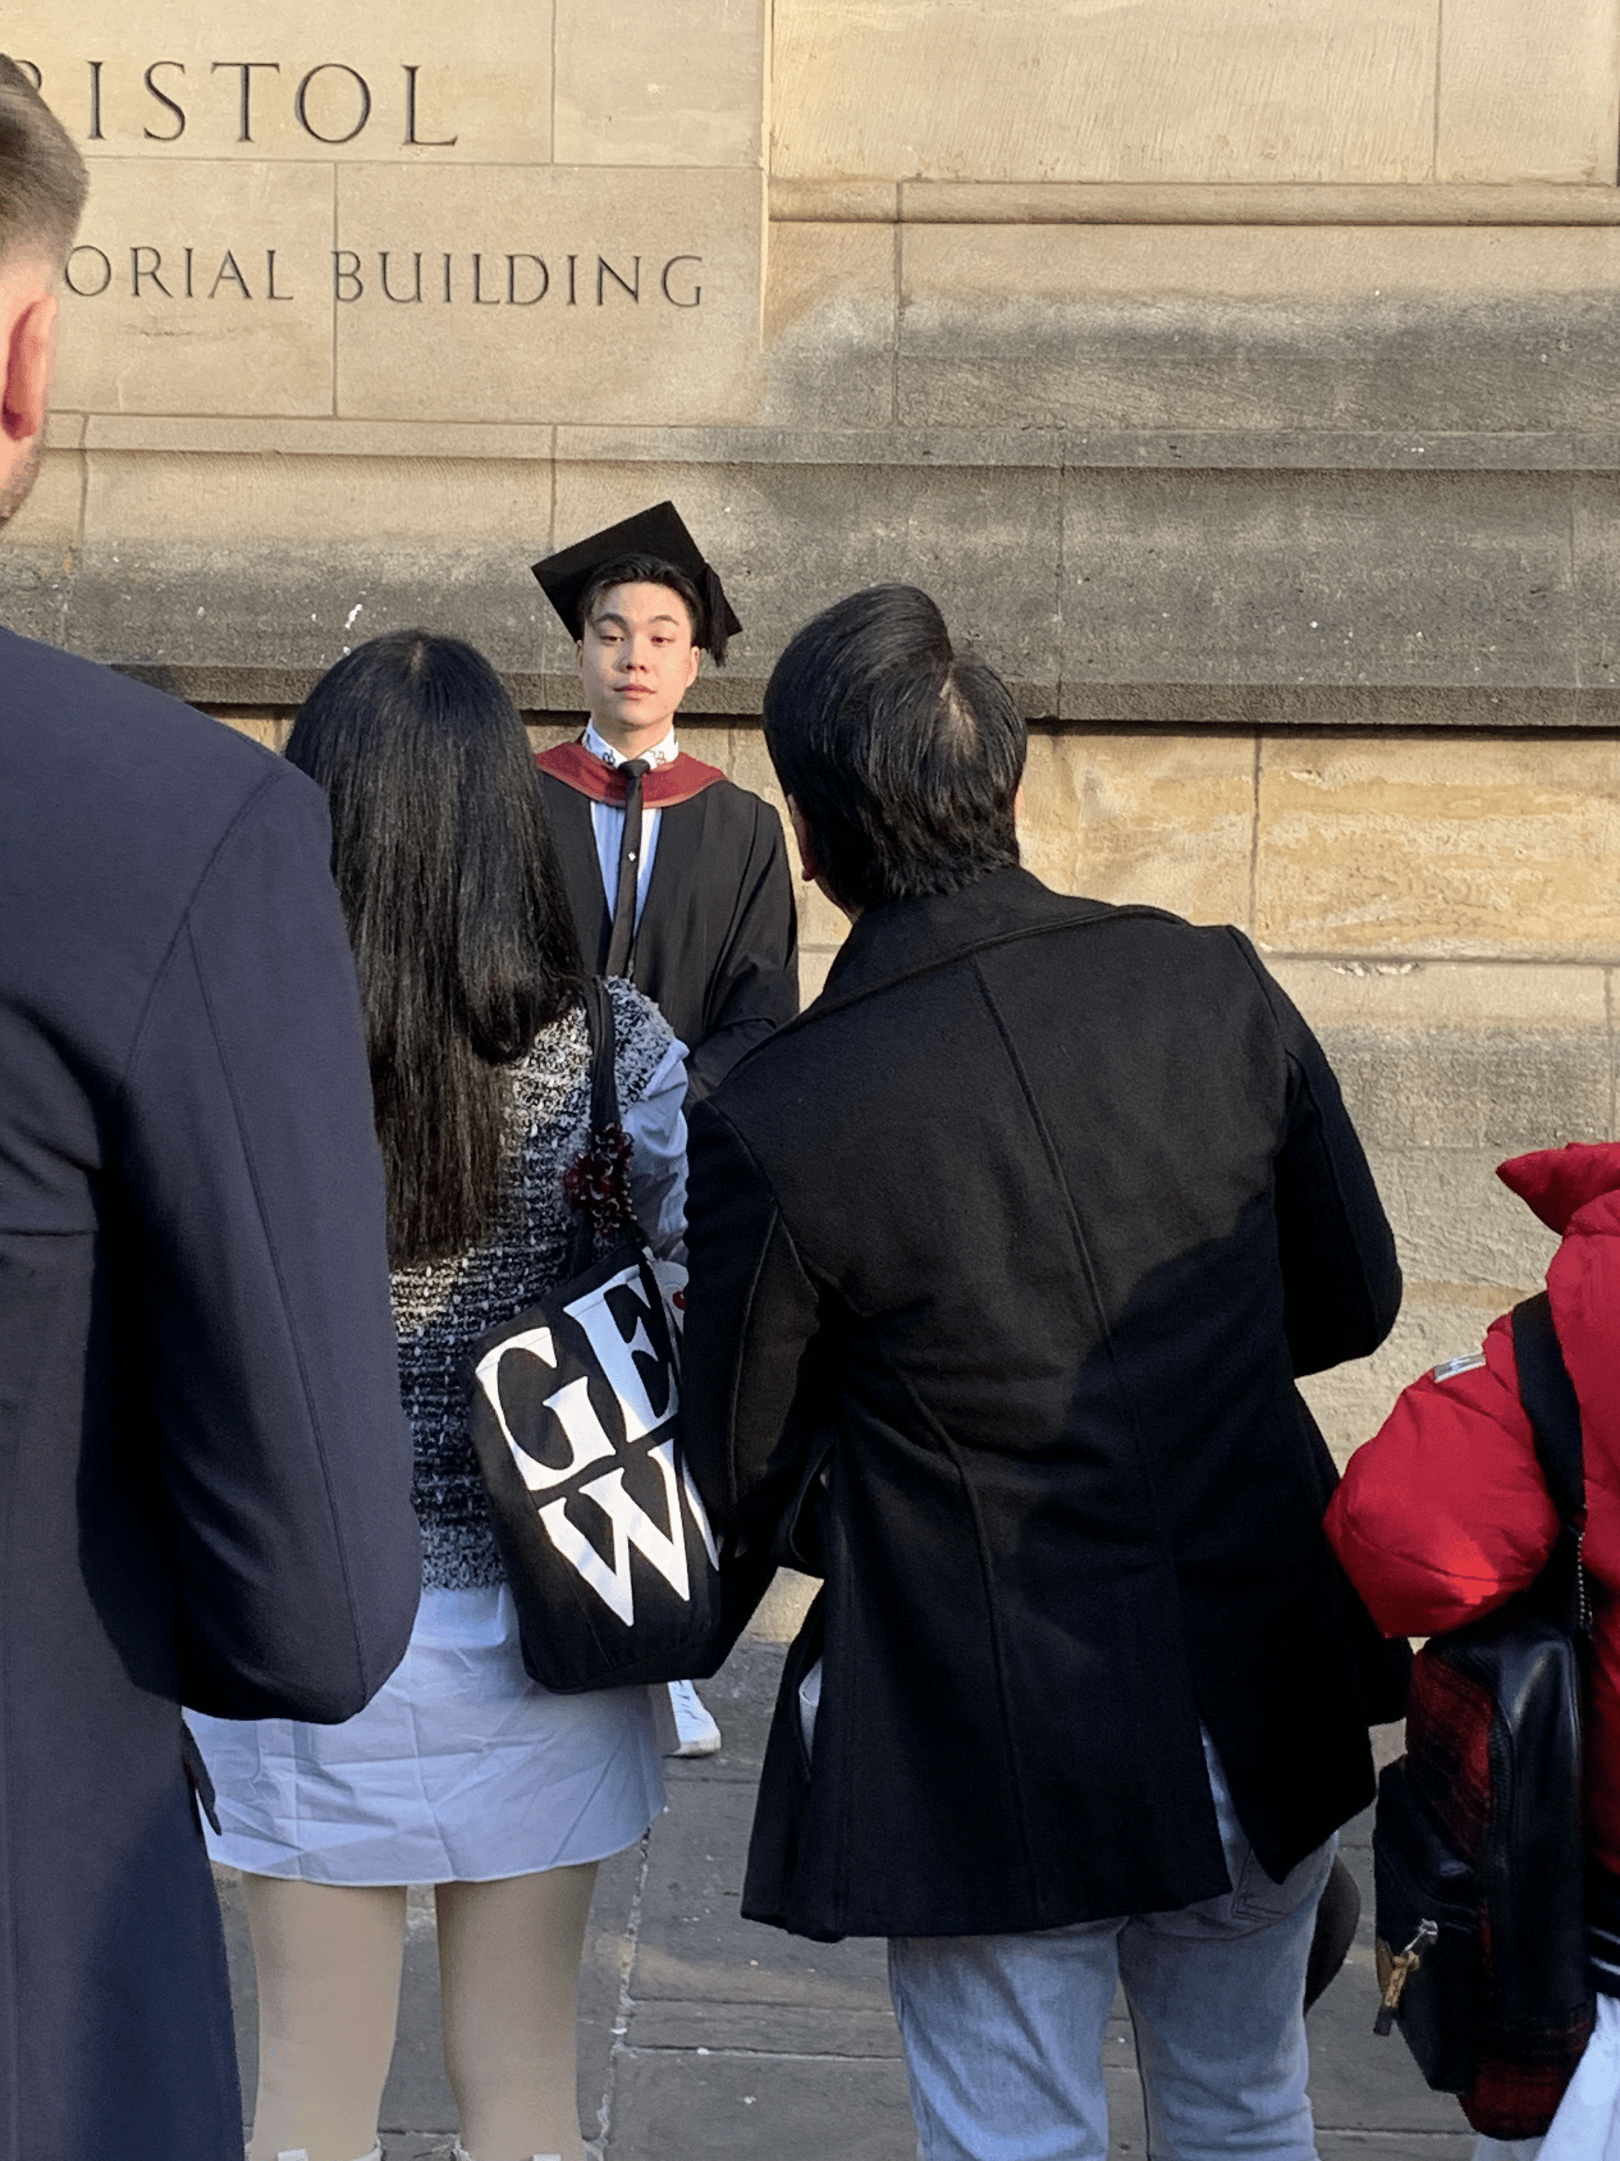
We love international students
Higher Education International students provide
  intercultural proficiency (Clarke et al., 2009)
  relationship-building (Gribble, 2008)
  poverty reduction(Kwak & Chankseliani, 2024)
  employability (Crossman & Clarke, 2010)
  engagement in global issues (Paige et al., 2009)
  financial income
Notes:
We love international students – they enrich our classes and the ethos of our universities in so many ways – and they provide important benefits for the economy of the hosting country and, in the UK, have become a critical component in the financial strategy that has allowed many of our institutions to thrive. Such benefits do, perhaps, make exploring the environmental impact of student travel a sensitive subject. But….

Slide 3
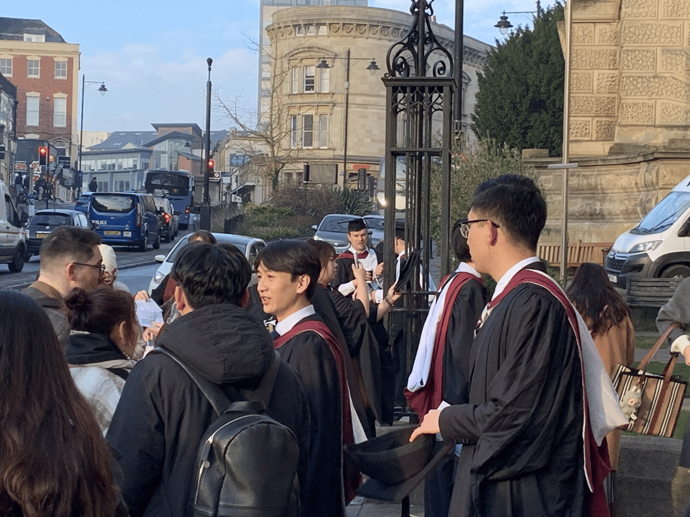
But there is an environmental cost
Shields (2019) assumed “low” and “high” emissions from one and two annual return flights respectively.
Both produced substantial emissions but Shields et al. emphasised the actual number of flights may be <1 (e.g. home every other year) or several per year.
Current discussion is not informed by data on the extent and purpose of student flying
Notes:
….there is an environmental cost and one which needs more accurately estimating. One of the very few attempts to estimate the carbon emissions of student flying was undertaken by Shields in 2019. He concluded that, whether one estimated a student took 1 or 2 return flights per year home, emissions were substantial. But he also emphasised that all current discussion on this topic was hampered by a lack of real data. It is necessary to know something of both the extent and the purpose of student flights in order to reflect on what actions might be appropriate to address this issue. A key question that such data might help answer, for example, is whether these emissions are anything to do with their studies? (and so, therefore, whether they need to be included in an instutions estimate of their Scope 3 emissions).

Slide 4
A lot of questions……
How to measure as a Scope 3 emission? E.g. one return journey home for every student per academic year? Travel survey? (8% return)
How many journeys home do international students make?
What about other journeys (e.g. Europe) when here? What is the responsibility of HE? Why do they fly?
What could be done anyway?
What about domestic students – isn’t this more about international flights than international students?
Research questions:
How much do students fly, where and why?
How can we address student international travel emissions?
Notes:
Indeed there are a lot of questions we might ask……
How can we measure how many flights are being taken in the first place? At UoB, we have been using a self-report survey – but one problem with this is that only 8% of student respond – probably the more diligent and socially conscious ones who might also be flying less.

Slide 5
Survey pinned to final assessment of year
Participating departments: Education, Psychological Sciences, Medicine and Business
Students (N=1709) required to open a “carbon survey” and complete it OR decline participation, before being able to submit assignment.
Ethics: Survey anonymous, removed 1 hr before deadline.
86% response rate (so good mix of environmental attitudes)
Once opened, the survey revealed four questions:
  Consent
  Numbers of flights to each of 5 world regions,
  Any seating classes used other than economy?
  which world region was their home located in?

Slide 6
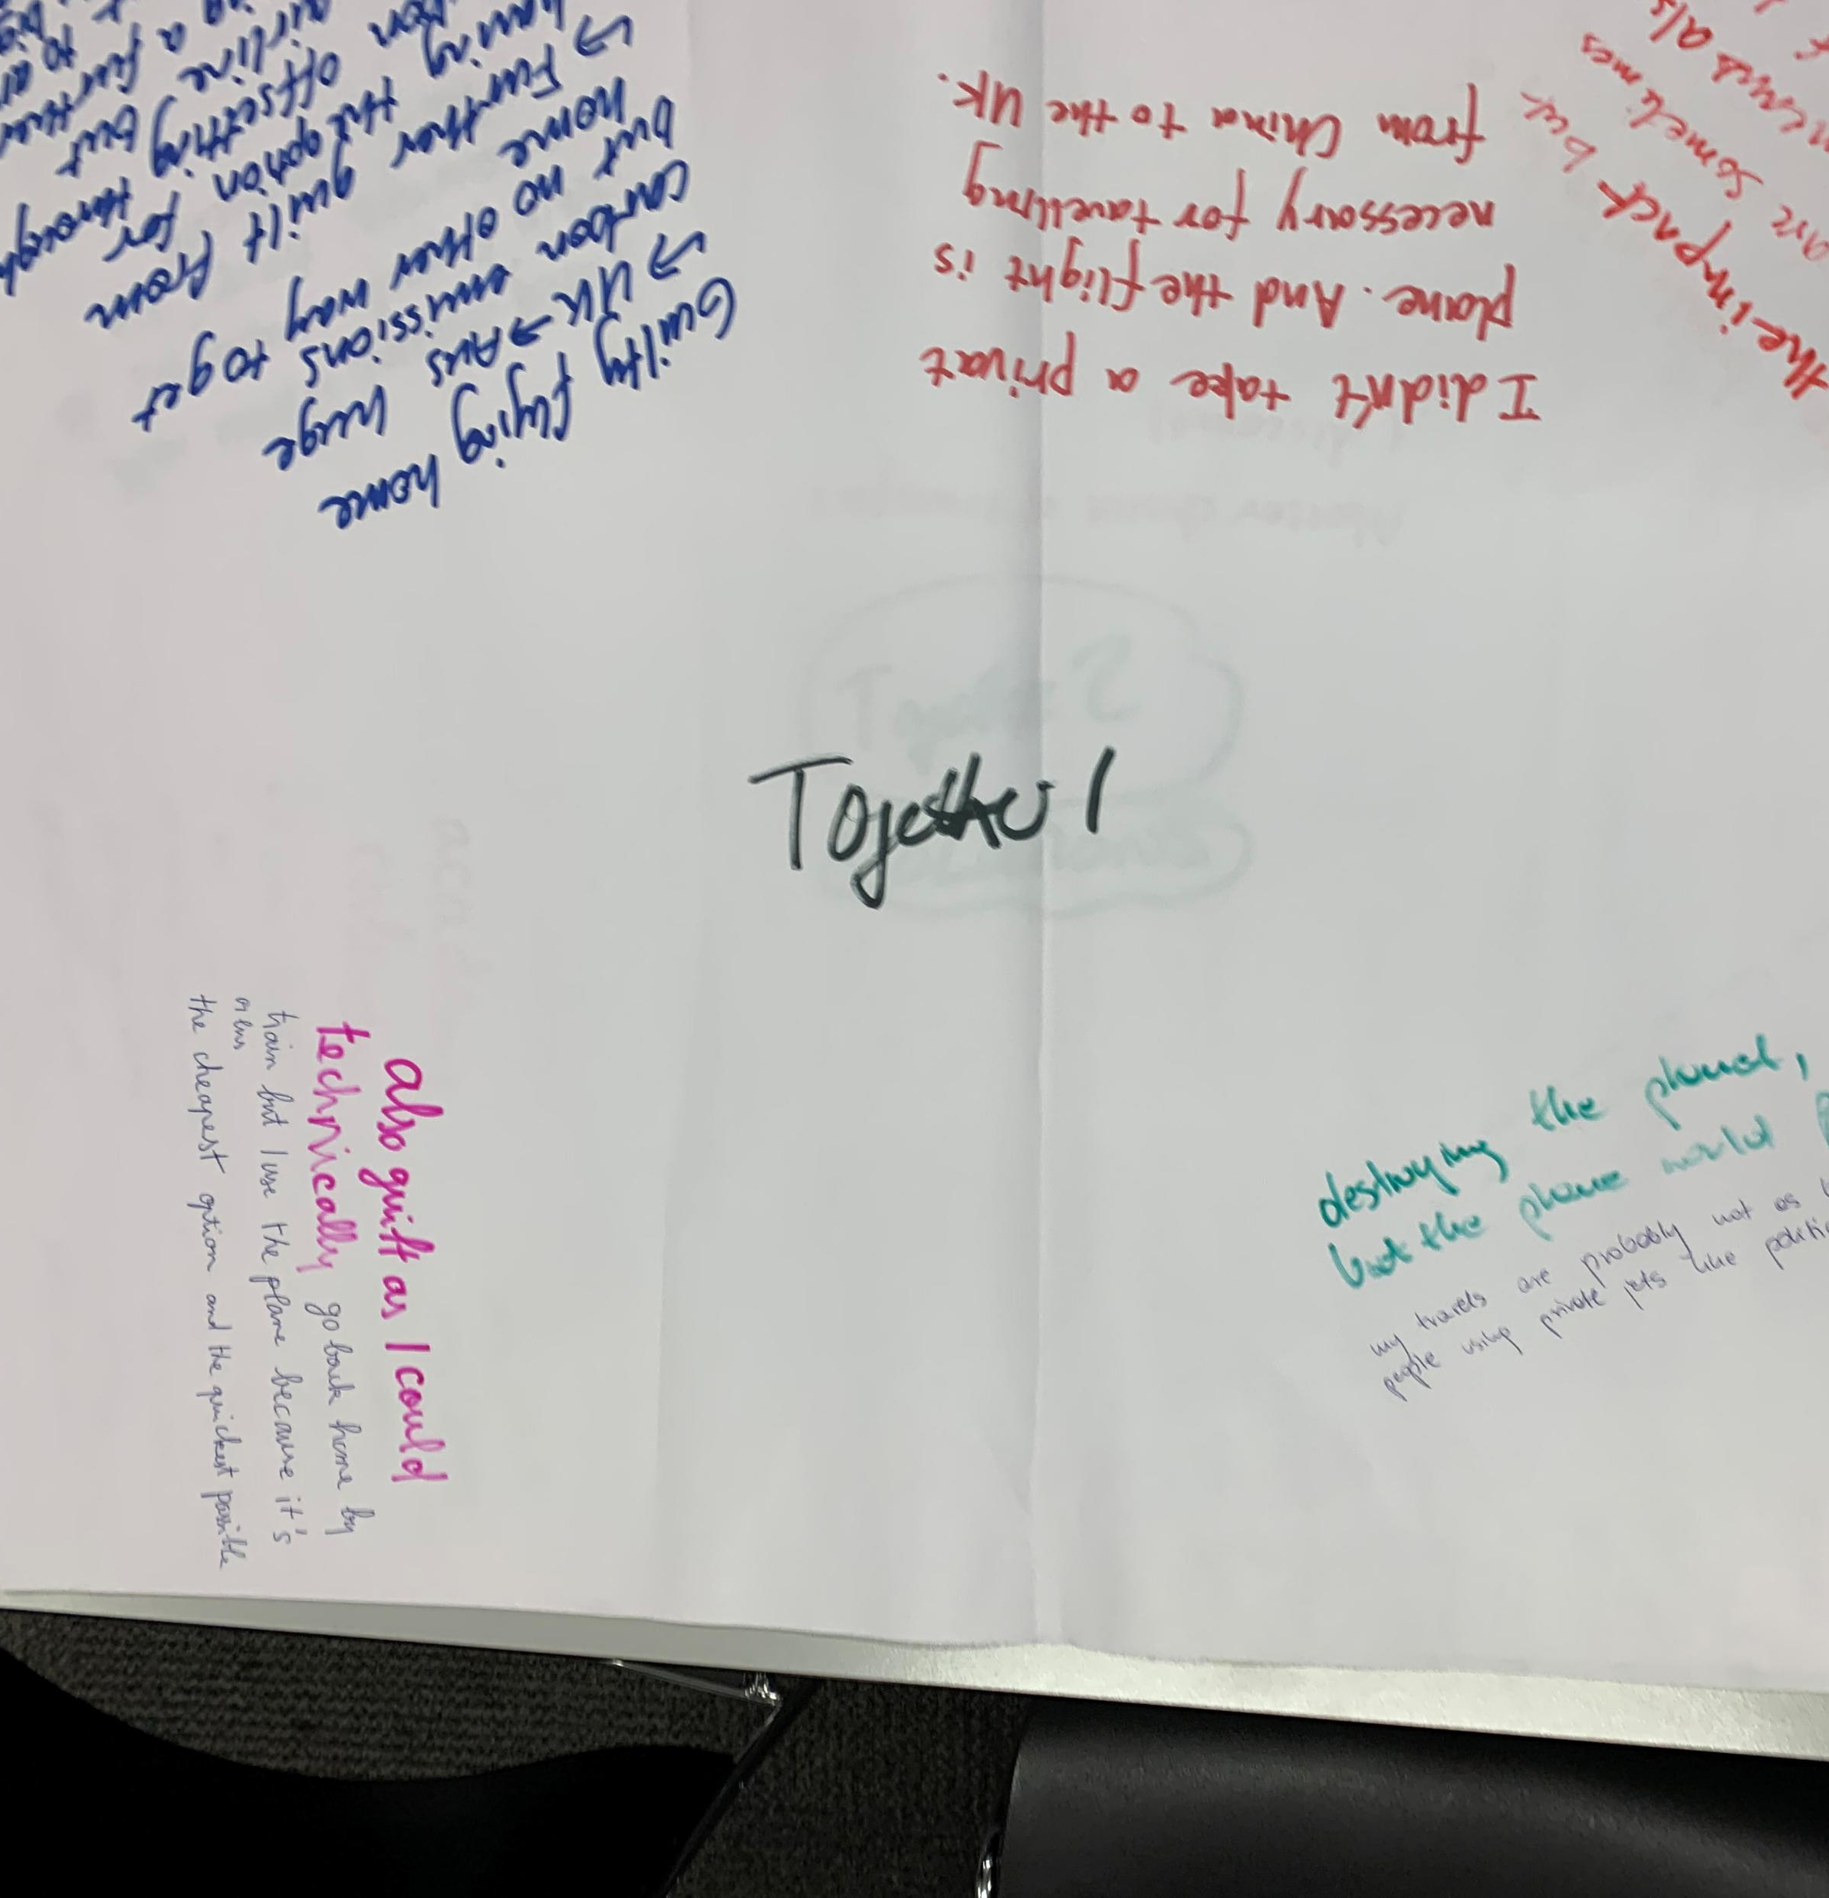
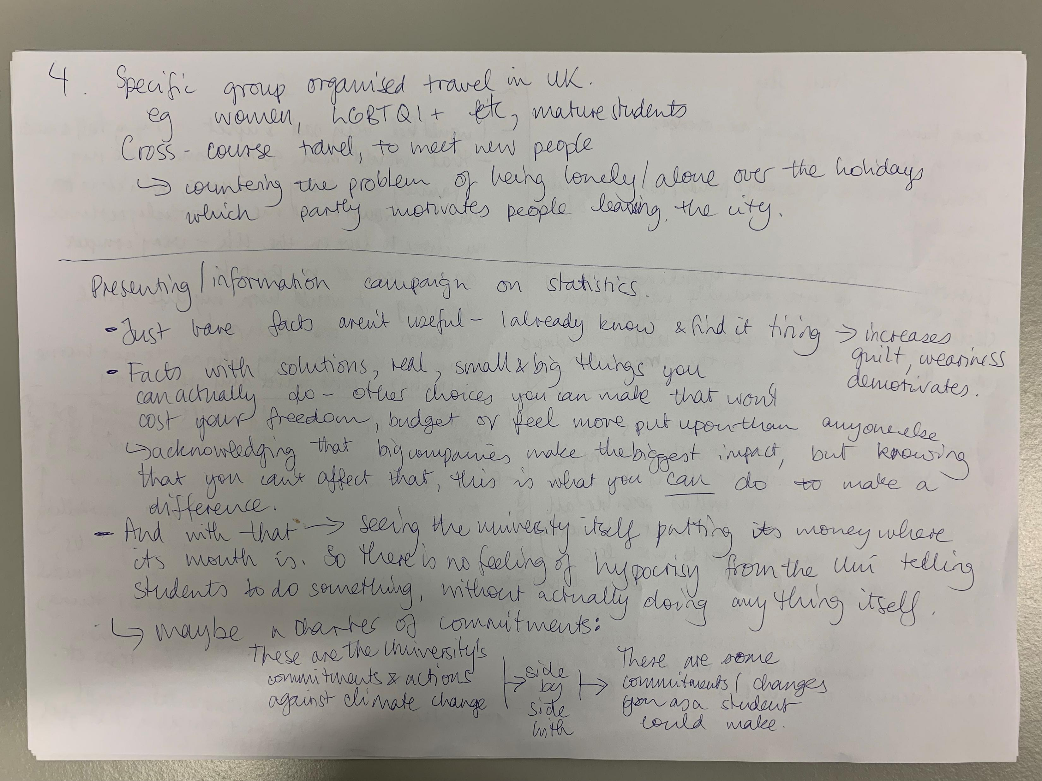
Student focus groups – to brainstorm solutions
4 x 90-min focus groups (4-5 students each ) across three universities in the South-West & South Wales.
Student participants (N=18) recruited via advertisements with £40 inducement; PGT, UG, Home and International students.
Participants wrote individual thoughts/feelings around flying and possible ways to address. Then discussed as a group while a researcher took notes.
Transcripts and notes subjected to deductive content analysis and a more inductive emergent thematic analysis, to address why fly and possible solutions.

Slide 7

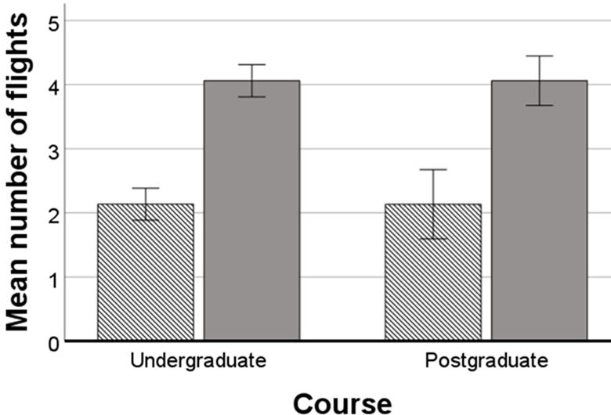
How much do students fly?
Course | Type of student | N | Mean (SD)
Undergraduate | Home | 563 | 2.13 (2.57)
 | International | 555 | 4.06 (3.11)
 | Total | 1118 | 3.09 (3.01)
Postgraduate | Home | 119 | 2.13 (2.84)
 | International | 234 | 4.06 (3.75)
 | Total | 353 | 3.41 (3.58)
Total | Home | 682 | 2.13 (2.62)
 | International | 789 | 4.06 (3.31)
 | Total | 1471 | 3.17 (3.16)

Slide 8
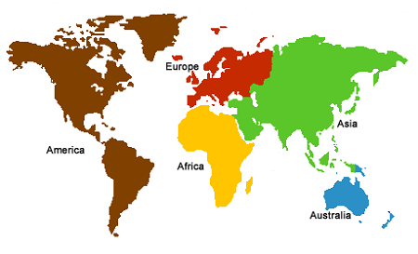
Example of survey question…
Q2. Please indicate number of return flights you will have made by completion of your Master's course:
Europe ______
Americas ______
Africa ______
Asia ______
Australia ______

Slide 9
How do they travel?
 | % Seat class (weighting factor for CO2e calculations in parentheses)
 | Economy (1.0) | Premium Economy (1.6) | Business Class (2.9) | 1st Class (4.0)
International students | 74 | 18 | 7 | 1
Home students | 86 | 8 | 5 | 1
Although only a small number of non-economy flights were taken (as below in Table 3), they inflated the average carbon footprint of international students by 27% and home students by 16%.

Slide 10
Where do they go?
Assuming the first flight between UK and the home region for international students was to enable attendance for the academic year, and flights to other regions were tourism.
International Students
20% to enable attendance for the academic year (i.e. 1 return flight)
31% additional trips home and
49% flights to non-home regions – assumed as tourism.
Home students: All flights taken by UK students are assumed to be tourism.
Most tourism flights are in Europe
% of flights for tourism | Europe | Americas | Africa | Asia | Australia
International | 84 | 5 | 4 | 6 | 1
Home | 77 | 7 | 4 | 11 | 1

Slide 11
What were the emissions?
Extrapolating to university student population
 |  | Estimated emissions from cohort (Kt C02e)
 | Number of students | Flights to home region | Flights to non-home regions (tourism) | Total
Home | 19,998 | N/A | 45.5 | 45.5
International | 9,994 | 57.4 | 18.7 | 76.1
Total | 29,992 | 57.4 | 64.2 | 121.6
UoB student flights 23/24 generated 121.60Kt CO2e
= ~five times Scope 1 and 2 emissions combined
Or…. = 27 excess deaths globally during this century (Bressler, 2021)
International students produce > three times the CO2e of UK-based peers
About two-thirds is from “additional” trips home (~41.6%) plus “tourism” (24.6%)

Slide 12
Emotions and sensitivity
* Justified re: maintaining relationships with family, friends and culture, plus tourism and leisure.
Some indignation about being to feel guilty about flying. One student concerned whether the issue discriminated against international students
Flying (home and elsewhere) as an escape from sadness and isolation/loneliness amongst international students:
“As an international student, we already have a limitation to only travel back home during breaks - the rest of the travel is mainly to overcome this feeling. Big travelling keeps my mind off things.”
Cost and time frequently cited as reasons to prefer flying
Concerns some potential employers recognised travel as important.
Many students pointed to use of private jets by pop stars and politicians – so why pick on them?

Slide 13
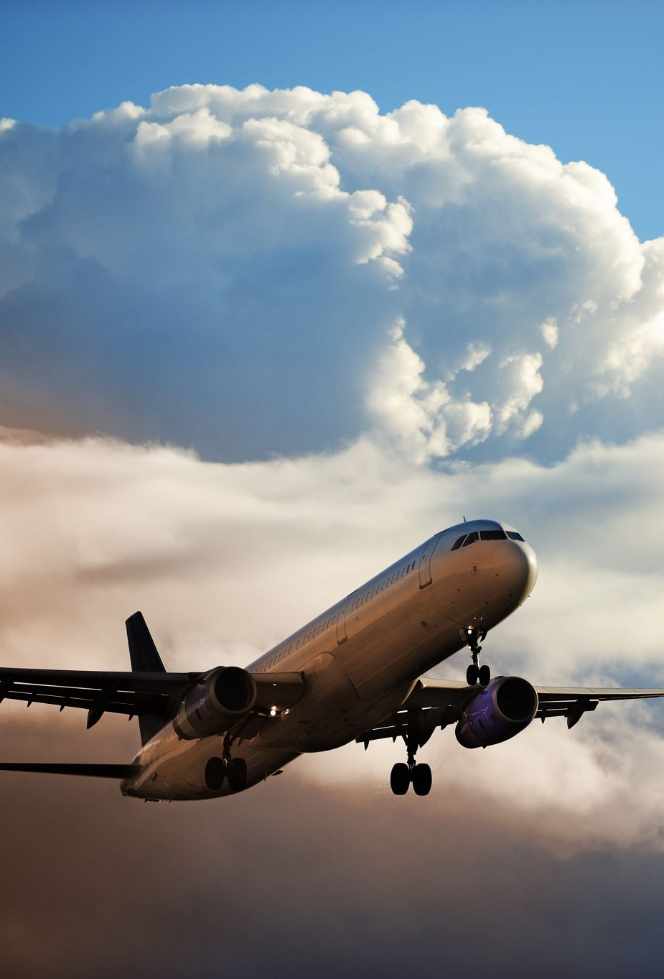
Misunderstandings
Flying emits no more emissions than driving
Since a scheduled flight would take off anyway, an individual’s decision to fly had no bearing
“The plane would take off anyway, even if I’m not on it”
Flying makes no significant contribution to climate change if the plane is full
Students wanted to know more about flying & climate

Slide 14
International students escaping Christmas
Several international students expressed a sense that there was little to stay for during breaks, particularly at Christmas – the idea that their university assumed students would go home during breaks.
“A lot of Chinese feel too lonely to stay at Xmas. They don’t celebrate Xmas. Then they go home a second time for Chinese New Year because that’s too important to miss.”
“Reading weeks” also discussed as a time when University life involved few events and a diminished sense of community, leading to European flights for leisure and tourism.
“No-one studies during reading week”
“crazy lot of free time, little contact and less workload” (than EU counterparts)
“Timetable is too flexible. Leads to more holidays and studying at a distance”.

Slide 15
Reducing student international travel emissions
  Suggestions included:
  Education and thoughtfully communicated information about flying and climate change
  Practical support for UK-based tourism
  Financial support for rail travel (e.g. discounted rail cards).
  Changing the academic year structure
  More support for international students to stay in the UK during breaks (e.g. more activities, Karaoke)

Slide 16
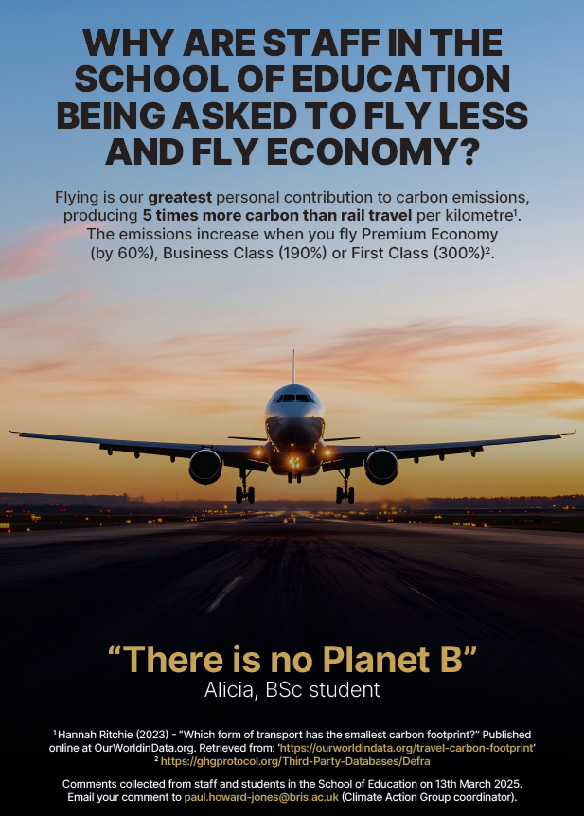
Reducing student international travel emissions

Slide 17
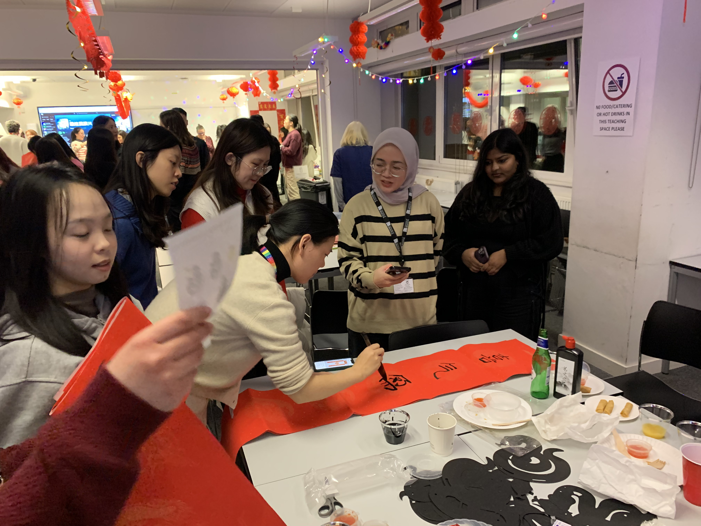
More support for international students to stay in the UK during breaks
Opportunity to reduce emissions, raise student wellbeing, while maintaining/increasing international recruitment

Slide 18

More support for international students to stay in the UK during breaks
Opportunity to reduce emissions, raise student wellbeing, while maintaining/increasing international recruitment

Slide 19
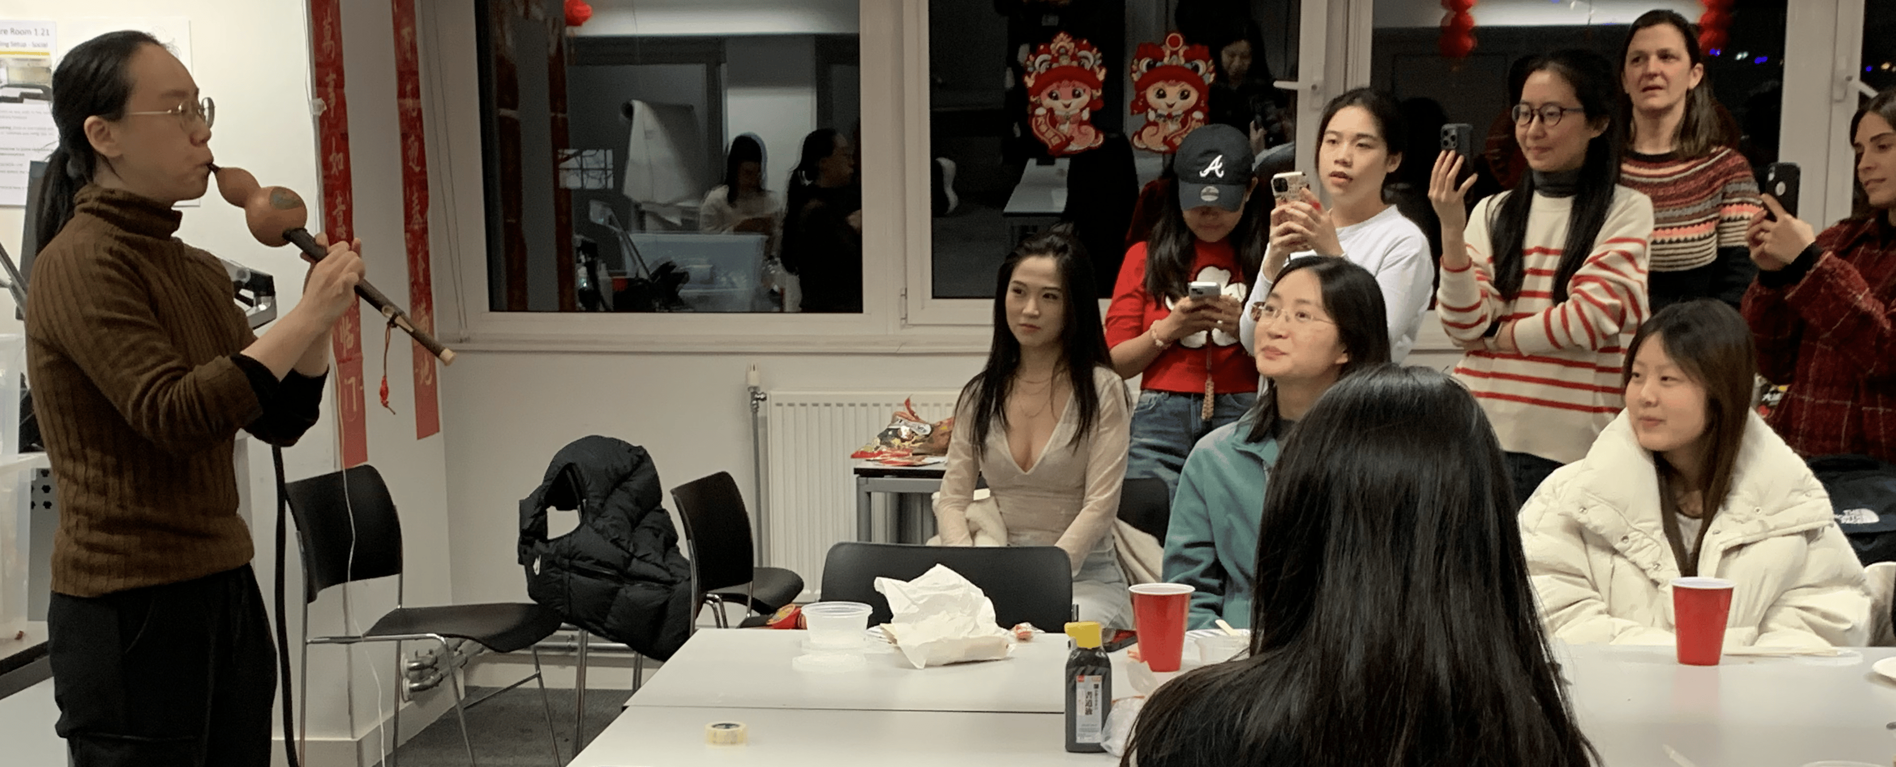
Netzero and wellbeing are entwined

Slide 20


Related podcast…..
linktr.ee/mindbrainplanet
Thank you for listening!

