Slide 1
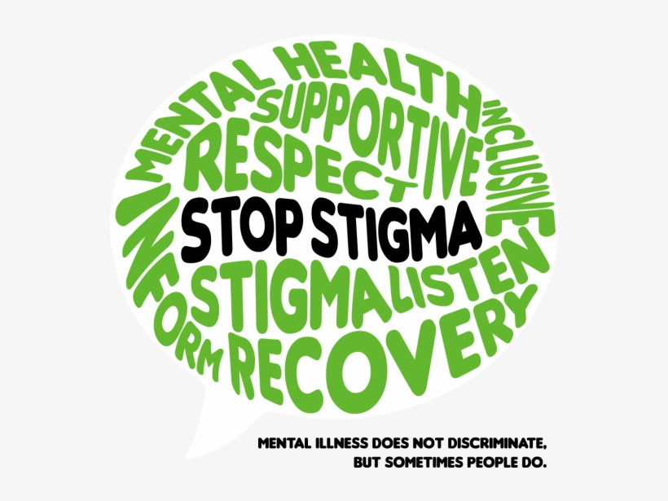

Exploring Academic Staff Perceptions of Disclosing Mental Ill Health and Perceived Barriers to Seeking Support from Line Management:
A Mixed Methodology Approach.
Ellie Brown& Dr Rosalyn Collings.
Background
Findings
Experiences of disclosing
9/38 had disclosed and all answered the question. 7 negative and 2 positive
“I would never recommend anyone disclose mental health issues to their employer in HE. I have heard too many others' stories”
“Not as good as it could have been, it was escalated beyond what I would have liked and unfortunately met with empty platitudes”
“Positive overall but I don't think he knew how to help”
What would help?
30/39 responded – therefore this was answered by individuals who did and did not have a current mental health diagnosis.
Areas identified: Supportive environment, understanding, workload
“A chance not to have to hide bad days, to feel safe at work, not to feel that bad days are viewed as negative performance by me, consistent line management that helped me with the bigger picture of managing my career through my mental illness.”
“If the University had a clear plan to help the person with the mental health problem without this having a knock-on effect on a colleague (e.g., work being passed onto an already overworked colleague).”
“the workload system is a fantasy and creates illness”
There is a plethora of student mental health research with university policies focusing on student wellbeing and belonging. In stark contrast there is an absence of mental health research from the academic’s point of view. With high levels of burnout understanding academic staff perceived stigma and barriers to help seeking is important.
Those who have had a mental health diagnosis are encouraged to disclose in order to gain further support (Hatchard, 2008). However, there are a different range of attitudes and perceptions in terms of an individual being able to disclose their mental health within their employment (Rusch et al., 2018). Contrasting views on disclosure are prevalent throughout literature, this is due to the diverse outcomes in which employees have received once disclosing mental health problems (Bonaccio et al., 2019). The awareness of mental health has improved over time, and recent studies suggests that individuals are now less likely to ‘conceal’ their mental health (Tay et al., 2018). Despite this, within a workplace individuals may face discrimination and stigma which increases the chance of ‘concealing’ mental health problems, in order to demonstrate their capability and performance within their working environment (Elraz, 2017).
A Qualitative study focusing on disclosure of mental ill health in academia that it was uncommon due to the misconception that ill mental health is a ‘weakness’, and the fear of judgement, discrimination, confidentiality and stigma within the academic work setting (Fox & Gasper, 2020).
The current study expands on research by …, focusing on academic staff. The aim of the research was to assess current levels of stigma and help seeking behaviour as well as seek to understand barriers to disclosing and experiences of mental ill health from an academic perspective
Nine participants (23%) had disclosed Mental Health to Line manager. Of those 56% had been referred to Occupational Health.
Individuals with a mental health diagnosis show significantly more positive thoughts towards help seeking in comparison to those who do not have a diagnosis (STATS). No differences between the two in levels of stigma (STATS)
The relationship between stigma and health seeking was negative with medium effect size r = -.295 for all participants. Noticeable differences between groups when correlations were split by diagnosis status: medium negative effect size for those without a diagnosis (r = -.363) versus no relationship for those with (r = 0.44)
Table 1: Average scores for independent items associated with work and colleagues within the Military Stigma Scale (Likert Scale 1 (definitely disagree) – 4 (definitely agree)
Conclusion
Both Quantitative and Qualitative analysis highlight the high level of fear and stigma still around relating to disclosing mental ill health and working within academia with a mental health diagnosis. Participants regualry discuss their concerns on how they would be viewed and the impact such disclosure would have on their career.
Participant recruitment was exceptionally difficult for this study – despite being a completely anonymous survey the supervisor received several anonymised messages via social media (where this was advertised in academic support networks with permission) that individuals were anxious that they would be identifiable. This level of concern is reflected within the results of the Military Stigma Scale with participants highlighting their worries about any diagnosis being on their records and what would happen with that information.
Those that discussed a positive response to disclosing mental ill health to their line manager also expressed the lackl of training on the line managers part. Despite having a good experience they felt line managers were not sure what to do with the information.
The experience of bullying was also rife amongst participants
Recommendations:
Mental Health to be present in disability equality charters and EDI committee’s
Line management training specific to Mental Health
Clear anti-bullying policies that are followed through
Occupational health recommendations to be completed and checked by HR
It is not possible to change ingrained stigma overnight but small steps can make a big difference.
Methodology
Table 1 demonstrates a high level of concern for confidentiality matters as well as career progression and respect from line managers and colleagues.
Qualitative Analysis
Barriers to Help Seeking:
17/38 participants answered this question
15/17 discussed issues with promotion and how they would be viewed and
“I think mental health issues in academic staff are looked upon as a weakness which has huge implications for career progression”
“Being thought less of and not being able to cope with things. It having an impact on my career and how people treated me”
“if I had to disclose an issue, I would be worried of it indicating I was not capable of managing the job”
4/17 specifically discussed how the information would be used – referring to previous bullying experiences
“It being used again me or being viewed differently once the diagnosis is known”
4/17 discussed confidentiality worries
“Uncertainty of confidentiality”
2/17 stated that they were very private individuals and didn’t see the benefit of disclosing
Mixed methodology online survey using secure platform of Qualtrics.
Participants: 38 UK Academics recruited via Social Media. 20 (?%) had a current mental health diagnosis.
Materials:
Military Mental Health Stigma Scale – adjusted to represent academia
Help Seeking scale
Open ended questions regarding barriers to disclosing mental ill health, experiences of disclosing and what would help
Ethical Approval: Sought and gained from the University of Wolverhampton January 2022.
Analysis: Exploratory data analysis and Content analysis

