Slide 1
Using the data
Stuart Marriott
Associate Director, Careers and Employability
Notes:
Worked in HE since January 2000
First role was to collect First Destination Survey data at DMU – which then become Destinations of Leavers from HE (DLHE)
Member of the AGCAS Graduate Labour Markets task group for 6 years
Latterly, since March 2016 have been Associate Director at Nottingham, with responsibility for Business Information
Collected last DLHE data in spring 2018 and since then have been a keen advocate of Graduate Outcomes survey

Slide 2
A wonderfully rich source of information
Making the most of the data we hold
Advice and Guidance – prospective, current and former students
League Table intelligence – institution and subject level comparisons
Business Development – employer mapping
Regional Retention – hot (and cold) spots
Academic Performance – planning and accreditation
Notes:
The data is fascinating – so rich, and flexible.
Benefit to UK institutions is that they receive individual outcomes, making analysis so much more detailed
Combined with other datasets, can do some really funky and useful things
Think broadly about how to use the information – it’s the closing chapter in the story of the relationship between the individual and the institution

Slide 3
Making the data accessible
Sharing complicated results in a digestible format
Data lends itself to visualisation
Excel based charts and booklets
‘What do Graduates do?’ publication
Software products
More recently business insight software
Tableau
PowerBI
Notes:
25 years ago I produced institution level and faculty level booklets to share the data
Overview of how the data had changed in previous years
Charts showing percentage of graduates working / studying / unemployed / not seeking work
Average salary
Response rate
Work by occupational level (traditional, modern, new, niche and non-graduate)
Excellent WDGD publication between Prospects and AGCAS was helpful to give national insight
One university produced a software product you could load your data into and run standard reports
Last 10 years – professional BI tools; dabbled with Tableau, now seriously involved in PowerBI.
Benefit of an excellent BI team – innovation, inquisitive and attuned to what the institution and Careers Service need.
National dataset bought each year – hugely helpful to compare subject by subject, location by location etc.

Slide 4
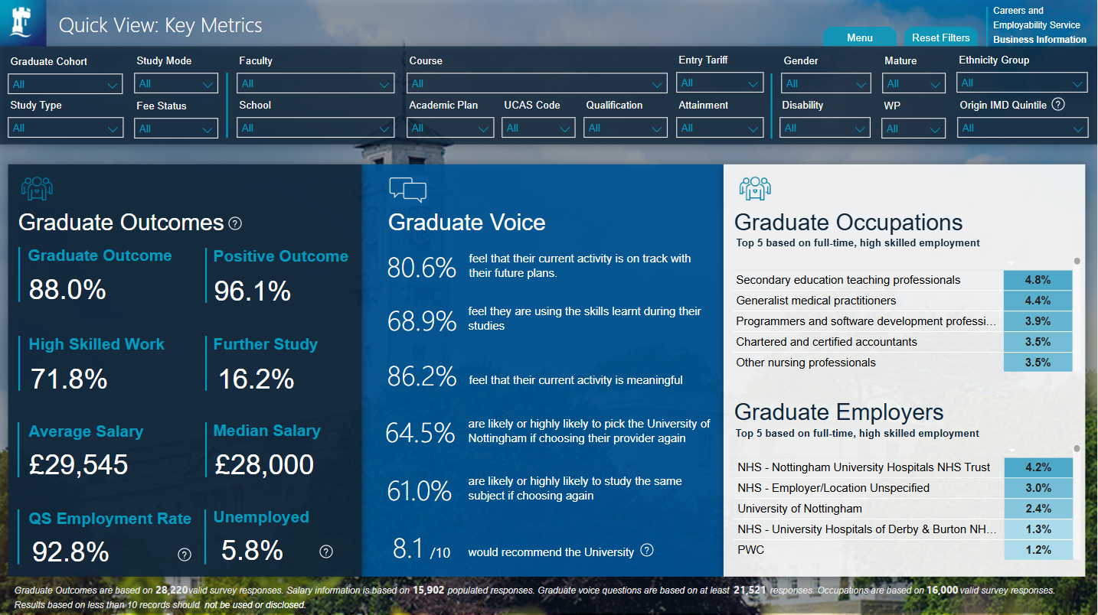
Notes:
High level overview – the headline statistics
Can drill down to look at year-by-year, or faculty-by-faculty and so on
Helpful quick view, answers a lot of questions
Designed to be copied and pasted if required!

Slide 5
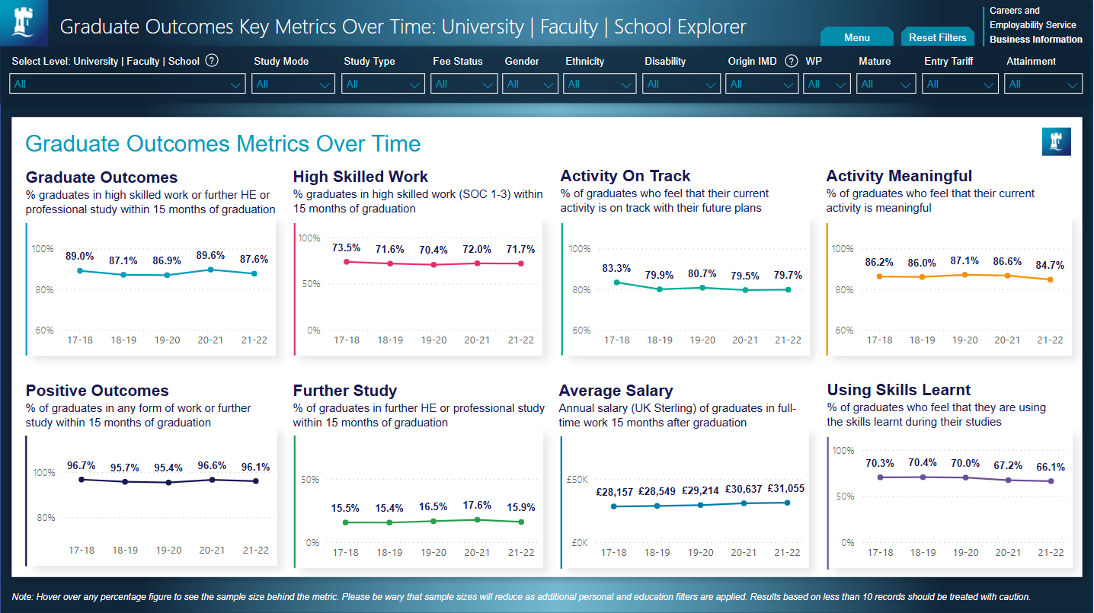
Notes:
5-year overview very helpful
Team are preparing the Class of 2023 data (currently embargoed)
For Nottingham, few signs of volatility – perhaps something to note in Activity on Track and Using Skills Learnt

Slide 6
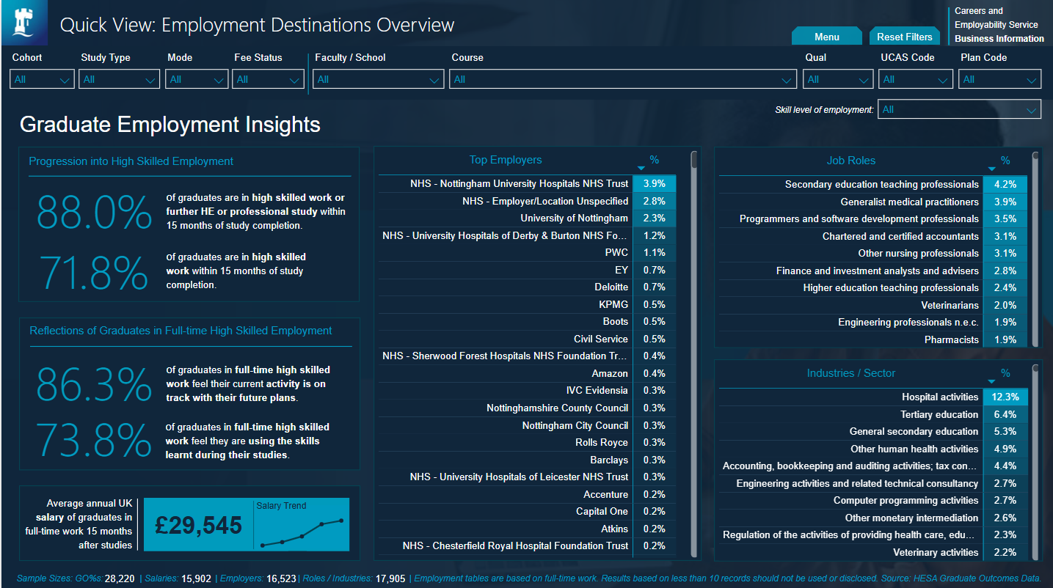
Notes:
Started to do more to share this info with students
Stay Local Careers Fair – screen with BI team colleagues showing students outcomes
Positive reinforcement – you are likely to get a ‘good’ job
Employers / Roles / Industries – helps understand what predecessors have gone on to do
Earnings – have you got an offer from an employer? Is it a fair offer?

Slide 7
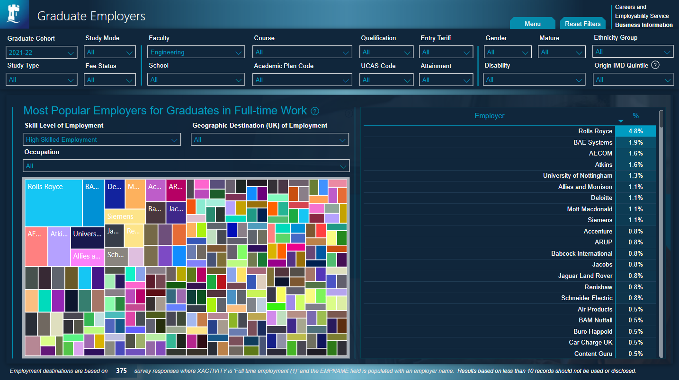
Notes:
Who do our graduates go on to work for?
Complicated and busy chart, so focused this on Class of 2022 for Faculty of Engineering, and those in highly skilled work
Gives an idea as to who recruits Nottingham graduates – inspires prospective and current students, informs finalists and recent graduates
Also helps with our Business Development activity
Are there recruiters hiring Nottingham students and graduates, that we don’t have a relationship with?
Are there recruiters who do lots with us, not represented on that list? And if so why is that?

Slide 8
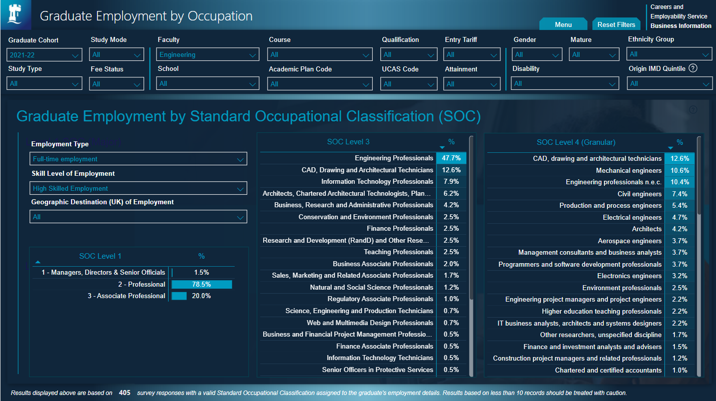
Notes:
And what type of jobs did our Class of 2022 Engineering graduates go on to do?
Uses the Standard Occupational Classification – done centrally, so should be consistently applied across all institutions
Helpful to show at Level 3 and Level 4 – breaks down the type of Engineering Professional roles for example
Very helpful to demonstrate to students, also good for academic colleagues to see where their alumni are

Slide 9
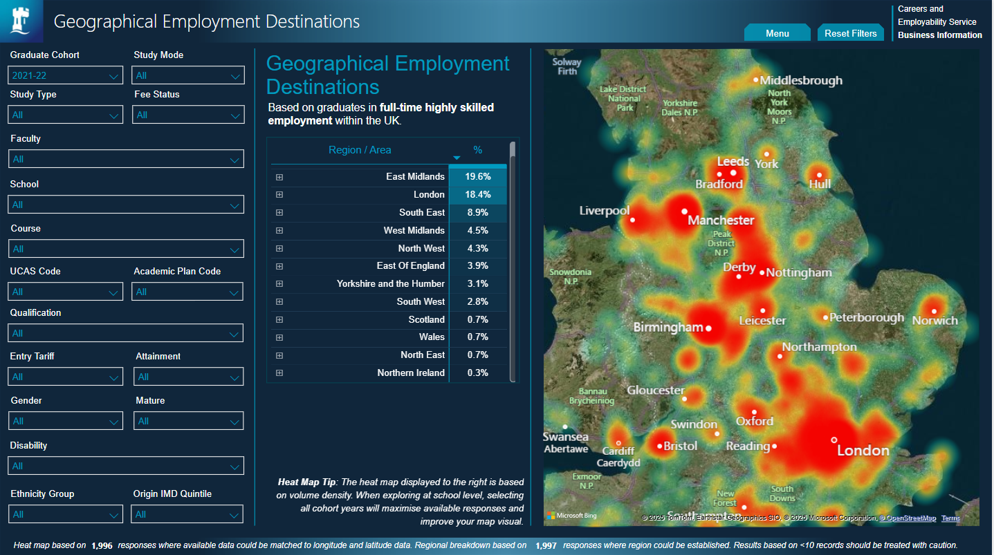
Notes:
Whereabouts do our graduates go?
Again, focusing on the Class of 2022
Regional retention of graduates is an issue in the East Midlands – one of, if not the lowest level, in the UK
London and the South East are a big draw (back home?)
Useful to see UK hot spots – and being able to break this down by Faculty and School is helpful
Medicine and Health Science almost exclusively East Midlands and London, whereas Arts much broader spread

Slide 10
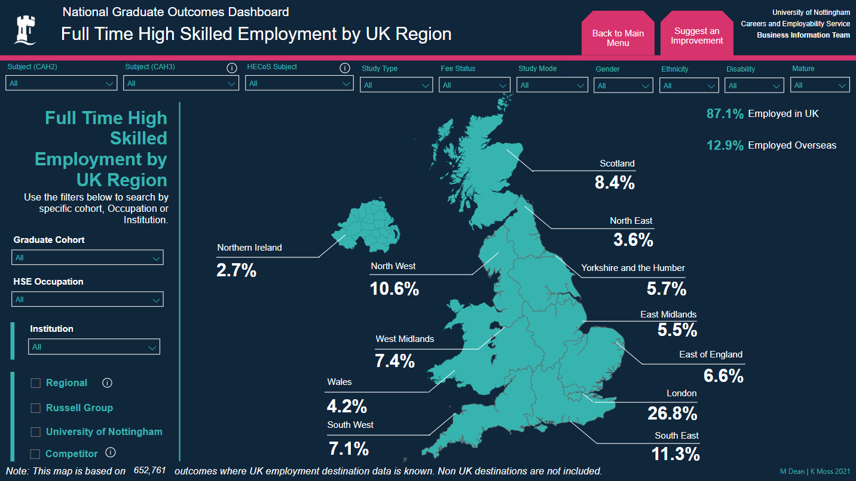
Notes:
Moving on to look at how we use national comparisons
* Regional graduate retention – 8% of students are taught in the East Midlands, but only 5.5% of those in highly roles are working in the East Midlands

Slide 11
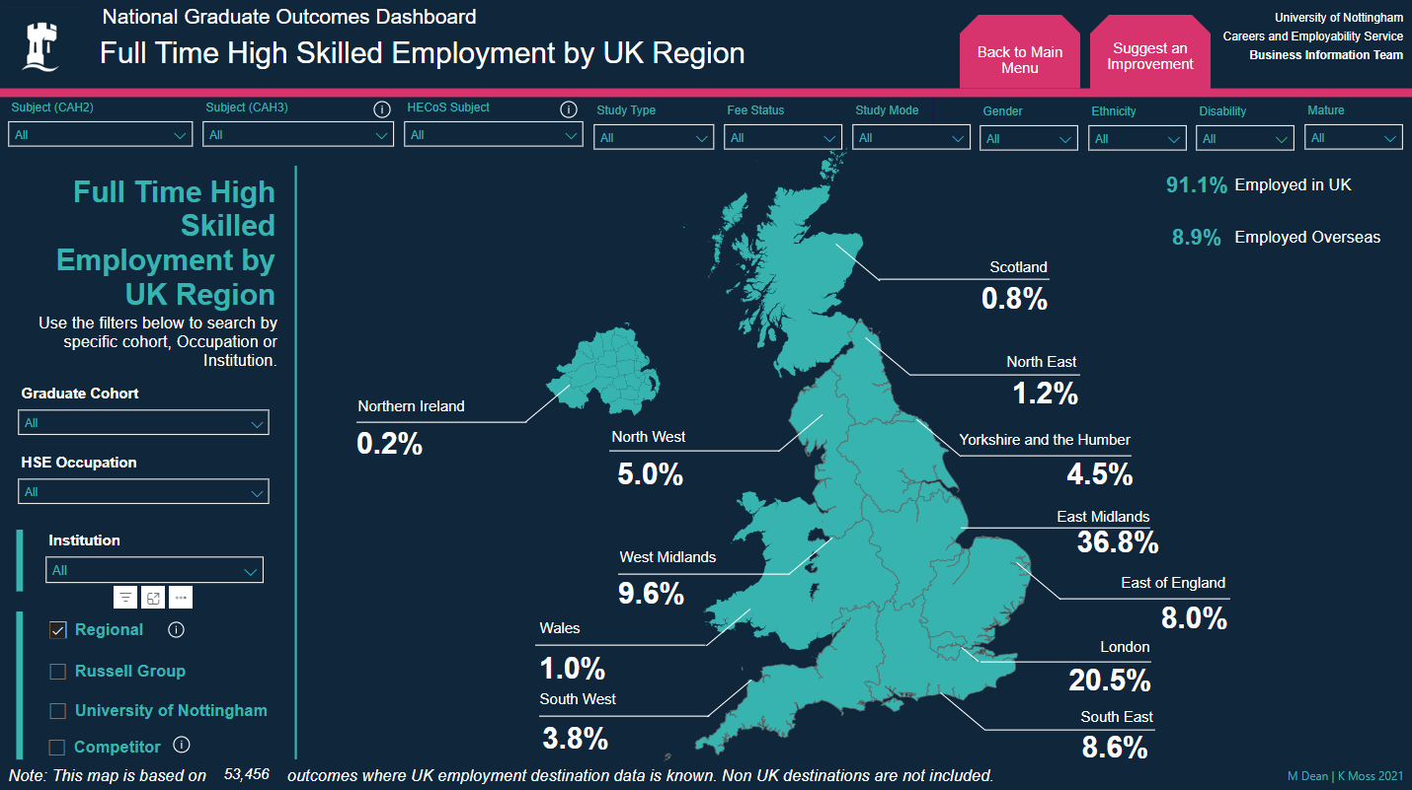
Notes:
And we can break this down to look at where graduates from the East Midlands universities go
Between 35% and 40% of those working in highly skilled roles are in the East Midlands – other parts of the UK have higher levels of retention
Helpful for measuring the impact of programmes to retain talent in the region
When mapped against salary data, gives us an important message to share with recruiters (East Midlands has one of the lowest median and average salaries for HSW in the UK too)

Slide 12
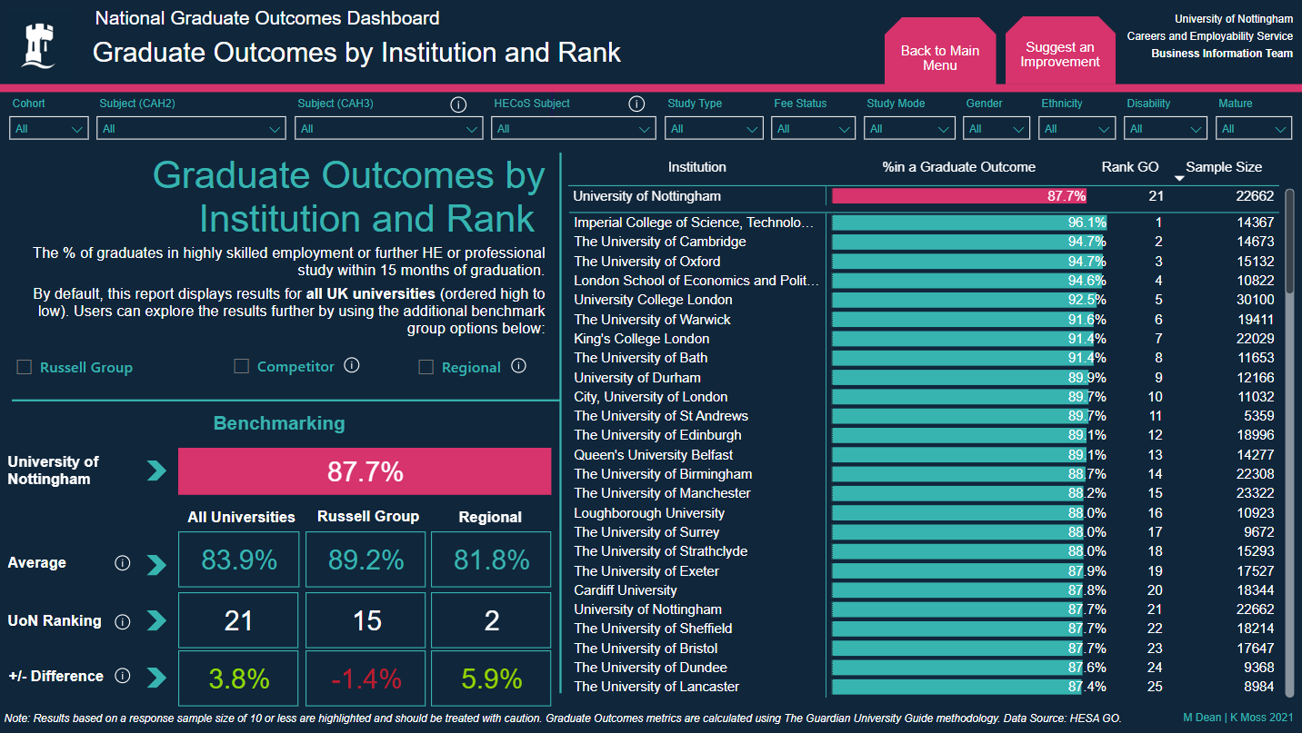
Notes:
Important to understand not only your score but your relative position too
University of Nottingham Class of 2021 had outstanding score – 89% in highly skilled work or study – but lots of other people did too
Use this slide to review where we are in the sector and how we compare Russell Group and Regional institutions too.
This type of information is used by senior colleagues for planning purposes – how do we compare against our peers, what do we need to do to move up in the league tables?
Also helpful to illuminate the tight banding of scores – 2.0% improvement moves Nottingham into the top 10 in the UK; 2.0% reduction in score moves Nottingham to 35th in the UK

Slide 13
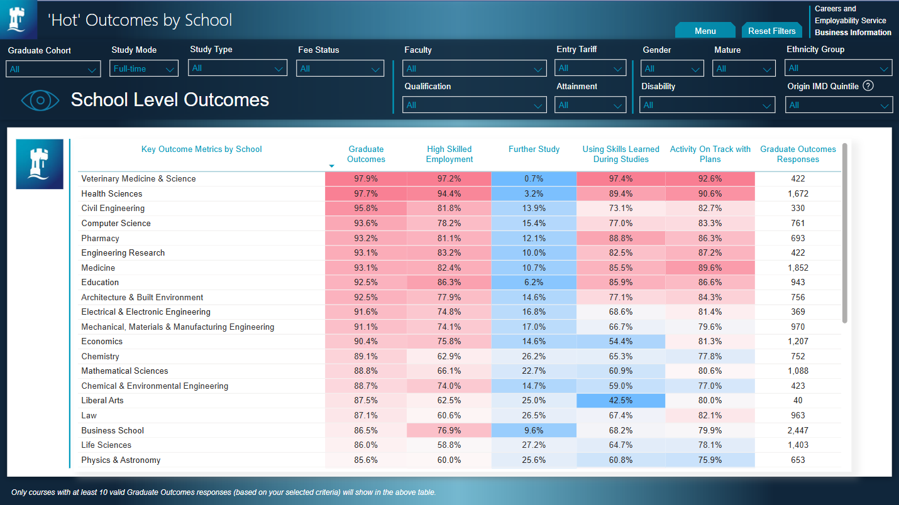
Notes:
Back to our internal dashboard
Helpful to see who the highest scoring Schools are (and can do this at course level too)
This isn’t a ‘stick’ tool; it’s there to see where we might need to make an intervention and to help Careers Consultants report facts back to Heads of School
Employability Partnership Agreements – use this data to report scores and design enhancement plans

Slide 14
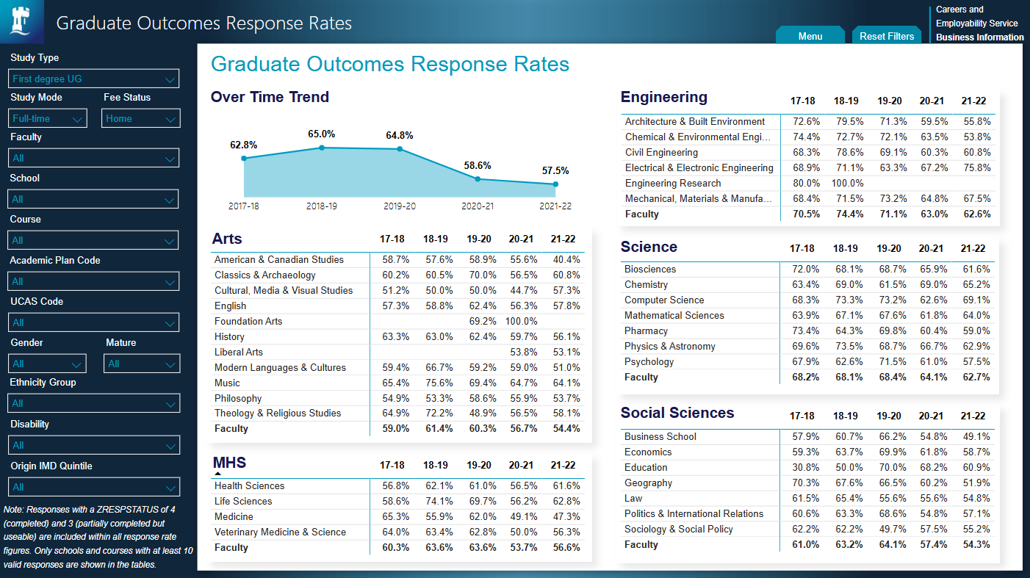
Notes:
And finally – Response Rates (League Table population)
Not terrible, but could be better in certain areas
Keen to do something to map response rate versus outcome
Aware though that it’s far more complicated – what about entry tariff and exit qualification too?
Helpful if we could do more to nudge people, IN THE COLLECTION WINDOW, to complete the survey

Slide 15
Key takeaways
My advice to (new) colleagues involved in reporting
Hugely rich dataset
Flexible, interesting, connectable
Try it, see what you come up with
Share ideas
“Create once, use many times”
Notes:
This is such an interesting source of information – yes it’s ‘dated’ by the time we can use it, but it’s still fascinating and relevant
Because we have line by line data we can couple it with lots of other things – placement impact, degree attainment, entry qualifications, WP markers
Don’t be afraid to try and visualise something – you’ll be surprised by what you come up with
Think about the end user – is this for BI people, or is it a snapshot for UEB/Council member
Shout up if you want to discuss / brainstorm – always happy to help
Great advice from CB – once you’ve created it, use it again and again, and let people know it’s there. Self-service has been so helpful for us.

