Slide 1
Data, data everywhere
Andy Youell, HEIR, 2023-05-19

Slide 2
What is data?
Science
Art
Magic
Gold
Power
Fairy dust
Something to describe the world

Slide 3
Is data any good?
The world
Complex
Universal
Fluid
Unpredictable
Data
Simple
Limited scope
Fixed
Planned
Data is a very poor facsimile of the world

Slide 5
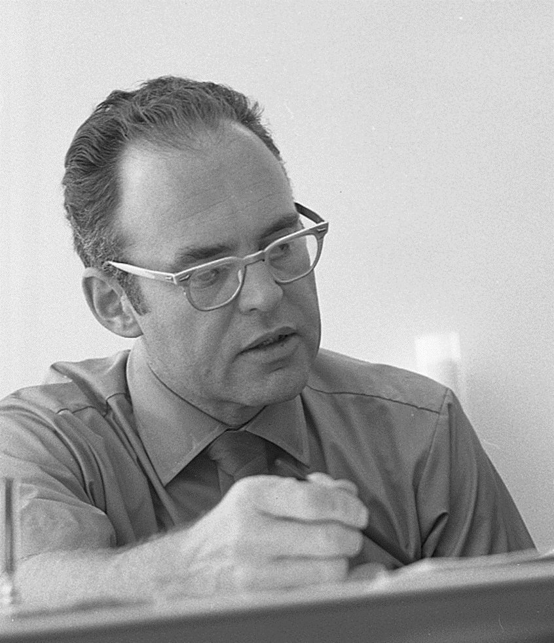
cc-by-sa-2.0 IntelFreePress

Slide 6
The law…
Moore’s Law – transistors on a slice of silicon
Keck’s Law – fibre-optic capacity
Haitz’s Law – LED lumens per dollar
Koomey’s Law – computations per joule of energy
Exponential growth in the power of information technology

Slide 7
Value expectations
Data
Statistics
Information
Intelligence
Insight
Foresight

Slide 8
Data lifecycle
Real world
Analysis
Data model
System
Business process
Foresight
Insight
Intelligence
Information
Statistics
Data

Slide 9
Governance of data as an asset
Data ownership
Data stewardship
Authority and accountability
Risk and issue management
…across different dimensions

Slide 10
Governance of processing and analysis
Largely non-existent
Many failures in this space
  Office for Students vs Bloomsbury Institute (2020)
  Exam grades fiasco (2020)
3 significant dimensions
  Alignment of expectations and capabilities – understanding of the real world
  Strong feedback from technical operations to policy level
  Technical assurance (including external review?)

Slide 11
Data gov challenges (before Inst Research gets good data)….
It’s probably upstream…not you
No CDO, pockets of local data governance, compartmentalised systems…..LEADERSHIP
Ignorance (e.g. “the Information Gov people do that, don’t they? They deal with GDPR”)
Resources
Burden
Skills

Slide 12
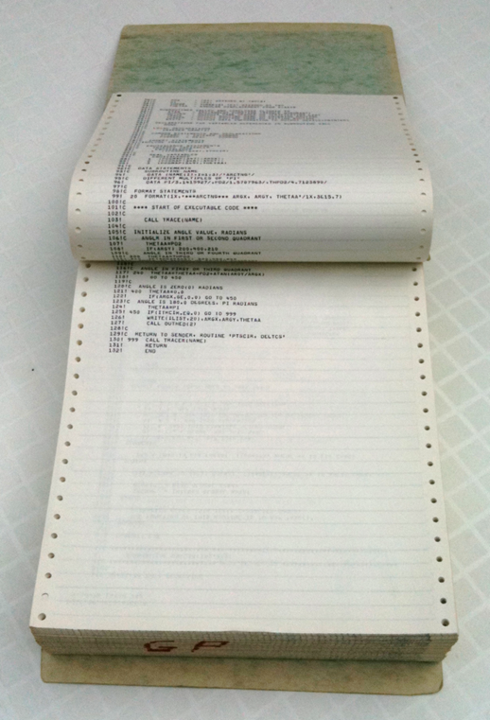
Some solutions – lack of governance structures
Build informal gov capacity through a coalition:
  Data is everywhere – there will be allies to be found outside Inst Research (Info Gov, Registry, IT, Schools)
  Get out there and talk to people (you will learn loads and get moral support)
  Collectively – tell the senior team you need it (it needs leadership)

Slide 13

Some solutions – Senior team engagement
What are the hooks for the senior team?
  Avoid a bin fire – all your processes are data-driven (even if on paper)!
  Risks - OfS registration, student recruitment, REF
  Operational Risk – e.g. we can’t enrol students
  Efficiency (savings, but also removing menial, repetitive work)
  Their reputation (selling the Lodge building)

Slide 14
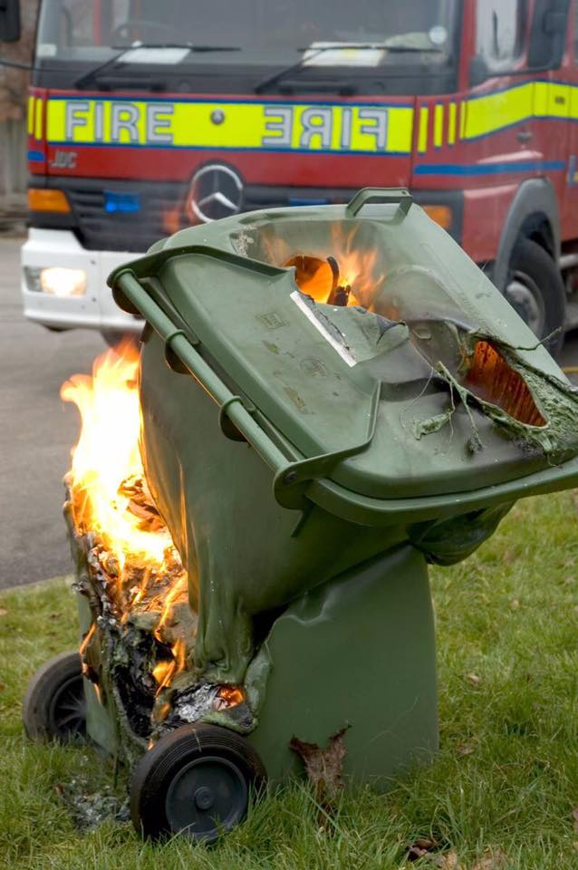
Big Bin Fire example
  XXXXX University's failed Student Lifecycle Project went through three leaders, several changes in scope and was ultimately superseded by regulatory policy change before the bulk of the £30m project was abandoned in what is shaping up to be a classic IT disaster.
  “as work began developers realised it was connected to so many other legacy systems – with little or no documentation – that this was not going to work.”
  “The plan to replace CIS was abandoned, and instead, the project was to use it to help the new system talk to all the legacy applications. But then the project team began to realise the data models between SLP and CIS were fundamentally incompatible.”
  “then the project leader felt like we needed to get more staff to look into that complexity, so we just snowballed the number of business analysts and spending started to go up so dramatically.”

Slide 15

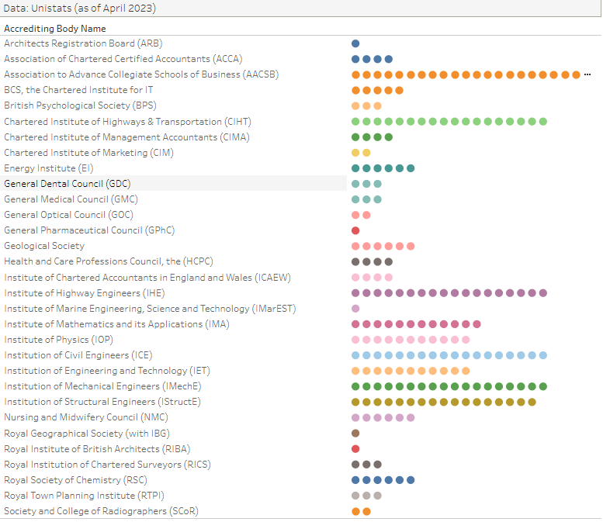
Some solutions – Awareness
Senior Team/Board level info
  Clear, basic info at start (as not usually HE data experts)
  What/how many systems? Integrations?
  How many regulators? Each is a risk [WonkHE article]….plus OfS, OIA, DQB etc

Slide 16
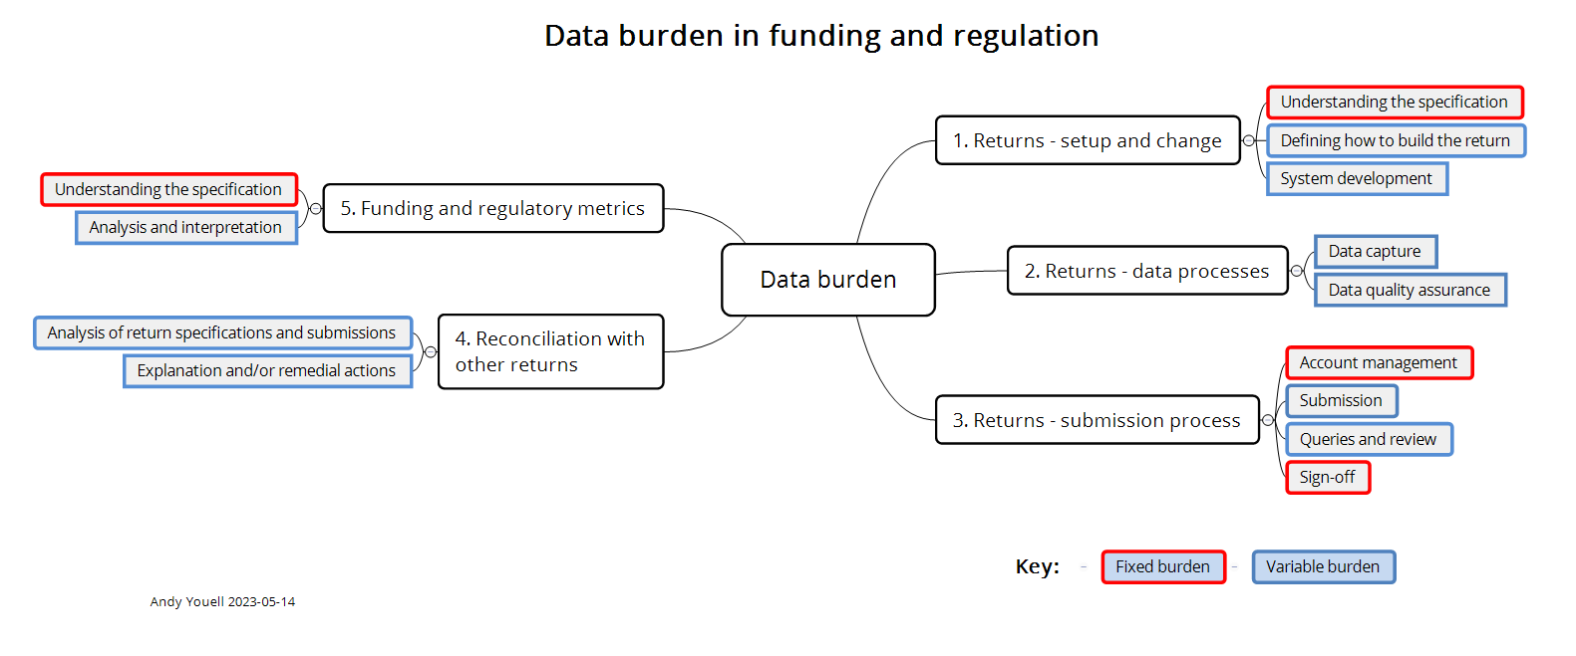
Some solutions – Awareness
Senior Team/Board level info
  What does it take to do a return?
  A striking feature of an article on Andy’s website – look at all the clever stuff that is needed to do a return (intellectual capacity, continuity)

Slide 17
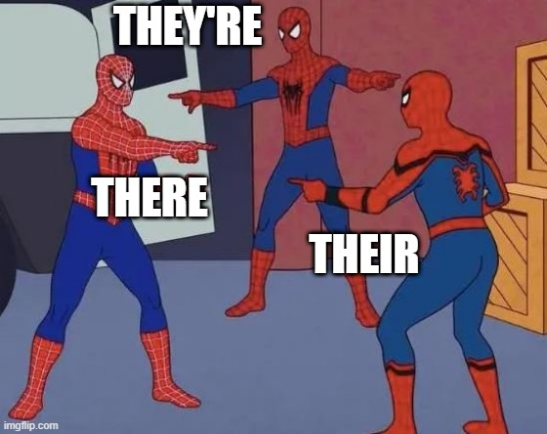
Some solutions – A good data team as a hub
Who organises – Data Professionals Network??
Coordination tackles a number of the weaknesses
  Understanding what our data is
  What are the priorities?
  What can we improve now/soon?
  Remove duplication
  Common definitions
Senior Team ‘buy in’ + coalition = platform for a meaningful Data Strategy

Slide 18

Some solutions – culture
“the collective behaviours and beliefs of people who value, practice and encourage the use of data to improve decision-making”
  Do what YOU CAN (but be kind to yourself)
  Cannot tell people – got to bring them with you
  Listen – value perspectives, views
  Academics – methodology, expertise, placements, talent flow & exchange of ideas …….empathy
  Hire well! (see next page)
  Reporting – about what you have done this year to a Board Committee

Slide 19

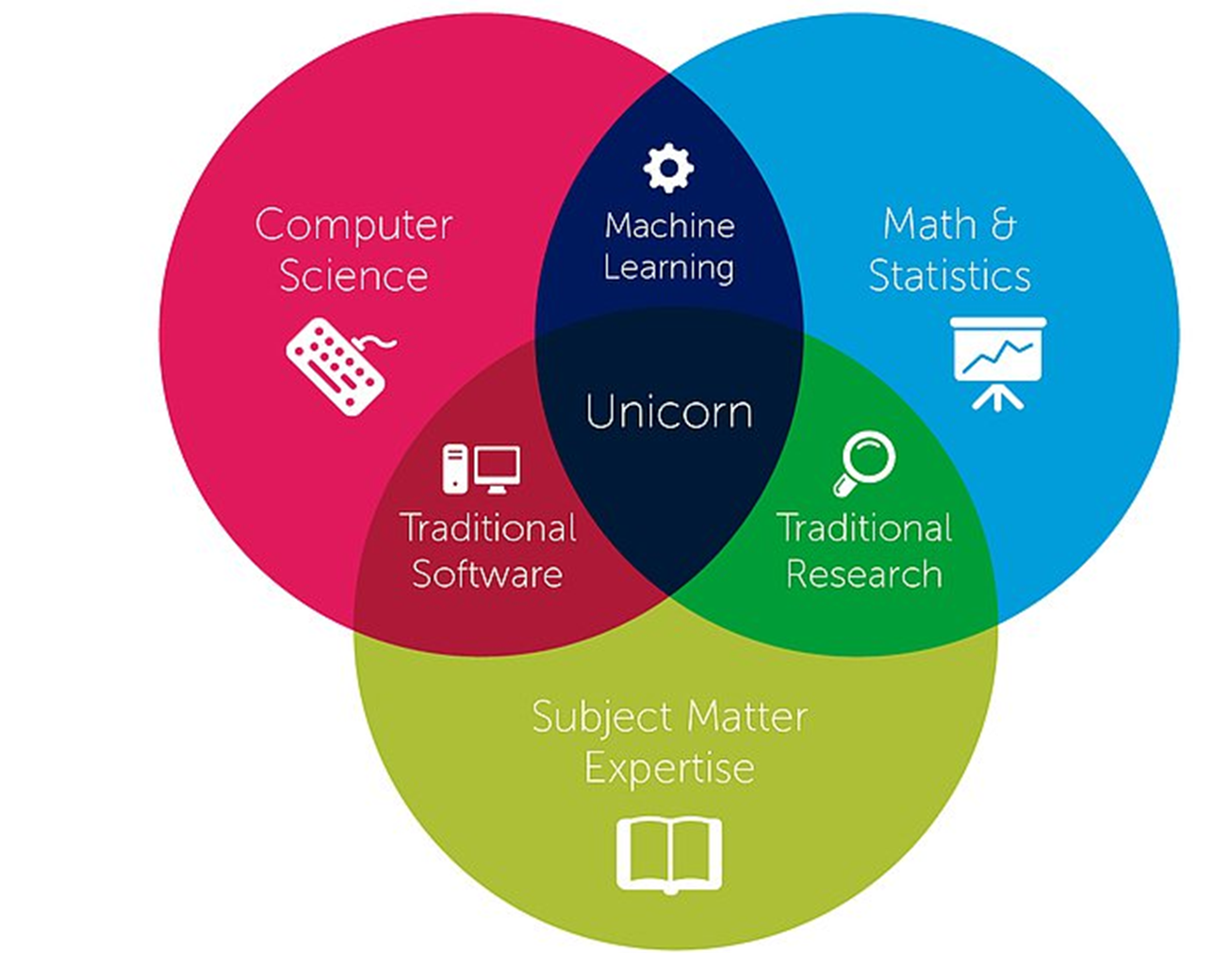
Some solutions – people
Good IR/Data Analyst/Planner as a ‘unicorn’
  Think about what you want from your team
  Talent flow (placements)
  Advertise hard!
  Embrace diversity – ‘the team as unicorn’
  Test practical skills in interview
  Test outlook at interview – keen to learn?
  A learning environment – upskilling, training
  Share a good analyst (if you can’t afford a whole one!)

Slide 20
Some solutions – external resources
Teaching others….
  HESA Supply-side Code of practice
    Honesty
    Impartiality
    Rigour
  FAIR Principles
    Findable
    Accessible
    Interoperable
    Reusable

Slide 21
A positive example from a client -
Visible senior team use of data-driven products
Culture of openness and support towards innovation in data use by management
Investments in data engineers and Power BI, in tandem with encouragement to widely use the tools
Data has already been used to improve services and generate efficiencies
Peer-to-peer sharing of insights and good practice
Culture of staff working in partnership with other organisations to improve data capability
A mature information governance function

