Slide 1

Notes:
Pre introduction
Say that we’ll be recording and encouraging engagement via polls in the chat. Best to open the chat in a separate window, as the polls will be squished in the sidebar
Please raise your hand as we discuss the poll results if you want to comment or question
There’ll be space for general comments and questions on the utility of this data set at the end

Slide 2




Graduate Choice / Graduate Regret / Graduate Contentment Matt Hiely-Rayner
Director of Strategic Planning & Performance | Director & Founder | Co-Chair of Planning Group
University of Sussex | Intelligent Metrix | HEIR Network for UK & Ireland
Notes:
Welcome. The purpose of this session is to explore some new data that we acquired for this year’s Guardian University Guide and consider how it should be regarded and the uses to which we can put it.
It’s important I introduce myself properly, because this work really spans my three roles. I managed to acquire this data through my role compiling the Guardian University Guide, which is a role I fulfil through my role as Director of Intelligent Metrix Ltd. The Guardian commission the league table each year with an objective of informing undergraduate choice, particularly for students of backgrounds that don’t have experience of UK Higher Education. Hence we focus on subject level, on teaching, and on undergraduate courses., with some acknowledgement of the different starting points from which students embark on their journeys.
I’m also co-chair of the institutional research network for UK and Ireland and we are always on the lookout for hot topics: topics that are somewhat novel to the network, or are of renewed interest due to policy developments. Last year we had sessions on educational gain and AI-driven interpretation of student survey comments, and this year we had a very interesting session on the UN sustainable development goals and how they can be embedded into institutional objectives.
At the University of Sussex I’m Director of Strategic Planning and Performance and throughout my career in strategic planning, I’ve always had to pay close attention to the policy landscape and how performance measures are being used to judge us. We want to be able to articulate excellence.
So I’ve called this slide Graduate Choice / Regret / Contentment partly in reflection of my mixed interests and partly because the data doesn’t have a good name already. Through Intelligent Metrix I am interested in student choice and graduate reflections can inform this. Through HEIR we are keen to feed data into our institutional research that can help enhance the student experience and protect them from undesirable outcomes. Avoiding a state of regret is important to that. And at Sussex we want to delight our students and have graduates who reflect positively on their time with us, retaining a sense of belonging but also feeling enabled to make a positive difference in the world. We want them to express their contentment with their choice of studying at Sussex.

Slide 3

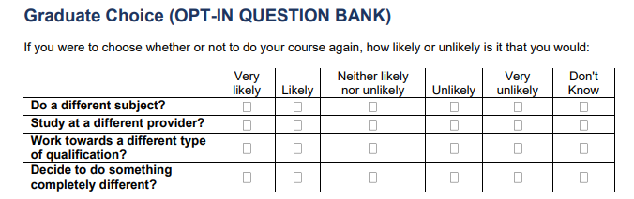
Graduate Choice / Hindsight
Notes:
The data comes from this bank of questions, which is labelled as optional, and it was generally understood that universities have to pay if they want the questions to be asked. Actually, for this bank of questions, the questions are included in the survey for all graduates of English universities and the extra cost comes in if universities want to access the data.
Now universities are very short on cash and it may be annoying that these results are not included in the normal subscription to JISC that universities pay for. But nevertheless, we’re talking between £1000 and £4000 to get a really valuable insight into what our students think of their experience, with the benefit of hindsight and some early insights into how their degree has prepared them for their early career steps. While being sympathetic to the financial difficulty of the HE sector, the Guardian were somewhat incredulous that we aren’t taking this opportunity to understand what our customers think.
And yes, response rates are a problem but any customer survey that captures the hindsight view of 40% - 50% of customers is extraordinarily valuable and, for me, is something we have a duty to understand better.
So: the questions graduates are asked: If you were to choose whether or not to do your course again, how likely or unlikely is it that you would do a different subject, study at a different provider, work towards a different type of qualification or decide to do something completely different. Students respond on a scale of very likely to very unlikely and we have to be careful when interpreting results. The most affirmative response, of ‘very likely’, can be interpreted as meaning that the student is wracked by regret at their decision, and they really strongly wish they’d chosen otherwise. Conversely, we can interpret being ‘very unlikely’ to take a different decision as a deep sense of contentment with the original selection.

Slide 4
Poll #1: Which question revealed most regret?
Q | Question
A | Do a different subject?
B | Study at a different provider?
C | Work towards a different type of qualification?
D | Decide to do something completely different?
‘Regret’ = ‘very likely’ + ‘likely’
all responses except ‘don’t know’
When responding to prompt ‘ if you were to choose whether or not to do your course again, how likely or unlikely is it that you would:’
Results are full time first degree respondents to GO survey from 2022/23 graduating cohort. Question only asked of graduates from English HE providers.
Notes:
So, before drawing insights from the data, we need to express it as a summary statistic of the proportion who were regretful of their previous choice – they selected ‘likely’ or ‘very likely’ to have chosen otherwise.
Expressed as a proportion of all respondents that were not ‘don’t know’

Slide 5
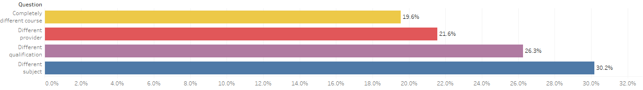
Poll #1: Which question revealed most regret?
Q | Question
A | Do a different subject? | 30.2%
B | Study at a different provider? | 21.6%
C | Work towards a different type of qualification? | 26.3%
D | Decide to do something completely different? | 19.6%
‘Regret’ = ‘very likely’ + ‘likely’
all responses except ‘don’t know’
Notes:
What proportion of you answered A? That was the correct answer.
Personally, I don’t see much helpful interpretation from the question of working towards a different type of qualification. It’s the source of the second highest level of regret, but it begs the question of what the students would have wanted to do instead. Do they regret debt levels and wish they had gone for an apprenticeship? Remember this data is filtered to full time first degree qualifiers, so while this might be a helpful question when comparing perceived utility of different qualifications, it’s not clear to me what alternative options respondents are thinking of when they express regret. Anyway, it’s quite a source of regret.
For policy-makers and those with an interest in articulating the value of HE, it is good news that less than 20% of the 2022/23 cohort wished they’d done something completely different instead of going to an English University. This is good as an overall result.
PAUSE: INVITE QUESTIONS AND COMMENTS

Slide 6
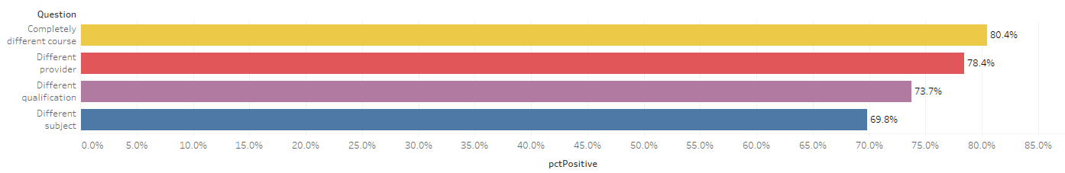
Flipped: which questions expressed most contentment?
‘Contentment’ = ‘very unlikely’ + ‘unlikely’ + ‘neither likely nor unlikely’
all responses except ‘don’t know’
Notes:
These are the same results but of course, when presenting to prospective students in the Guardian University Guide, we flipped it around and tried to express it as a positive. It’s hard to say what the opposite of regret is, but we settled on ‘contentment’. We were particularly interested in the relatively low contentment with the subject choices of students, as we assume students come to our guide with a strong sense of what they want to study. When we launched the guide this year, this is the angle that featured in the editorial.

Slide 7
Poll #2: Which subject garnered most contentment?
S | Subject
A | Medicine
B | General Nursing
C | Psychology
D | Computer science
E | Business & Management
F | Fine Art
% of respondents stating that they would be ‘unlikely’, ‘very unlikely’, or ‘neither likely nor unlikely’ to choose a different subject
Notes:
You may have seen the article at the time, but there was not much detail, and I found some of the results surprising. Which of these subjects do you think generated the highest proportion of graduates who were content with their choice of subject?

Slide 8
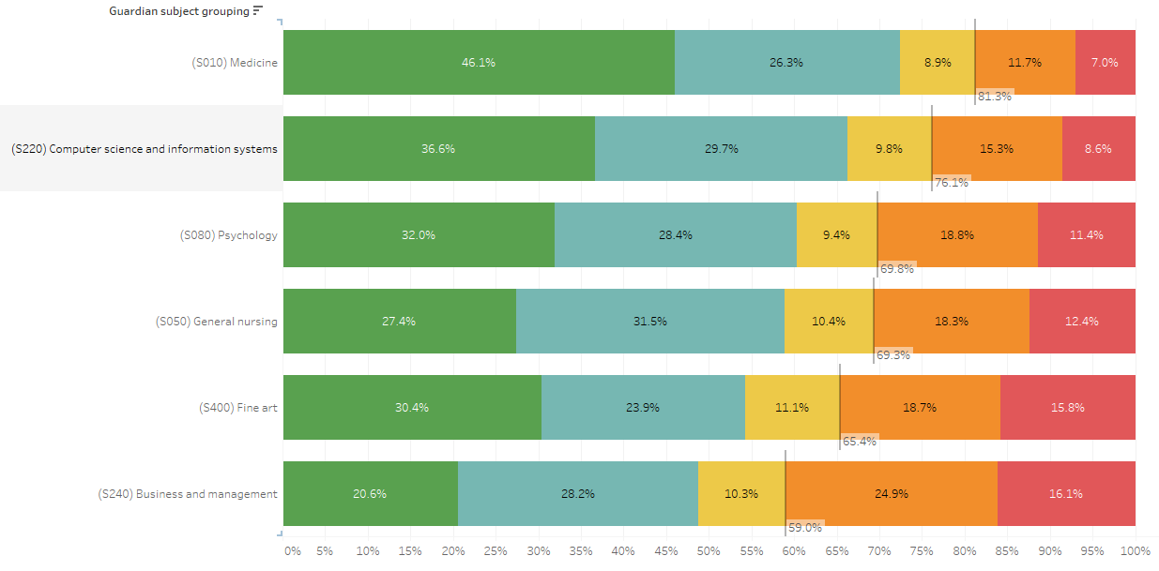
Poll #2: Which subject garnered most contentment?
S | Subject
A | Medicine
B | General Nursing
C | Psychology
D | Computer science
E | Business & Management
F | Fine Art
% of respondents stating that they would be ‘unlikely’, ‘very unlikely’, or ‘neither likely nor unlikely’ to choose a different subject
Notes:
The correct answer is medicine, and that may well be the least surprising thing you find out today, though it might be of interest to those trying to avert the BMA’s strike action and previous concerns about the workload of junior doctors
But there is more surprising news elsewhere. Here are the full details for each of these subjects.
I only really chose larger subjects for this. Dentistry is actually top. The top 10 is dominated by health-related professions, for which degree courses lead directly into employment. But then there are some surprises further down. General nursing leads to employment but there’s relatively high regret. On the other hand, graduate employment in computer science has always been mysteriously low but here there is a very high level of contentment.
One of the frequent complaints we get in the university guide is that we are measuring things that aren’t important to prospective students. Graduate employment is actually the most important factor for most students but, so the story goes, its not what art students go to university for. So I was really expecting to see some happy artists who might not be in professional, managerial or technical occupations, but the rates are pretty low.
Not as low as business and management – the largest subject and the most regretted. What’s the story here? Is it a generic choice for students who don’t have a strong interest in any particular subject?
As a counterpoint to self-satisfied graduates of courses in medicine (81%), spare a thought for the graduates of biomedical sciences, who have one of the highest levels of regret – only 61% were content with the subject they studied. The remainder wished they had studied medicine/

Slide 9
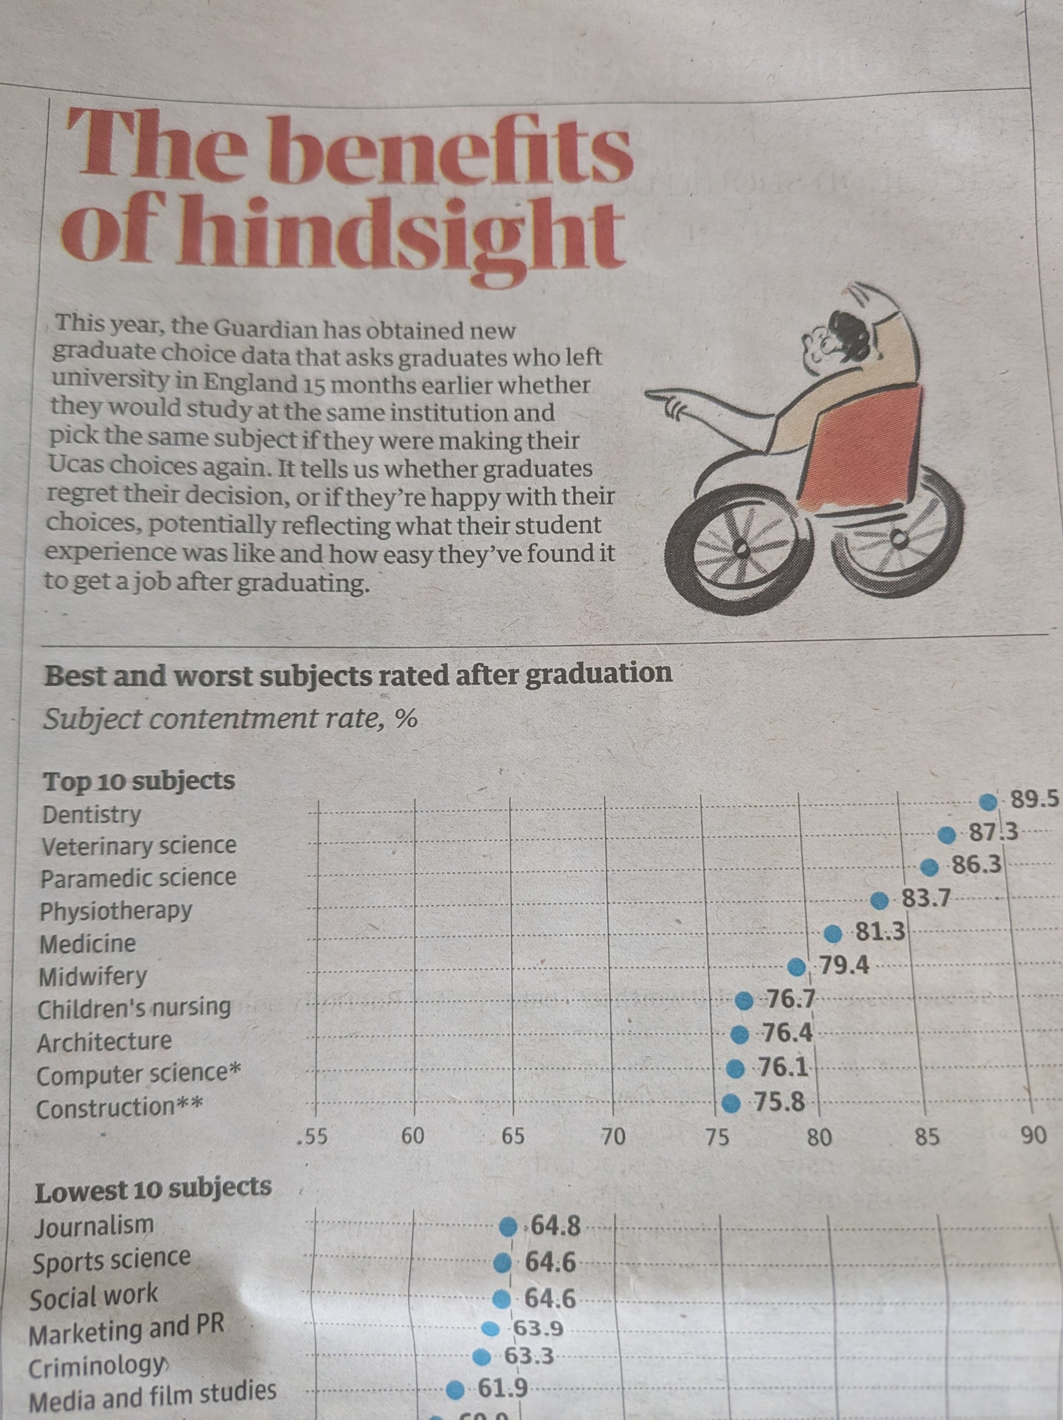

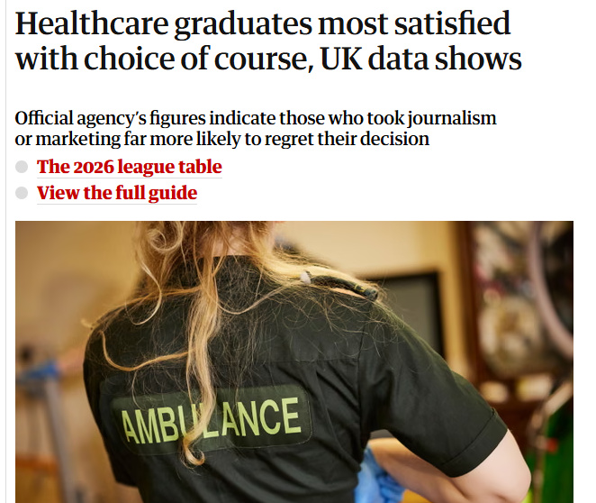
Graduate Choice
Notes:
So here’s what went out in the Guardian

Slide 10
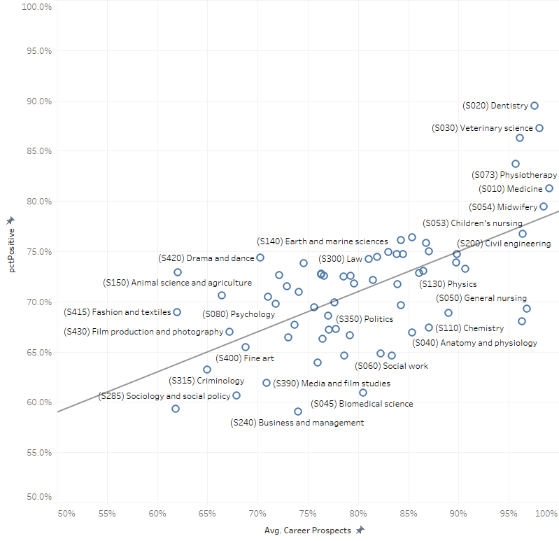
Relationship between subject choice and other factors
Notes:
The news about Art was particularly interesting, and its important to note that some of the more expected results were observed for other art subjects: Drama and Dance, Fashion & textiles: well above the line, meaning that there are many students who don’t have an occupation regarded as good 15 months after graduation but are still pleased they took the subject.. Generally health professions are associated with most contentment but low levels of contentment with mental health nursing, social work and general nursing bely high employment rates.
Incidentally, the relationship between the question of whether students regret entering HE at all is weaker, subject by subject, than this relationship we are seeing here.

Slide 11
Poll #3: Which provider relationship is true?
P | Provider
A | There is no overall relationship between institutional ranking and provider contentment
B | Providers with the highest overall ranking have the highest graduate contentment with their choice of provider
C | Providers with the most professionally-focused portfolios receive the highest contentment
% of respondents stating that they would be ‘unlikely’, ‘very unlikely’, or ‘neither likely nor unlikely’ to choose a different provider
Notes:
Coming on to providers now, there

Slide 12
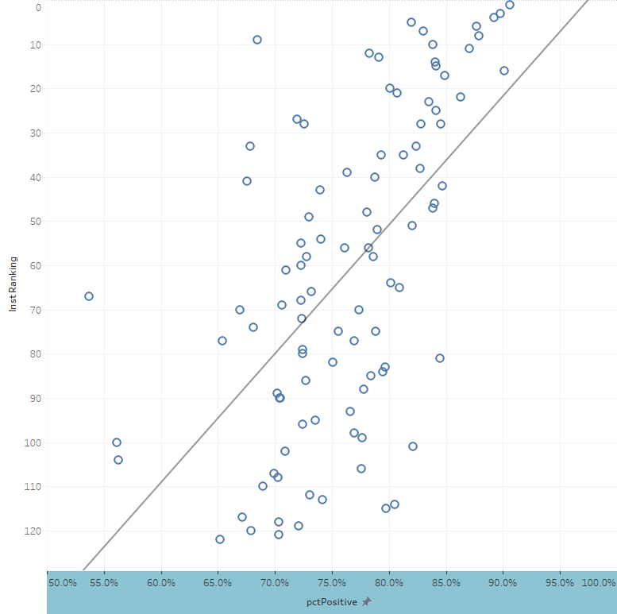
Poll #3: Which provider relationship is true?
UAL
P | Provider
A | There is no overall relationship between institutional ranking and provider contentment
B | Providers with the highest overall ranking have the highest graduate contentment with their choice of provider
C | Providers with the most professionally-focused portfolios receive the highest contentment
Goldsmiths
% of respondents stating that they would be ‘unlikely’, ‘very unlikely’, or ‘neither likely nor unlikely’ to choose a different provider
Newcastle
Notes:
Resoundingly, it’s B. There is a huge relationship between overall institutional ranking and contentment with the provider. Over 0.6 correlation, provider by provider
So much so, that the outliers are the very interesting ones. Arts institutions such as UAL and the University of the Creative Arts are doing better in the rankings than they do for graduate contentment. This is likely because their low career prospects rates are being standardised at the subject level and therefore being treated as a relative positive in the rankings. But the low career prospects also associate with low contentment, and this is not being accounted for.

Slide 13
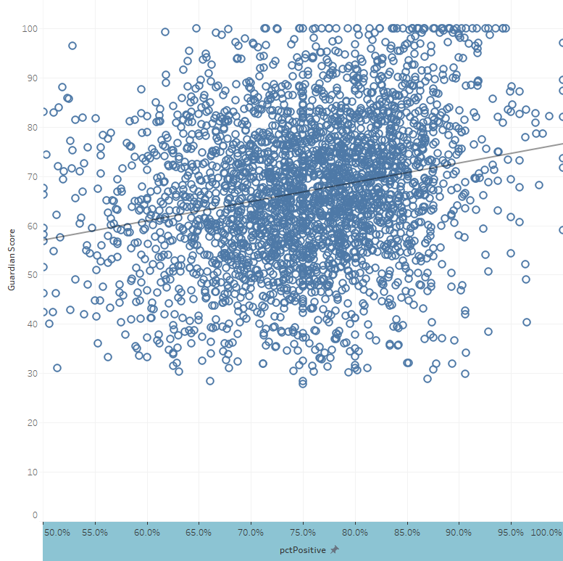
Department level: total score vs provider contentment
Notes:
The same information but operating department by department, against total score this time (always out of 100). We see the same relationship but it’s not quite as strong. Maybe this is because there are many subject rankings in the Guardian guide in which the top 10 places are not reserved from the major research intensive players, which also tend to have higher tariff requirements.
The total correlation here is 0.31. This is similar to the relationships between the other metrics and overall score, when filtering to departments that have a complete data set. The weaker correlation here actually presents more of an opportunity, more confidence that we are not just measuring the same thing, but to be clear on that we need to look at the correlations metric by metric.

Slide 14
Poll #4: Which standardised metric has the clearest relationship with provider contentment?
M | Metric
A | Average entry tariff
B | Student: staff ratio
C | Expenditure per student
D | Continuation
E | Satisfaction with teaching
F | Satisfaction with assessment & feedback
G | Value added scores
H | Career prospects
% of respondents stating that they would be ‘unlikely’, ‘very unlikely’, or ‘neither likely nor unlikely’ to choose a different subject
Vs
individual Guardian University Guide metrics standardised at the subject level
Notes:
If we consider this as a potential metric in the rankings, we’d probably focus on the provider contentment score. But is it just capturing the same reflections as the metrics we already have? The overall correlation is

Slide 15
Poll #4: Which standardised metric has the clearest relationship with provider contentment?
M | Metric | c | g
A | Average entry tariff | 0.31 | 2.5
B | Student: staff ratio | 0.13 | 1.2
C | Expenditure per student | 0.15 | 1.4
D | Continuation | 0.09 | 0.8
E | Satisfaction with teaching | 0.14 | 1.1
F | Satisfaction with assessment & feedback | -0.05 | -0.4
G | Value added scores | 0.02 | 0.2
H | Career prospects | 0.32 | 2.6
Notes:
Yes, the obvious answer is career prospects. Because departments that generate students who find positive occupations also generate students who are content with their provider choice.
That’s interesting in itself, but expected. What is less expected, because there’s no obvious reasoning, is that this metric is only ahead of average entry tariff for strength of relationship by an absolute whisker. Data taken from the opposite end of the student journey is very highly correlated.
My reading of this is saying that the main consideration going through respondents minds when considering this question is am I in a good place now, and did I get into a provider that was reasonably exclusive?

Slide 16
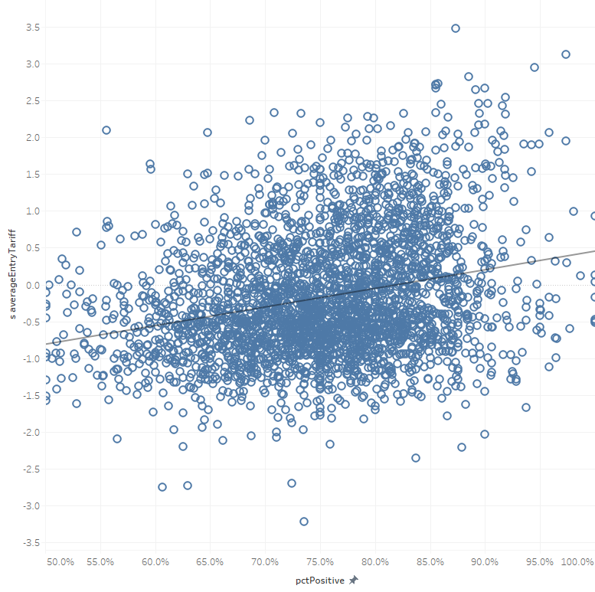
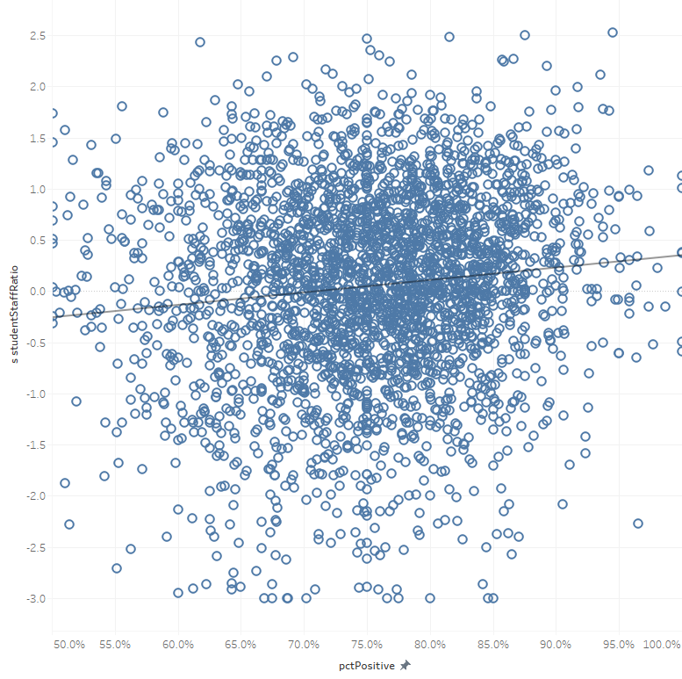
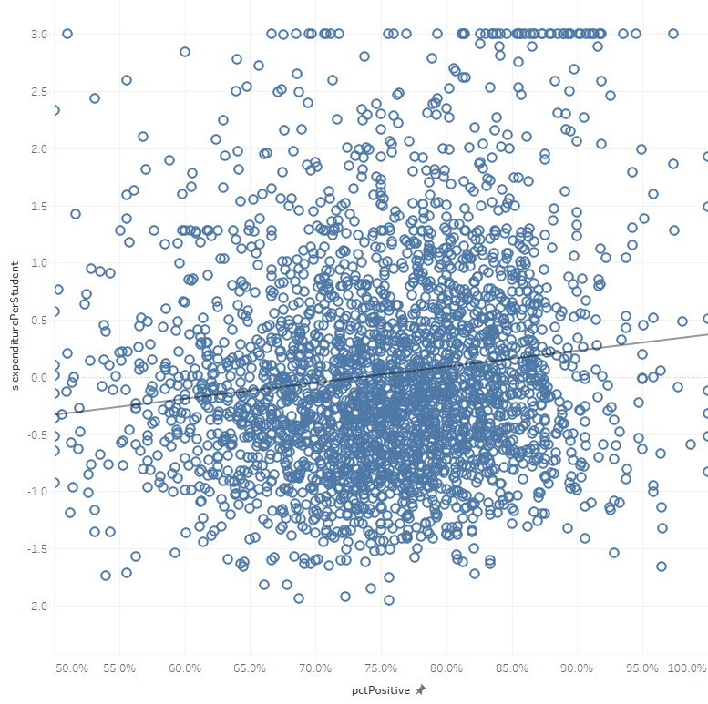
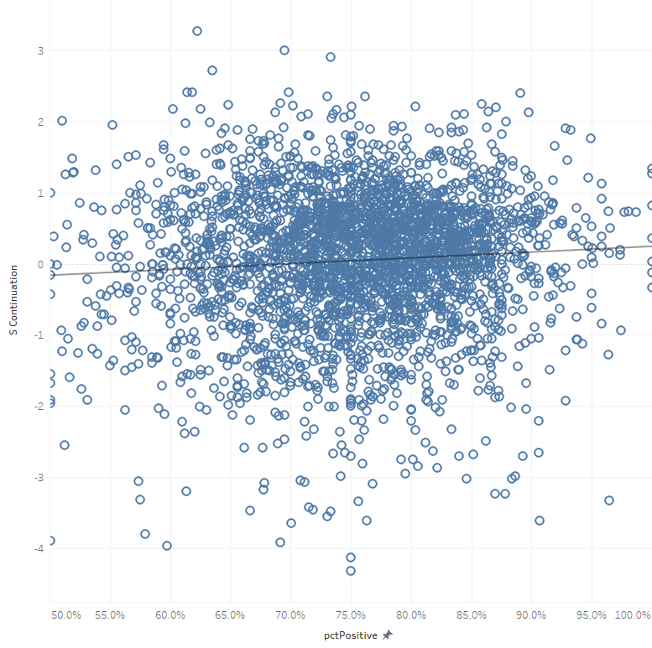
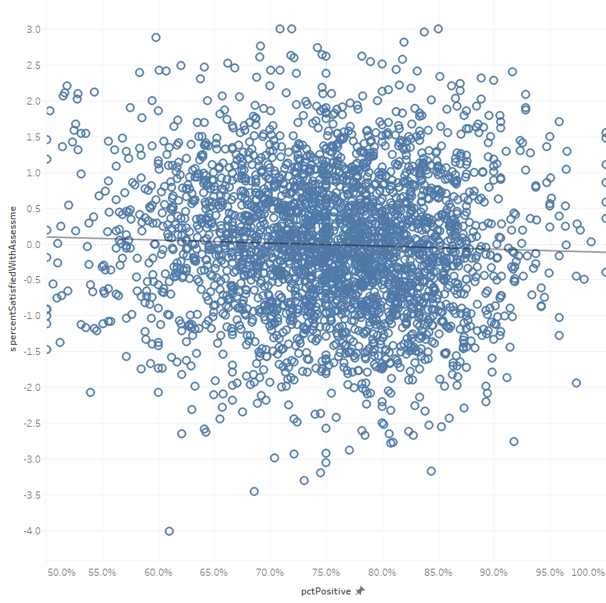
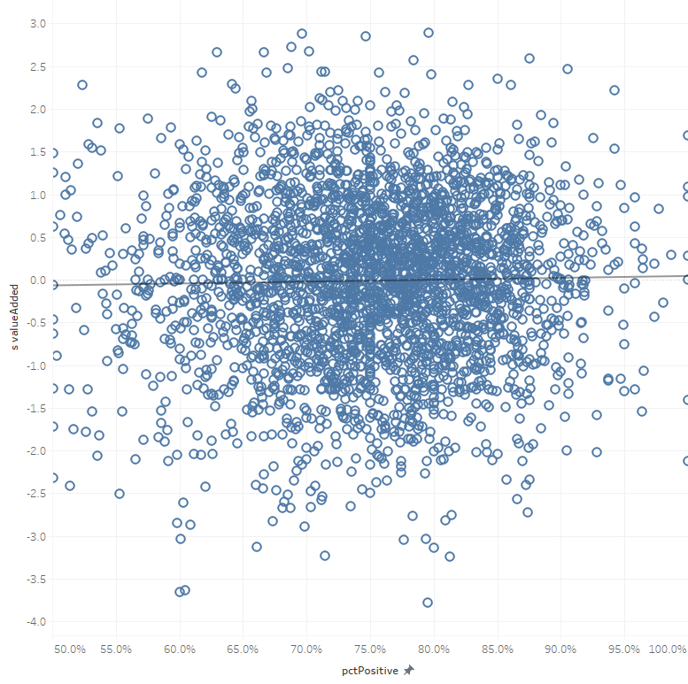
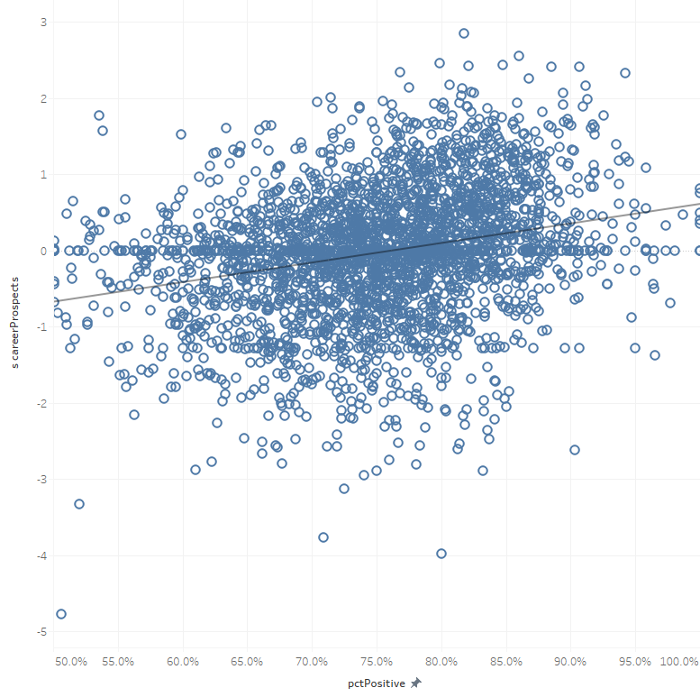
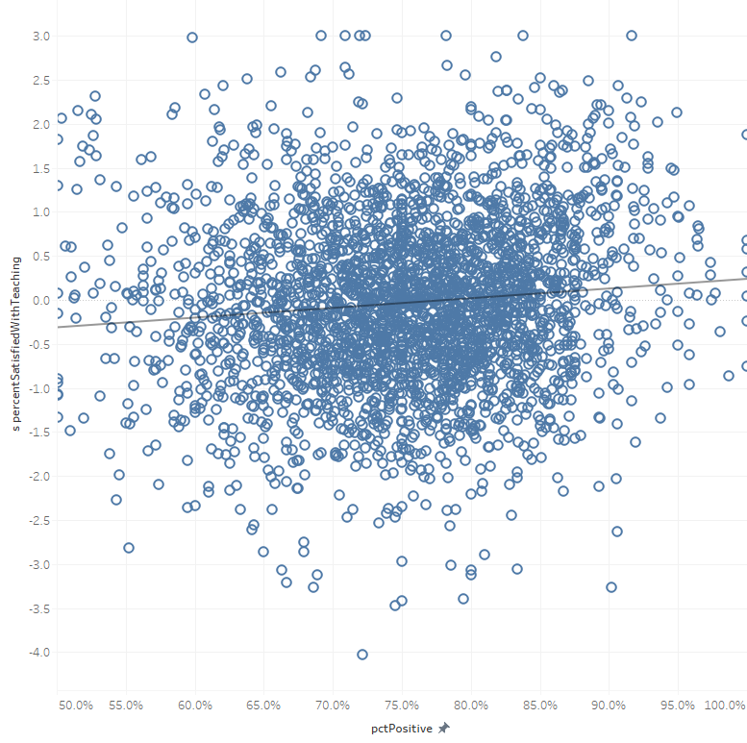
Entry tariff
SSR
Expenditure
Continuation
Teaching quality
Assessment & feedback
Value added
Career prospects

Slide 17
Questions
Can we use “graduate regret” as a signal to inform student choice, or “graduate contentment” as a signal of excellence?
Notes:
In terms of a league table metric:
There are practical barriers, but also I am somewhat disappointed by the relationships with other metrics. I had seen this as a potential alternative to the career prospects metric in subjects where the focus is less on an occupation and the broader benefit a student feels from their degree might come through their sense of contentment. It might serve that purpose, but the relationship with entry tariff is problematic.
There’s big potential to use this to help students with their study choices. We can show students the subjects that are more likely to result in them feeling that they wish they’d studied something else, or not entered HE at all. I’d envisage this being available for every subject, and in some cases encouraging students to think a bit deeper about the options available to them.
But what about utility in the TEF. If you’re lucky enough to be at a provider that students are content they made the right choice to attend, and they don’t regret entering HE at all, can that be used as a signal of excellence beyond the other outcomes described in the GOS?

