Slide 1

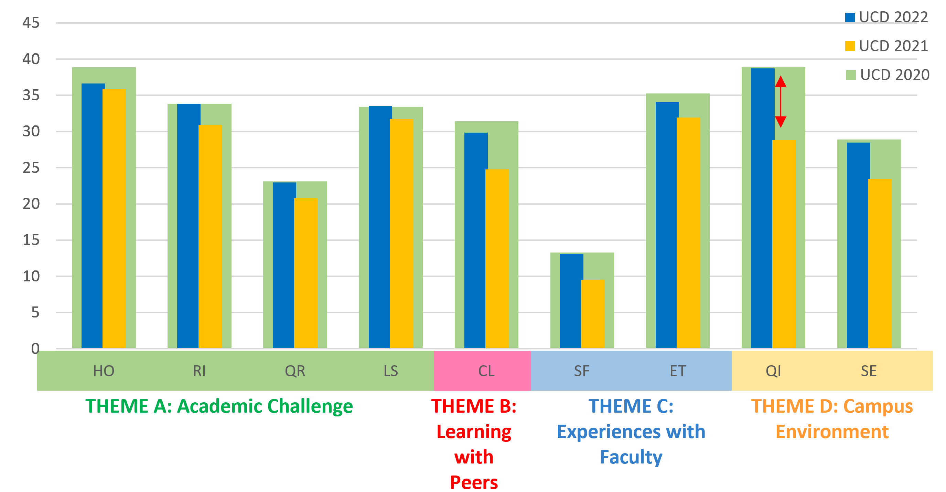


Learning at distance and return to campus – The impact of Covid-19 on student engagement* at University College Dublin
Maura McGinn & Lisa Bennett, University College Dublin
Introduction
Methods
Discussion
Research has shown that learning-at-distance during the COVID-19 pandemic impacted the engagement of undergraduate and postgraduate students in higher education in Ireland (Nic Fhlannchadha et al, 2022).
For the purposes of this presentation, student engagement is measured via StudentSurvey.ie (the Irish national survey of student engagement). This annual survey collects data on the time and effort that students put into meaningful and purposeful educational activities, and the extent to which institutions provide opportunities and encourage students to engage with them. The data collected reflects students’ self-reported perceptions of their experiences.
As the survey is carried out annually, University College Dublin can track the changes in student engagement pre-covid (2020 survey), during Covid where students had a fully online educational experience (2021 survey), and post-Covid with the resumption of on-campus activity (2022 survey).
StudentSurvey.ie is an annual online survey which invites responses from first year undergraduate, final year undergraduate and taught postgraduate students in 25 higher education institutions in Ireland. The survey is administered at a national level with fieldwork taking place in February and March each year. The analysis below is based on data from over 15,000 University College Dublin students from the 2020, 2021 and 2022 surveys.
These results were explored to identify the questions that recorded the biggest changes under the following themes: student engagement with their learning, student engagement with their peers, student engagement with academic staff and student engagement socially and with the community. Presented here are those questions which noted decreases in scores between the 2020 and 2021 surveys, with some emphasis on those that have not recovered in the 2022 survey. The results are presented separately for each of the student cohorts; first and final year undergraduate and graduate taught.
Changes to the way students engage with their learning, peers, academic staff and socially are evident in the data presented here. Learning strategies changed as students learned online, with a reduction in levels of reviewing notes and identifying key information from readings, which have not returned to pre-Covid levels. Is this because lectures and lecture material were available for students to access at any time? Graduate taught students had a particularly challenging experience during remote learning in 2021 with a decrease in ratings for most questions. In 2022 the experience of graduate taught students has not recovered, and most questions remain rated below 2020 levels. Collaborative learning activities such as making presentations in class or working with other students on projects are important in graduate programmes and so it is concerning to see levels of these activities remaining low. At UCD we are examining the open-ended responses to seek further evidence to explain these changes and will explore further with programme directors and colleges as data are discussed across the campus in the coming weeks.
Results
Change in student engagement 2020 - 2022
Figure placeholder
HO | Higher-Order Learning
RI | Reflective and Integrative Learning
QR | Quantitative Reasoning
LS | Learning Strategies
2020 (pre-Covid) – 2021 (learning-at-distance) : UCD StudentSurvey.ie indicator scores all fell between 2020 and 2021 as a result of learning-at-distance during the Covid-19 pandemic. The greatest decreases were noted in indicators that explored student interaction and relationships with each other and staff: Collaborative Learning (how students learned and worked together), Student-Faculty Interaction (student relationships and interactions with staff) and Quality of Interactions (how students rate their interactions with other students and staff cohorts on campus).
2021 (learning-at-distance) – 2022 (return to campus) : UCD Indicator scores have all risen between 2021 and 2022.
The largest decrease in 2021 was in the indicator for Quality of Interactions which fell by 10.1 points. This indicator has now returned to 2020 levels.
Indicators have recovered to 2020 levels except for Higher Order Learning and Collaborative Learning
CL | Collaborative Learning
SF | Student-Faculty Interaction
ET | Effective Teaching Practices
QI | Quality of Interactions
SE | Supportive Environment
LC | Learning, Creative & Social Skills
Figure 1: UCD StudentSurvey.ie Indicator Scores – 2020, 2021, 2022
First Year UG Students
Final Year UG Students
Graduate Taught Students
First years are attending class and social events more often than in pre-covid times.
Quality of Interactions with other students have improved with the return to on campus activities.
First years have low levels of discussing topics with faculty, however this is higher in 2022 than pre-covid times.
In 2022, final year students are reviewing notes to a greater extent than pre-covid.
Final year students have resumed preparing for exams with other students but not to the same levels as in 2020.
Quality of Interactions with Academic Staff has greatly improved.
Final year students are attending social events more often than in pre-covid times.
Graduate taught students are making class presentations less than in pre-covid times.
They are not blending their learning with workplace experience to the same extent or working with other students on projects or assignments.
Graduate taught students do not feel that faculty are providing feedback to the same levels and believe that UCD should improve its provision of opportunities to be involved socially in order to return to pre-Covid levels.
Finally, graduate taught students are exercising to a greater level than in 2020.
Figure 2: First year student highlights
Figure 2: Final year student highlights
Figure 4: Graduate taught student highlights
References
Contact info
Maura McGinn
Director, UCD Institutional Research
Lisa Bennett
Institutional Research Analyst, UCD Institutional Research
StudentSurvey.ie data, 2020, 2021 & 2022
Fhlannchadha, S.N., Lau, J. and Stanley, B., 2022. Using the Irish Survey of Student Engagement to understand the impact of COVID-19 on first-year undergraduate students. In Global Student Engagement (pp. 97-115). Routledge.
UCD Institutional Research: institutional.research@ucd.ie

Slide 2
Change in Student Engagement 2020, 2021, 2022
HO | Higher-Order Learning
RI | Reflective and Integrative Learning
QR | Quantitative Reasoning
LS | Learning Strategies
CL | Collaborative Learning
SF | Student-Faculty Interaction
ET | Effective Teaching Practices
QI | Quality of Interactions
SE | Supportive Environment
LC | Learning, Creative & Social Skills

Slide 3
First year undergraduate

Slide 4
Final year undergraduate

Slide 5
Graduate Taught

Slide 6
Final Thoughts
Most survey scores for first and final year undergraduates have increased since 2021 and largely reached 2020 levels
Still some recovery to be made on questions in indicators Higher-order Learning and Collaborative Learning
Most survey scores for Graduate Taught students have not recovered
We will be analysing open-text comments and discussing during presentations across UCD in coming weeks to explore possible reasons for these findings

